Slide 1
IETF Network Slice Topology YANG Data Model
draft-liu-teas-transport-network-slice-yang-06
Co-authors:
Xufeng Liu (IBM)
Jeff Tantsura (Microsoft)
Igor Bryskin (Individual)
Luis M. Contreras (Telefonica)
Qin Wu (Huawei)
Sergio Belotti (Nokia)
Reza Rokui (Ciena)
Aihua Guo (Futurewei)
Italo Busi (Huawei)

Slide 2
Motivation
A network slice may demand additional level of control to customize its connections, as described in Section 2 of draft-ietf-teas-ietf-network-slices
“Additionally, the IETF Network Slice service customer might ask for some level of control of, e.g., to customize the service paths in a network slice.”
A network slice can benefit from using a customized topology to allow better resource sharing among the connections
“network slice topology”
A network slice topology expresses the slice customer’s intent with customer-oriented SLO/SLEs
Existing topology models, e.g. network topology or TE topology is neither intent-oriented nor contains the SLO/SLEs needed from customer’s perspective
The network slice topology can be either technology-agnostic or technology-specific depending on the specific network slice to be built
A network slice may reference a network slice topology and build explicit path for its connections

Slide 3
Clarification of Terminologies
Native MDSC topology: topology resources managed by the MDSC (internal topology)
Abstract topology: an abstraction of the network topology resources, exposed by the MDSC at its NBI (topology discovery)
Customized topology: the customer intent for reserving topology resources within the network and express connectivity constraints
--> what we need for network slicing is the customized topology and NOT the abstract topology

Slide 4
Reusing Existing Model for Network Slice Topologies
draft-liu-teas-transport-network-slice-yang-05 originally exists to represent and configure a network slice as a topology
The SLO/SLE attributes for topological resources need to align with what is defined in the network slice framework & ns-nbi YANG model
No need to augment TE models to model connectivity constraints (they are covered by the ns-nbi YANG model)

Slide 5
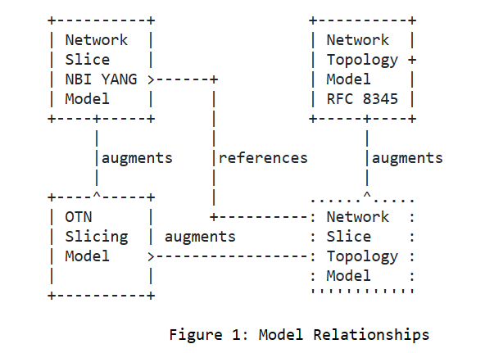
Model Relationships

Slide 6
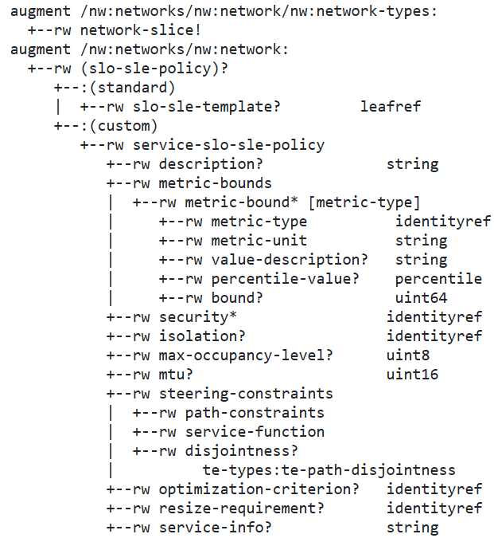
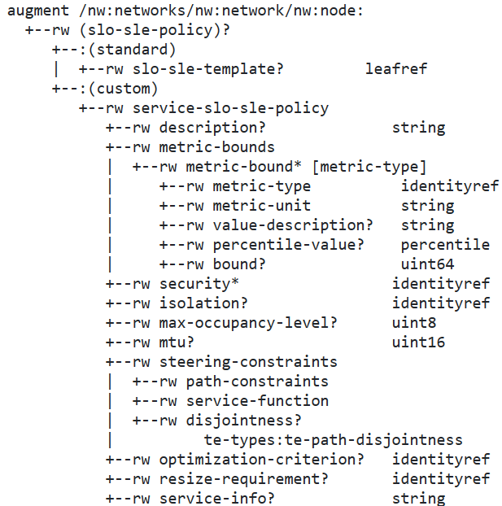
Model Tree
Network augments
Node augments

Slide 7
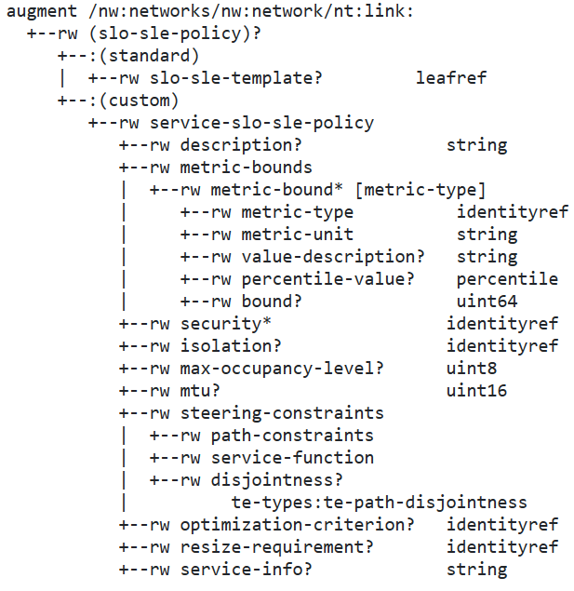
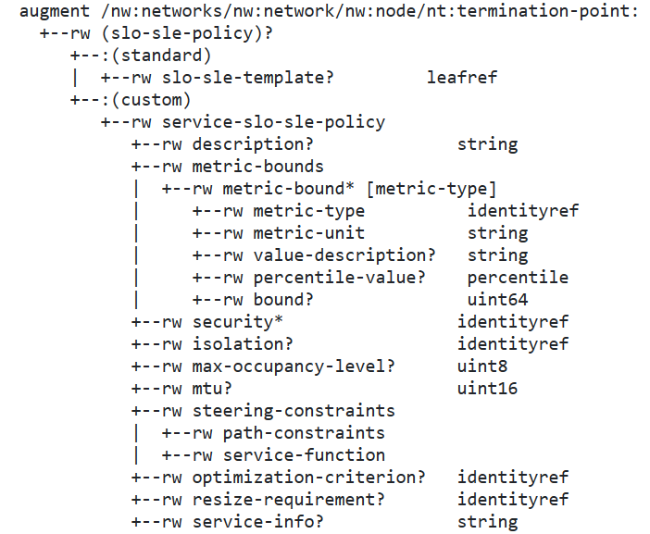
Model Tree
Link augments
TP augments

Slide 8
Open Issue
Should the NS-NBI model reference this topology model, or any topology model?
Restrain that the topology to be reference is of type “network-slice”

Slide 9
Next Steps
Resolve open issues
Request for WG adoption
* GitHub Repo
https://github.com/aguoietf/ietf-network-slice-topology

Slide 10
Thank You!

