Slide 1
Delivery of Premium Services with Multi-technology Network Slicing
Aihua Guo, Principal Architect
UFBB BASe 2022
2022-09-09

Slide 2


Network Vision : Fiber to Everywhere, Enabling All Industries
Data Centre (Core, Backbone, Metro, etc.)
Home/Business
Campus/Verticals
Device/Machine
OTN extending CO -> Site
FTTH -> FTTR
FTTO->FTTD
FTTC->FTTM
1000KM
10KM
1KM
10M
1M
Fiber to everywhere, end to end (FTTx, optical to cloud)
Extending reach to more end users : 2Home/Room/Business/Consumer/Mobile/Device/Machine
Massive number of connections: x3 (room), x10(desk), x30(machine), x100(smart city)

Slide 3
Main Features for Extending and Enhancing Fixed Networks
eFBB
10GPON → 50G PON
200/400G → 800G
1G OTN → Sub-1G OSU
WIFI 6 → WIFI 6e/7
GON
//////
RRL
Green Optical Network
Realtime Reliable Link
Optical to the Site
One-hop to Cloud
Optical Switching
Field-bus Control System
Energy/Transport Control and Communications
Native Hard Pipe (Jitter, Packet loss…)
Fiber To
Everywhere
FFC
GRE
FTTHome → FTTRoom
FTTOffice → FTTDesk
FTTFactory → FTTMachine
Premium Broadband
Premium Private Line
Ultra-low Latency
Autonomous Networking (AND L3 → L4 )
OPS
Optical Precise Sensing
Reference: ETSI F5G Network Architecture
Fiber Positioning and Visualization
Fiber Digitalization

Slide 4
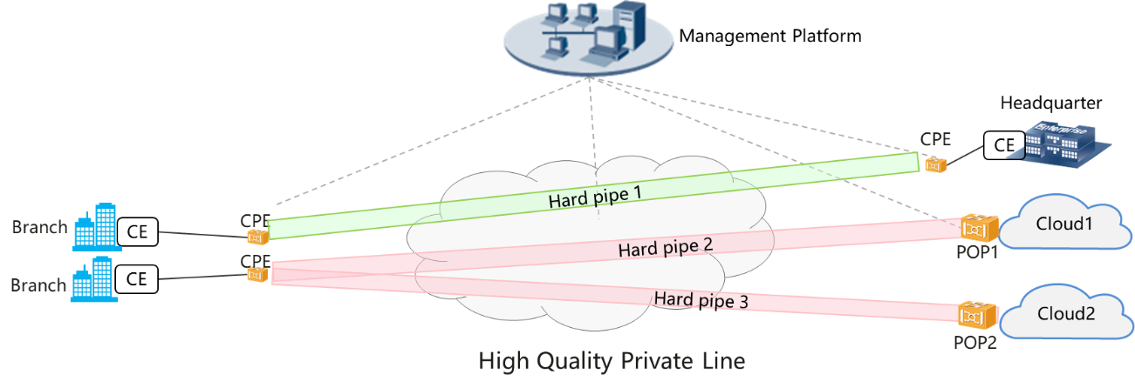



Enabling Premium Services with Full Fiber Connectivity
2B scenario: High Quality Private Line
Hard isolation among different services
High availability
ONT
Gaming Cloud
OLT1
GW
ONT
OLT2
...
2B scenario: Multi-cloud enterprise private line
End-to-end QoE assurance
Multi-cloud access
Service awareness and service driven
ONT
OLT800
...
VR education cloud
ONT
OLTXXX
GW
2H scenario: CloudVR/All-optical gold pipe
High performance channel through home, access and metro network
Dynamic channel driven by VR applications
Efficient resource utilization
VPN
Cloud Optical Network
Headquarters
Boutique
Public cloud
branching
Industry cloud
Headquarters
Private Cloud
branching

Slide 5

End-to-end Management and Control
Intent
Orchestration Layer
E2E Service Orchestrator
Unified management & control across multi-technology domains
Standard, open interfaces ensuring multi-vendor interoperability
CPN NBI
AN NBI
AggrN NBI
CN NBI
CPN Controller
AN Controller
AggN Controller
CN Controller
AN Controller
IP Controller
Management Layer
CPN SBI
AN SBI
IP SBI
CN SBI
E
-
CPE
FTTR
CPN
-
A
OTN SBI
E
-
CPE
RG
ONU
Core
IP/Eth AggN
Core PE
Network
WG
ONU
OLT
Network Layer
(ASON+/OSP)
CE
ONU
AggN
Edge
IE
ONU
DC GW
Cloud/
OTN
'
Local DC
CE
OTN-CPE
Edge
OTN
XC
Customer Premises Network
Access Network
Aggregation Network
Core Network

Slide 6
Realizing Premium Services with End-to-end Network Slicing
Intent driven
Differentiated services on a shared infrastructure with different technology domains
Customized network partitioning with OAM based on customer requirements
Network service self-containment and isolation
Guaranteed / Deterministic QoS
Intent
E2E Slice Orchestrator
CPN NBI
AN NBI
IP NBI
OTN NBI
CN NBI
CPN Slice
Controller
AN Slice
Controller
IP Slice Controller
CN Controller
OTN Slice Controller
Best effort
AN Slice
IP Slice
DC Slice
Medium Quality
OTN Slice
Premium Quality
L0 Slice

Slide 7
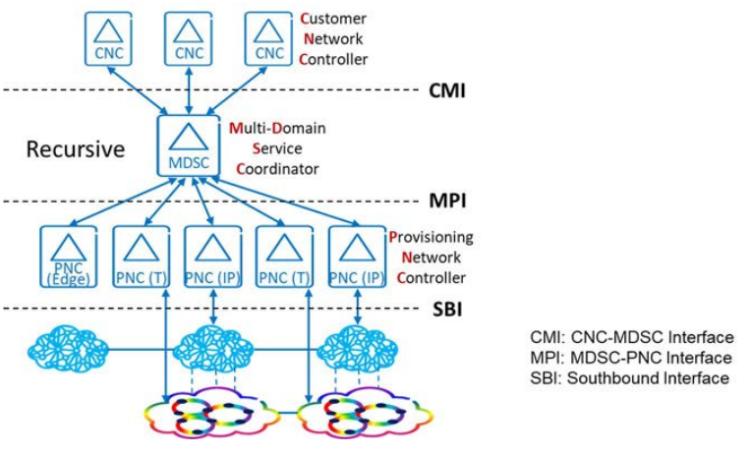
Hierarchical Slice Control: IETF ACTN Architecture
Abstraction and Control of Traffic-engineered Networks (ACTN): solution for hierarchical network slice management
Open YANG-based data models for technology-agnostic slicing and technology-specific slicing, e.g. IP, OTN, L0, Microwave
IP Slice
OTN E2E Slice
OTN Slice – Domain 1
OTN Slice – Domain 2
L0 Slice – Domain A
L0 Slice – Domain B
L0 Slice – Domain C
L0 Slice – Domain D

Slide 8
Standards: IETF YANG Data Models for ACTN and Slicing
ACTN Arch. & Info Model
RFC / RFC process
ACTN framework RFC8453
MW SDN framework RFC8432
WG
ACTN Info Model RFC8454
ID
ACTN NBI YANG model Applicability
Network Models @ MPI
Service Models @ CMI&MPI
Others
Topology Model
Tunnel Model
Path
Computation
Model
CMI Service Model
MPI Service Model
Other Model
L3
L3 topo RFC8346
L3SM RFC8049
L2
Non-TE
Non-TE L2 topo
L2SM RFC8466
L2 TE
ETH TE topo
ETH/Client Tunnel
VN Service
ETH Service
TE Service mapping
Alarm model RFC8632
Network Topo RFC8345
Generic OAM model RFC8351
L1
OTN topo
TE Tunnel
OTN tunnel
Path Computation
L1CSM
L1 Client service
TE Topo
WDM topo
Flex-grid topo
WDM tunnel
Flex-grid
tunnel
Telemetry
L0
OIA topo
MW
MW topo
MW config RFC8561
L1 types
L0 types
Network Slicing
IETF Network Slicing Framework
TE types RFC8776
IP Network Slicing
OTN Slicing

Slide 9
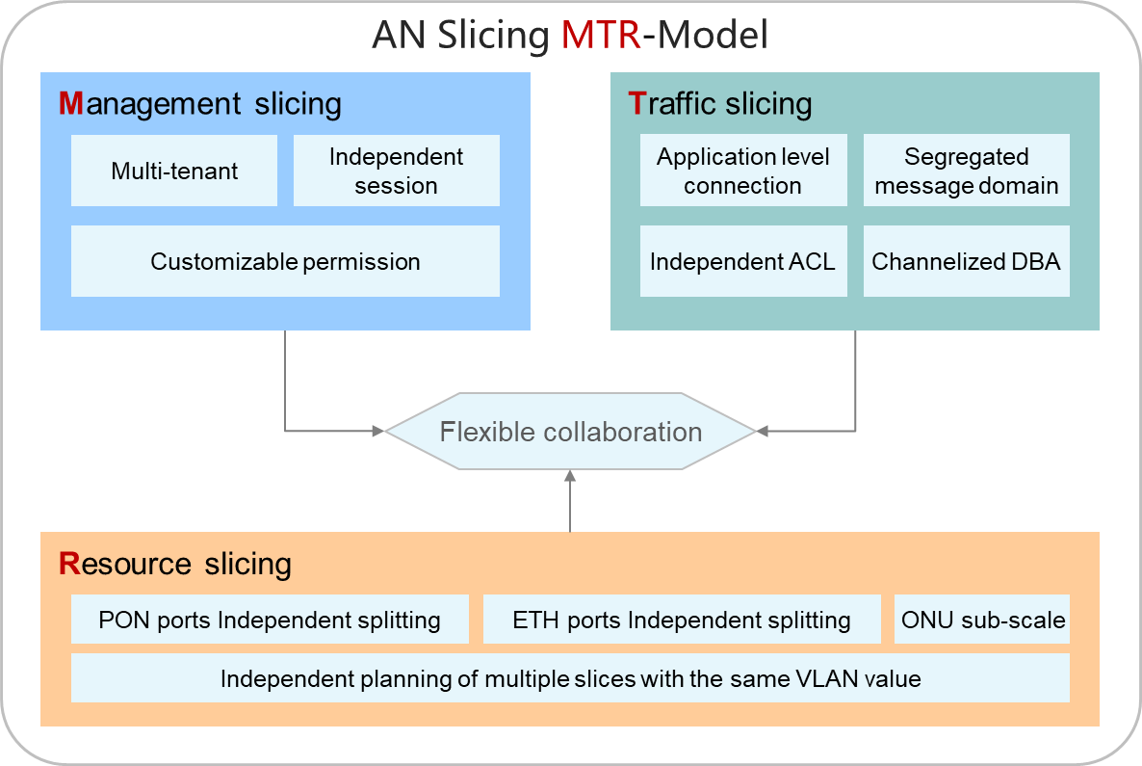
Access Network Slicing: BBF FAN Sharing and Data Models
OSS / Slicing Management
OSS 1
OSS 2
User 1
User 2
User 3
RESTCONF/YANG
SDN Controller
Mgmt Slice 1
Mgmt Slice 2
Mgmt Slice0
D-Net1
D-Net1
D-Net2
D-Net0
NSI 1
NSI 2
D-Net2
NSI 4
D-Net0
NSI 1
NSI 2
NSI 3
NSI X
NSI Y
NETCONF/YANG
ONT
OMCI
OLT
WIFI
RU
D-NET1
NSI1
NSI1
NNI
NSI2
NSI1
D-Net1
NSI1
D-Net1
NSI2
NSI2
NSI2
NSI2
NSI3
NSI3
NSI3
D-Net2
NSI3
NSI4
NSI4
D-Net2
NSI4
D-NET2
NSI4
NSIX
NSIX
NSIX
D-Net0
NSIX
NSIY
NSIY
D-Net0
NSIY
D-NET0
NSIY

Slide 10








PoC Demo: Cloud VR Premium Services
OTN Slice
Optical Transport Controller
Wi-Fi 6
10GPON
MA5800
OSN9800
OSN9800
ONT1
OLT
OA
OE
DC GW
Cloud VR Server
ONT2
0) Service protocol
User/cloud address learning
1) Get VR server address
2) VR app identification
3) VR BW request
3) VR BW request
4) Connection Protocol
OTN connection creation / BW modification
DC GW
Cloud VR Server
Phase 2 Demo*
User 1 starts a first VR application, triggering the OTN slice creation (with one OTN connection)
Demo Steps
User 2 starts a second VR application, triggering the OTN connection BW increasing
User 1 terminates his VR application, triggering the OTN connection BW decreasing
User 2 terminates his VR application, triggering the OTN connection deletion
* The multi-cloud case will be supported in phase2, wherein the OTN needs to sense the multiple users/clouds, and map different traffics into correct OTN connections

Slide 11
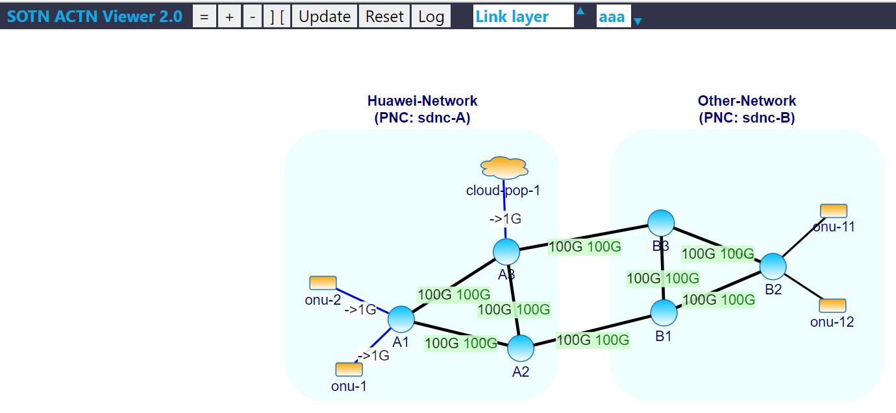
PoC Demo: Closed-loop Automation
Slice User
User Intent Interface
ONAP Orchestrator
(IBN framework)
Closed-loop Automation
IETF/ACTN Interface
Physical network controller (domain A)
Physical network controller (domain B)
Physical network domain A
DC
Physical network domain B
Campus network
Campus network

Slide 12
Summary
Fiber-to-everywhere makes the network infrastructure future proof
Wider reach to massive end users, larger bandwidth for access & transport, fine granular OTN
End-to-end management and control is a key component for service delivery across multi-technology domains
Network slicing enables the provisioning of premium services with flexible resource isolation and guaranteed performance across CPN, Access, Aggregation and Core/DC networks

