Slide 1
End-to-end Management for Transport and Access Networks: Architecture and Data Models
Aihua Guo
May 19, 2022

Slide 2
Agenda
Overview of End-to-end Management and Control
Standardization Work on Data Models

Slide 3
End-to-end Management and Control Towards Autonomous Networking
End-to-end management and control is a key component towards autonomous networking
Integrating the control for transport and access networks has proven challenging
Silos of management domains
Multi-technology, multi-domain, multi-layer, multi-vendor
Emerging technologies addressing the challenges
SDN Control – provides centralized intelligence and big-data analytics
Open interfaces – same languages between transport & access, and between different vendors
Network orchestration – enables closed-loop automation

Slide 4

End-to-end Management and Control Architecture
Service Intent Interface
E2E Service Orchestration
E2E Service Orchestrator
CPN NBI
AN NBI
AggrN NBI
CN NBI
Hierarchical SDN control
CPN Controller
AN Controller
AggN Controller
CN Controller
AN Controller
IP Controller
CPN SBI
AN SBI
IP SBI
CN SBI
E
-
CPE
FTTR
CPN
-
A
OTN SBI
E
-
CPE
RG
ONU
Core
IP/Eth AggN
Core PE
Network
WG
ONU
OLT
Routing
CE
ONU
AggN
Edge
IE
ONU
OMCI
DC GW
Cloud/
OTN
'
Local DC
CE
OTN-CPE
Edge
OTN
XC
ASON
Customer Premises Network
Access Network
Aggregation Network
Core Network

Slide 5
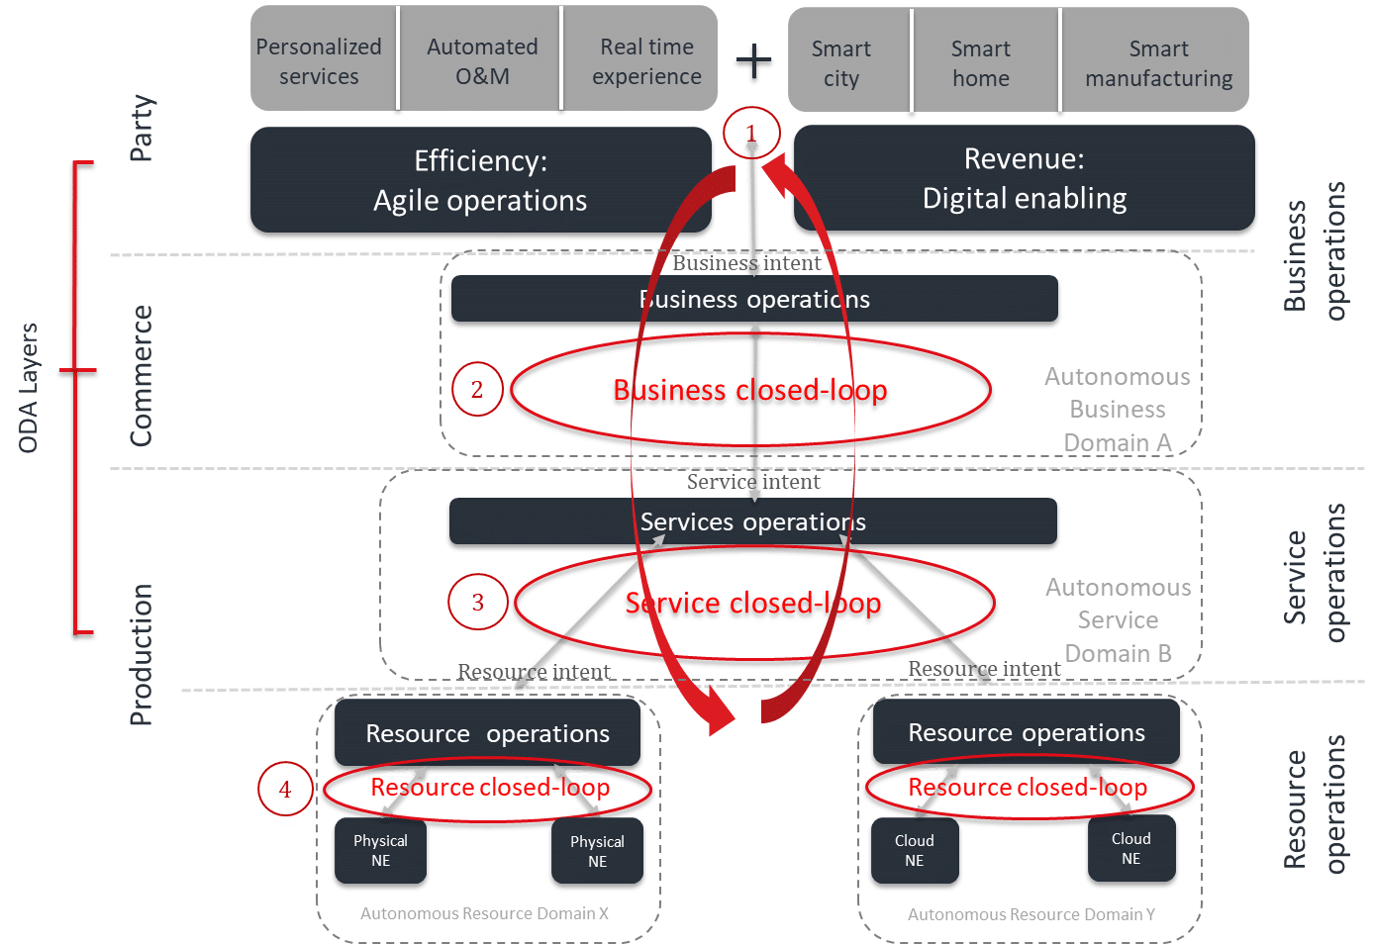
Hierarchical SDN Control for Transport and Access Networks
Service Intent Interface
E2E Service Orchestrator
Network Service Interface
Hierarchical Controller
AN NBI
IP NBI
OTN NBI
AN Controller
OTN NBI
AN Controller
IP Controller
OTN Controller
OTN Controller
AN SBI
IP SBI
OTN SBI
Hierarchical (recursive) SDN control
Domain controller – single-domain, single vendor
Hierarchical controller for multi-domain and multi-vendor
Hierarchical controller could be integrated with the orchestrator
Open and model-driven interfaces at both the NBI and SBI of SDN controllers
IETF ACTN YANG data models
BBF CloudCO and Common YANG modules
Closed-loop automation
Target: TMF autonomous network architecture
TMF Autonomous Network Architecture

Slide 6
Agenda
Overview of End-to-end Management and Control
Standardization Work on Data Models

Slide 7
IETF ACTN Framework
ACTN Architecture
CNC
CNC
CNC
Customer Network Controller
IETF ACTN defines a unified SDN control architecture for transport (IP + OTN/optical+ MW).
Suite of YANG data models defined by various WGs in IETF (which also defines the YANG modeling language and Netconf/Restconf protocols)
Three layers of controllers
CNC (Customer Network Controller)
MDSC (Multi-Domain Service Coordinator)
PNC (Provisioning Network Controller)
CMI
MDSC
Multi-Domain Service Coordinator
MPI
PNC
(Edge)
PNC (T)
PNC (IP)
PNC (T)
PNC (IP)
Physical Network Controller
SBI
RFC8453

Slide 8
Mapping between IETF ACTN Framework and BBF CloudCO Architecture
ACTN Architecture
BBF CloudCO Architecture
CNC
CNC
CNC
Customer Network Controller
SD-AN
CMI
FAN-SC
Evolution
MDSC
Multi-Domain Service Coordinator
ANI
MPI
PNC
(AN)
PNC
(Edge)
PNC (T)
PNC (IP)
PNC (T)
PNC (IP)
Physical Network Controller
SBI
≈
SD-AN Domain
BBF TR-411
BBF CloudCO and common YANG shares the same IETF model base and definitions with ACTN YANG models

Slide 9
IETF YANG Data Models
ACTN Arch. & Info Model
RFC / RFC process
ACTN framework RFC8453
MW SDN framework RFC8432
WG
ACTN Info Model RFC8454
ID
ACTN NBI YANG model Applicability
Network Models @ MPI
Service Models @ CMI&MPI
Others
Topology Model
Tunnel Model
Path
Computation
Model
CMI Service Model
MPI Service Model
Other Model
L3
L3 topo RFC8346
L3SM RFC8049
L2
Non-TE
Non-TE L2 topo
L2SM RFC8466
L2 TE
ETH TE topo
ETH/Client Tunnel
VN Service
ETH Service
TE Service mapping
Alarm model RFC8632
Network Topo RFC8345
Generic OAM model RFC8351
L1
OTN topo
TE Tunnel
OTN tunnel
Path Computation
L1CSM
L1 Client service
TE Topo
WDM topo
Flex-grid topo
WDM tunnel
Flex-grid
tunnel
Telemetry
L0
OIA topo
MW
MW topo
MW config RFC8561
L1 types
L0 types
TE types RFC8776
Covers all L0 ~ L3 network models, including, e.g., IP/MPLS, OTN, WDM and Microwave
Compatible with legacy protocol-based control plane as well as with SDN control
Many contributing companies including IP vendors, transport vendors, carriers and research institutions
ACTN architecture and core YANG models are mature enough with published RFCs and stable WG documents
Interoperability tests were conducted in carrier labs and in standard organizations including ETSI

Slide 10
BBF CloudCO Data Models
NBI: Specify Northbound of SDN Management & Control:
TR-413 SDN management and control interface for CloudCO network
TR-411 for CloudCO Architecture and functional Requirement on its Interfaces
TR-454 for YANG Models in Cloud CO Architecture
BAA: Abstracting Device Level features；
TR-451 vOMCI
OB-BAA, L2 Device & Service Abstracted model
Service
E2E SO
Os-Ma-ccodo
NFV MANO
CCO DO
Orchestration
NFVO
O_{CCO}-N_{f-sdn-access}
O_{CCO}-N_{f-sdn-edge}
O_{CCO}-N_{f-sdn-dc}
Access SDN M&C
Access SDN M&C
Or-Vnfm
SDN Management
and Control
Access MP Funct.
M_{inf}
Access
CP Funct.
Access MP Funct.
M_{inf}
Access
CP Funct.
DC SDN M&C
Or-Vi
M_{inf}
M_{fc}
M_{inf}
M_{fc}
SBI: Specify NE level Modules (e.g., OLT)；
Continue working on TR-383 and others in Common YANG
OD-360 for YANG BCP
BAA
D-OLT
VNFM
Network Functions
(PNFs/VNFs)
M_{fc-sdn-dc}-Vi
Vi-Vnfm
Device specific
or M_{inf}/M_{fc}
M_{inf}
M’_{fc}
M_{fc}
M_{fc}
M_{fc-sdn-dc}-Nf
M_{inf}
Traditional and Disaggregated Access PNFs
Edge PNFs / VNFs
NFVI
VIM

Slide 11
Enabling Cross-domain Applications: E2E Network Slicing
Network Slicing is one of the core features in 5G
Network slicing can be supported in the transport and access domain using standard models under development
Access : BBF CloudCO + Fan sharing
Transport: IETF ACTN support for slicing on IP/MPLS, OTN and L0 optical networks
Slice intent
NSMF (e2e slice orchestrator)
Network slicing YANG
Hierarchical Controller
CloudCO YANG
Network Slicing YANG
OTN slicing YANG
AN Slice Controller
IP Slice Controller
OTN slicing YANG
OTN Slice Controller
AN Controller
OTN Controller
FAN Sharing
L2 VPN
L3VPN
SR
PCEP
Netconf
GMPLS

Slide 12
WT-370 & WT-386i2：FAN Sharing and Data Models(progressing)
resource-slice
bbf-fans-slicing(M)
M:module
L:list
C:container
Resource Allocation
Hardware resources can be sliced to satisfy the requirement of different tenants;
Logical resources, such as MAC address pool, can be sliced and provided to different tenants;
fans-slicing(L)
-slice-id(key)
augment
augment
resource-slicing(C)
management-slicing
(C)
management-slice
Management Authority
Multi-tenant can share the physical Access Network with multiple access authority;
Different authority level could be sliced due to security requirement;
Logical (C)
Physical (C)
-name(key)
session (C)
priority
mac-pool
board（C）
port（C）
NETCONF-
User (C)
shaper-name
resource-slice
management-slice

Slide 13
Summary
End-to-end management and control for transport and access networks can be achieved with
Hierarchical SDN control and orchestration
Unified, standard and open interfaces for vendor-neutral interoperability
Support for cross-domain applications such as network slicing requires further work in common YANG modeling for transport and access networks

