Slide 1
Media Channel

Slide 2
Media Channel Definitions
Clause 3.2.2 of G.807 Amd1
3.2.2 media channel: A media association that represents both the topology (i.e., the path through the media) and the resource (i.e., frequency slot or effective frequency slot) that it occupies. A media channel supports zero or more OTSi.
Clause 7.2.1 of G.807 Amd1
The media channel represents both the topology (i.e., the path through the media) and the resource (i.e., frequency slot or effective frequency slot) that it occupies. A media channel is bounded by its ports. A media channel guides zero or more OTSi between its ports. A media channel may be formed by a serial concatenation of multiple media channels, each with its own frequency slot. A media channel that cannot be decomposed into a concatenation of other media channels is known as an atomic media channel. The media channels that exist within other media constructs (e.g. a filter, coupler, optical amplifier, or fibre) are examples of atomic media channels.

Slide 3
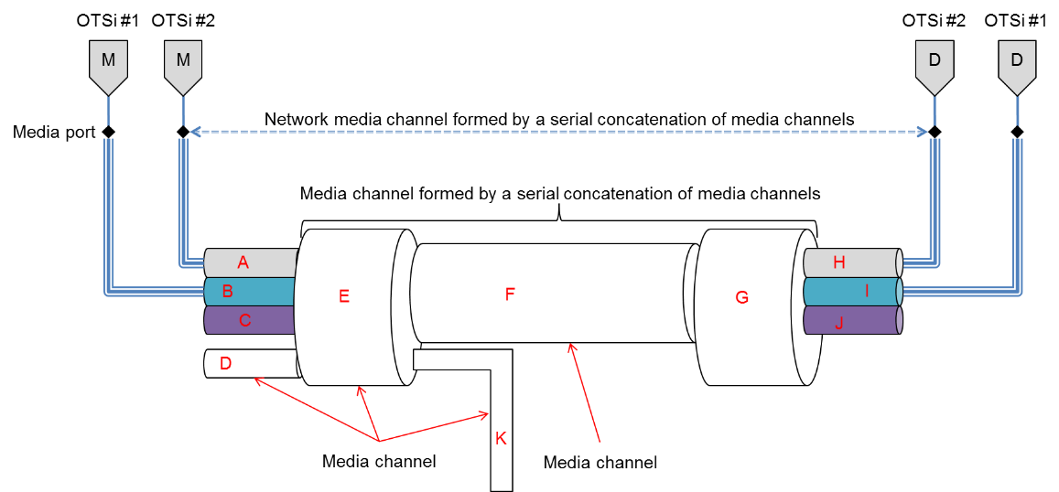
Serial concatenation of media channels
No hierarchy is created in either the media channels or the signals carried.

Slide 4
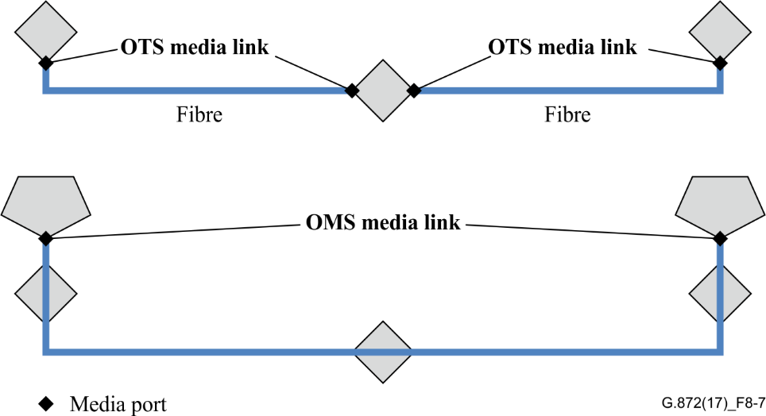
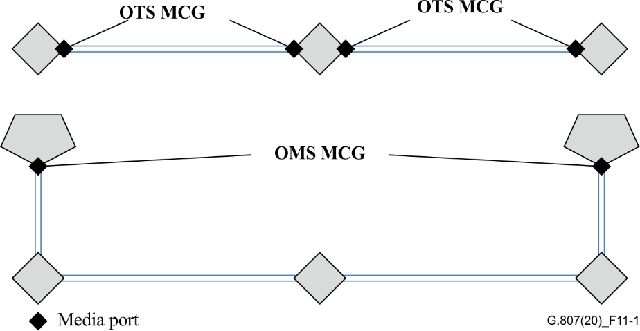
Media Links became MCG (MC Group)

Slide 5
Not all media channels are configurable
Clause 7.1.2 of G.807 Amd1
A media channel may be dimensioned to carry more than one OTSi. It may be possible to configure a media channel before it has been decided which OTSi will be allocated to it. A media channel may not be capable of supporting the transfer of a particular OTSi.
Clause 7.4 of G.807 Amd1
As described in clause 7.1.2 a media channel may be a serial concatenation of one or more media channels, each with its own frequency slot. Media subnetworks provide a point of flexibility where the route of a media channel across the media network may be created or modified.
For some media channels the frequency slot is fixed. If the media channel includes a configurable filter function, the frequency slot can be configured via the management/control plane. The configuration of a frequency slot in a configurable filter may create or modify the media channel between media ports of the filter function. This configuration can modify the route of a media channel across the network (an example of this is provided in Appendix I). The route of a media channel may also be created, or modified, by configuring a media channel in a media element such as a ROADM (that encompasses a media subnetwork and filter functions as described in clause 7.2).

Slide 6
Connection setup
Clause 10.3.1
From a management control perspective, a request to carry an OTSiA should be considered as a single action. This action involves the configuration of the modulator(s) and demodulator(s), the media channels and the OTSiG O. Configuration of the NMCs in the MCG that supports the OTSiG includes the configuration of the media elements that encompass the media constructs (e.g., media subnetworks, configurable filters and possibly amplifiers) that are part of the serial concatenation of media channels that forms the NMC.
<…>
Two simple cases for the configuration of a media element that includes a media subnetwork when an OTSiA connection request is received are described below:
Pre configured media elements
The media elements are not configured
In this case, the media channels in the media subnetworks and filters are configured as a result of the OTSiA connection request

Slide 7
Spectrum Optimization
C1722 describes the use case where multiple OTSis belonging the to same OTSiG are placed in the same “network-wide” MC
The “network-wide” MC is a management entity and not a functional entity: outside the scope of G.807
This is the entity that drives the configuration of the frequency slots on the WSSes along the path
The NMC is a functional entity, therefore defined in G.807, but not necessarily a management entity

Slide 8
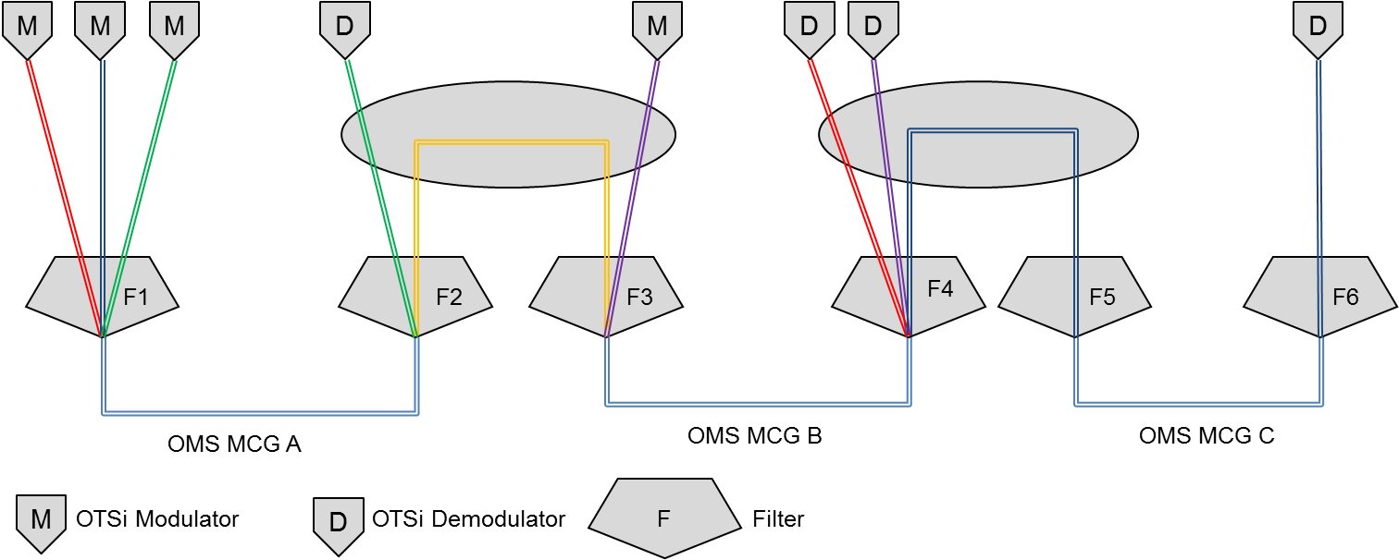
Network media channel construction
Appendix 1:
The OMS MCGs shown in blue provides connectivity between the different sites. The filters F1‑F6 aggregate and disaggregate the media channels.
The NMCG is a type of MCG that represents the set of media channels that support the transfer of a single OTSiG. This construct allows management of a NMCG as a single entity. To avoid excessive differential delay all NMCs in a NMCG should be co-routed
NMCG should indicate the central frequency and spectrum resources reserved for each of the NMCs in the NMCG
The OTSi carried by the NMCG may have the same spectral width, modulation format in order to avoid the impact of non-linear effect

Slide 9
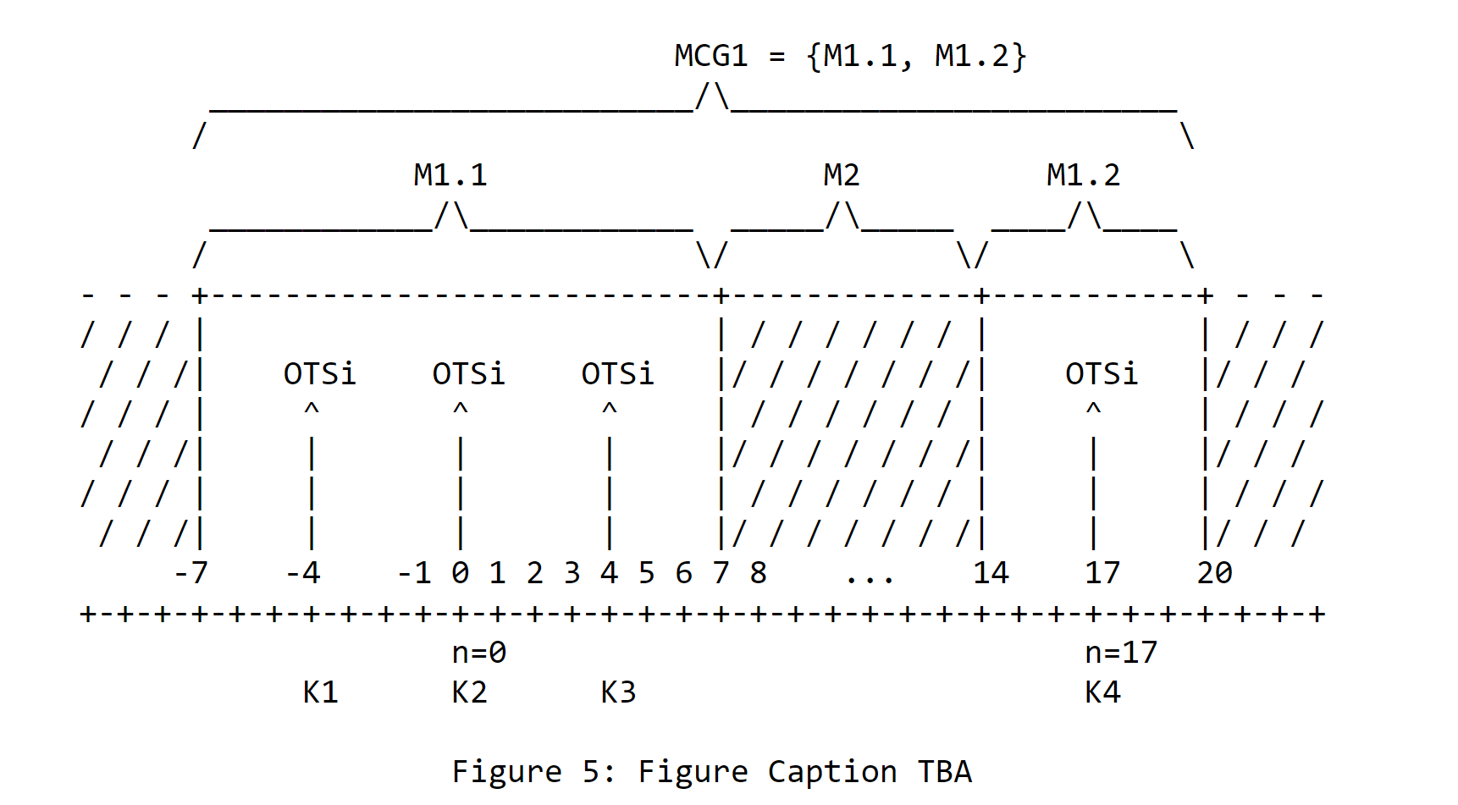
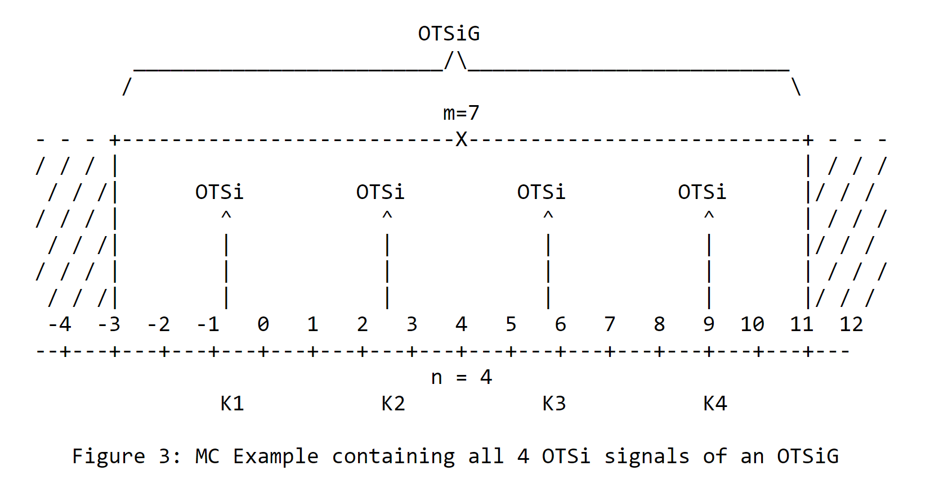
draft-ietf-ccamp-optical-impairment-topology-yang-06
The MC is an end-to-end topological network construct and can be
considered as an "optical pipe" with a well-defined frequency slot
between one or more optical transmitters each generating an OTSi and
the corresponding optical receivers terminating the OTSi's. If the
MC carries more than one OTSi, it is assumed that these OTSi's belong
to the same OTSiG.
Note – The MC defined in the OIA Topology draft corresponds to the “network-wide” MC defined in C1722

Slide 10
Layer0-Types
+--:(flexi-grid)
+--rw (single-or-super-channel)?
+--:(single)
| +--rw flexi-n? l0-types:flexi-n
| +--rw flexi-m? l0-types:flexi-m
+--:(super)
+--rw subcarrier-flexi-n* [flexi-n]
+--rw flexi-n l0-types:flexi-n
+--rw flexi-m? l0-types:flexi-m
The flexi-grid label represents the frequency slots configured on each hop
Each frequency slot is associated to one MC as defined in OIA topology draft
The model defines only one path for multiple frequency slots ensuring the MCs carrying the OTSis of one OTSiG are co-routed by definition

Slide 11
Pre-configured MCs
WD14-36 describes some management issues with pre-configured MCs (restrict connectivity flexibility)
What is the advantages of these configurations to justify the additional management/control complexity?

Slide 12
OTN Hierarchical Link
1.1
What information to report at MPI?
What information is needed to trigger the setup at MPI?
- Assumptions about which information is provided by other modules (e.g., the topology information is provided by the flexi-grid topo)
PNC
OTN XC
OTN XC
OTN Link
Optical Tunnel supports an OTN Link
OPS
OPS
Edge ROADM
WDM Network
Edge ROADM
Optical Tunnel
TXP
TXP

Slide 13
OTN Hierarchical Link
1.2
No different at the MPI from the previous use case: PNC can hide these implementation details
PNC
OTN XC
OTN XC
OTN Link
TXP
Optical Tunnel supports an OTN Link
TXP
WDM Network
Optical Tunnel

Slide 14
OTN Hierarchical Link
2.5 (tbc)
I think that the overlay can be OTN but also IP: should we differentiate these two use cases?
MDSC
OTN PNC
OTN XC
OTN XC
OTN Link
WDM PNC
OPS
OPS
Edge ROADM
WDM Network
Edge ROADM
Optical Tunnel
TXP
TXP

Slide 15
Client Signal
2.1
PNC
Edge ROADM
WDM Network
Edge ROADM
xGE
Optical Tunnel
xGE
TXP
TXP
2.2
PNC
Edge ROADM
WDM Network
Edge ROADM
Optical Tunnel
n*xGE
…
MXP
MXP
…
n*xGE

Slide 16
Client Signal
2.3
PNC
WDM Network
xGE
Optical Tunnel
xGE
OT
OT
2.4
PNC
WDM Network
Optical Tunnel
n*xGE
…
OT
OT
…
n*xGE

Slide 17
Partial Disaggregation
3.1
MDSC
xGE
Optical Tunnel
xGE
OT
OT
PNC
WDM Network
Optical Tunnel Segment
How to discover the adjancy between the external TXP and the edge ROADM

Slide 18
OTN Hierarchical Link
3.2
I think that the overlay can be OTN but also IP: should we differentiate these two use cases?
MDSC
OTN XC
OTN XC
OTN Link
TXP
Optical Tunnel supports an OTN Link
TXP
Optical Tunnel
PNC
WDM Network
Optical Tunnel Segment

Slide 19
Questions for further discussion
How to model the mapping of client signal?
See: https://github.com/ietf-ccamp-wg/draft-ietf-ccamp-optical-impairment-topology-yang/files/5334183/3R-Modelling-04.pptx
What happens with 3R?
See: https://github.com/ietf-ccamp-wg/draft-ietf-ccamp-optical-impairment-topology-yang/files/5334183/3R-Modelling-04.pptx
Is the Optical Tunnel Segment supporting only one OTSiG (like an end-to-end Optical Tunnel)?
Which information should the MDSC provide to the PNC to configure the optical tunnel segment hand-off?
With routing and wavelength assignment, the MC frequency slots depend on the optical path, so they are an output and not an input for path computation

