Slide 1
Problem Statement and Gap Analysis for Connecting to Cloud DCs via Optical Network
CCAMP, IETF 114
Philadelphia, PA
draft-liu-ccamp-optical2cloud-problem-statement-02
Authors:
Sheng Liu (liushengwl@chinamobile.com)
Haomian Zheng (zhenghaomian@huawei.com)
Aihua Guo (aihuaguo.ietf@gmail.com)
Yang Zhao (zhaoyang@chinamobile.com)

Slide 2
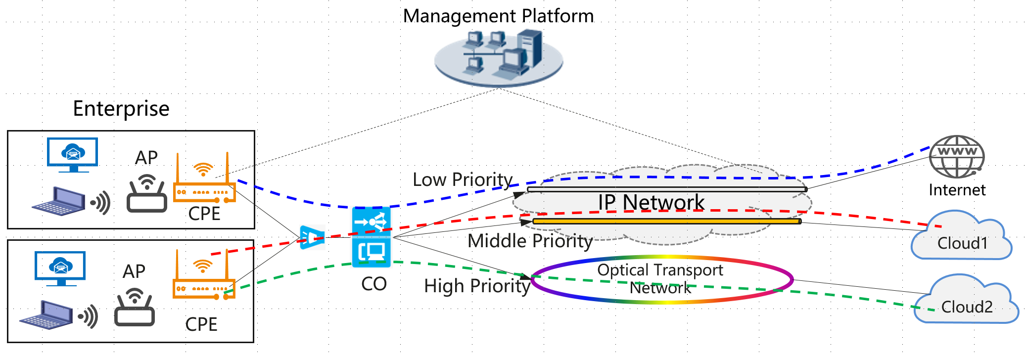
Motivation
OTN-based optical networks are being used for connecting cloud-oriented traffic
High quality, premium experience : cloud VR, premium leased line, etc.
One-hop direct access to cloud services
Complements IP-based
Traditionally connections in OTN networks are preconfigured with fixed mapping of client services to the connections
PE nodes are non-service aware, do not meet the needs for dynamic cloud service connections
New capabilities are being introduced to OTN networks to make it service aware
Control plane needs extensions to support service-driven OTN networks

Slide 3
Updates in -02
Consolidated use cases for data plane and moved them to the overview section
Data plane requirements are out of scope
Added gap analysis for control plane protocols
Added framework descriptions
Added references

Slide 4
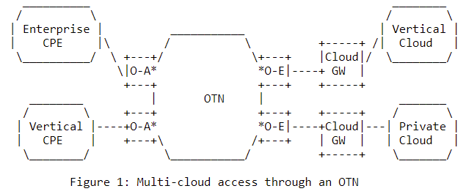
Requirement – Multi-cloud Access
Cloud services are typically hosted in multiple clouds. OTN networks need to support the scenario for multi-cloud access
L2VPN/L3VPN/native IP/ETH over OTN for multi-cloud access
Support for P2MP and MP2MP OTN connections

Slide 5
Requirement – Service-Driven OTN
Cloud-oriented traffic are dynamic in nature
Network needs to be agile
Traditionally OTN is not service driven
Fixed mapping through configuration from management and control plane at the PE nodes
Preconfigured OTN connections
New capabilities are introduced to OTN networks to make it service driven
Capability to sense type of cloud traffic and QoS requirements
Examining OTN payload : IP header (destination, TOS), VRF id, VLAN id
Predict QoS requirements such as bandwidth, delay tolerance and jitter tolerance
Capability to distribute service information to the control entity to make intelligent decisions
Dynamic connection establishment and modification
Dynamic service mapping onto OTN connections
Control plane protocol support is required

Slide 6
Gaps in Control Plane Protocols
Protocol extensions needed for communicating client information between OTN PE nodes and from OTN nodes to the controller
PCEP-LS and BGP-LS are two potential candidates for this purpose
BGP is typically not supported on OTN PE nodes due to its complexity and a possible overkill for OTN.
PCEP-LS is a better candidates for extension definition

Slide 7
Framework - Service identification and mapping
Service information that can be derived by inspecting packet headers at OTN PE nodes:
Source and destination MAC addresses
Source and destination IP addresses
VRF identifier
VLAN (S-VLAN and/or C-VLAN) identifier
MPLS label
Dynamic mapping of services to OTN tunnels
Mapping can be updated dynamically
OTN tunnels can be created and reconfigured dynamically
E.g. dynamic bandwidth change

Slide 8
Framework - Reporting Service Identification
Need protocol extension for reporting to controller the service identification contents
Private network or network slice identifier, to identify corresponding tenants or applications supported by the private network
OTN PE node identifier
Service information such as the client IP/MAC addresses
When the PCEP protocol is used, this extension may be defined as a PCEP Report message.

Slide 9
Framework - Configuring Service Mapping
Control plane protocol extension may be defined to push the mapping table between service address to ODU connections from the controller to the OTN PE nodes.
Private network or network slice identifier, to identify corresponding tenants or applications supported by the private network
A mapping table of {service address, ODU connection identifier}
Entry data: {remote OTN node, remote service address}
When the PCEP protocol is used, this extension may be defined as a PCEP Update message.

Slide 10
Next steps
Integrate framework into this draft and prepare for WG adoption
Call for interest & joint contribution
Solicit comments from the WG
Define protocol extensions

Slide 11
Thank You!

