Slide 1
Framework and Data Model for OTN Network Slicing
draft-zheng-ccamp-yang-otn-slicing-02
Co-authors:
Haomian Zheng (Huawei)
Italo Busi (Huawei) Aihua Guo (Futurewei)
Victor Lopez(Nokia)
Sergio Belotti (Nokia)
Dieter Beller (Nokia)
Reza Rokui (Nokia)
Luis M. Contreras (Telefonica)
Oscar Gonzales (Telefonica)
Yunbin Xu (CAICT)
Yang Zhao (China Mobile)
Contributors:
Henry Yu (Huawei)

Slide 2
Major Updates Since IETF 110
Admin
Weekly meeting (Thu 10-11am EST)
GitHub: https://github.com/aguoietf/ietf-ccamp-yang-otn-slicing
Expanded list of authors and contributors
Draft Updates
Added use case: end-to-end network slicing
Clarified definitions
OTN Slice
OTN Slice Controller (OTN-SC)
Relationship between an OTN slice and an IETF network slice
Abstraction methods for OTN slices
Connectivity-based vs. resource-based
OTN-SC recursion

Slide 3
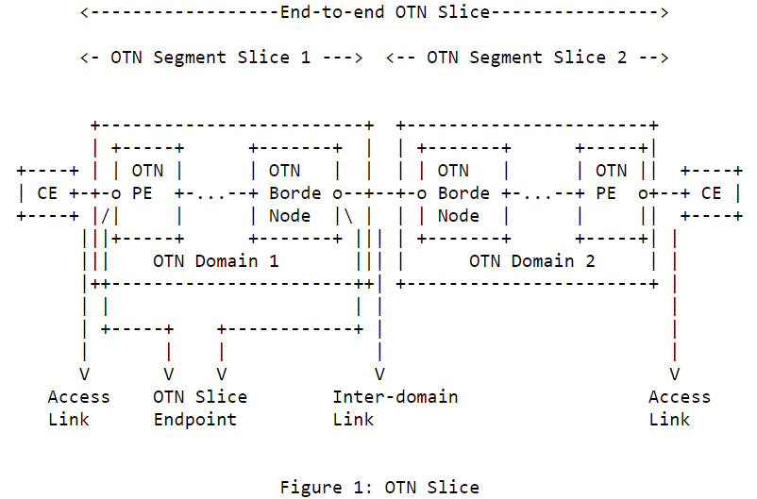
Definition & Scope of OTN Slice
Aligned the definition with IETF network slicing [I-D.ietf-teas-ietf-network-slices]
An OTN slice is an OTN virtual network topology connecting a number of OTN endpoints using a set of shared or dedicated OTN network resources to satisfy specific service level objectives (SLOs).
An OTN slice is a technology-specific realization of an IETF network slice in the OTN domain
Scope of OTN slice for single-domain & multi-domain
Access link – Access link
Access link – Inter-domain link
OTN segment slices in hierarchical or sequential (stitched) combination

Slide 4
Abstraction Method for OTN Slices
Connectivity-based OTN slices are abstracted as a set of endpoint-to-endpoint links, with each link formed by an end-to-end tunnel across the underlying OTN networks
Resource-based OTN slices are abstracted as an abstract topology to allow resource sharing between endpoints, and on-demand commissioning within the slice.
Better optimization of resources
Real world example: OTN slice supporting high-quality, real-time broadcasting of sports events between multiple stadiums and TV station
The methods are similar to the Virtual Network (VN) concept defined in RFC8453
VN type 1 – connectivity-based slicing
VN type 2 – resource-based slicing

Slide 5
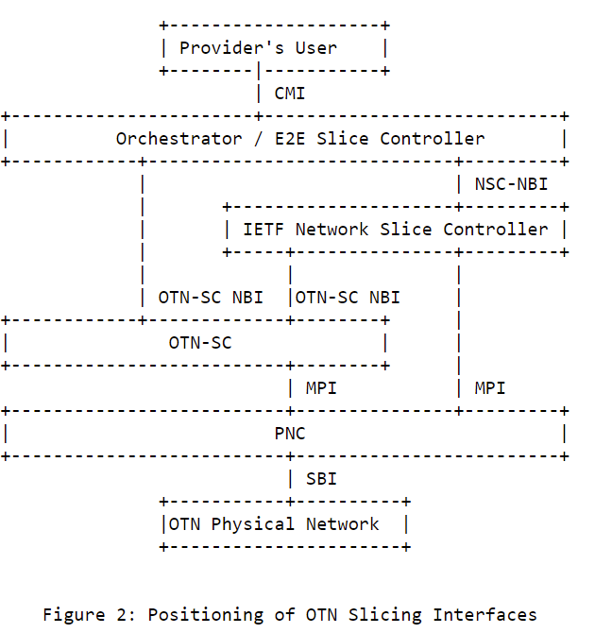
OTN Slicing Controller & Interfaces
OTN Slice Controller (OTN-SC)
A logical function responsible for the life-cycle management of OTN slices instantiated within the corresponding OTN network domains
Translating slice configuration into TE tunnels or TE abstract topologies with resource coloring at the MPI
Flexible deployment
Recursive
OTN-SC NBI
Serves orchestrator for direct OTN slice requests
An IETF NSC has the option to use OTN-SC NBI or directly interface with PNC/MDSC to realize slices
OTN-SC SBI
SBI clients: ACTN PNC / MDSC

Slide 6
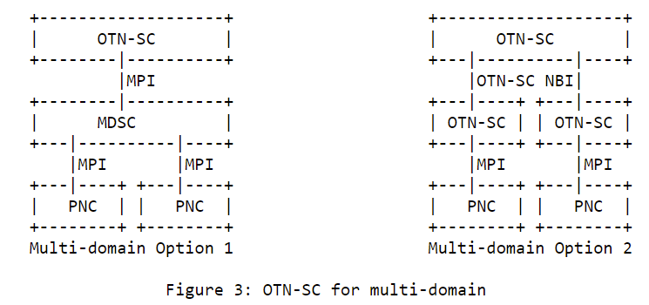
OTN Slicing for Multi-domain
OTN-SC – OTN-SC recursion
OTN-SC – MDSC – PNC

Slide 7
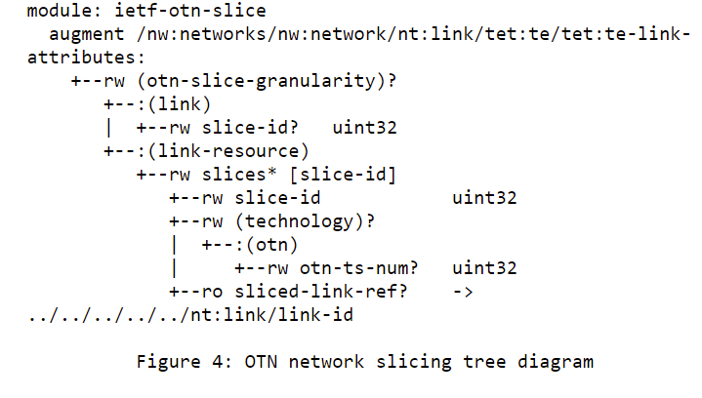
YANG Models @ MPI
Coloring TE links
Either type/number of ODU containers or number of time slots could be used for coloring TE link resources at the MPI
* A prior version of this YANG model was contributed to ONAP and is included in its Guilin Release.

Slide 8
Next Steps
Continue updating the YANG model for OTN-SC SBI (i.e. MPI in Fig. 2)
Develop YANG model for OTN-SC NBI. Looking into related work, e.g.
draft-liu-teas- transport-network-slice-yang
draft-wd-teas-transport-slice-yang for NBI towards the orchestrator
draft-contreras-teas-slice-controller-models
draft-ietf-teas-actn-vn-yang
Address the slicing for external (access and inter-domain) links that support client signals other than OTN
Address comments and reviews from the WG
The authors believe the draft is ready for WG adoption
Consensus on the definition & scope among authors
Good interest
Stable YANG MPI and clear development path for NBI

Slide 9
Thank You!

