Slide 1
Framework and Data Model for OTN Network Slicing
draft-zheng-ccamp-yang-otn-slicing-02
Co-authors:
Haomian Zheng (Huawei)
Italo Busi (Huawei) Aihua Guo (Futurewei)
Victor Lopez(Nokia)
Sergio Belotti (Nokia)
Dieter Beller (Nokia)
Reza Rokui (Nokia)
Luis M. Contreras (Telefonica)
Oscar Gonzales (Telefonica)
Yunbin Xu (CAICT)
Yang Zhao (China Mobile)
Contributors:
Henry Yu (Huawei)

Slide 2
Major Updates Since IETF 110
Admin
Weekly meeting (Thu 10-11am EST)
GitHub: https://github.com/aguoietf/ietf-ccamp-yang-otn-slicing
Expanded list of authors and contributors
Draft Updates
Added use case: end-to-end network slicing
Clarified definitions
OTN Slice
OTN Slice Controller (OTN-SC)
Relationship between an OTN slice and an IETF network slice
Abstraction methods for OTN slices
Connectivity-based vs. resource-based
OTN-SC recursion

Slide 3
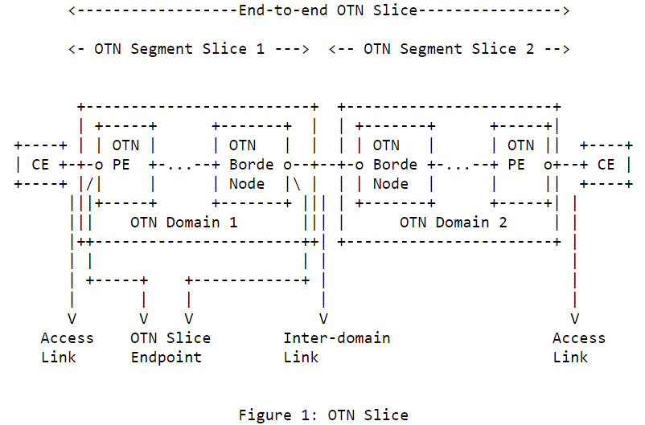
Definition & Scope of OTN Slice
Aligned the definition with IETF network slicing [I-D.ietf-teas-ietf-network-slices]
An OTN slice is an OTN virtual network topology connecting a number of OTN endpoints using a set of shared or dedicated OTN network resources to satisfy specific service level objectives (SLOs).
An OTN slice is a technology-specific realization of an IETF network slice in the OTN domain
Scope of OTN slice for single-domain & multi-domain
Access link – Access link
Access link – Inter-domain link
OTN segment slices in hierarchical or sequential (stitched) combination

Slide 4
Abstraction Method for OTN Slices
Connectivity-based OTN slices are abstracted as a set of endpoint-to-endpoint links, with each link formed by an end-to-end tunnel across the underlying OTN networks
Resource-based OTN slices are abstracted as an abstract topology to allow resource sharing between endpoints, and on-demand commissioning within the slice.
Better optimization of resources
Real world example: OTN slice supporting high-quality, real-time broadcasting of sports events between multiple stadiums and TV station
The methods are similar to the Virtual Network (VN) concept defined in RFC8453
VN type 1 – connectivity-based slicing
VN type 2 – resource-based slicing

Slide 5
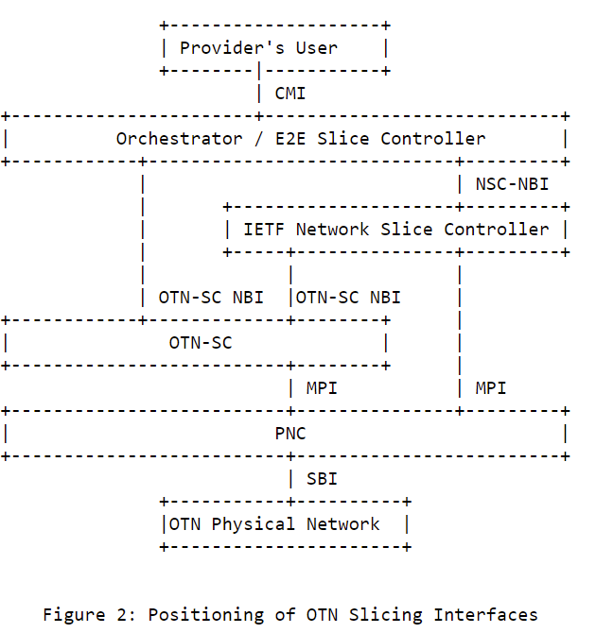
OTN Slicing Controller & Interfaces
OTN Slice Controller (OTN-SC)
A logical function responsible for the life-cycle management of OTN slices instantiated within the corresponding OTN network domains
Translating slice configuration into TE tunnels or TE abstract topologies with resource coloring at the MPI
Flexible deployment
Recursive
OTN-SC NBI
Serves orchestrator for direct OTN slice requests
An IETF NSC has the option to use OTN-SC NBI or directly interface with PNC/MDSC to realize slices
OTN-SC SBI
SBI clients: ACTN PNC / MDSC

Slide 6
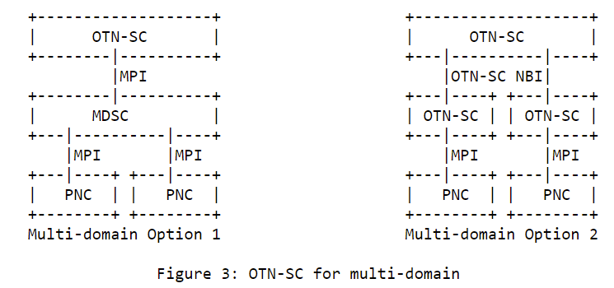
OTN Slicing for Multi-domain
OTN-SC – OTN-SC recursion
OTN-SC – MDSC – PNC

Slide 7
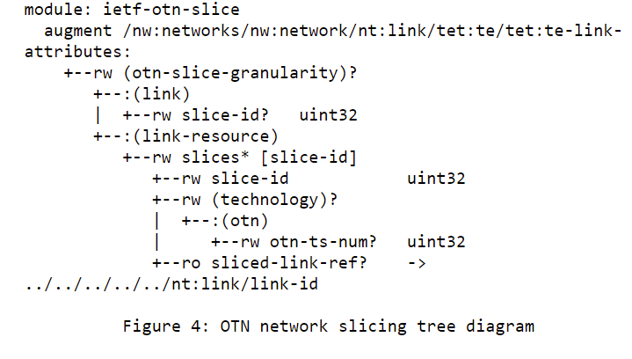
YANG Models @ MPI
Coloring TE links
Either type/number of ODU containers or number of time slots could be used for coloring TE link resources at the MPI
* A prior version of this YANG model was contributed to ONAP and is included in its Guilin Release.

Slide 8
Next Steps
Continue updating the YANG model for OTN-SC SBI (i.e. MPI in Fig. 2)
Develop YANG model for OTN-SC NBI. Looking into related work, e.g.
draft-liu-teas- transport-network-slice-yang
draft-wd-teas-transport-slice-yang for NBI towards the orchestrator
draft-contreras-teas-slice-controller-models
draft-ietf-teas-actn-vn-yang
Address the slicing for external (access and inter-domain) links that support client signals other than OTN
Address comments and reviews from the WG
The authors believe the draft is ready for WG adoption
Consensus on the definition & scope among authors
Good interest
Stable YANG MPI and clear development path for NBI

Slide 9
Next Steps
The OTN slicing NBI needs to support both connectivity-based slices and topology-based slices.
It is possible to have two models for each type of slices, with one model to augment from some generic TEAS network slice NBI model and the other to augment from the network-topology-based model(draft-liu-teas-transport-network-slice-yang). Aihua also raised the point whether we could do with one model to cover both types of slices. This remains to be investigated.
The current TEAS network slice model (draft-wd-teas-ietf-network-slice-nbi-yang) is tightly coupled with packet services, and we need a more generic model to augment from for OTN connectivity-based slicing.
The participants agreed to investigate the current parameters of draft-wd-teas-ietf-network-slice-nbi-yang and explores the option of a more generic model suitable for OTN slicing augmentation.

Slide 10
Draft-liu-teas-transport-network-slice-yang
module: ietf-network-slice
augment /nw:networks/nw:network/nw:network-types:
+--rw network-slice!
augment /nw:networks/nw:network:
+--rw network-slice
+--rw optimization-criterion? identityref
+--rw delay-tolerance? boolean
+--rw periodicity* uint64
+--rw isolation-level? identityref
augment /nw:networks/nw:network/nw:node:
+--rw network-slice
+--rw isolation-level? identityref
+--rw compute-node-id? string
+--rw storage-id? string
augment /nw:networks/nw:network/nt:link:
+--rw network-slice
+--rw delay-tolerance? boolean
+--rw periodicity* uint64
+--rw isolation-level? identityref
draft-liu-teas-transport-network-slice-yang-04 (ietf.org)

Slide 11
Draft-wd-teas-transport-slice-yang
module: ietf-network-slice
+--rw network-slices
+--rw slice-templates
| +--rw slo-template* [id]
| +--rw id string
| +--rw template-description? string
+--rw network-slice* [network-slice-id]
+--rw network-slice-id uint32
+--rw network-slice-name? string
+--rw network-slice-tag? string
+--rw network-slice-topology* identityref
+--rw network-slice-slo-group* [slo-group-name]
| +--rw slo-group-name string
| +--rw default-slo-group? boolean
| +--rw (slo-template)?
| | +--:(standard)
| | | +--rw template? -> /network-slices/slice-templates/slo-template/id
| | +--:(custom)
| | +--rw network-slice-slo-policy
| | +--rw latency
| | | +--rw one-way-latency? uint32
| | | +--rw two-way-latency? uint32
| | +--rw jitter
| | | +--rw one-way-jitter? uint32
| | | +--rw two-way-jitter? uint32
| | +--rw loss
| | | +--rw one-way-loss? decimal64
| | | +--rw two-way-loss? decimal64
| | +--rw availability-type? identityref
| | +--rw isolation-type? identityref
| | +--rw network-slice-metric-bounds
| | +--rw network-slice-metric-bound* [metric-type]
| | +--rw metric-type identityref
| | +--rw upper-bound? uint64
| +--rw network-slice-member-group* [network-slice-member-id]
| | +--rw network-slice-member-id -> /network-slices/network-slice/network-slice-member/network-slice-member-id
| +--ro slo-group-monitoring
| +--ro latency? uint32
| +--ro jitter? uint32
| +--ro loss? decimal64
+--rw status
| +--rw admin-enabled? boolean
| +--ro oper-status? operational-type
+--rw network-slice-endpoint* [endpoint-id]
| +--rw endpoint-id uint32
| +--rw endpoint-name? string
| +--rw endpoint-role* identityref
| +--rw geolocation
| | +--rw altitude? int64
| | +--rw latitude? decimal64
| | +--rw longitude? decimal64
| +--rw node-id? string
| +--rw port-id? string
| +--rw network-slice-match-criteria
| | +--rw network-slice-match-criteria* [match-type]
| | +--rw match-type identityref
| | +--rw value? string
| +--rw endpoint-ip? inet:host
| +--rw bandwidth
| | +--rw incoming-bandwidth
| | | +--rw guaranteed-bandwidth? te-types:te-bandwidth
| | +--rw outgoing-bandwidth
| | +--rw guaranteed-bandwidth? te-types:te-bandwidth
| +--rw mtu uint16
| +--rw routing
| | +--rw bgp
| | | +--rw bgp-peer-ipv4* inet:ipv4-prefix
| | | +--rw bgp-peer-ipv6* inet:ipv6-prefix
| | +--rw static
| | +--rw static-route-ipv4* inet:ipv4-prefix
| | +--rw static-route-ipv6* inet:ipv6-prefix
| +--rw status
| | +--rw admin-enabled? boolean
| | +--ro oper-status? operational-type
| +--ro endpoint-monitoring
| +--ro incoming-utilized-bandwidth? te-types:te-bandwidth
| +--ro incoming-bw-utilization decimal64
| +--ro outgoing-utilized-bandwidth? te-types:te-bandwidth
| +--ro outgoing-bw-utilization decimal64
+--rw network-slice-member* [network-slice-member-id]
+--rw network-slice-member-id uint32
+--rw src
| +--rw src-network-slice-endpoint-id? -> /network-slices/network-slice/network-slice-endpoint/endpoint-id
+--rw dest
| +--rw dest-network-slice-endpoint-id? -> /network-slices/network-slice/network-slice-endpoint/endpoint-id
+--rw monitoring-type? network-slice-monitoring-type
+--ro network-slice-member-monitoring
+--ro latency? uint32
+--ro jitter? uint32
+--ro loss? decimal64
draft-liu-teas-transport-network-slice-yang-04 (ietf.org)

Slide 12
Modeling for OTN Slices
2-in-1:
Build a topology
Single-node for connectivity-based slices
Multi-node/link topology for resource-based slices
Create connectivity on the topology
Mandatory for connectivity-based slices
Optional for resource-based slices

Slide 13
Modeling for Connectivity-based OTN Slices
Option 1: single-node topology
Endpoint list
Each endpoint has:
Endpoint id
Reference to PE LTP
(Optional) Resource id (time slot, VLAN ids etc.)
Connectivity matrix - p2p connectivity between endpoints
Committed: resource is activated
Uncommitted: resource is reserved but not activated
Default behavior of connectivity matrix
EP1
EP3
Connectivity
EP2
EP4
Node

Slide 14
Modeling for Connectivity-based OTN Slices
Option 2: edge-edge topology
Endpoint list
Each endpoint has:
Endpoint id
Reference to PE LTP
(Optional) Resource id (time slot, VLAN ids etc.)
Connectivity matrix - p2p connectivity between endpoints
Committed: resource is activated
Uncommitted: resource is reserved but not activated
Default behavior of connectivity matrix
Path associated with a p2p connection
EP1
TP1
TP3
EP3
Link1
path
EP2
TP2
TP4
Link2
EP4
Node1
Node2

Slide 15
Modeling for Resource-based OTN Slices
Full topology
Endpoint list
Each endpoint has:
Endpoint id
Reference to PE LTP
(Optional) Resource id (time slot, VLAN ids etc.)
SLOs
SLOs for network, link, node and TP
Connectivity matrix - p2p connectivity between endpoints
Committed: resource is activated
Uncommitted: resource is reserved but not activated
Default behavior of connectivity matrix
Path associated with a p2p connection
EP1
TP1
TP3
EP3
Link1
EP2
TP2
TP4
EP4
Node1
Link2
Link3
Node2
TP5
Node3
EP5

Slide 16
Thank You!

