Slide 1
ANALYSTLAB AFRICA | WEEK 5 PROJECT
SWIFTLOG LOGISTICS
Supply Chain Analytics & Business Intelligence
Executive presentation | Power BI dashboard and business insights
Prepared by: Agu Precious Ayomide
Date: October 2026
Notes:
Introduce the SwiftLog Logistics supply-chain analytics project. Explain that the presentation summarises a Power BI solution built to consolidate operational data and highlight areas for management investigation.

Slide 2
Business Challenge & Project Objectives
THE BUSINESS NEED
PROJECT OBJECTIVES
The business problem: orders are cancelled, deliveries are late, and returns cost money.
The goal is to bring operational information into one view so leaders can monitor performance and investigate emerging issues.
1
Prepare the data
Clean and join 11 tables into one reliable model
2
Measure performance
Build KPIs for revenue, customers, stock, delivery and returns
3
Explain the results
Show what drives cancellations, delays and returns
4
Recommend action
Translate findings into practical business recommendations.
Give management clear, measurable next steps
ORDERS ANALYSED
CUSTOMERS
PRODUCTS
WAREHOUSES
5,000
1,000
250
15
2

Slide 3
Data Preparation & Analytical Method
01
02
03
04
05
SOURCE
PREPARE
MODEL
MEASURE
VISUALISE
11 operational datasets,
plus a data dictionary
Review data types, completeness and consistency
Build relationships between related business tables
Create DAX KPIs for revenue, orders, delivery and stock
Develop five Power BI dashboard pages
Scope: descriptive insights and management recommendations; causal explanations require further investigation.
3

Slide 4
DASHBOARD DEMONSTRATION
The dashboard has five pages plus drill-through
Executive Overview
Revenue, orders, delivery and returns with status and location filters
Customer Analytics
Top customers, retention, order frequency and city comparison
Inventory & Warehouse
Stock levels, stock share by warehouse, units sold to stock
Shipment & Delivery
Delivery status, delays by location, monthly shipment trend
Supplier & Product
Revenue and returns by product, category and cancellations
Also included: drill-through to Customer Detail, bookmarks for each status, tooltips by warehouse, and a delay-threshold What-If parameter.

Slide 5
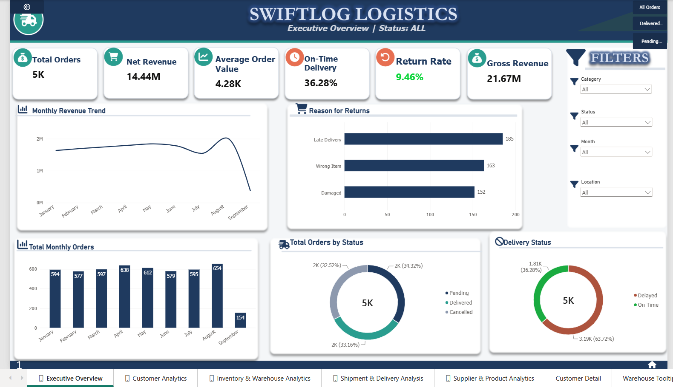
Executive Overview
AT A GLANCE
GROSS REVENUE
NON-CANCELLED REVENUE
₦21.67M
₦14.44M
CANCELLATION
ORDER RETURNS
32.52%
9.02%
Management focus
• Cancellations
• Delivery reliability
• Returns and data quality
Revenue figures are order-item calculations, not profit or cash received.
4
Notes:
Recorded order-item revenue is approximately ₦21.67 million; revenue associated with non-cancelled orders is ₦14.44 million. The latter is not refund-adjusted accounting revenue.

Slide 6
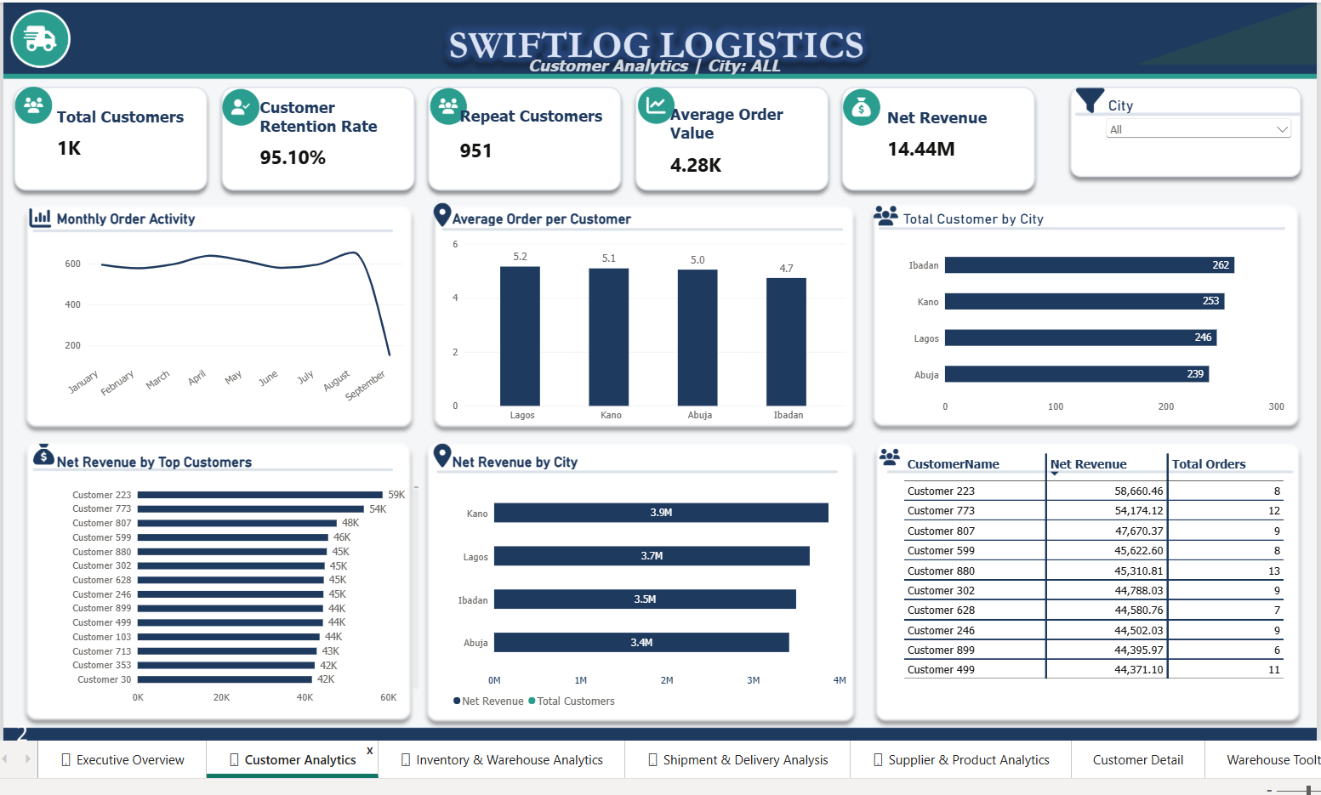
Customer Analytics
WHAT THE DATA SHOWS
CUSTOMERS
REPEAT CUSTOMERS
1,000
951
REPEAT-CUSTOMER RATE
95.10%
Management focus
Compare activity by city.
• Explore order frequency and revenue contribution.
• Use patterns to guide engagement initiatives.
5
Notes:
There are 951 repeat customers among 1,000 customers, giving a repeat-customer rate of 95.10% in this dataset. This is not formal retention because no defined observation period or cohort analysis was used.

Slide 7
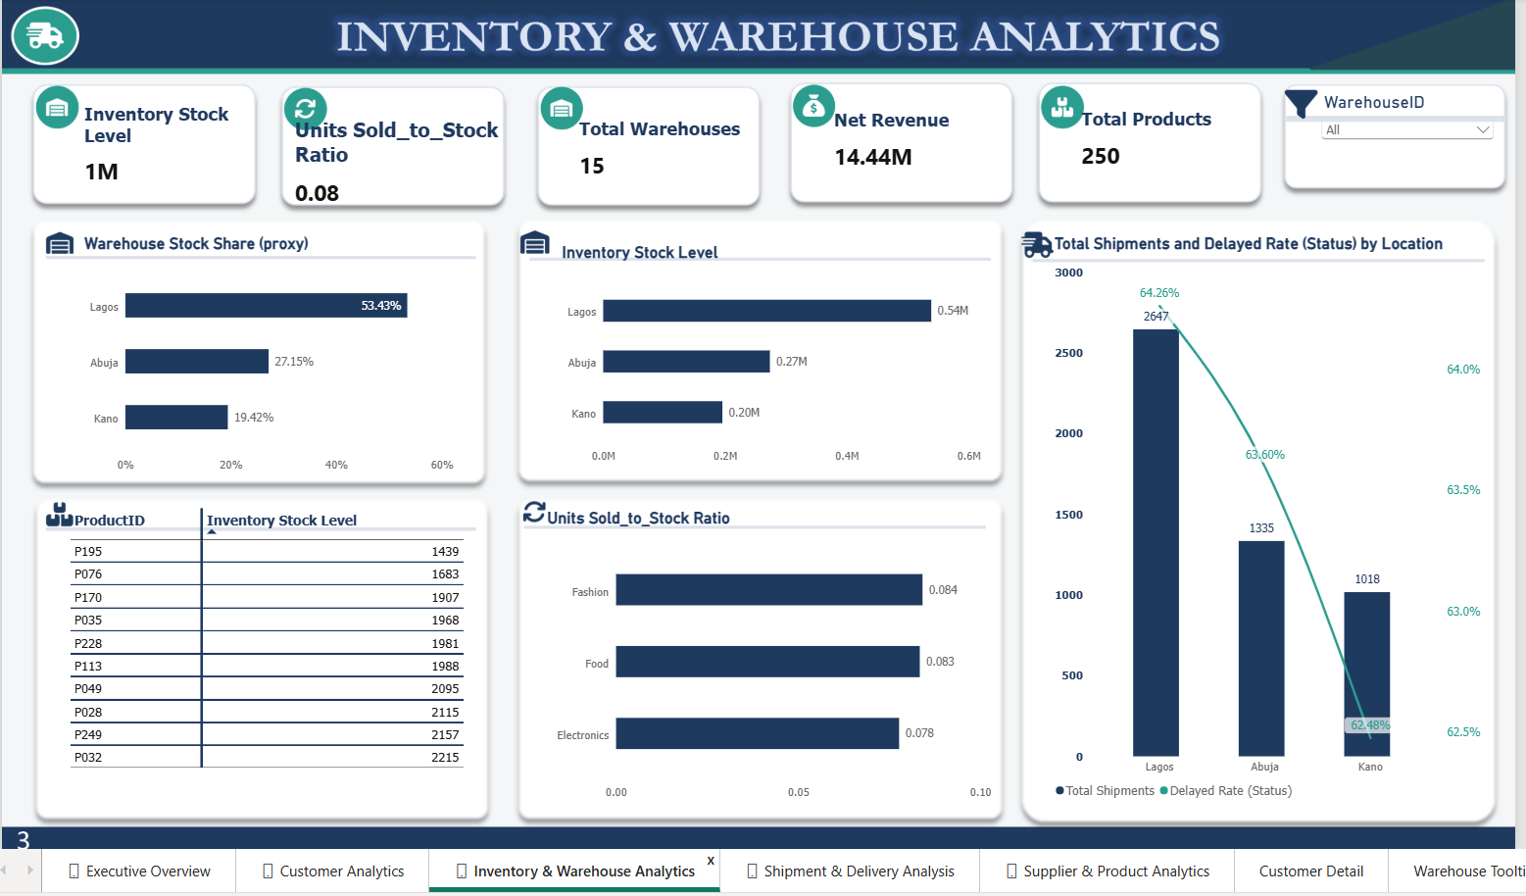
Inventory & Warehouse Analytics
OPERATIONAL QUESTIONS
WAREHOUSES
PRODUCTS
15
250
UNITS SOLD-TO-STOCK RATIO
0.08
Management focus
Review stock distribution by location.
• Investigate low-stock records.
• Set replenishment thresholds using validated demand.
Descriptive ratio, not conventional inventory turnover.
6
Notes:
The page compares stock distribution across locations and product categories. The 0.08 units-sold-to-stock ratio is descriptive not conventional inventory turnover.

Slide 8
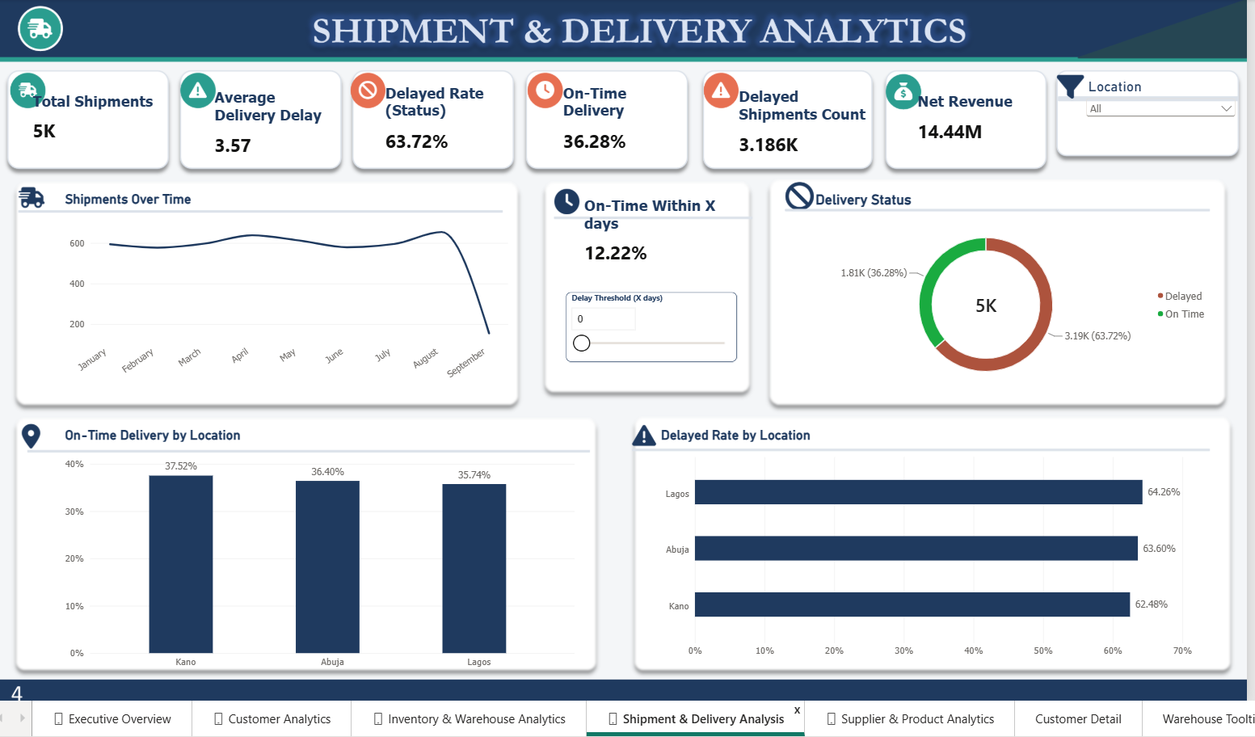
Shipment & Delivery Performance
DELIVERY SNAPSHOT
SHIPMENTS
AVERAGE DELAY
5,000
3.57 days
STATUS DELAYED
ON TIME
63.72%
36.28%
DelayDays flags 4,000 shipments with positive delay, while status classification shows 3,186 delayed.
7
Notes:
Delivery status classifies 3,186 shipments as delayed (63.72%) and 1,814 as on time (36.28%). A separate count based on DelayDays > 0 flags 4,000 shipments. Recommend reconciling definitions before operational targets are set.

Slide 9
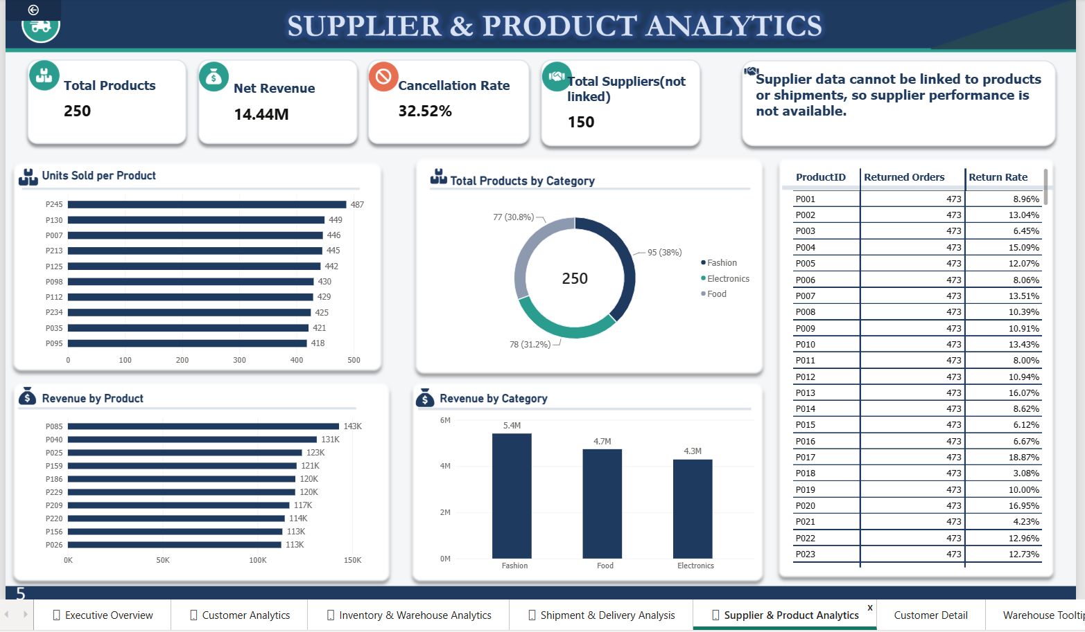
Supplier & Product Analytics
PRODUCT PERFORMANCE
PRODUCTS
SUPPLIERS
250
150
Revenue by category
FASHION
FOOD
ELECTRONICS
₦5.4M
₦4.7M
₦4.3M
Supplier performance is unavailable because supplier data cannot currently be linked to products or shipments.
8
Notes:
Fashion shows approximately ₦5.4 million in revenue from non-cancelled orders, Food ₦4.7 million, and Electronics ₦4.3 million. The supplier table cannot be linked to products or shipments, so do not infer supplier-level performance.

Slide 10
Key Business Findings
Three signals deserve management attention
CANCELLATION RATE
STATUS-CLASSIFIED DELAYS
ORDER RETURN RATE
32.52%
63.72%
9.46%
Cancelled orders represent about a third of gross revenue
Shipments exist for 1,626 cancelled and 1,716 pending orders
Dispatch may be starting before orders are confirmed
Average delay is 3.57 days
Delayed rate is 62 to 64% in all three locations
The gap between locations is about two points
The problem is network-wide, not one site
Late delivery is 37% of 500 return records
Wrong item and damaged goods make up most of the rest
Return rate is 9.46% of orders
ADDITIONAL INSIGHTS
TO NOTE;
• 951 customers are classified as repeat customers.
August is the peak: 654 orders
• Fashion has the highest revenue among the three displayed categories with NGN 5.41 million net revenue
Product return rates vary: P032 is highest at 21.28%
• September covers only 1–8 September in the order data.
• Observed patterns do not establish causes by themselves.
9

Slide 11
Strategic Recommendations
Investigate cancellations
Improve delivery monitoring
01
02
Segment by month, customer, location and available order attributes.
Cut cancellations through a pre-confirmation check
Review location-level performance and recurring delay patterns.
Link suppliers to products and shipments
Reduce avoidable returns
Strengthen inventory decisions
03
04
Investigate late delivery, wrong-item and damaged-item reasons.
Fix late delivery, the largest return cause
Review stock distribution and set demand-informed replenishment thresholds.
Reduce stock that is not selling
Deepen customer insight
Improve data governance
05
06
Analyse purchase frequency and revenue contribution.
Reconcile delayed-shipment definitions and document KPI formulas.
10

Slide 12
Data Limitations & Next Steps
LIMITATIONS TO COMMUNICATE
RECOMMENDED NEXT STEPS
• September order data is incomplete (1–8 September).
• DelayDays and delivery-status measures produce different delayed counts.
• Supplier data cannot currently be linked to products or shipments.
• Revenue measures do not establish profit, cash received or refund-adjusted revenue.
• Compare equivalent date ranges and confirm table coverage.
• Agree on one operational definition of a delayed shipment.
• Create validated supplier-product linkages.
• Assign owners to priority KPIs and review them regularly.
Reliable decisions depend on consistent definitions, complete data and transparent assumptions.
11

Slide 13
CONCLUSION
From operational data to clearer decisions
Revenue is healthy and spread across customers and products.
The biggest losses come from cancellations and delivery failures, and they are linked to returns.
The first step is to confirm orders before dispatch, then fix delivery timing.
The five Power BI dashboard pages provide a consolidated view of SwiftLog’s customers, orders, inventory, deliveries, products and returns.
The next opportunity is to validate key measures, add a supplier key, investigate the strongest signals and track improvements using consistent reporting periods.
Thank you.
12

