Slide 1
FUYAO CASE STUDY
MISSION POSSIBLE

Slide 2
TABLE OF CONTENTS
01
03
05
ABOUT US
MORAINE’S SUCCESS PLAN
CIRCULAR ECONOMY
02
04
06
PRODUCTION PROCESS
SOURCING STRATEGY
QUANTITATIVE ANALYSIS

Slide 3
Executive Summary
Fuyao Glass started in 1987 and has grown to the largest supplier of automotive glass products.
It has factories in different capacities in China, Russia and US.
Currently, the production efficiency in their US plant Moraine is not at par with their efficiency in China (Tianjin) and their multiple causative factors.
We will go over the sourcing decision while considering the various aspects of circular economy.
Then, we will do a deep dive into the quantitative analysis based on the factor of electricity.

Slide 4
01
ABOUT US

Slide 5
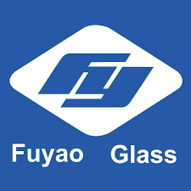
BUSINESS OVERVIEW
Since 1987, parent company Fuyao Group, has been producing outstanding automotive glass for the OEM & ARG markets. Now a global company and world leader in auto glass manufacturing, Fuyao’s expansion into the U.S. marks a return to the midwest’s manufacturing roots.

Slide 6
OUR EVOLUTION
1987
1994
2006-2008
Cao Dewang founded company in Fuqing, Fujian Province
Established a sales office in USA
Established subsidiaries in Germany, South Korea, Japan, USA
2
3
1
2
3

Slide 7
OUR EVOLUTION
2011
2014
2018
Established production facility in Russia
Decided to establish a factory in Moraine, Ohio
FGA turned its first annual profit
2
3
4
5
6

Slide 8





WE’RE AN OEM GLASS SUPPLIER TO ALL MAJOR AUTO MANUFACTURERS
General Motors
Ford
BMW
HONDA
BENTLEY
Notes:
1-8 slides - Udisha

Slide 9
02
PRODUCTION PROCESS

Slide 10
REASONS FOR EXPANSION
Proximity
Cost
Main purpose was to be close to the US customers
Sourcing from Tianjin incurred substantial packaging, and shipping costs
Exports from US to China had so many risks that were hard to protect
Unsustainability of low container shipping rates
For customers having Just-In-Time supply chains
Notes:
First, we will talk about the reasons for the expansion of Fuyao from china to America.
What were the factors behind that:-
To be close to the customers here in america and it creates value for the supply chain.
There were so many risks in the export process of the product from china to america.
There are customers having Just-In-Time supply chain process and need the product at specific time and delivery at that time is crucial
Again sourcing from Tianjin was leveraging substantial packaging and shipping costs which needed to be optimized
Lastly, there was uncertainty of container shipping rates as they were going to be higher

Slide 11
Did they do a good job bringing up the production process?
NO.
Notes:
No the biggest question:- Did they do a good job bringing up the production process in America:-
They had valid reasons for it but the answer of this question is no.
Why?

Slide 12
REASONS FOR FAILURE
COST
MANAGEMENT
TRAINING
CULTURE
SITE
Total cost per windshield was approx. 20$ more in moraine
Very poor upper management
It was automated still it lacked proper trainings of the employees
Failed to create proper and consistent culture in the company
The site was not ready to fulfill big and important orders
Notes:
Because the total cost of the windshield here in american site was 20$ more than what was in tianjin
The process of developing upper management was very poor
The site of moraine was more automated than any other production sites but still it lacked proper trainings of the employees to handle it
They couldn’t rely on moraine site to fulfill the big and important orders as they were scared of the huge fines if the order couldn’t be fulfilled by the site
Last they failed to create proper and consistent culture in the company among all the employees.

Slide 13
03
Moraine’s Success Plan

Slide 14
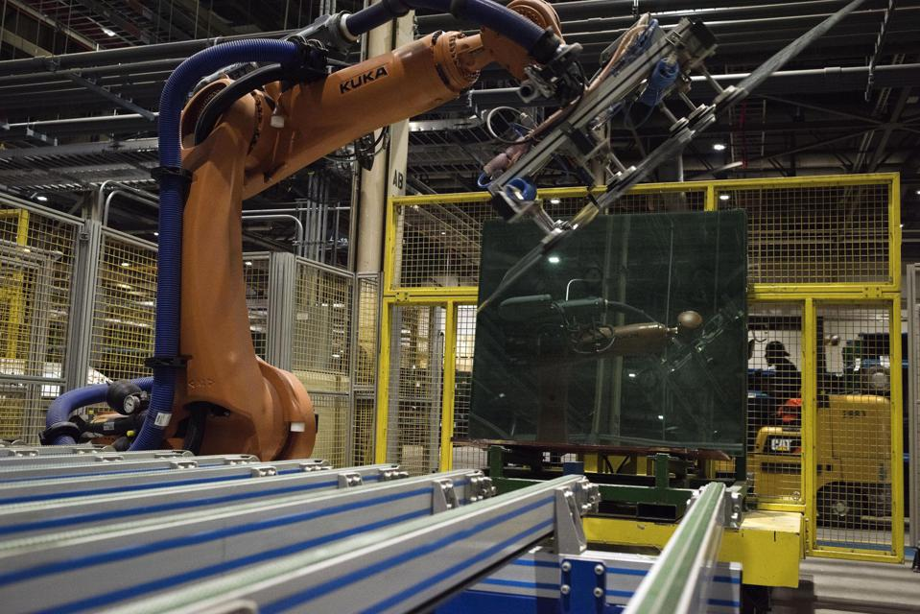
Moraine’s Path to Success
Take advantage of the location being closer to US customers
Adapt to the difference in Moraine’s automation vs. Tianjin’s labor
Better management that aligns with an American company’s culture
Have a smoothly run domestic supply chain

Slide 15

Notes:
13-15 Jilliane

Slide 16
04
SOURCING STRATEGY

Slide 17
Should the glass be sourced from Moraine or Tianjin?
We recommend sourcing glass from Moraine based on the following circular economy factors-
Refurbishment/Recycling:
Easy to refurbish/recycle materials at Moraine because its high automation
Less wastage
Decreases cost of raw materials and avoid transportation costs (much higher if we have transport it from Tianjin).
New Markets: While China automobile market is the largest, US market has more appetite for circular economy (demand for sustainability, lesser carbon emissions).
Tradability: US made windshield is better in quality.

Slide 18
05
Circular Economy and Safety
Notes:
Let’s talk about how can we expand our markets in terms of circular economy and safety?
Why circular economy?
Shifting to a circular economy will help fuyao to reduce, reuse and recycle

Slide 19
REVERSE LOGISTICS
REMANUFACTURING
REFURBISHING
PACKAGING
Take previously purchased, aged, or non-functional items or parts and restore them to a suitable condition for purchase again
Operation of upgrading old or updated products to meet new specifications and standards.
With reusable packaging, a company can reduce packaging waste, labor and transportation costs, and inspection
Notes:
We can use reverse logistics to increase our market and also to create more jobs.
There are multiple reverse logistics methods, depending on the product’s condition.
The relative proximity of the maraine factory to its customer’s assembly plant is of great advantage for reverse logistics.
Remanufacturing
Some companies will take previously purchased, aged, or non-functional items or parts and restore them to a suitable condition for purchase again.
Reburshing :
Refurbishing is the operation of upgrading old or updated products to meet new specifications and standards.
After an item is tested and verified, the manufacturers improve its appearance and performance for resale. During the refurbishment process, the product is never dismantled.
Packing :
million tons of containers and packaging goes to landfills. Landfills emit toxins which can cause pollution. With reusable packaging, a company can reduce packaging waste, labor and transportation costs, and inspection.

Slide 20
How can Reverse Logistics help fuyao expand?
Businesses can repair or replace damaged goods, which increases customer satisfaction and loyalty
Reverse logistics decreases the supply cost
Strong relationship between the business and its customers
Businesses can learn about their customers and that customer’s concerns about a purchase
Pay close attention to customer service.
Positive impact on the environment
Notes:
The first advantage of reverse logistics is that it creates a strong relationship between the business and its customers. Businesses can learn about their customers and that customer’s concerns about a purchase.
Fuyao can expand on the relationship with their consumers by addressing reverse logistics scenarios.
Fuyao can help repair or replace damaged goods, which increases customer satisfaction and loyalty.
Another advantage of reverse logistics is its positive impact on the environment. Used merchandise that is still in good condition can be restored and sold again to other customers.
It is expensive for companies to buy new supplies for producing merchandise. However, reverse logistics decreases the supply cost because it provides companies with more raw materials from products that have been returned.

Slide 21
Safety Measure
Better Equipments
Improved Procedures
Continuous Employee training
Notes:
Fuyao has been imposed with 100’s of thousands of dollars of penalty for violating safety measure. The inspections found workers exposed to operating parts of machinery because Fuyao failed to implement energy control procedures and install adequate machine guarding, electrical safety violations,unmarked exits,lack of personal protective equipment, a failure to guard electrical wires to prevent contact with employees and improper use of electrical cords therefore taking safety measure.

Slide 22
How can Safety measures help fuyao expand?
Increased Employee Efficiency
Increased Quality of products
Decreased Rate of Errors
Notes:
19-23 Surbhi

Slide 23
06
QUANTITATIVE ANALYSIS

Slide 24
ELECTRICITY CONSUMPTION
TIANJIN
MORAIN
4%
$1.55
3%
$1.58
Electricity cost depends on the overall yield. Higher the yield, lower would be the cost of electricity.

Slide 25
TIANJIN
YIELD | 93% | 95% | 100%
ELECTRICITY | $1.55 | $1.52 | $1.44
New electricity cost = Current yield * Current Cost
—--------------
Target yield

Slide 26
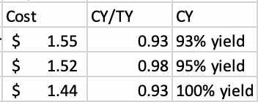
CALCULATION AND ANALYSIS
Tianjin has a current yield rate of 93% but also a 2% repair and rework rate. Thus, we aim to increase the yield to 95%.
Increasing the yield to 95%, we will achieve an electricity cost of $1.52/unit.

Slide 27
MORAINE
YIELD | 81% | 93% | 95% | 100%
ELECTRICITY | $1.58 | $1.38 | $1.35 | $1.28
New electricity cost = Current yield * Current Cost
—--------------
Target yield

Slide 28
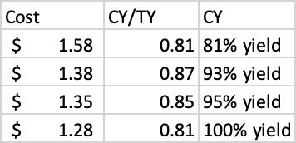
CALCULATION AND ANALYSIS
Moraine has a current yield rate of 81% at which our electricity cost is $1.58/unit.
Thus, we analyse higher yields of 93%, 95% and 100%.

Slide 29

CONCLUSION
Setting up a factory in Moraine was a smart move by Fuyao
With better implementation, the company could have avoided the challenges they faced
Even though the cost of production per unit is higher in USA, it is more feasible due to various factors discussed previously
There is scope of better optimization in Moraine

Slide 30
REFLECTIONS
Treating all the employees as equal and bridge down the gap between all the cultures.
Proper safety measures should be taken.
Training of the employees
Understanding business goals and continuous improvement in sourcing the materials.
Strategic planning for the better functioning of operations.
Notes:
These are some reflections and our learnings from the Fuyao case:-
It is very important in treating all the employees as equal as they are very important part of the organization and diversity and inclusion should be respected.
Proper safety, security and protection measures should be taken for the well-being of the employees.
Training should be provided with proper time table and proper investment should be made in employee development.
Making proper sourcing strategies and understanding the business goals
Strategic planning should be done for the better functioning of the operations in the organization.

Slide 31



OUR TEAM
ANJALI GUPTA
SHRIYA SAHU
UDISHA MADNANI
JILLIANE SUPATRA
SURBHI ZAMBAD
Notes:
24-30 Udisha

Slide 32
Thank you!

