Slide 1
Peering at the Internet’s Frontier: A First Look at ISP Interconnectivity in Africa
Arpit Gupta Georgia Tech
Matt Calder (USC), Nick Feamster (Georgia Tech), Marshini Chetty (Maryland), Enrico Calandro (Research ICT Africa), Ethan Katz-Bassett (USC)
Notes:
I will talk about my paper on “”
Joint effort of researchers in Georgia Tech, Maryland, Research ICT Africa and USC
In this talk I will see why we observe degraded Internet performance in Africa and how we can solve these problems

Slide 2

Broadband Connectivity in Africa
According to ITU in 2013
93 million broadband subscriptions
27% growth in past 4 years (Highest)
Broadband associated with economic growth + development
Yet, very little is known about performance in Africa and what causes poor performance when it does arise.
Notes:
End with slide like:
So question to ask here is how well does broadband performs in Africa

Slide 3


How Well Does Broadband Perform?

Slide 4
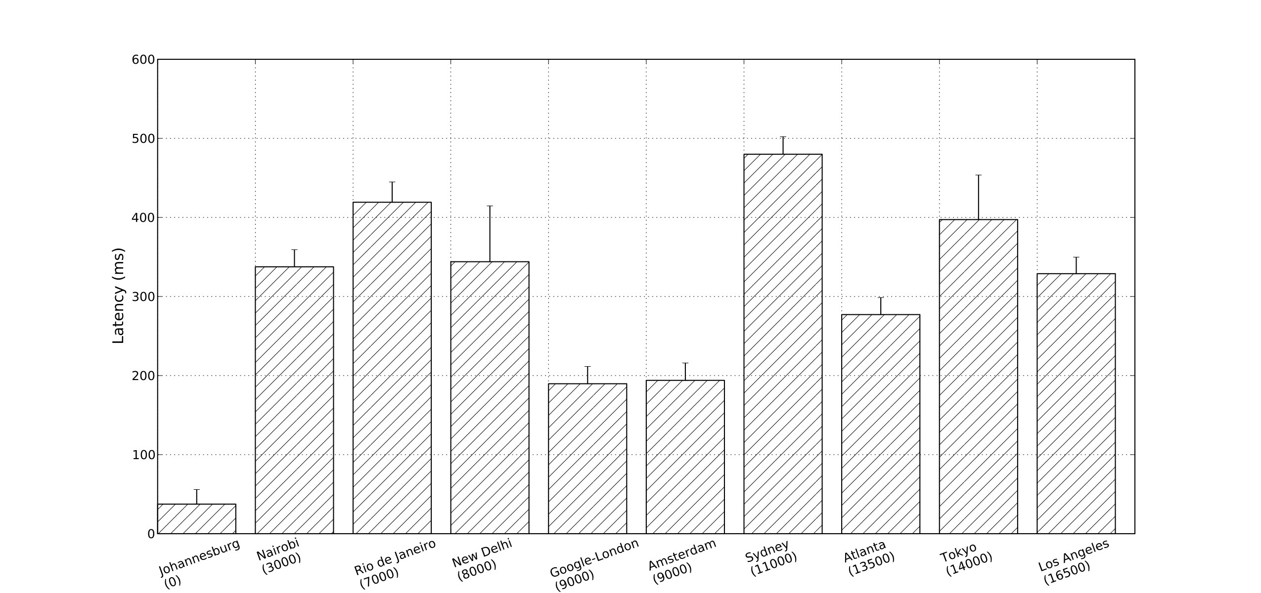
Latencies to Nearby Locations are High
Latencies from South Africa to Kenya, Brazil, India are 2x higher than latencies to Europe.
500
300
Latencies (ms)
Europe
Kenya
Brazil
India
100
Notes:
In our previous works we identified that latencies to nearby locations are high

Slide 5
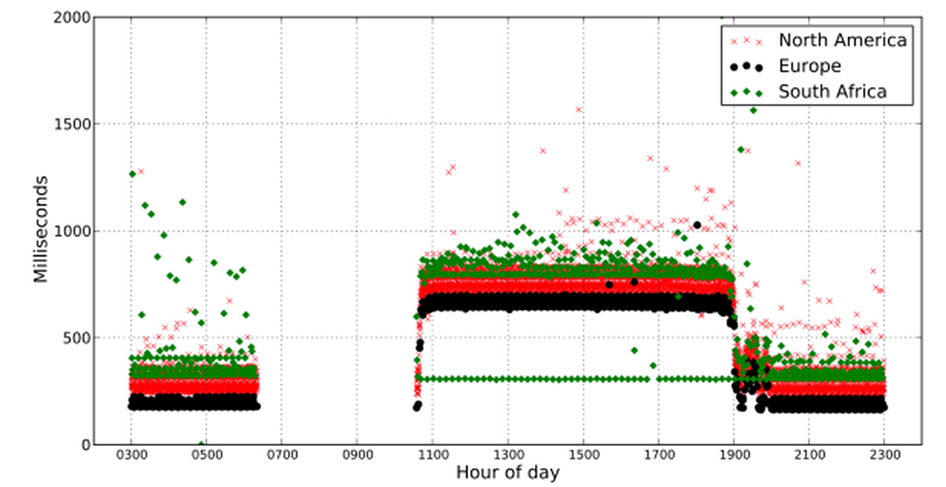
Latencies are Even Higher During Failures
March 27, 2013 0620 UTC: SWM4 Fiber Cut
All BISmark hosts could not reach KENet for 3+ hours
Latencies remain high for another 8+ hours (except for Neotel, in South Africa)
More details: http://connectionmanagement.org
Latencies remain high from Europe and North America. Only one AS in S. Africa, Neotel sees decent latency after 3 hours.
Notes:
Even under normal conditions latencies to nearby locations like Kenya is significantly high. What can be the reason for such a high latency

Slide 6
Causes of High Latency: Circuitous Routing Paths
LINX (London
9000 km
7000 km
Europe/ US
Africa
South Africa
Kenya
3000 km
Notes:
Given this context we tried to answer two important questions

Slide 7
Two Questions
What is the nature of Internet interconnectivity (between ISPs) in Africa?
What can be done to reduce latency to common Internet services?

Slide 8
Two Questions
What is the nature of Internet interconnectivity (between ISPs) in Africa?
What can be done to reduce latency to common Internet services?

Slide 9

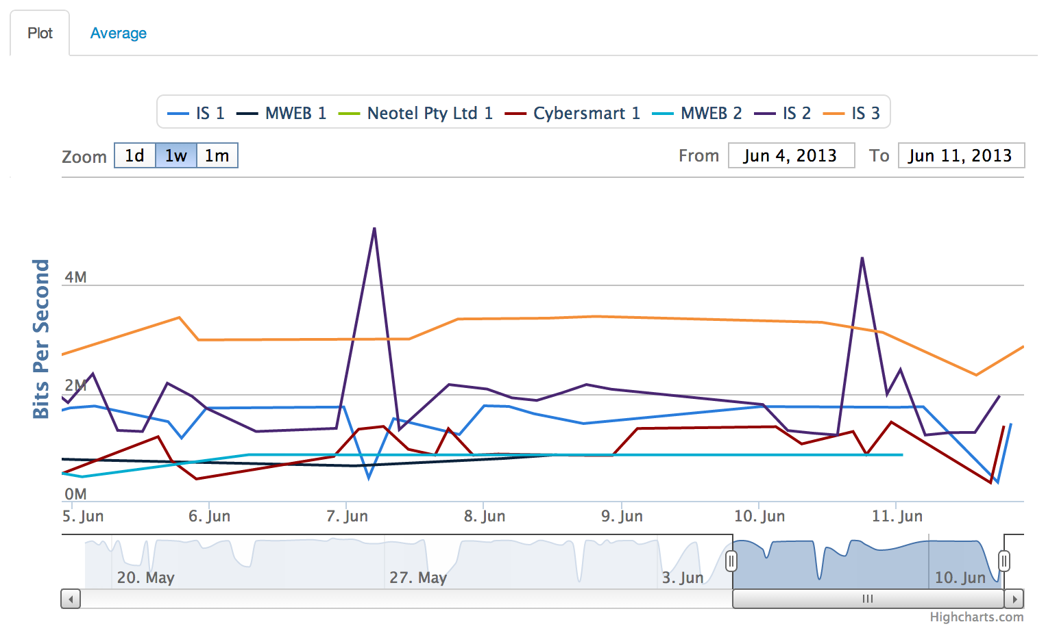
BISmark: Measurements from Fixed Locations
Example: Cape Town Users
175+ Active Routers, 20+ countries
Users install routers in home networks
Custom firmware performs periodic measurements
Can aggregate by country, city, ISP
Notes:
Emulates Internet performance observed by end users or eyeballs

Slide 10
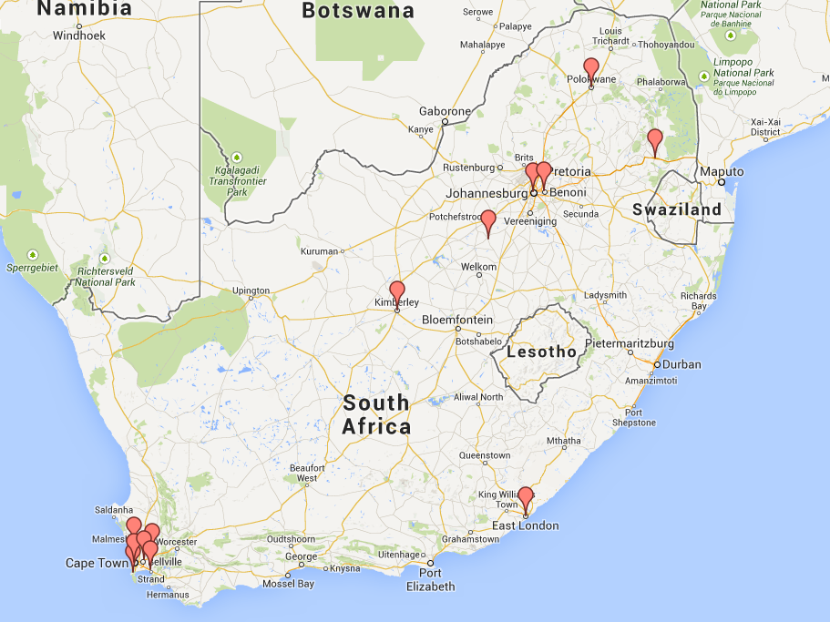
BISmark Deployment in South Africa
Periodic latency and throughput measurements
Traceroutes to explain the cause of path performance
Router-based deployment
17 home networks, 7 ISPs, all 9 provinces

Slide 11
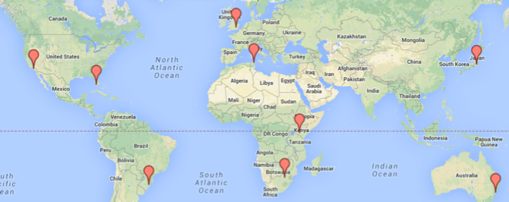
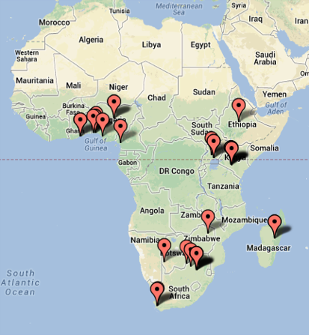
Destinations for Traceroute Probes
Global M-Lab Servers
Google Caches in Africa

Slide 12
High Latencies to Nearby Locations…
Cape Town (SA) to M-Lab Johannesburg (SA)
Cape Town (SA) to M-Lab Nairobi (KE)
…
7, 196.44.0.74, 7.793, South Africa, AS16637
8, 196.223.22.24, 8.338, South Africa, Cape Town IXP
9, 41.164.0.243, 34.679, South Africa, AS36937
…
14, 196.24.45.146, 92.511, South Africa, AS2018
…
8, 209.212.111.201, 199.446, South Africa, AS16637
9, 195.66.225.31, 217.301, United Kingdom, London IXP (LINX)
10, 196.32.209.77, 201.569, South Africa, AS36944
…
14, 197.136.0.108, 368.107, Kenya, AS36914
High Latency
Notes:
The circuitous routing paths are indicators of poor ISP interconnectivity in Africa

Slide 13
… Circuitous Routing Paths
Cape Town (SA) to M-Lab Johannesburg (SA)
Cape Town (SA) to M-Lab Nairobi (KE)
…
7, 196.44.0.74, 7.793, South Africa, AS16637
8, 196.223.22.24, 8.338, South Africa, Cape Town IXP
9, 41.164.0.243, 34.679, South Africa, AS36937
…
14, 196.24.45.146, 92.511, South Africa, AS2018
…
8, 209.212.111.201, 199.446, South Africa, AS16637
9, 195.66.225.31, 217.301, United Kingdom, London IXP (LINX)
10, 196.32.209.77, 201.569, Kenya, AS36944
…
14, 197.136.0.108, 368.107, Kenya, AS36914
Packets leaving Africa

Slide 14
Poor ISP Interconnectivity in Africa
Reasons
Local ISPs not present at regional IXPs
IXP participants don’t peer with each other
Consequences
Local traffic does not stay local
Paths leave continent

Slide 15

Local ISPs not Present at Regional IXPs
ISPs prioritize connecting to European IXPs
Lesser incentives to connect at regional ones
South Africa
Kenya
KENET
Liquid Telecom
JINX
(Johannesburg)
KIXP (Nairobi)
Notes:
Like one stop shop for these local ISPs

Slide 16
Missing Peering Links at Regional IXPs
Most content not available locally
Less incentive to peer with local ISPs
South Africa
Kenya
KENET
MTN, SA
MTN, KE
JINX (Johannesburg)
IS, SA
IS, KE
KIXP (Nairobi)

Slide 17
Regional IXPs Only Prevalent on Intra-Country Paths
Within South Africa: High Fraction of Paths Have at Least one Major Regional IXP
Between South Africa and Kenya: Few Paths have Regional IXPs
BISmark Routers (Fraction)
BISmark Routers (Fraction)
JINX (SA) is most prevalent
LINX (UK) is most prevalent
IXP Prevalence (Normalized)
IXP Prevalence (Normalized)
M-Lab Johannesburg
M-Lab Nairobi

Slide 18
Two Questions
What is the nature of Internet interconnectivity (between ISPs) in Africa?
What can be done to reduce latency to common Internet services?

Slide 19
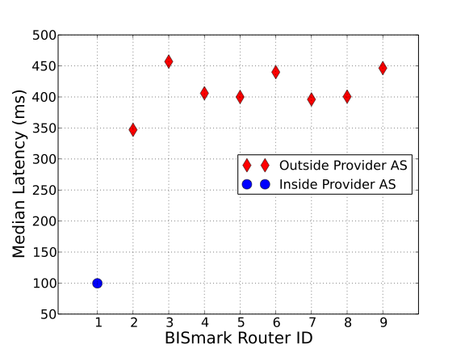
Solution #1: Add More Caches
Traceroute Probes between BISmark routers (eyeball) and Google Cache Node in Uganda (content)
Google cache hosted by MTN
Emulates scenario where content is in nearby country
Latency Improvements
Inside Customer Cone
Latency improvements are limited when peering to the cache is not adequate.
BISmark Routers

Slide 20
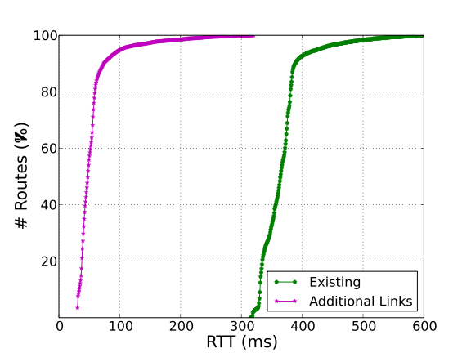
Solution #2: Add More Peering Links
Simulation: Add peering links between all the participants at
JINX (Johannesburg)
KIXP (Nairobi)
Emulates scenario where more ISPs connect and peer at regional IXPs
Δ ~ 250ms
Latency Improvements
Additional peering links → Significant latency improvements
Notes:
Adding cache nodes improves latency performance and adding more peering links ensures that this benefit trickles down to more number of users

Slide 21
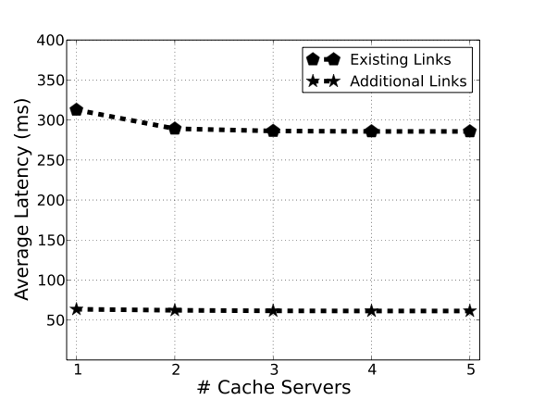
Better Peering is a Substitute for Additional Caches
Experiment:
add caches in Kenya
traceroute Probe from SA
Two scenarios
Use existing peering links
Add more peering links
Existing Links
Additional caches have little effect on average latency (compared to adding more peering links).
Additional Links

Slide 22
Summary
What is the nature of Internet interconnectivity (between ISPs) in Africa?
Many ISPs are not present in regional IXPs
Many ISPs do not interconnect at regional IXPs
What can be done to reduce latency to common Internet services?
Peering at regional IXPs can reduce median intra-continent latencies by 250ms
Next steps: Better incentives for interconnectivity
Arpit Gupta
agupta80@gatech.edu

Slide 23
Backup Slides

Slide 24
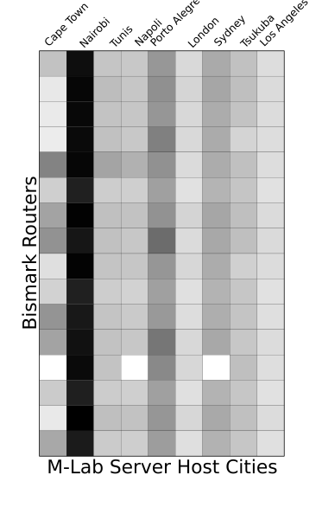
High Latency Paths within Africa
Geographical Distance
Normalized Latency:
Ratio of observed and speed of light propagation latencies
Darker blocks imply higher latency penalties
High Penalties for routes to M-Lab server in Nairobi
High Normalized Latency
24
M-Lab Servers

Slide 25
IXP Prevalence
Quantifies presence of IXPs for routing paths
Similar to routing path prevalence
Lower IXP prevalence observed for circuitous routing paths

