Slide 1
SDX: A Software-Defined Internet Exchange
Arpit Gupta
Laurent Vanbever, Muhammad Shahbaz, Sean Donovan,
Brandon Schlinker, Nick Feamster, Jennifer Rexford,
Scott Shenker, Russ Clark, Ethan Katz-Bassett
Georgia Tech, Princeton University, UC Berkeley, USC

Slide 2
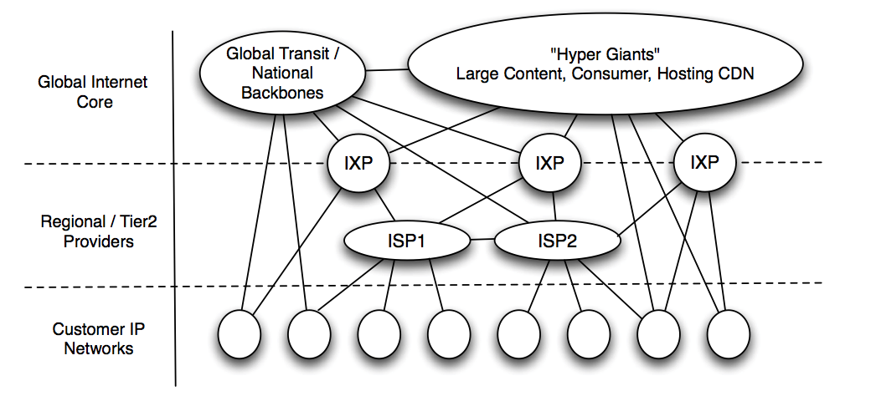
The Interdomain Ecosystem is Evolving ...
Flatter and densely interconnected Internet*

Slide 3
…But BGP is Not
Routing only on destination IP prefixes
(No customization of routes by application, sender)
Can only influence immediate neighbors
(No ability to affect path selection remotely)
Indirect control over data-plane forwarding (Indirect mechanisms to influence path selection)
How to overcome BGP’s limitations?

Slide 4
SDN for Interdomain Routing
Forwarding on multiple header fields (not just destination IP prefixes)
Ability to control entire networks with a single software program (not just immediate neighbors)
Direct control over data-plane forwarding (not indirect control via control-plane arcana)
How to incrementally deploy SDN for
Interdomain Routing?

Slide 5
Deploy SDN at Internet Exchanges
Leverage: SDN deployment even at single IXP can yield benefits for tens to hundreds of ISPs
Innovation hotbed: Incentives to innovate as IXPs on front line of peering disputes
Growing in numbers: ~100 new IXPs established in past three years*

Slide 6

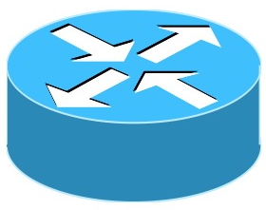

Background: Conventional IXPs
Route Server
BGP Session
IXP
Switching Fabric
AS A Router
AS B Router
AS C Router

Slide 7
SDX = SDN + IXP
SDX Controller
SDX
BGP Session
SDN Switch
AS A Router
AS B Router
AS C Router

Slide 8
SDX Opens Up New Possibilities
More flexible business relationships
Make peering decisions based on time of day, volume of traffic & nature of application
More direct & flexible traffic control
Define fine-grained traffic engineering policies
Better security
Prefer “more secure” routes
Automatically blackhole attack traffic

Slide 9
Use Case: Inbound Traffic Engineering
SDX Controller
SDX
AS A Router
C1
C2
10.0.0.0/8
AS B Router
AS C Routers

Slide 10
Use Case: Inbound Traffic Engineering
Incoming Data
C1
C2
AS A Router
AS B Router
10.0.0.0/8
AS C Routers
Incoming Traffic | Out Port | Using BGP | Using SDX
dstport = 80 | C1

Slide 11
Use Case: Inbound Traffic Engineering
Incoming Data
C1
C2
AS A Router
AS B Router
10.0.0.0/8
Fine grained policies not possible with BGP
AS C Routers
Incoming Traffic | Out Port | Using BGP | Using SDX
dstport = 80 | C1 | ?

Slide 12
Use Case: Inbound Traffic Engineering
Incoming Data
C1
C2
AS A Router
AS B Router
10.0.0.0/8
Enables fine-grained traffic engineering policies
AS C Routers
Incoming Traffic | Out Port | Using BGP | Using SDX
dstport = 80 | C1 | ? | match(dstport =80)→ fwd(C1)

Slide 13
Building SDX is Challenging
Programming abstractions
How networks define SDX policies and how are they combined together?
Interoperation with BGP
How to provide flexibility w/o breaking global routing?
Scalability
How to handle policies for hundreds of peers, half million prefixes and matches on multiple header fields?

Slide 14
Building SDX is Challenging
Programming abstractions
How networks define SDX policies and how are they combined together?
Interoperation with BGP
How to provide flexibility w/o breaking global routing?
Scalability
How to handle policies for hundreds of peers, half million prefixes and matches on multiple header fields?

Slide 15
Directly Program the SDX Switch
Switching Fabric
A1
B1
match(dstport=80)→drop
match(dstport=80)→fwd(C1)
C1
C2
AS A & C directly program the SDX Switch

Slide 16
Conflicting Policies
Switching Fabric
drop? C1?
A1
B1
match(dstport=80)→drop
match(dstport=80)→fwd(C1)
C1
C2
How to restrict participant’s policy to traffic it sends or receives?

Slide 17
Virtual Switch Abstraction
Switching Fabric
Virtual Switch
Virtual Switch
A1
AS A
AS B
B1
match(dstport=80)→drop
Virtual Switch
AS C
match(dstport=80)→fwd(C1)
C1
C2
Each AS writes policies for its own virtual switch

Slide 18
Combining Participant’s Policies
Switching Fabric
Virtual Switch
Virtual Switch
A1
AS A
AS B
B1
p
match(dstport=80)→fwd(C)
Virtual Switch
AS C
Pol_{A}
match(dstport=80)→fwd(C1)
C1
C2
Pol_{C}
Policy(p) = Pol_{A} → Pol_{C}

Slide 19
Building SDX is Challenging
Programming abstractions
How networks define SDX policies and how are they combined together?
Interoperation with BGP
How to provide flexibility w/o breaking global routing?
Scalability
How to handle policies for hundreds of peers, half million prefixes and matches on multiple header fields?

Slide 20
Requirement: Forwarding Only Along BGP Advertised Routes
20/8
A
SDX
B
10/8
C
match(dstport=80) → fwd(C)

Slide 21
Ensure ‘p’ is not forwarded to C
dstip = 20.0.0.1
dstport = 80
20/8
p
A
SDX
B
10/8
C
match(dstport=80) → fwd(C)

Slide 22
Solution: Policy Augmentation
20/8
A
SDX
B
10/8
C
(match(dstport=80) && match(dstip = 10/8))→ fwd(C)

Slide 23
Building SDX is Challenging
Programming abstractions
How networks define SDX policies and how are they combined together?
Interoperation with BGP
How to provide flexibility w/o breaking global routing?
Scalability
How to handle policies for hundreds of peers, half million prefixes and matches on multiple header fields?

Slide 24
Scalability Challenges
Reducing Data-Plane State: Support for all forwarding rules in (limited) switch memory (millions of flow rules possible)
Reducing Control-Plane Computation: Faster policy compilation (policy compilation takes hours for initial compilation)

Slide 25
Scalability Challenges
Reducing Data-Plane State: Support for all forwarding rules in (limited) switch memory millions of flow rules possible
Reducing Control-Plane Computation: Faster policy compilation policy compilation could take hours

Slide 26
Reducing Data-Plane State: Observations
Internet routing policies defined for groups of prefixes.*
Edge routers can handle matches on hundreds of thousands of IP prefixes.

Slide 27
Reducing Data-Plane State: Solution
Group prefixes with similar forwarding behavior
10/8
40/8
20/8
SDX Controller

Slide 28
Reducing Data-Plane State: Solution
Advertise one BGP next hop for each such
prefix group
forward to
BGP Next Hop
10/8
40/8
20/8
Edge router

Slide 29
Reducing Data-Plane State: Solution
Flow rules at SDX match on BGP next hops
forward to
BGP Next Hop
match on
BGP Next Hop
10/8
fwd(1)
40/8
fwd(2)
20/8
Edge router
SDX FIB

Slide 30
Reducing Data-Plane State: Solution
For hundreds of participants’ policies, few millions ➔ < 35K
flow rules

Slide 31
Reducing Control-Plane Computation
Initial policy compilation time
Leveraged domain-specific knowledge of policies
Hundreds of participants requires < 15 minutes
Policy recompilation time
Leveraged bursty nature of BGP updates
Most recompilation after a BGP update < 100 ms

Slide 32
SDX Testbed
Mininet-based Testbeds
Uses Transit Portal
Emulates edge routers
Check out our demo
Application specific peering
Inbound traffic engineering
Github repo: https://github.com/sdn-ixp/sdx/

Slide 33
Summary
SDN-based exchange (SDX) is promising for fixing Internet routing
Solved various challenges in building a real deployable SDX
Many open research problems, both for building and using SDX

