Slide 1
Predictive Maintenance
Bearing Fault Detection
CNN + LSTM | CWRU Bearing Dataset | 10-Class Classification
Submitted By
4,600
10
97.83%
Divyam Mittal · 1024030008
Paarth Mendiratta · 1024030030
Samples
Fault Classes
Accuracy
Arnav Gupta · 1024030780

Slide 2
Problem Statement
Industrial Need
10 Fault Classes
Rotating machinery failures cause costly downtime. Early fault detection is critical for manufacturing reliability.
Normal
IR_014
Ball_007
IR_021
Dataset
Ball_014
OR_007
CWRU Bearing Dataset — 4,600 vibration samples across 10 fault classes at 48kHz sampling rate.
Ball_021
OR_014
IR_007
OR_021
Objective
Build a deep learning pipeline to classify bearing faults (Ball, IR, OR defects) at 3 severity levels + Normal.
Normal
Ball Fault
Inner Race
Outer Race

Slide 3
ML Pipeline
Load
.NPZ Data
Feature
Engineering
Train/Test
Split 80:20
1D-CNN +
LSTM Model
Train
40 Epochs
Evaluate
& SHAP
Time Domain
Freq Domain
Data Shape
Mean, Std, RMS
Peak, Crest, P2P
FFT Spectrum
Dom_Freq, FFT_Std
FFT_Mean, FFT_Peak
4600 × 32 × 32
460 per class
Perfectly Balanced
Model Architecture
Input
32×32
Conv1D
64 filters
MaxPool
Conv1D
128 filters
MaxPool
Conv1D
256 filters
LSTM
128 units
Dropout
0.3
Dense
10 (Softmax)

Slide 4
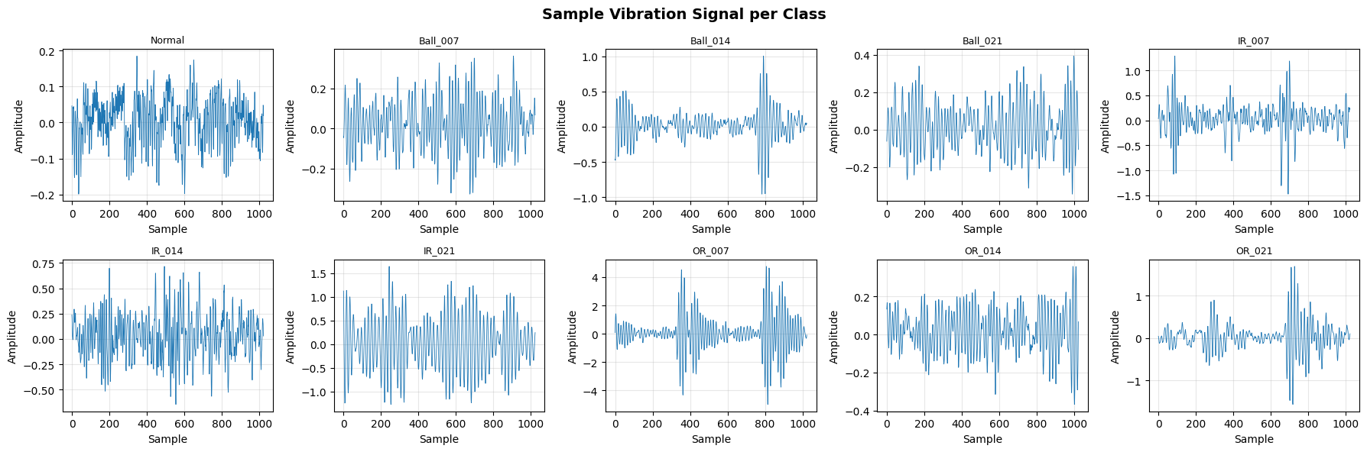
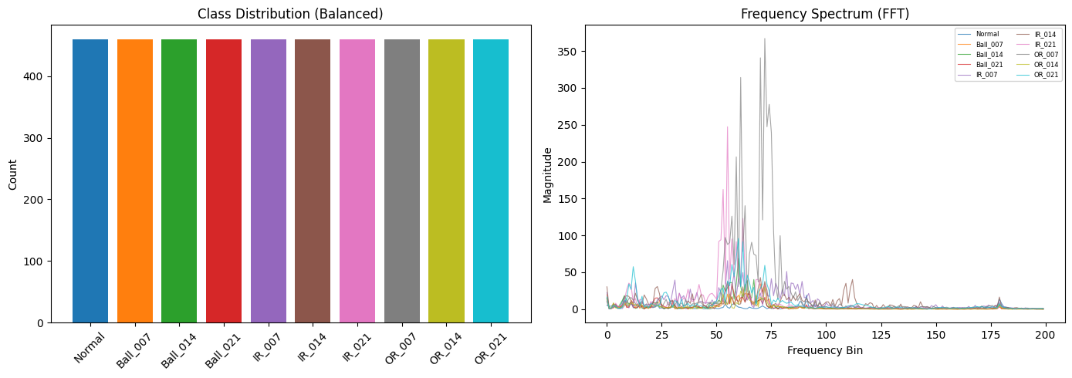
Data Exploration
Sample Vibration Signals per Fault Class
Class Distribution (Balanced) & Frequency Spectrum (FFT)

Slide 5
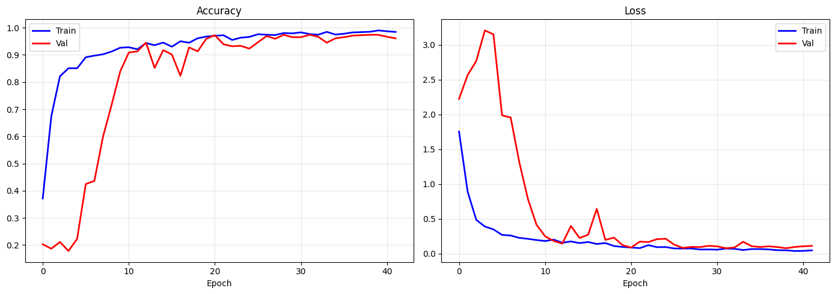
Model Training
Training Curves — Accuracy & Loss
Training Configuration
Optimizer
Adam
Loss
Cat. Cross-Entropy
Epochs
40
Batch Size
32
Dropout
0.3
97.83%
Imbalance Fix
Class Weights
Test Accuracy

Slide 6
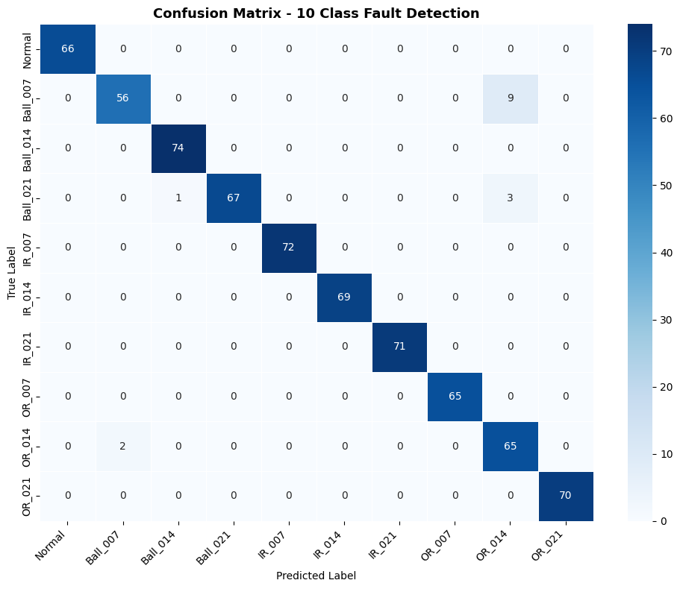
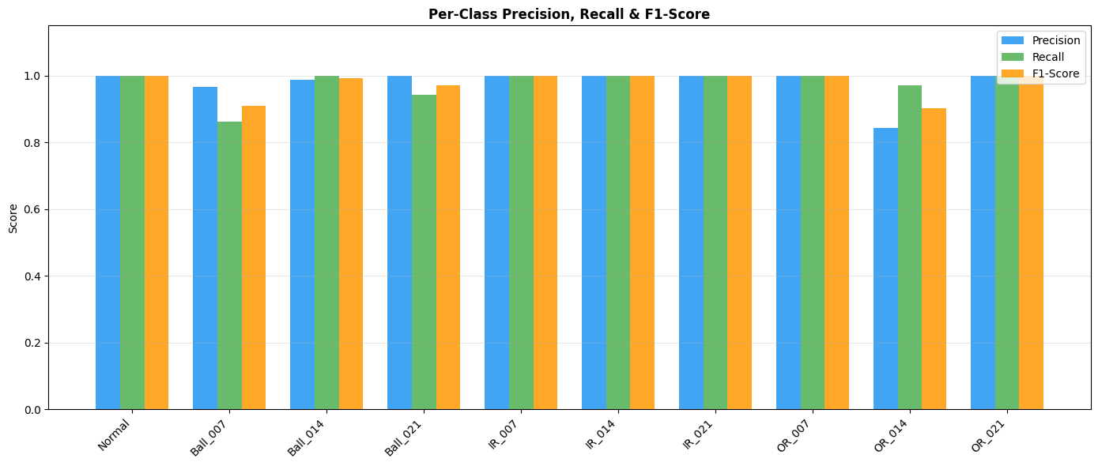
Results & Evaluation
Confusion Matrix — 10 Classes
Per-Class Precision, Recall & F1-Score
0.9796
0.9775
0.9778
0.0642
Avg Precision
Avg Recall
Avg F1-Score
Test Loss
Total Model Parameters: 86,218 | Total Samples: 4,600 | 10 Fault Classes

Slide 7
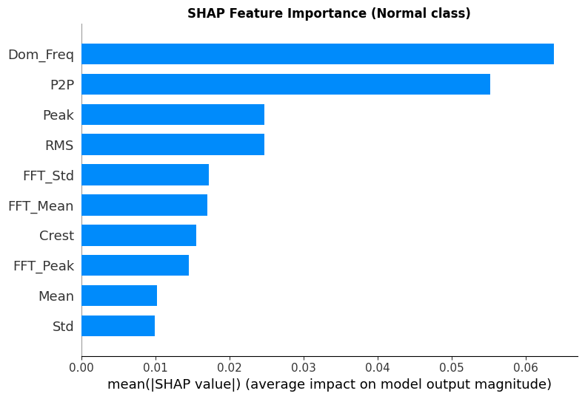
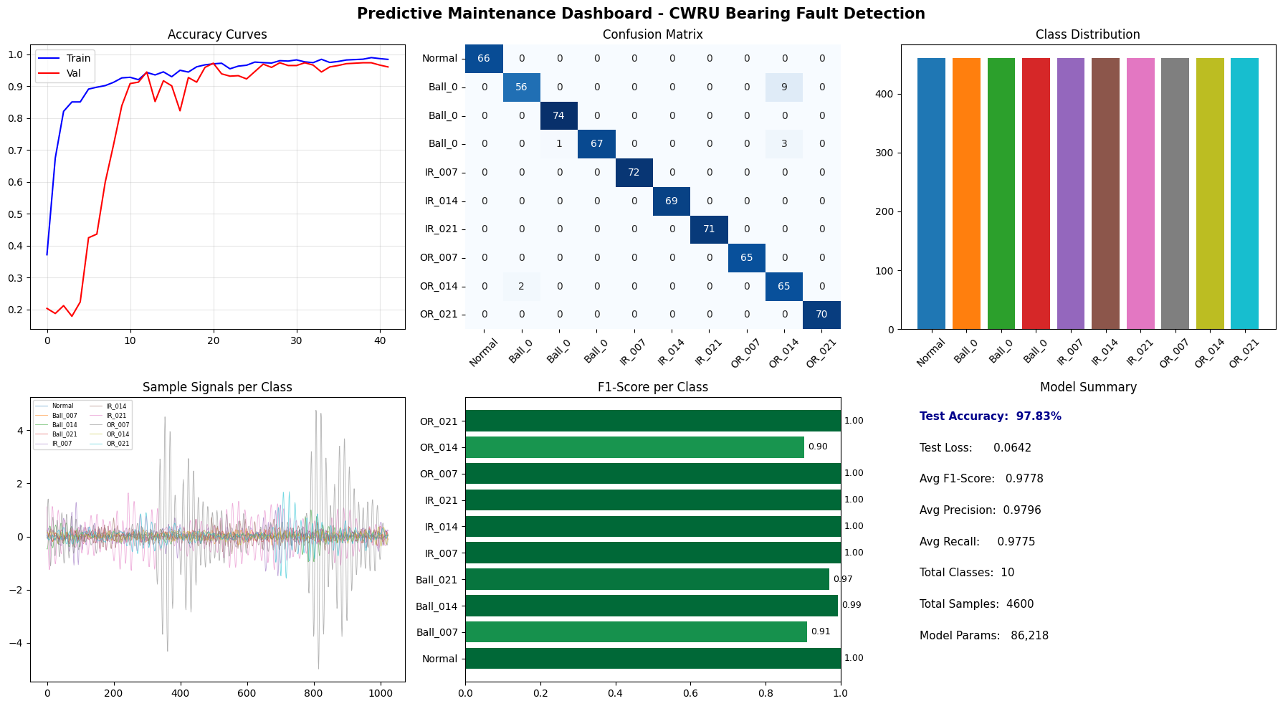
SHAP Analysis & Dashboard
SHAP Feature Importance (Normal class)
Key Insights
🔴 Dom_Freq (dominant frequency) is the most important feature — fault type clearly shifts frequency signature
🟡 P2P (peak-to-peak amplitude) is second — fault severity changes vibration amplitude range
🟢 RMS & Peak energy metrics are strong indicators, especially for Ball faults
🔵 Geographic / ID features (Customer, Order) contribute minimally — physics drives this model
Predictive Maintenance Dashboard

Slide 8
Conclusion & Future Scope
✅ Achievements
🚀 Future Scope
End-to-end CNN+LSTM pipeline on CWRU bearing vibration data
🔊 Real-time edge deployment on IoT vibration sensors
97.83% test accuracy across all 10 fault classes
🤖 Experiment with Transformer-based models for time series
Balanced dataset maintained — 460 samples per class
📡 Multi-sensor fusion (temperature + vibration + current)
SHAP explainability: Dom_Freq & P2P are top drivers
🌐 Web dashboard for live fault monitoring & alerts
Comprehensive evaluation: Confusion matrix, P/R/F1 per class
📈 Extend to other bearing datasets (MFPT, IMS, FEMTO)
⚡ Model compression / quantization for embedded systems

