Slide 1
B9 Chop
CCIA for Linear Hall Effect Sensor
Team members (not read in presentation)
Discord name | Affiliation | Experience | Role
alang | University of Florida | Master’s Student | Team lead

Slide 2
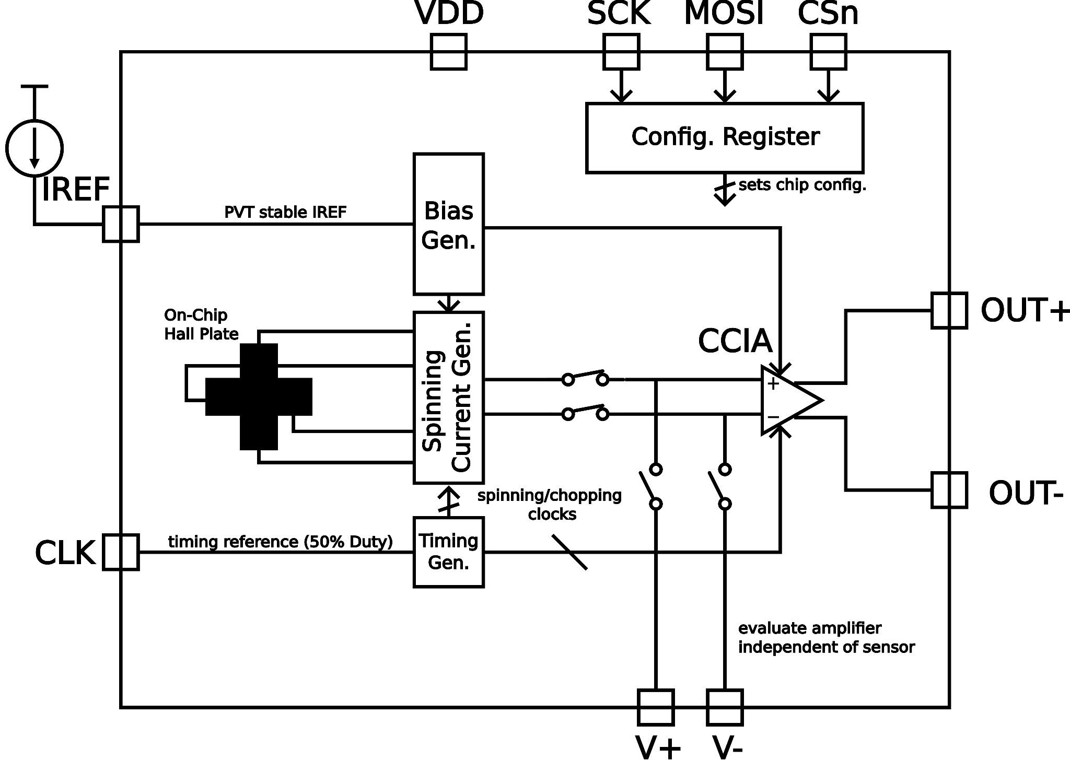
Project information
Goal
Enable monolithic magnetic sensing applications in GF180 technology
Build and evaluate sensor & front-end for future projects (e.g., Hall sensor array, digital read-out)
Design (Pad Frame D - 10 pin, 1/16)
Spinning current method [1] used to bias on-chip sensor (modulates hall voltage)
CCIA [2] amplifies and demodulates Hall voltage
Spinning removes sensor/amplifier offset and 1/f noise
Simple SPI configuration register used to control on-chip switches to enable several test configurations (test amplifier with voltage input, test sensor with off-chip amplifier, vary sensor bias current, etc.)

Slide 3
Project information
Application
Many applications for monolithic magnetic sensors
Contact-less Current Sensing [3]
Position/Velocity Sensing [4]
Biosensors [5]
Chipathon implementation will target lower bandwidth sensor (~10 kHz) to reduce complexity
References
[1] V. Mosser, N. Matringe and Y. Haddab, "A Spinning Current Circuit for Hall Measurements Down to the Nanotesla Range," in IEEE Transactions on Instrumentation and Measurement, vol. 66, no. 4, pp. 637-650, April 2017, doi: 10.1109/TIM.2017.2649858.
[2] Q. Fan, F. Sebastiano, J. H. Huijsing and K. A. A. Makinwa, "A 1.8 $\mu$ W 60 nV$/\surd$ Hz Capacitively-Coupled Chopper Instrumentation Amplifier in 65 nm CMOS for Wireless Sensor Nodes," in IEEE Journal of Solid-State Circuits, vol. 46, no. 7, pp. 1534-1543, July 2011, doi: 10.1109/JSSC.2011.2143610.
[3] M. Crescentini, M. Marchesi, A. Romani, M. Tartagni and P. A. Traverso, "A Broadband, On-Chip Sensor Based on Hall Effect for Current Measurements in Smart Power Circuits," in IEEE Transactions on Instrumentation and Measurement, vol. 67, no. 6, pp. 1470-1485, June 2018, doi: 10.1109/TIM.2018.2795248.
[4] B. Wang, X. Lai, Z. Niu and L. Li, "A Fully Integrated Chopped Hall Sensor for Gear Rotation Measurements," in IEEE Transactions on Instrumentation and Measurement, vol. 74, pp. 1-11, 2025, Art no. 2001311, doi: 10.1109/TIM.2024.3522378.
[5] S. Gambini, K. Skucha, P. P. Liu, J. Kim and R. Krigel, "A 10 kPixel CMOS Hall Sensor Array With Baseline Suppression and Parallel Readout for Immunoassays," in IEEE Journal of Solid-State Circuits, vol. 48, no. 1, pp. 302-317, Jan. 2013, doi: 10.1109/JSSC.2012.2224531.

