Slide 1



What Makes a Good Sleep Habit
How much does alcohol consumption hurt our sleep?
Does what we eat affecting the quality of our sleep?
Is spending your time doing workout activities (hiking, running) help to improve the quality of our sleep?
Does your social life affect your sleep quality?
Does more sleep mean better sleep?
General description of what your conclusion is all about and what it means for those reading this timeline.
CONCLUSION TWO
General description of what your conclusion is all about and what it means for those reading this timeline.
CONCLUSION TWO
General description of what your conclusion is all about and what it means for those reading this timeline.
CONCLUSION TWO
General description of what your conclusion is all about and what it means for those reading this timeline.
CONCLUSION TWO
General description of what your conclusion is all about and what it means for those reading this timeline.
General description of what your conclusion is all about and what it means for those reading this timeline.
CONCLUSION TWO
General description of what your conclusion is all about and what it means for those reading this timeline.
General description of what your conclusion is all about and what it means for those reading this timeline.
General description of what your conclusion is all about and what it means for those reading this timeline.
CONCLUSION ONE
General description of what your conclusion is all about and what it means for those reading this timeline.
CONCLUSION ONE
CONCLUSION ONE
CONCLUSION ONE
CONCLUSION ONE

Slide 2
Modelling Process
Models Tested
Elastic net
Neural Network
Decision Forest
Boosted Decision Trees
1
Training Process
- 10-fold cross validation on
Azure for initial screening and
parameter testing
Linear models turned out to
be the best
2
Final Test
Trained linear models in R and
on Azure with Q1 data and predicted
Q2 results.
0.3195427 Q2 MAE on Q2 data regression
0.755113 Accuracy on binary classification
3

Slide 3
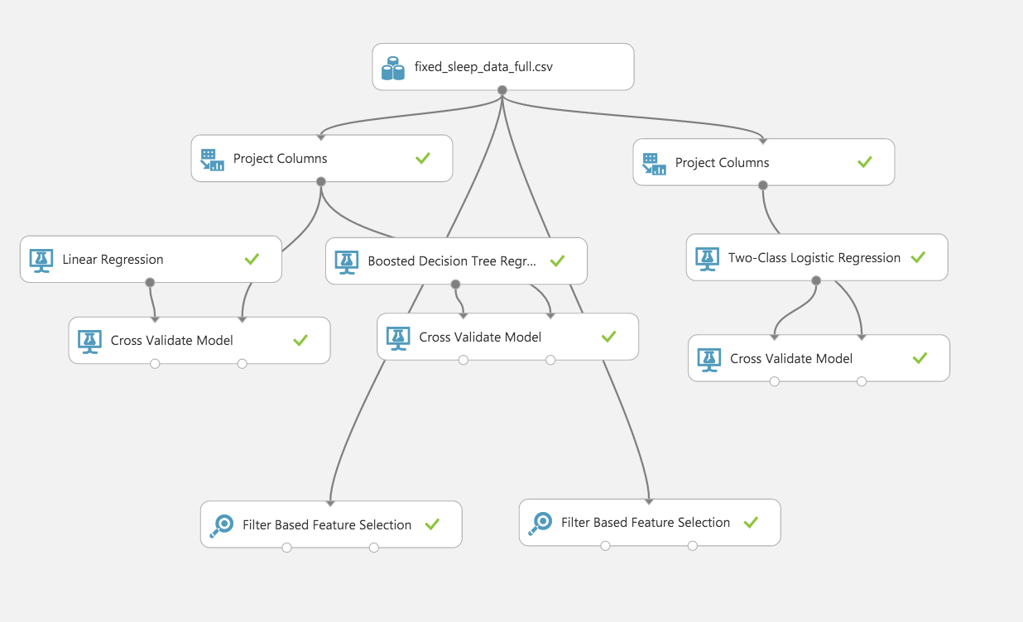
Data Manipulation and Data Organization (done in R and Azure)
Feature Selection (done in Azure)
Linear Regression, Boosted Decision Tree, Binary Logistics Regression (done in R and Azure)
10-Fold Cross Validation (done in Azure and validate with R)

Slide 4




Outdoor Habits – Social Life
Outgoing Social Life Indicator
Factors that Contribute to Sleep Quality
Coefficient: 0.49024
Coefficient: 0.24549
Having a social life filled with outdoor habits such as hiking, skiing, and exercise greatly increases your chance of getting a good night’s sleep. In fact, it’s as good for your sleep as alcoholism is bad.
Being an outgoing person – i.e. having an active social life will make for a better night’s sleep.
Another chronic habit that many people have is smoking. It turns out that this habit isn’t only bad for your lungs. Smoking is the second best predictor for having a bad nights sleep.
We’ve all been told that drinking makes you have a worse nights sleep and it turns out that it’s true! Being an alcoholic is the very strongest predictor of a bad nights sleep.
Alcoholic Profile
Smoking Habits
Coefficient: -0.48270
Coefficient: -0.24373
Alcoholic Indicator
Smoker Habits
Alcoholic Indicator
Smoker Habits
Alcoholic Indicator
Smoker Habits
Conclusion or summary of your infographic should live here. Nunc vel justo cursus, porttitor nibh vitae, aliquam quam. Praesent finibus nibh eget viverra ultrices. Integer mattis finibus nibh, quis condimentum dolor porta malesuada. Vivamus sed lacus pharetra, auctor nulla.
Want to learn more or get more details? Great! How about a nice -

