Slide 1
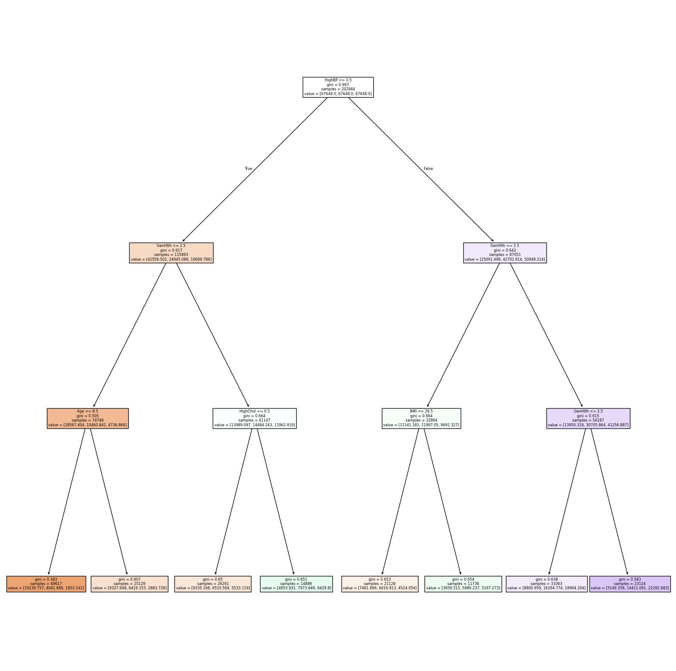
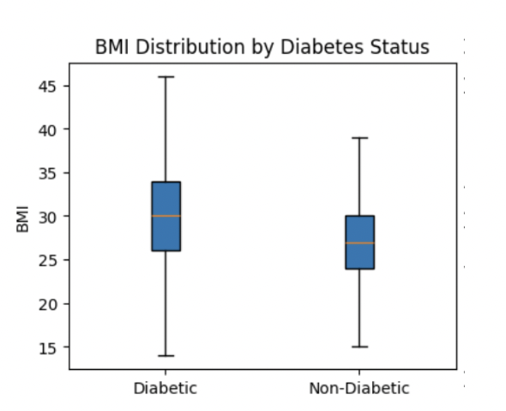
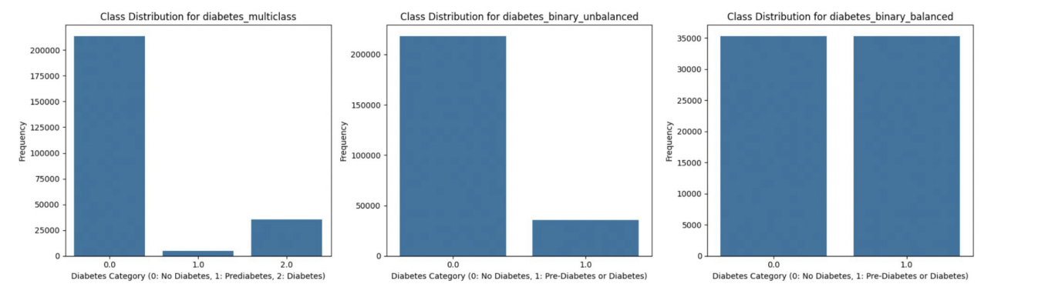
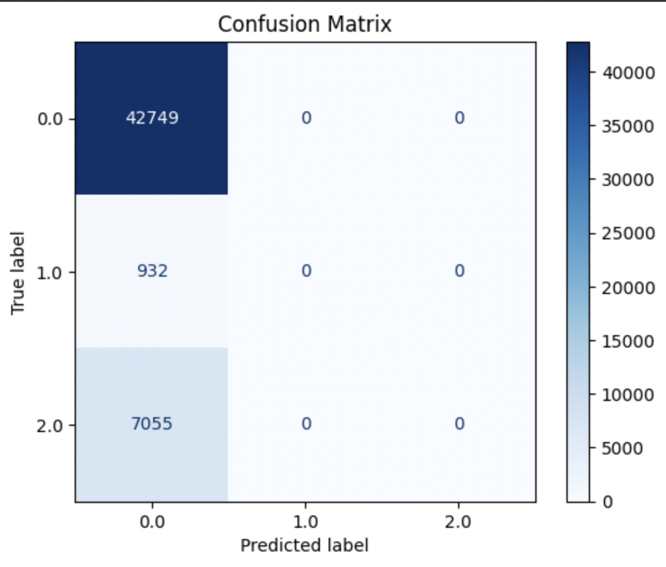
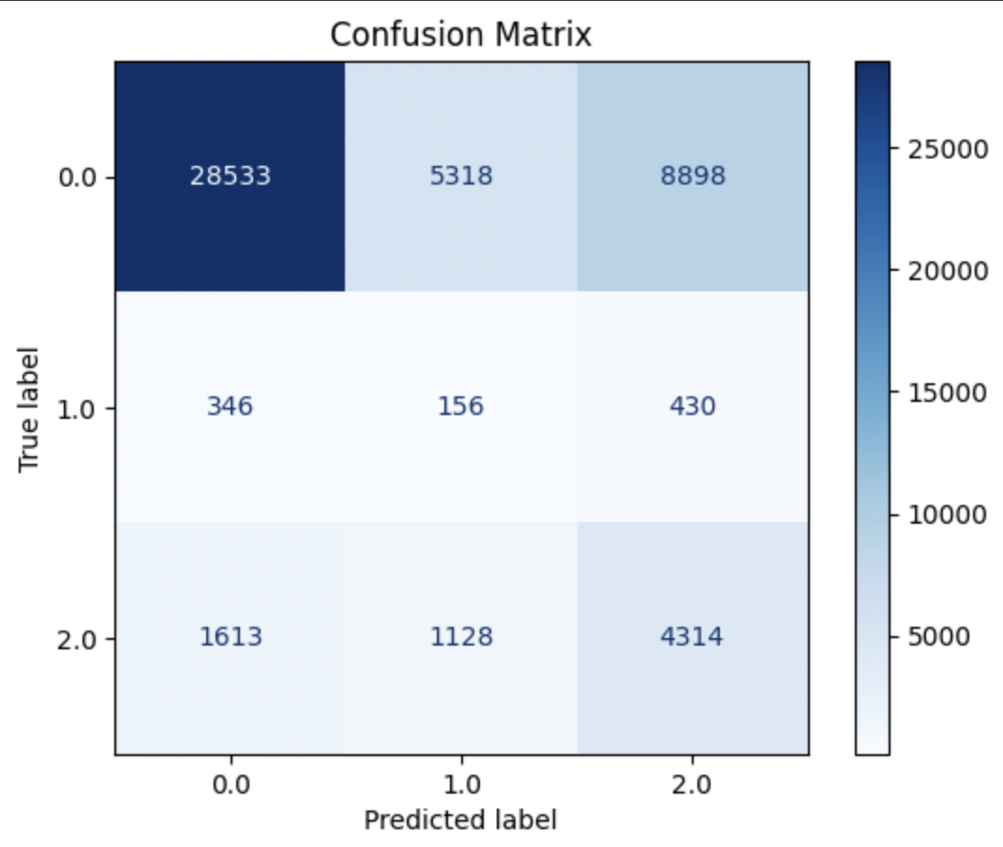
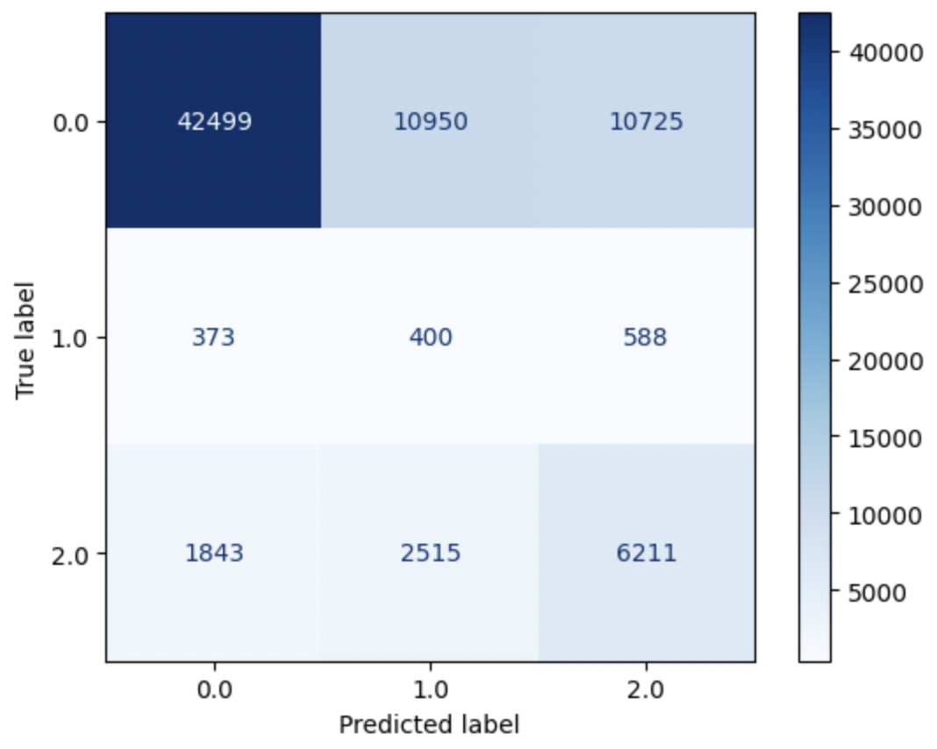
Predicting Diabetes Risk: Leveraging Machine Learning for Early Detection and Intervention
DATA 110 Intro to Data Science Fall 2024 Prof. Richard Marks
Agustin Orozco, David Yeboah, Prateek Mishra, Yannick Apedo
Question and Background
Methods
Our Model
When we look at the dataset the question that emerges is, how can health and lifestyle indicators be used to predict the likelihood of diabetes and prediabetes among individuals, and what targeted interventions can effectively reduce diabetes risk?
Diabetes is a major public health issue globally, impacting millions and leading to serious complications if untreated. Predicting diabetes risk based on behavioral and demographic factors can help create targeted preventive strategies, ultimately reducing the burden on healthcare systems. We are interested in this because understanding these risk factors not only informs medical practices but also helps individuals take proactive steps in managing their health.
We first conducted exploratory data analysis by visualizing predictor relationships with the response variable. Given mostly categorical variables, we decided that boxplots would be appropriate.
For our model, we utilized a decision tree as a technique to predict diabetic condition from the wide range of features provided and the ability to handle non linear relationships. Implementing balanced class weights and max depth of 3, the model utilized “High Blood Pressure” as the root node and thus the most important feature in prediction.
For example, higher average BMI and high blood pressure may correlate with increased diabetes likelihood. These insights can guide targeted interventions, such as promoting physical activity or healthier eating habits,
which can effectively reduce risk factors associated with diabetes and prediabetes. We then decided to move into data modeling where we tried various techniques like KNN, Decision Tree, and Logistic Regression and examined how class imbalance affected results.
We noticed that using class weights is compatible with logistic regression models. After fitting it on the unbalanced data, we found similar high false negative rates, with 0 individuals in Class 1 being classified correctly. So, we again wanted to address the class imbalance through class weights to see if this improves the model. The logistic regression model with class weights had a 65% test accuracy score which was 20% lower than the previous logistic regression model, but this time, 5000 more individuals were correctly classified from class 2 and 400 individuals were classified correctly in Class 1. These minority class results were easily our best yet. Even with the tradeoff in overall accuracy, we decided this model is more valuable with its lower false negative rates.
Data Visualization(s):
Results
Conclusion
In this visual, we display the class distributions of our datasets. On the left, we have multiclass data where 0 represents non-diabetes, 1 represents pre-diabetes, and 2 represents diabetes. This data has a severe class imbalance as only 1.8% of data is in class 1. In the middle, we have binary data where 0 represents non-diabetes and 1 represents pre-diabetes or diabetes. Again, the classes are very imbalanced as most individuals are non-diabetic. On the right, we have the binary dataset again, but it is balanced. Class 0 was undersampled to match the amount that was in Class 1. We will use these balanced vs. unbalanced scenarios and see how model performance compares. Because of this imbalance, we will likely get models that predict well for Class 0, but not for Class 1 and 2. We decided that even if high accuracy is achieved, we want to minimize false negative rates. In context, false negatives mean patients who actually have diabetes are classified as non-diabetic. This misdiagnosis could bring dire consequences, and thus we aim to reduce this as much as possible through balancing techniques like class weights.
In conclusion, major health conditions and diseases such as diabetes often come with a range of factors and indicators needed to conclusively diagnose and prescribe changes to an individual. With our decision tree and logistic regression models, healthcare professionals can utilize and implement these as a diagnostic tool to predict diabetes type based on patient data. This tool would assist healthcare providers in prioritizing tests, tailoring treatments, and identifying high-risk patients early. It could also be integrated into electronic health record (EHR) systems to provide real-time predictions during patient consultations.
The left confusion matrix displays how our decision tree performed when data was left unbalanced while the right displays how it performed after using class weights for balance.
This confusion matrix to the left shows our best model. This was the performance of logistic regression when using class weight for balance. We achieved, by far, the best false negative rates for Class 1 and 2
Of course, it should be noted that the model is prone to setbacks and biases, such as the high class imbalance and overrepresentation of non-diabetic samples, inability to be generalized over different populations and demographics, and most importantly, the ethical considerations of patients being mislabeled. Ultimately, we hope for this model to serve as a resource and guide for healthcare professionals as they combat growing health complications.
References

