Slide 1


OPENVINO Hackaton 2019
Arranged by :
Agus Prayudi 3110161058
Guided by :
Dr.Eng. Indra Adji Sulistijono, ST, M.Eng.
Anhar Risnumawan, S.ST, M.Cs.
Zaqiatud Darojah, S.Si, M.T.
Mechatronics Engineering Division
Politeknik Elektronika Negeri Surabaya
Kampus PENS, Jalan Raya ITS Sukolilo, Surabaya
60111
Notes:
First of all, I would like to say thanks to all of examiner, and to my supervisor, mr. indra adji sulistijono, and mr. anhar that give me an opportunity to present my final project proposal, and then, let me introduce my self, my name is agus Prayudi, in here I would like to explain about my final project proposal, and my tittle for final project proposal is …………..
1

Slide 2


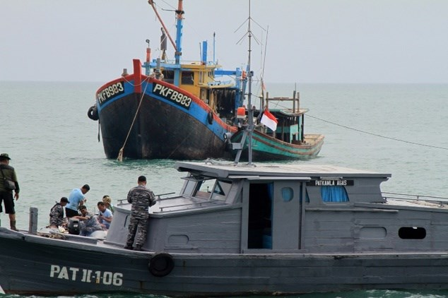
Introduction
Source : https://kkp.go.id/artikel/7551-hingga-november-2018-pemerintah-tangani-134-kasus-illegal-fishing (accessible on 11 July 2019)
In November 2018, there are at least 633 illegal fishing vessels with a composition of 366 Indonesian-flagged vessels and 267 foreign fishing vessels.
Notes:
Illegal fishing is able to be done by another country or own country itself.
1

Slide 3

Introduction
Amount of ship registered in Indonesia.
Source : http://rvia.kkp.go.id/data-kapal (accessible on 11 July 2019).
There are many vessels which are have a size under 30 GT (16 meters),
that is indicated that there are not much using VMS.
Then, according to globall fishing watch, no nation has ever shared its Vessel Monitoring System (VMS) data publicly before, In 2019, only two country in the world has shared its VMS data, that is Indonesia and Peru.
Notes:
From this information, we are able to conclude that VMS application still have a lack
1

Slide 4
System design to detect illegal fishing
So what’s the solution for that problem?
Notes:
UAV will scan ships in ocean, and then the image from scanned by UAV will process in micropfocessor, and microprocessor will be classifying and mapping location of ships. After ships has classified and mapped, microprocessor will send location and visual data to server, server act as comparison of GPS data from object detection and VMS data to know that is illegal or not.
1

Slide 5
Surveillance System for Illegal Fishing Prevention

Slide 6
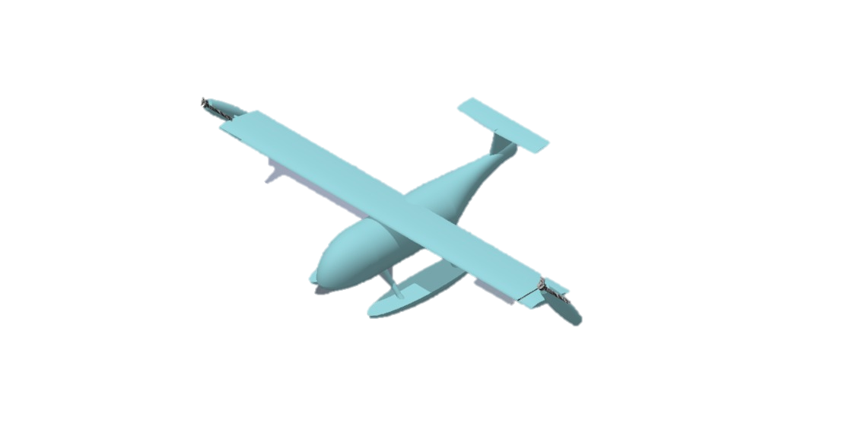
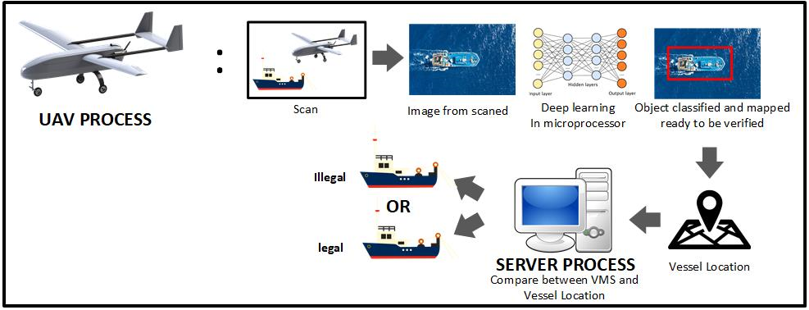

System design to detect illegal fishing
Notes:
UAV will scan ships in ocean, and then the image from scanned by UAV will process in micropfocessor, and microprocessor will be classifying and mapping location of ships. After ships has classified and mapped, microprocessor will send location and visual data to server, server act as comparison of GPS data from object detection and VMS data to know that is illegal or not.
1

Slide 8
Advantages
Minimizing the surveillance operational cost by ministry
Optimalization the fishery activities surveillance system of Indonesia
Enhacing the effectiveness of investigation and monitoring and also prevent illegal fishing activities by early warning
Giving a mass impact to environment and economy of Indonesia fisherman
Notes:
Why I publicate the dataset? Because dataset for UAV imagery is deficient, and image from satellite is not for free. and because 90% ships in Indonesia is traditional Ship, so we should suitable the dataset with condition of ship In Indonsesia
1

Slide 9
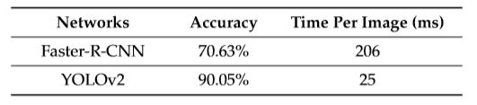
State of The Art
Method : The last research has used Faster RCNN and YOLO v2 to detect ships [1].
Table of accuracy and speed detection comparison using SSDD dataset.
Source : A. Amare, et. al., “Ship Detection Based on YOLOv2 for SAR Imagery.”, Dept of Electrical Engineering, National Taipei University of Technology, Taiwan, hal. 8.
Sensing : there is not much research that using UAV imagery for detect ship [2]-[3], it is because lack of dataset in UAV imagery, it is because usually dataset from satellite imagery is not for free.
Notes:
In here, I devided state of the art into two point, that is method and sensing
Yolo has increased the accuracy and speed, because it used convolution layer for predict each pixel within image.
1

Slide 10
Thank You
You can download my project in my github :)
HERE : github.com/aguspray001
Notes:
1

Slide 11
Reference
[1] A. Amare, et. al., “Ship Detection Based on YOLOv2 for SAR Imagery.”, Dept of Electrical Engineering, National Taipei University of Technology, Taiwan, 2 April 2019.
[2] X. Chao, et. al., “BgCut: Automatic Ship Detection from UAV Images.”, School of Computer Software, Tianjin University, China, 3 April 2014.
[3] A. M. Klimkowska, I. Lee, “A Prealiminary Study of Ship Detection From UAV Images Based on Color Space Conversion and Image Segmentation.”, Dept of Geoinformatics, University of Seoul, Korea, 2017.
Notes:
<number>

