Slide 1
DLAS Project
Title: Noise Event Detection in Meeting Rooms
Agustín M. de los Riscos Mayorga

Slide 2

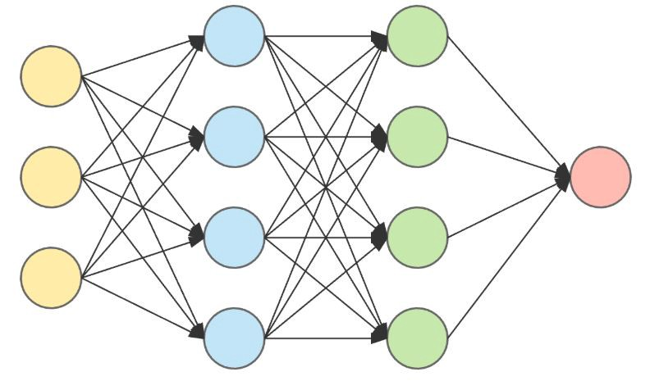
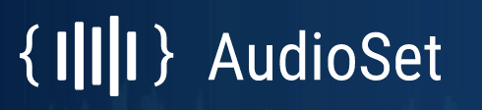
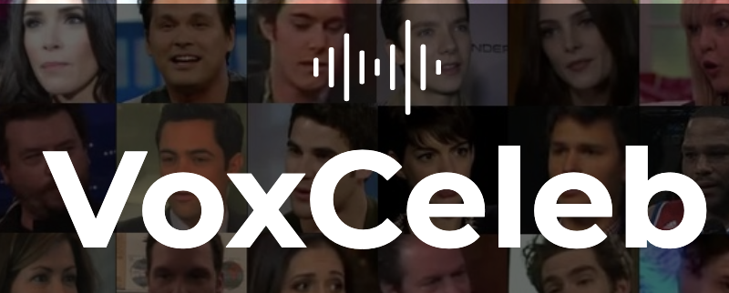
Introduction
Objective: Develop a system for detecting different types of noise in meeting rooms.
Dataset: UrbanSound, AudioSet and VoxCeleb
Analysis: STFT and MFCC spectograms
Models: Deep Neural Networks. MLP and CRNN

Slide 3
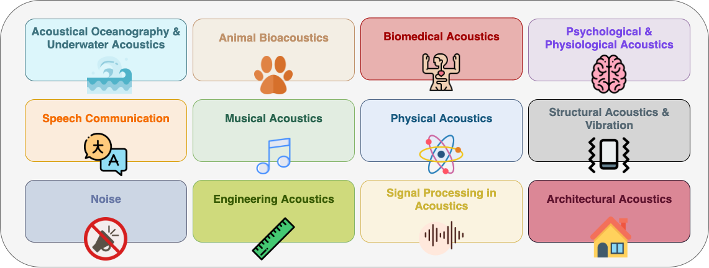
Deep Learning for Acoustic Signal Processing
Sound event detection (SED)
DL recent advances
Sound source location

Slide 4


CASE STUDY
Measure the productivity of work agile teams with:
Actual number of meeting attendees
Actual duration of the meeting
Metrics on time spent in conversation / typing / silence
Actual noise level

Slide 5
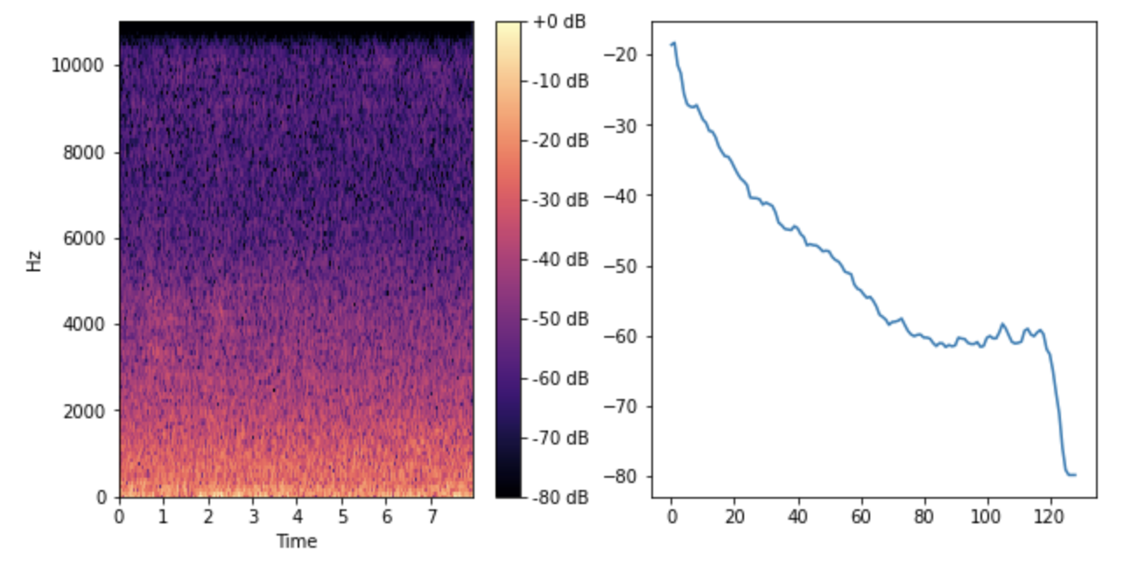
Audio Spectrograms

Slide 6
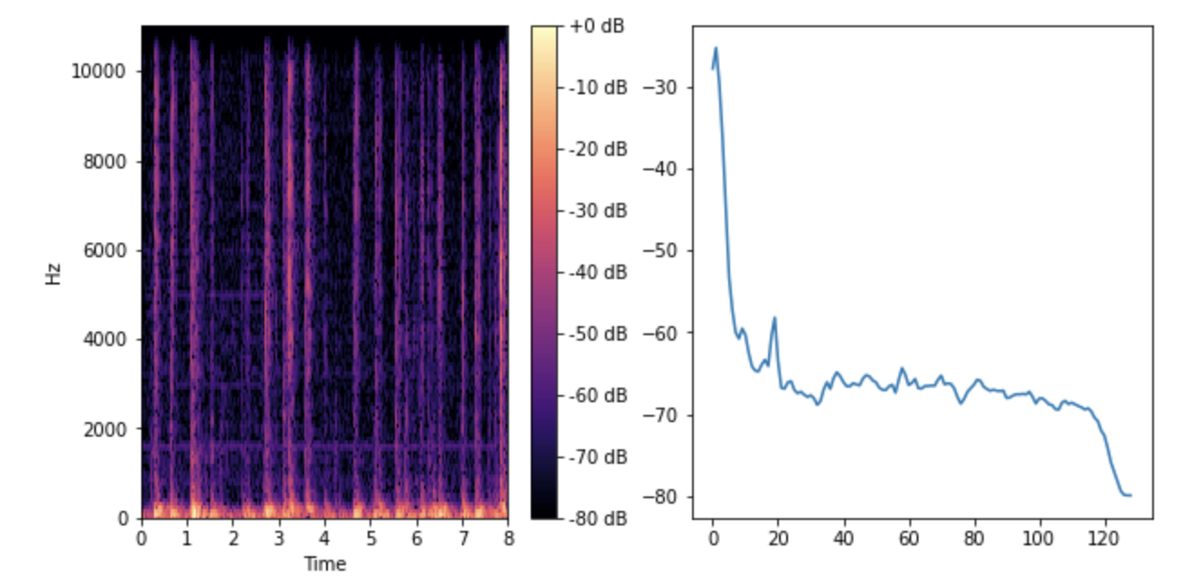
Audio Spectrograms

Slide 7
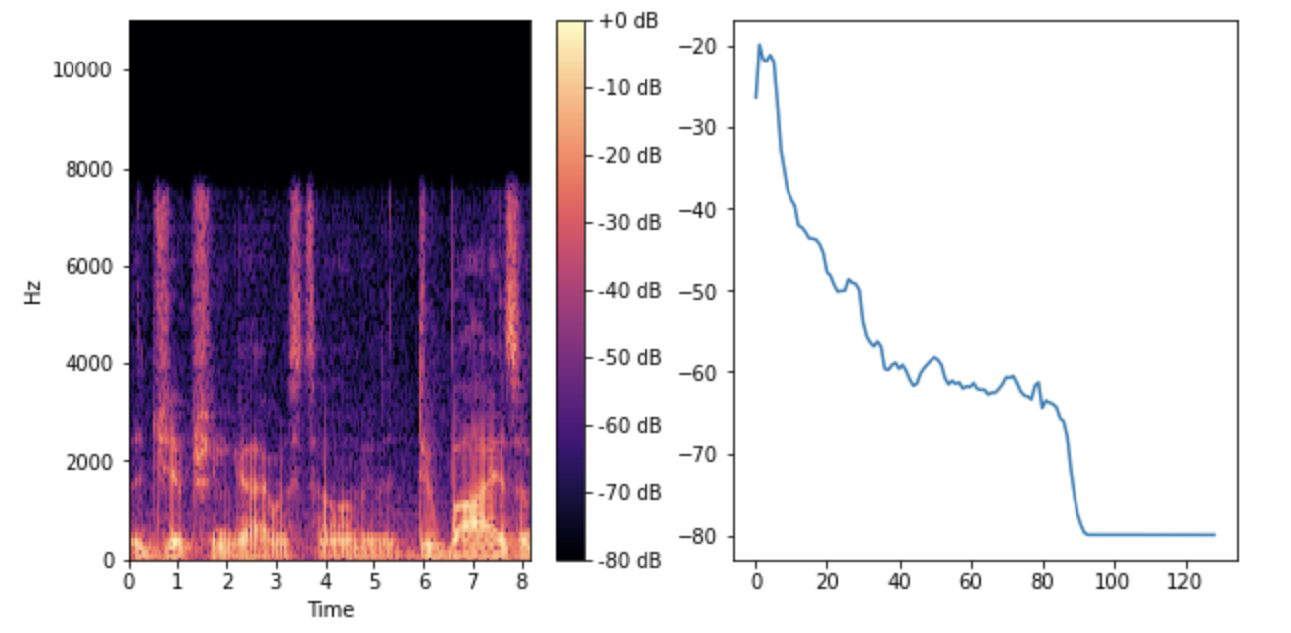
Audio Spectrograms

Slide 8
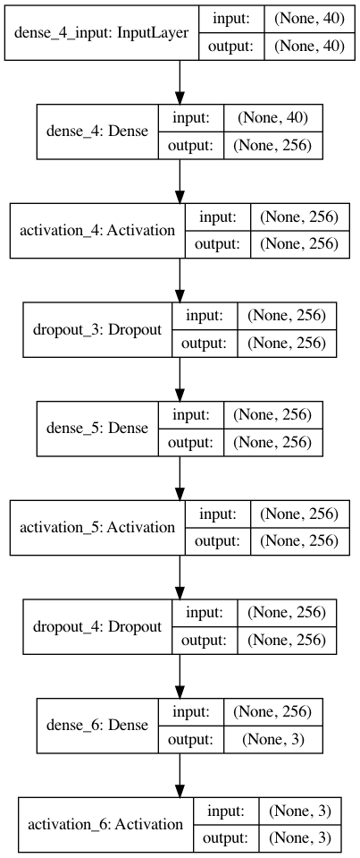
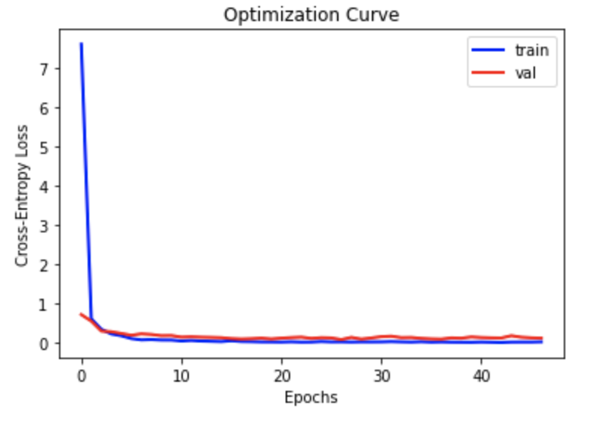
Multi-Layer Perceptron (MLP)
40 MFCC input features
Fully connected layers
Dropout regularization
Output layer: Softmax

Slide 9
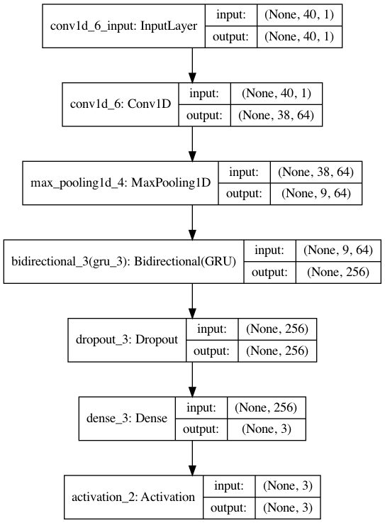
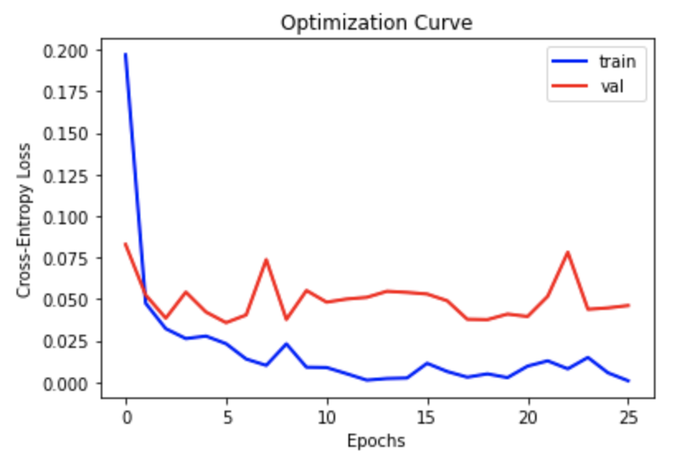
Convolutional Recurrent Neural Network (CRNN)
40 MFCC input features
ConvNet with 64 filters
Max pooling filtering
BiGRU of 128 cell units
Dropout and Softmax layers

Slide 10
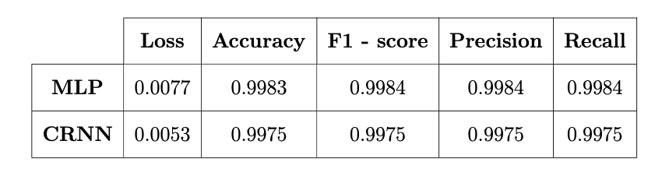
Results and conclusions
Conclusions
  Learn how to process audio signals in Python
  Learn how to extract STFT and MFCC features
  Develop a state-of-the-art multiclass SED system

