Slide 1
What it is talked about when it is discussed
about economic inequality?
Unsupervised topic modeling and zero-shot LLM classification for analyzing
economic inequality discussions in the USA Congress and NYT over time
SEDS Master’s thesis work in progress

Slide 2
Topic classification method
Bottom-up definition of topics with probabilistic topic modeling
1
2
3
Retrieval of economic inequality documents and preprocessing
- Querying articles and selecting speeches
- Preprocessing text for Structural Topic Modeling (STM)
STM model fitting and selection
- Fit of STM for different K values
- Evaluating meaningful vs. boilerplate topics with ChatGPT assistance
- Selecting best performing model
Codebook development
- Developing a classification codebook from STM-derived topics
- Structuring topics hierarchically into main topics (1-12) and subtopics (A-D)
Document classification with a large language model (LLM)
4
5
Zero-shot document classification
- Designing prompt with codebook for in-context learning.
- Classifying documents implementing Llama-3.3-70B in a zero-shot setting.
Visualization of topics and subtopics prevalence over time
- Calculating prevalence
- Creating time series visualizations for topic and subtopics
Hypothesis
The incidence of horizontal inequalities in economic inequality discussions has increased over time.

Slide 3
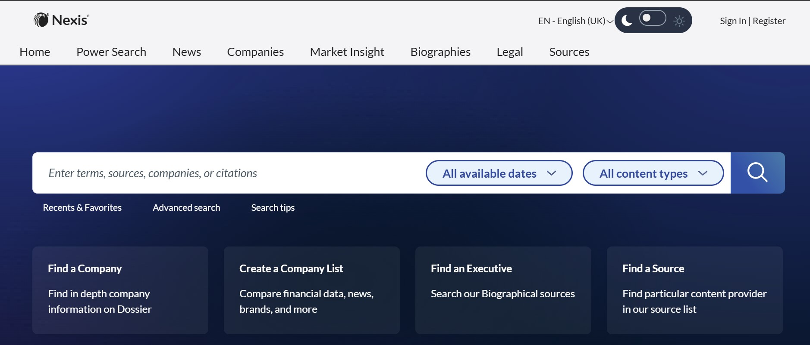
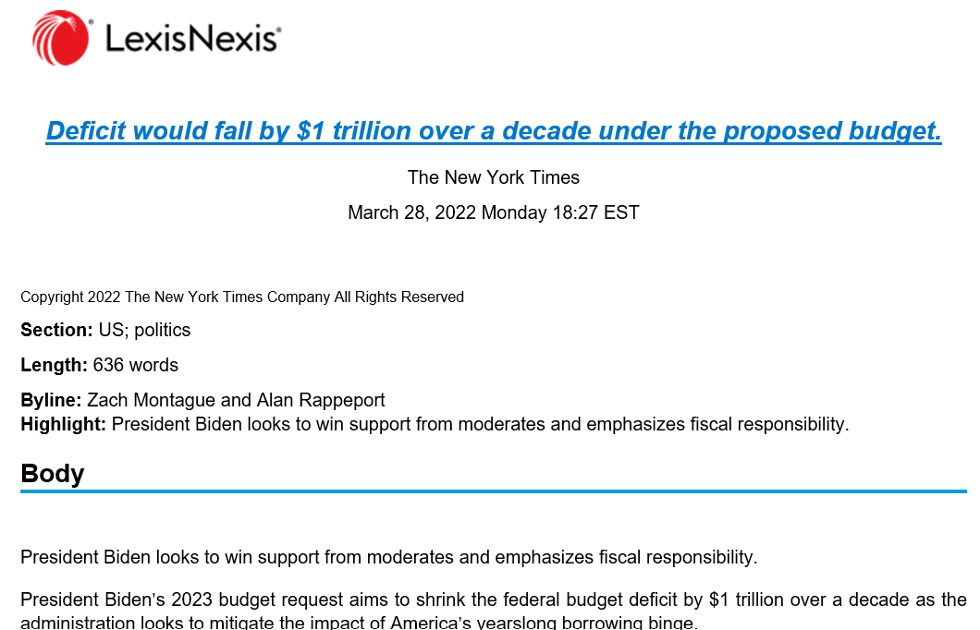
1
Retrieval of economic inequality documents
Economic inequality query definition
(economic, income, salary, wage, compensation, pay or wealth) [5-word window] (inequ or gap)
NYT (n = 13.838)
Nexis Uni extracted articles from June 1980 to November 2024 (available coverage)
NYT Archive API extracted total articles for prevalence calculation
#End of body titles
end_of_body_subtitles = ("Graphic", "End of Document", "Related Articles")
#Dates
months = ["January", "February", "March", "April", "May", "June", "July", \
"August", "September", "October", "November", "December"]
copyright_pattern = r"Copyright\s+(\d{4})" #for date retrieval
# Loop through paragraphs and extract data
for idx, paragraph in enumerate(doc.paragraphs):
text = paragraph.text.strip()
# Extract title
if idx == 3:
data["title"] = text
USA Congress (n = 3.844)
Speeches from both bodies from 1980 to 2022
Preprocessing for STM
# Load spaCy model
nlp = spacy.load("en_core_web_sm")
def process_text(text):
# Process text with spaCy
doc = nlp(text.lower())
- Parsing and duplicate handling of NYT .doc files
- Lowercase
- Lemmatization and uni-gram tokenization
- Removal of punctuation, numbers and stopwords
- Filtering of infrequent tokens (1% threshold)
#Remove unfrequent words (in less than 1% of documents)
lower_bound <- ceiling(0.01 * nrow(df))
out <- prepDocuments(processed$documents, processed$vocab,
processed$meta, lower.thresh = lower_bound)

Slide 4
1
Coverage of economic inequality visualization over time

Slide 5
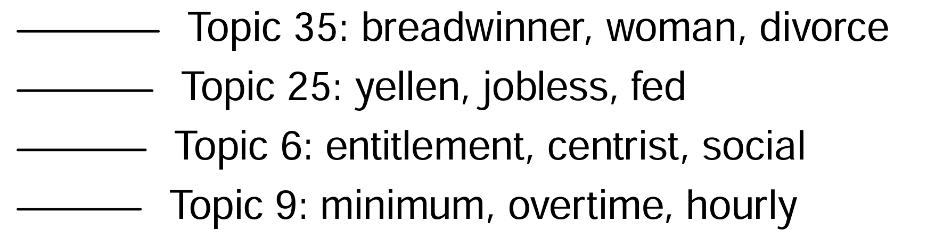
2
stm50fit <- stm(documents = out$documents,
vocab = out$vocab,
prevalence =~ dataset * s(year)
content =~ dataset,
K = 10,
max.em.its = 75,
data = out$meta,
init.type = "Spectral")
STM model fitting
- Covariates for topic prevalence (dataset and year) and topic word content (dataset)
- Fit of 7 STM models with topics ranging from 10 to 70
- All models successfully converged
High prevalence of 35th topic untokenized text
STM model selection
Mr. Speaker. today I rise on behalf of the women who are part of the fabric of our Nations workforce. Nationally. women working full time are paid 77 cents for every dollar paid to men. These disparities are even worse for women of color. In Ohio. my home State. African American women are paid only 62 cents. and Hispanic American women only 54 cents for every dollar paid to white males. The gender wage gap not only hurts women. unfair wages hurt entire families. (...)
- Inspection of topic words and documents for labeling and definition.
- ChatGPT assistance to leverage its input on context-specific terms (e.g., USA bills, historical references like Fed chair Janet Yellen).
- Selection of the 50-topic model for topics based on coherence and effective separation of boilerplate document sections.
High prevalence of topic 25th topic untokenized text
In the Bond Market, the American Economy Is Still Something to Worry About Get the DealBook newsletter to make sense of major business and policy headlines -- and the power-brokers who shape them The huge swings that defined stock trading in December have ended. That doesn't mean investors think everything is fine. In the bond market, traders of government debt are still signaling concerns about the direction of the United States economy. (...)
Notes:
Boilerplate topics: Boilerplate topics are common phenomena in topic models (Mimno & Blei, 2011). They have no substantive meaning, but their emergence sharpens other meaningful topics “by segregating boilerplate terms in a distinct location” (DiMaggio et al., 2013, p. 586)
Reference: Maier, D., Waldherr, A., Miltner, P., Wiedemann, G., Niekler, A., Keinert, A., ... & Adam, S. (2021). Applying LDA topic modeling in communication research: Toward a valid and reliable methodology. In Computational methods for communication science (pp. 13-38). Routledge. doi: https://doi.org/10.1080/19312458.2018.1430754

Slide 6
2
STM meaningful and boilerplate topics average prevalence visualization

Slide 7
3
1. Horizontal Inequalities:
Disparities tied to a social identity. They highlight issues like unequal treatment in employment, historical and contemporary oppression, and marginalization.
A. Gender (Topics 35 & 4): Gender disparities in work and family life.
B. Race (Topics 23, 34, 38, & 8): Historical and ongoing racial injustices, including slavery, massacres, incarceration, reparations, and racial liberation.
C. Religion (Topic 16): Religious themes and figures, encompassing Islam, Judaism, Catholicism or others.
D. Immigration and Border Issues (Topic 24): Immigration themes, including undocumented individuals and borders policing.
2. Macroeconomics:
Policies and frameworks shaping national and global economies, including fiscal policies, trade, and labor markets.
A. Budget and Fiscal Policy (Topic 3): Issues related to government spending, deficits, and fiscal strategies.
B. Taxation (Topic 14): Tax brackets, deductions and estate taxes.
C. Monetary Policy and Economic Recovery (Topic 25): Role of monetary policy and the Federal Reserve's in managing unemployment, recession, inflation and economic recovery.
D. International Trade (Topic 27): Global trade issues, including tariffs, exports, and trade relations with other countries.
(…)
Codebook development
- Development of a classification codebook from STM-derived topics
- Hierarchically structured topics into main topics (1-12) and subtopics (A-D)
Notes:
1. Horizontal Inequalities:
Disparities tied to a social identity. They highlight issues like unequal treatment in employment, historical and contemporary oppression, and marginalization.
A. Gender: Gender disparities in work and family life.
B. Race: Historical and ongoing racial injustices, including slavery, massacres, incarceration, reparations, and racial liberation.
C. Religion: Religious themes and figures, encompassing Islam, Judaism, Catholicism or others.
D. Immigration and Border Issues: Immigration themes, including undocumented individuals and borders policing.
2. Macroeconomics:
Policies and frameworks shaping national and global economies, including fiscal policies, trade, and labor markets.
A. Budget and Fiscal Policy: Issues related to government spending, deficits, and fiscal strategies.
B. Taxation: Tax brackets, deductions and estate taxes.
C. Monetary Policy and Economic Recovery: Role of monetary policy and the Federal Reserve's in managing unemployment, recession, inflation and economic recovery.
D. International Trade: Global trade issues, including tariffs, exports, and trade relations with other countries.
3. Debt and Housing:
Economic issues related to housing access, ownership, and the financial structures impacting homeownership, as well as the challenges posed by debt.
A. Housing Status and Affordability: Homeownership and rental market conditions, including assistance programs like rental vouchers, efforts to support affordable housing, and barriers to homeownership
B. Debt and Lending: Issues in borrowing and lending, including loans, foreclosure, and repayment, focusing on challenges faced by borrowers, the role of lenders, and the broader economic implications of debt.
4. Corporations and Entrepreneurship:
Different aspects of business operations, including entrepreneurship, corporate finance, excecutive pay and mergers and acquisitions.
A. Entrepreneurship and Innovation: Role of entrepreneurs, innovation, startups, battery technology and venture capital.
B. Corporate Finance and Compensations: Financial structures within corporations, including shareholder interests, stock compensation, executive compensation and bonuses and company performance and shareholder value.
C. Mergers, Acquisitions, and Antitrust: Mergers, acquisitions, antitrust regulations, monopolies and fair competition in sectors like banking or others.
5. Welfare State:
The role of government programs in reducing economic inequality and promoting social well-being.
A. Historical Development and current systems: Origins of welfare systems, reforms and political movements shaping their evolution. Societal efforts to enhance upward mobility and comparisons of system of redistribution.
B. Entitlements and Poverty Alleviation: Programs addressing poverty and economic insecurity (e.g., unemployment benefits, supplemental nutrition support).
C. Labor and Wages: Minimum wage debates, overtime pay, and turnover rates, for different earners and rungs in the ladder.
D. Labor Unions and Worker Rights: Collective bargaining, unionization, and organization efforts for labor protections.
6. Public Sector Employment:
Inequalities within employment in the public sector and between the public and private sectors, including pay gaps, recruitment practices, and disparities in treatment.
A. Federal and Other Forms of Public Employment: Civilian federal employees, military personnel, firefighters, police, and judiciary-related roles, addressing discriminatory practices, recruitment, supervisory challenges, and relevant legislative frameworks like the Federal Employees Pay Comparability Act of 1990.
7. Discussions About Political Parties:
Reflections on the U.S. Democratic, Republican and other parties, their candidates, members and supporters.
A. Democrats, Republicans and Party Discussions: Discussions on the party's candidates running for the presidency and other offices, party members and supporters' proposals and ideas.
8. Healthcare System:
Components of the healthcare system, including insurance coverage, medical services, and public health challenges.
A. Medicare and Health Insurance: Issues related the role of insurers and pharmaceuticals in providing medication and healthcare access (e.g. Medicare).
B. Hospitals and Healthcare Providers: Examines hospitals, physicians, nurses, patient care and reimbursements.
C. Public Health and Disease Management: Public health efforts towards diseases prevention, vaccination, and management, including COVID-19.
9. Education System:
Issues across all levels of education and policies affecting students and educational institutions.
A. Early Childhood Education: Foundational education such as preschool and kindergarten, early learning and childhood development.
B. Elementary Education and School Management: Discusses elementary school structure, management, and educational practices, including roles like superintendents and the influence of charter schools.
C. Higher Education: Issues related to higher education, including bachelor’s and graduate degrees, for example in fields like STEM and others.
10. Environment:
Environmental issues like those related to energy production, emissions and pollution.
A. Energy and Sustainability: Examines the environmental impact of energy sources, from traditional industries like oil and agriculture to renewable energy and addresses the role of emissions in climate change and the need for sustainable practices in farming and energy production.
B. Pollution and Environmental Degradation: Focuses on the effects of pollution, particularly from transportation (e.g., airlines, highways, traffic), and its impact on natural spaces like forests, highlighting the consequences of environmental degradation.
11. International Issues:
Global political dynamics, focusing on conflicts, diplomatic relations, and geopolitical concerns.
A. Asia and Korean Peninsula: Political and military tensions between North and South Korea and broader regional contexts.
B. Cold War and Global Politics: Examines the ideological rivalry between the Soviet Union and Western powers during the Cold War, covering themes like communism, socialism, diplomatic tensions, missile crises, and political repression.
C. Iraq and U.S. Military Engagement: U.S. involvement in Iraq and Afghanistan, military operations, figures like President George W. Bush, and the economic and political ramifications.
12. Art and Sports:
Covers sports and cultural products, like films and music.
A. Films and Cultural Products: Forms of artistic expression such as films, music, and literature.
B. Sports: Sports like soccer and baseball, major events like the Olympics, and the role of athletes and teams.

Slide 8
4
<begin_of_text_token>You are a classifier for economic inequality-related texts based on a codebook. You will receive a text from the {text_type} that deals with economic inequality, and your task is to classify it according to the most prominent topic and subtopic. Use the codebook provided below.
# Instructions:
1. Determine the TOPIC:
Select the single primary topic (numbered 1 to 12) that best matches the text's main theme based on the descriptions provided below. Every text has a topic, choose the one that most closely aligns with the dominant message or has according keywords.
2. Determine the SUBTOPIC: (...)
Prompt build up
- Prompt build up including codebook with topics description
model_id = "meta-llama/Llama-3.3-70B-Instruct"
quantization_config_arg = BitsAndBytesConfig(load_in_4bit=True)
# Load the model with quantization
model = AutoModelForCausalLM.from_pretrained(
model_id,
device_map="auto",
quantization_config=quantization_config_arg,
torch_dtype=torch.bfloat16)
Zero-shot classification
- Llama-3.3-70B zero-shot classification
def cliff_case(row, cliff_prompt, json_examples, topics_descrip, idx, idx_error):
text = row["text"]
text_type = "New York Times" if row["dataset"] == 'nyt' else "USA Congress"
cliff_prompt = cliff_prompt.format(text_type = text_type, json_examples = json_examples,
topics_descrip = topics_descrip, text = text)
# Tokenize input and move to CUDA
inputs = tokenizer(cliff_prompt, return_tensors="pt").to("cuda") # to GPU
# Generate response
outputs = model.generate(**inputs, max_new_tokens=20,
pad_token_id=tokenizer.eos_token_id, temperature=0.2)

Slide 9
5
Visualization of topic prevalences for the Llama zero-shot classification

Slide 10
5
Visualization of subtopic prevalences for the Llama zero-shot classification

Slide 11
Future research
Expand data media outlet coverage and media types
- Explore datasets from conservative media and social media news platforms.
Public opinion predictability testing
- Analyse cross-correlations between horizontal inequality topic prevalence and public opinion polls on attitudes toward redistribution and inequality legitimacy
Public opinion forecasting with LLMs
- Simulate the impact of different media diets on scales and poll results (e.g. Belief in a Just World (BJW), General System Justification Scale)

Slide 12
More robust topic modeling
“Pre-register”
a) what topics a good model would include or not include,
b) how many topics you would expect at a minimum and maximum, or
c) which patterns would you expect to find (external events correlations)
Model build-up
Trimming (95%/0.5% , 90%/1%)
k (4 to 50)
α (0.1 to 1), (β was set to 1/k)
runs (3)
Model validation
Shallow (qualitatively checking 10 top words and 5 documents)
chose two models which have the most interpretable topics for further human-based validation.
a) be meaningfully interpreted by humans and
b) are theoretically sensible for the context of Austrian politics between 2004 and 2020.
In depth (two best models from shallow validation)
- Word intrusion task
- Topic Labeling: we read 10 documents per topic
- External Events
(Bernhardt, 2023)
Next steps
?
Divide between training and test set?
Other topic selection approaches?
-Alina approach / BertTopic
-Prompting approach (TopicGPT)

Slide 13
LLM Codebook annotation and results evaluation
Follow previous research and perform ablation experiments
Halterman (2025) steps:
1- Prepare Codebook
- definition, positive example, and negative example can improve zero-shot performance
- chain of thought
2- LLM basic capabilities (Label-free behavioral testing): order, change definitions
3- Zero-hot accuracy
4- Analyzing errors (lable robustness, ablation and manual analysis)
5- Supervised training (QLoRA finetuning)
Next steps
?
n° of classifiers?
- 2 LLMs + train a BERT?
How many ground truth labels?
Ablations for codebook characteristics?

Slide 14
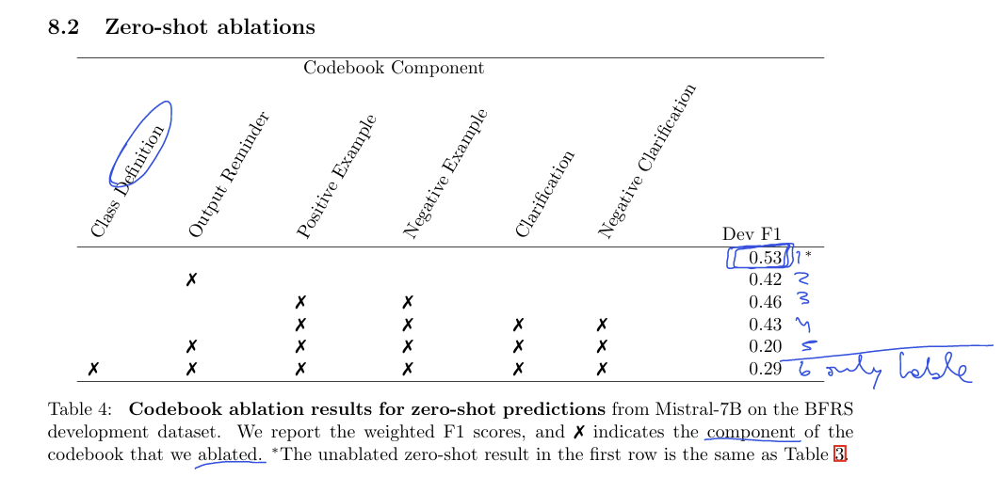
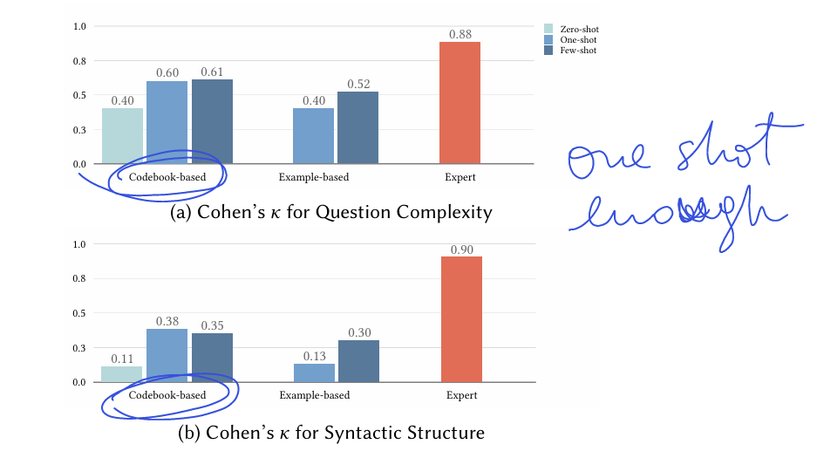
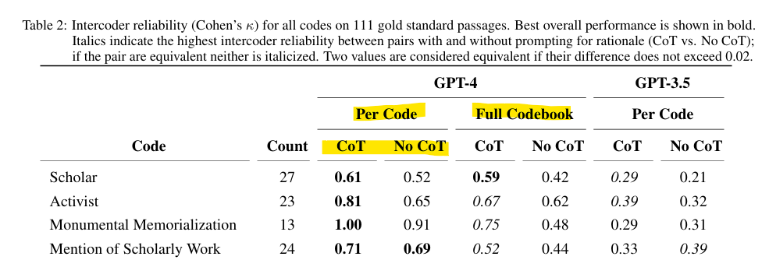
(Halterman & Keith, 2025)
(Xiao et al., 2023)
(Dunivin, 2024)

Slide 15
?
Divide between training and test set?
Other topic selection approaches?
-Alina approach / BertTopic
-Prompting approach (TopicGPT)
Other next steps…
In silico polling (Deb Roy [Chu et al., 2023])?
-What is inequlity?
-Support for redistribution?
-Poverty causes/attributions?
-Poverty/horizontal inequality stereotypes?
Get more newspapers (e.g. Factiva)?
Meeting with Claudia?
Thesis month extension
?
n° of classifiers?
- 2 LLMs + train a BERT?
How many ground truth labels?
Ablations for codebook characteristics?

