Slide 1
Under hybrid bridge
leon
2016.6

Slide 2
Directory
Introduction
Design
Instance to explain

Slide 3
Web History
HTML2.0
HTML3.0
HTML1.0
W3C
JS 1.0
JS 2.0
ES
1993
1994
1995
1996
ES1.0
ES5.0
ES3.0
ES2.0
HTML4.0
2009
1999
1998
1997
HTML5.0
ES6.0
2014
2015

Slide 4
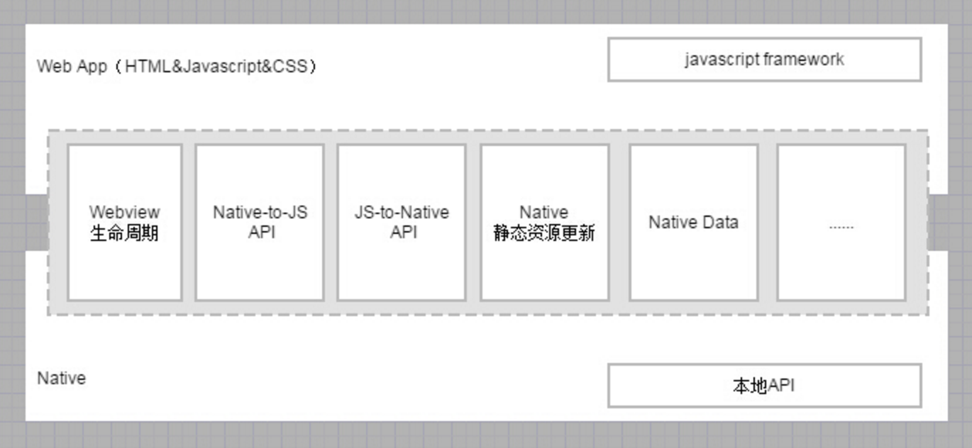
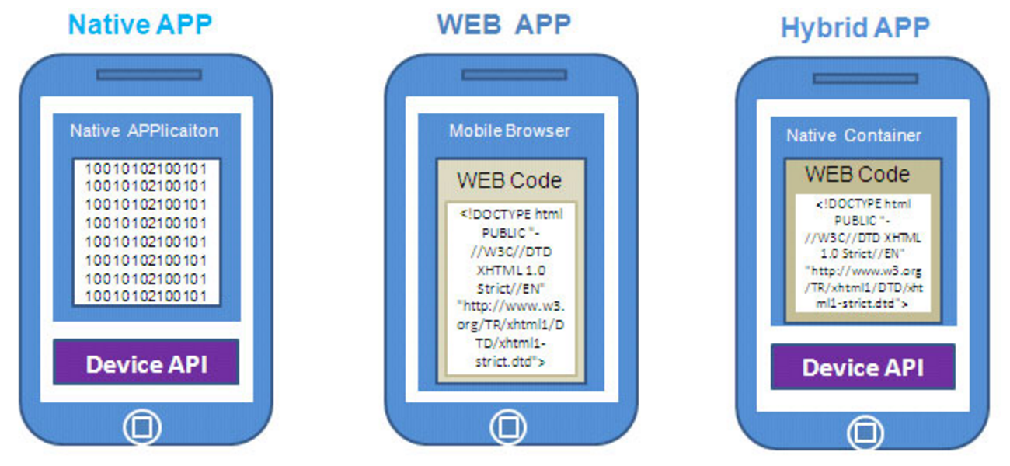
Introduction

Slide 5
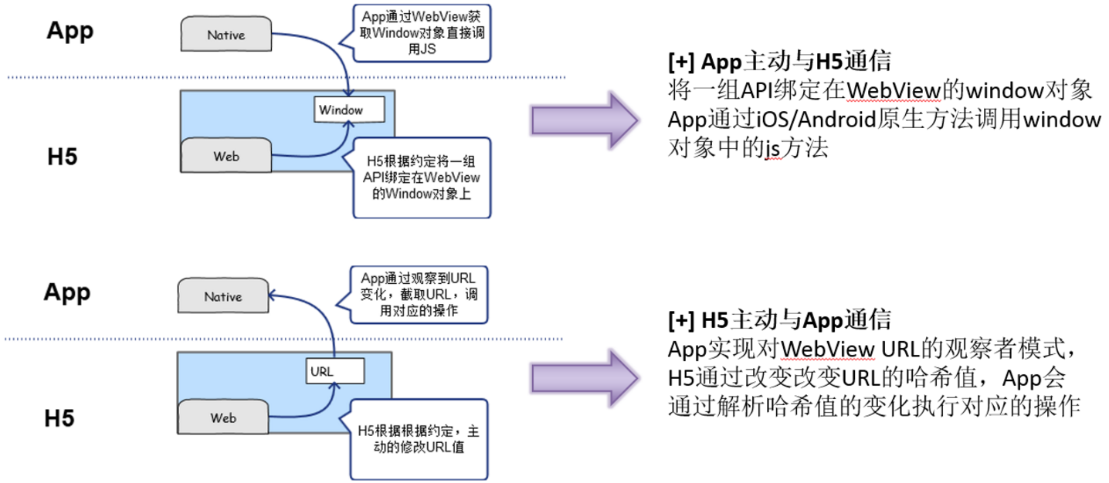
Design
Browser|WebView
Server|Native
Server API
创建XHR对象
执行回调
创建Native请求
Native API
执行回调

Slide 6
Design – common bridge
Header
Native UI
系统、设备信息获取及操作
Web页与Native页相互跳转
消息与请求

Slide 7
Instance to explain
 | WebView | UIWebView
load | loadUrl | loadRequest
execute js | loadUrl(“javascript:…”) | stringByEvaluatingJavaScriptFromString
url intercept | shouldOverrideUrlLoading | shouldStartLoadWithRequest
Android >= 4.4(sdk: 19) ： 采用和chrome相同的Chromium引擎
IOS >= 8.0.0 (WKWebView)： 采用和Safari相同的JS引擎

Slide 8
Instance to explain
Sync:
var netType = bridge.getNetType();
Async:
bridge.pay({…},{
success: function(){ … },
fail: function(){ … },
cancel: function(){ … }
})

Slide 9
Instance to explain - debug
Android
webview: mWebView.setWebContentsDebuggingEnabled(true)
chrome: chrome://inspect/#devices
IOS
ios device: Settings → Safari → Advanced → Web Inspector (switch on)
safari: develop → (device name) → (site url)

