Slide 1
On-Chip Bus
Speaker: Tian-Sheuan Chang
July, 2004

Slide 2
Goal of This Lab
Understand how AHB-Lite works.
Learn how to add new slaves.
Learn to verify AHB-Lite compliance of a slave.

Slide 3
Outline
AMBA AHB system
AHB-Lite system
AHB compliance verification
Lab – On-chip bus: AHB-Lite

Slide 4
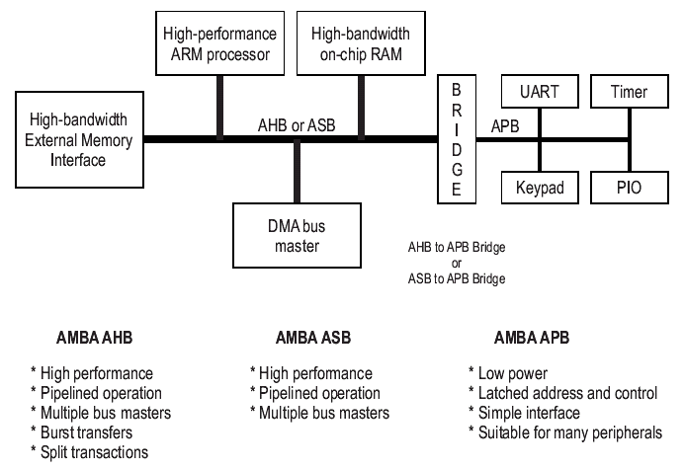
Typical AMBA system

Slide 5
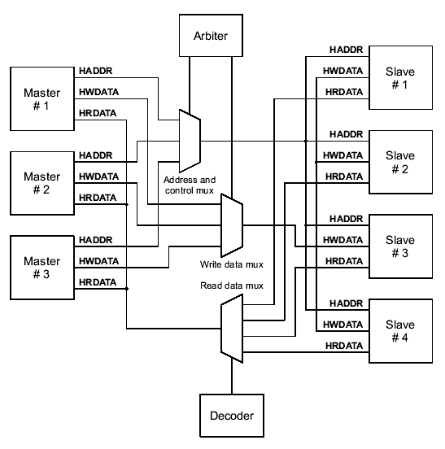
An AHB System
HBUSREQ_x
HGRANT_x
HSEL_x

Slide 6
Components in AHB (1/2)
Master
  AHB master is able to initiate read and write operations by providing an address and control information. Only one bus master is allowed to actively use the bus at any one time.(max. 16)
Slave
  AHB slave responds to a read or write operation within a given address-space range. The bus slave signals back to the active master the success, failure or waiting of the data transfer.

Slide 7
Components in AHB (2/2)
Arbiter
  AHB arbiter ensures that only one bus master at a time is allowed to initiate data transfers.
Decoder
  AHB decoder is used to decode the address of each transfer and provide a select signal for the slave that is involved in the transfer. A single centralized decoder is required in all AHB implementations.

Slide 8
AHB Signals
AHB Signals can be classified as
  Clock (HCLK)
  Address and read/write data (HADDR, HRDATA, HWDATA)
  Arbitration (HGRANTx, HMASTER, HMASTLOCK,…)
  Control signal (HRESETn,…)
  Response signal(HREADY, HRESP)

Slide 9
AHB Transfer Signals
Transfer signals
  HCLK
    bus clock. All signal timings are related to the rising edge.
  HADDR[31:0]
    32 bits system bus
  HWDATA/HRDATA [31:0]
    32 bits write/read data bus
  HWRITE
    High: write data
    Low: read data
  HREADY
    Transfer done

Slide 10
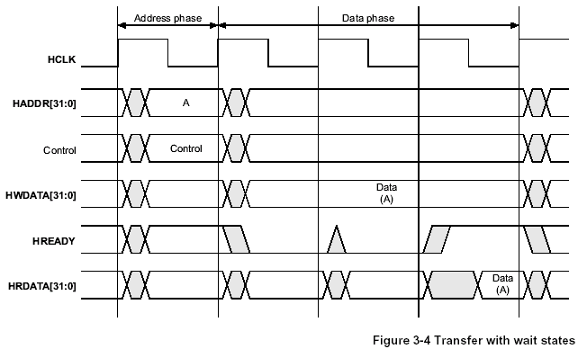
AHB Basic Transfer
Each transfer consists of
  An address and control cycle
  One or more cycles for the data

Slide 11
AHB Control Signals
Control signals
  HTRANS[1:0]
    Current transfer type
  HBURST[2:0]
    When sequential transfer, control transfer relation
  HSIZE[2:0]
    Control transfer size=2^HSIZE bytes(max=1024bits)
  HPROT[3:0]
    Protection data

Slide 12
AHB Control Signal - HTRANS
HTRANS[1:0]
  IDLE: master don’t need data to be transfered
  BUSY: allows bus masters to insert IDLE cycles in the middle of bursts of transfers.
  NONSEQ: The address and control signals are unrelated to the previous transfer.
  SEQ: the address is related to the previous transfer.

Slide 13
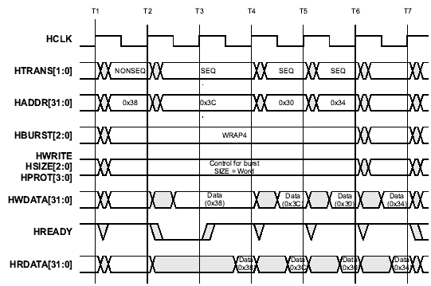
AHB Signals - HBURST

Slide 14
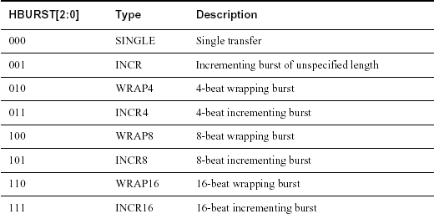
AHB Signals - HBURST

Slide 15
AHB Response Signals
Response signals
  HREADY
    Transfer done, ready for next transfer
  HRESP[1:0]
    OKAY transfer complete
    ERROR transfer failure(ex: write ROM)
    RETRY higher priority master can access bus
    SPLIT other master can access bus

Slide 16
AHB Arbitration Signals
Arbitration signals
  HGRANTx
    Select active bus master
  HMASTER[3:0]
    Multiplex signals that sent from master to slave
  HMASTLOCK
    Locked sequence

Slide 17
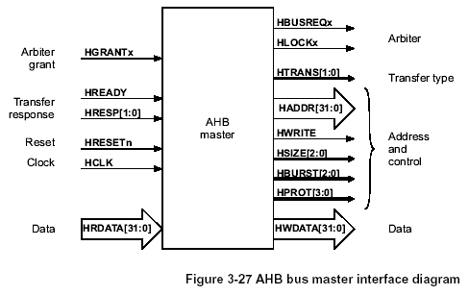
Master Signals

Slide 18
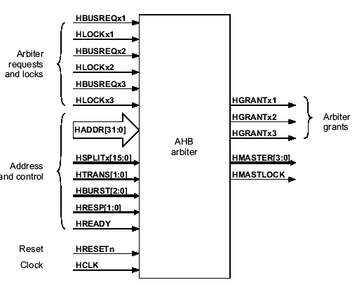
Arbiters Signals

Slide 19
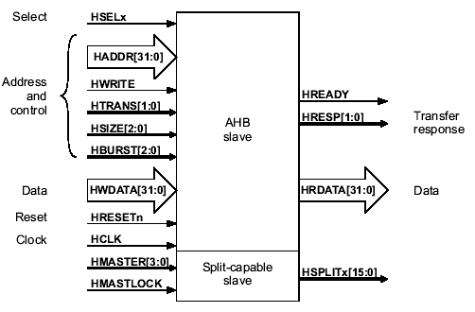
Slave Signals

Slide 20
Outline
AMBA AHB system
AHB-Lite system
AHB compliance verification
Lab5 – On-chip bus: AHB-Lite

Slide 21
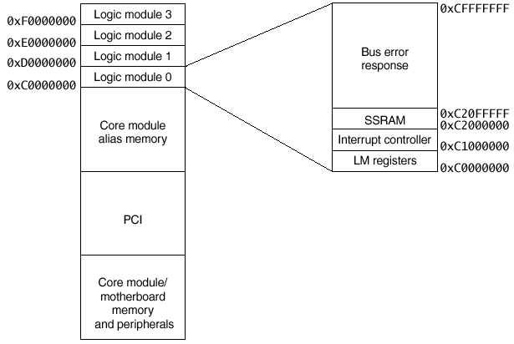
Logic Module Memory Map

Slide 22
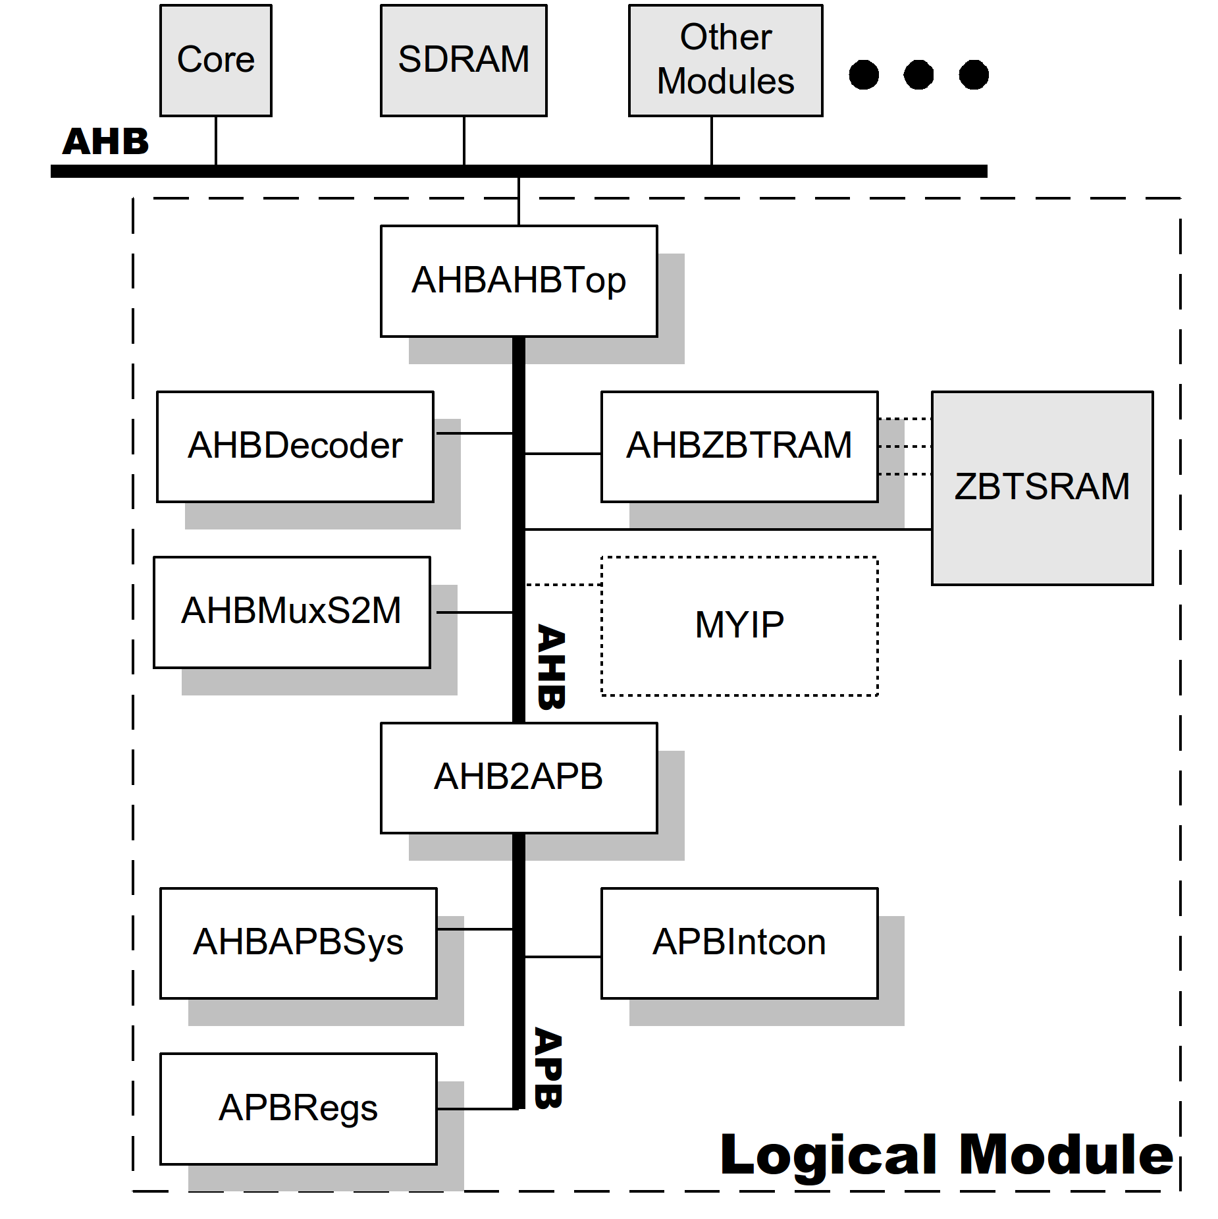
LM AHB-Lite Block Diagram

Slide 23
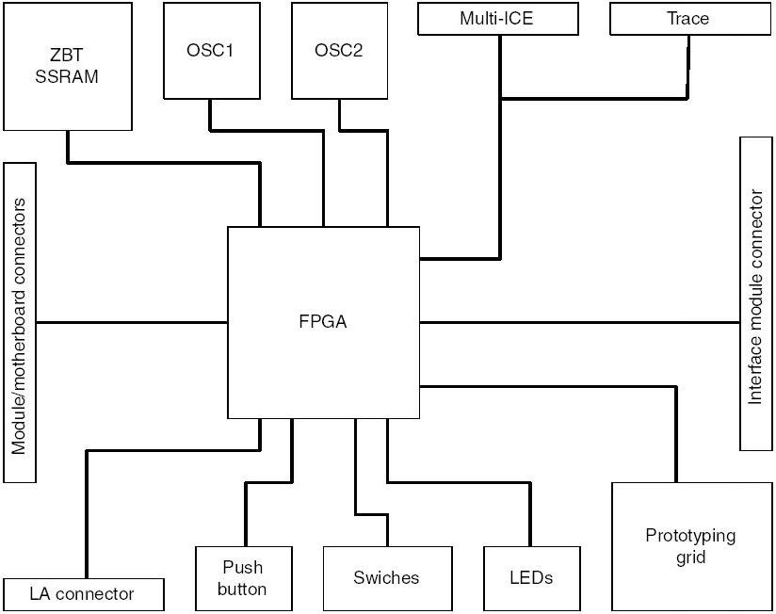
Integrator LM Block Diagram

Slide 24
Notes about LM AHB-Lite system
LM AHB-Lite is a slave in Integrator system
Uses bi-directional tri-state signals
  HDATA
  SDATA
  HREADY
AHB ZBT SRAM controller needs ZBT to be able to read/write without dead cycle.
  HREADY always HIGH → No wait-state access
  ZBT→Zero Bus Turn-around

Slide 25
Modified AHB-Lite system(1/1)
Modified from LM AHB-Lite system
  Replaced bi-directional signal with independent input and output signals
    HDATA → HWDATA/HRDATA
    SDATA → SWDATA/SRDATA
    HREADY → HREADYout/HREADY (internal)

Slide 26
Modified AHB-Lite system(2/2)
Added 2 more modules
  AHB_HC_master
    Master module to drive test pattern to AHB-Lite
  SRAM_8X8X4096
    Connected to ZBT SRAM controller
    Limitation:
      16 KB (originally was 1MB on LM)
      Cannot perform read after write immediately due to AHB pipeline access characteristic.
Removed some signals (pins)
  Flash related signals
  TDI, TDO, RTCK, etc.

Slide 27
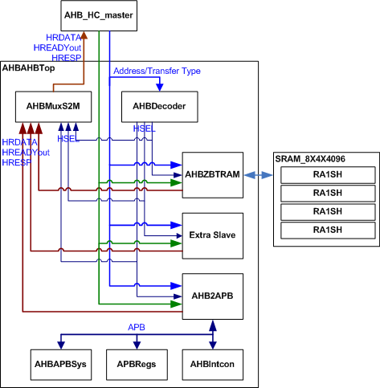
AHB-Lite system diagram

Slide 28
AHB-lite Access (2/2)
Master checks HREADYin
  HREADYin LO: hold control
  HREADYin HI: initiates access request
    Read/write
    Transfer type
    Transfer size
Decoder decodes access address
  HDRID=0xC → First LM
  HADDR[27:20]= 0x20 → ZBT SRAM controller
  HSEL_zbtssram=1’b1 → send slave select signal

Slide 29
AHB-lite Access (1/2)
ZBT SRAM controller
  Write: master send HWDATA to slave in data phase
  Read: slave returns HRDATA to MUX
MUX slave to master read data:
  HSEL_zbtssram=1’b1→ select HRDATA from ZBT SRAM controller to send to master
    Ready signals
    Response signals

Slide 30
Outline
AMBA AHB system
AHB-Lite system
AHB compliance verification
Lab – On-chip bus: AHB-Lite

Slide 31
Compliance check method (1/2)
Simulation check (coverage driven)
  Create check list according to specification
  Create test pattern to hit all the cases in check list
    Synopsys DesignWare Verification IP (VIP) + Vera
    ARM AMBA Compliance Test-bench (ACT)
    Manually check (most error prone)
  May not cover some corner case
    100% coverage (of check list) does not suggest 100% proven

Slide 32
Compliance check method (2/2)
Formal techniques
  Property and rules extraction
  Model & property checking and state space exploration
  Averants Solidify SolidAHB
    If rules are 100% proven, the interface will not violate the rules

Slide 33
Example of check list from DesignWare VIP
State cases
State Name # defined values # hits
---------- ---------------- ------
cv_nseq_rd 1 26
cv_seq_rd 1 14
cv_busy_rd 1 3
cv_nseq_wr 1 9
cv_seq_wr 1 8
cv_busy_wr 1 2
Transition cases
Transition Name # defined transitions # hits
--------------- --------------------- ------
cv_nseq2nseq 1 22
cv_nseq2seq 1 5
cv_nseq2idle 1 3
cv_nseq2busy 1 3
cv_seq2seq 1 13

Slide 34
Outline
AMBA AHB system
AHB-Lite system
AHB compliance verification
Lab -On-chip bus: AHB-Lite

Slide 35
Lab : On-chip bus: AHB-Lite
Goal
  Familiarize AHB using AHB-Lite
  Learn how to add new slave into AHB-Lite
  Practice checking the compliance of an AHB-Lite slave
Principles
  AMBA Protocols
Guidance
  Observer the AHB read/write
  Identify which module defines the memory map
Steps
  Run the example AHB-Lite
  Observe signals
Requirements and Exercises
  Add a new slave
  Check AHB-Lite compliance of the new slave
Discussion
  Disadvantage of using AMBA AHB (Overhead)

Slide 36
Files Descriptions
Modify AHB_HC_master.v to modify test pattern
Modify AHB_Testbench.v to modify simulation cycles
Modify AHB_Testbench.f to add new files
MyIP.v is the new slave to be added into AHB-Lite
Files | Path | Description
AMBA_declare.v | /beh | AMBA related predefined keywords
AHB_HC_master.v | /beh | AHB_HC_master behavioral module
SRAM_8X4X4096.v | /beh | 16KB SRAM module
RA1SH.v | /beh | SRAM behavioral model
AHB_Testbench.v | /beh | AHB_Testbench top module including AHB_HC_master, SRAM_8X4X4096, and RA1SH
AHBAHBTop.v | /rtl | AHBAHBTop modified module
AHBDecoder.v | /rtl | AHBDecoder module
AHBMuxS2M.v | /rtl | AHBMuxS2M module
AHBZBTRAM.v | /rtl | AHBZBTRAM module
AHB2APB.v | /rtl | AHB2APB module, it is also a slave
AHBAPBSys.v | /rtl | AHBAPBSys module
APBRegs.v | /rtl | APBRegs module
APBIntcon.v | /rtl | APBIntcon module
MyIP.v | /rtl | Slave to be added into AHB-Lite
AHB_Testbench.f | /verif | File lists of the whole test bench
LM_AHBAPB.f | /verif | File lists of AHBAHBTop and its sub-modules

Slide 37
Accesses made by AHB_HC_master
7 Accesses
Data and control are not within the same cycle
No. | HWRITE | HSIZE | HADDR | HRDATA/ HWDATA | Remarks
1 | Read | 32-bit | 0xc2000000 | 0xXXXXXXXX
2 | Read | 32-bit | 0xc2000010 | 0xXXXXXXXX
3 | Write | 32-bit | 0xc2000000 | 0x00001234
4 | Read | 32-bit | 0xc2000010 | 0x00001234 | SRAM cannot read immediately after write using ZBT SRAM controller.
5 | Read | 32-bit | 0xc2000010 | 0xXXXXXXXX
6 | Read | 32-bit | 0xc2000000 | 0x00001234
7 | Read | 32-bit | 0xc2000010 | 0xXXXXXXXX

Slide 38
Lab Requirements for Students
Run the modified AHB-Lite system using verilog simulator
  Use Debussy nWave to observe the AHB signals during the 7 accesses intiated by AHB_HC_master.
  Explain the waveforms to TA, they must point out the pipeline transfer characteristic of AHB bus.

Slide 39
Lab Exercise for Students
Add a new slave device: MyIP to the modified AHB-Lite system.
  MyIP is a slave device provided for exercise
Verify the slave’s AHB compliance
  Make check lists
    Nonseq_16_write, write_after_read_16, etc.
  Write test pattern to check the check list for compliance

Slide 40
References
[1] AMBA Specification, Rev. May, 2.0, 1999.
[2] High-Speed Single-Port SRAM (HS-SRAM-SP) Generator User Manual, Artisan Components Inc., Release 4.0, Aug. 2000.
[3] Debussy User Guide and Tutorial, NOVAS Software Inc., Sept. 2002.
[4] Compatibility of Network SRAM and ZBT SRAM, Mitsubishi LSIs Application Note (AP-S001E), Rev. C, Renesas Tech. Corp., Sept. 2002.
[5] DesignWare AHB Verification IP Databook, ver. 2.0a, Synopsys Inc., July 2002.
[6] VMT User Manual, Release 2.0a, Synopsys Inc., July 2002.
[7] Vera User Guide, ver. 5.1, Synopsys Inc., June 2002.
[8] SolidAMBA, Averant Inc., Dec. 2003.

