Slide 1

IR - FINAL PROJECT - HACKER NEWS
Gregorieu, Juan Agustin

Slide 2
INTRODUCTION
WHAT IS HACKER NEWS?
Hacker News (HN) can be defined as a mixture of both a news website and a forum.
Its focus is to provide a list of posts or news regarding technology and entrepreneurship.
All posts and comments are moderated to assure good quality of content.
The users submit content and if a user considers it to be useful for the community, the post is voted.
Users can comment posts and due to the nature of HN most of the times interesting and informative discussions emerge.

Slide 3
INTRODUCTION
WHAT IS HACKER NEWS?
With over a thousand posts/news per day, the very nature of HN allows us to filter the good quality posts.
For example, if we want to know the latest and most relevant news about “React”, we can get very useful results.

Slide 4
INTRODUCTION
PROBLEMS
HN provides a search engine powered by Algolia. I have identified the following problems with it:
  Given a query string, the search engine only retrieves documents either sorted by popularity or by date.
  It is quite restrictive in how we can express our query.
  It needs to match all query terms in order to consider a document.
  UI can display results with no title or snippet, so the user cannot identified what the document is about.

Slide 5
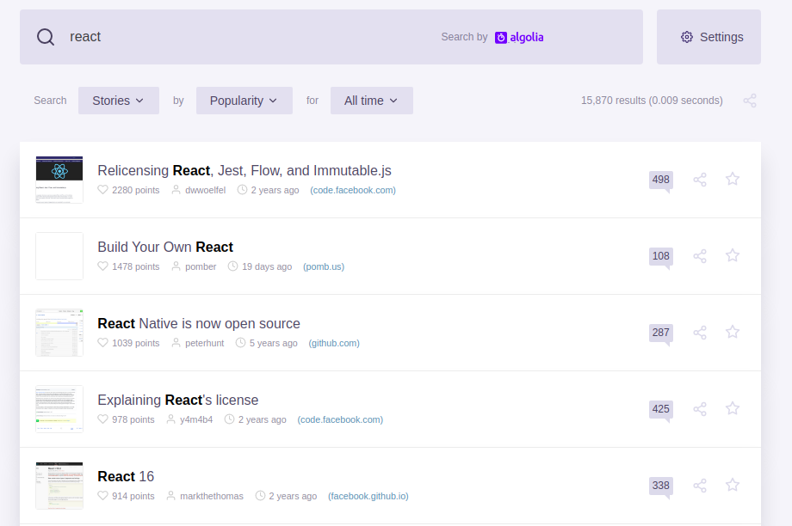
INTRODUCTION

Slide 6

INTRODUCTION

Slide 7
INTRODUCTION
MY SOLUTION
Achieving a relevant search using some criteria, like freshness and popularity.
Create a UI to show my results.

Slide 8
DATASET
1

Slide 9
DATASET
HN provides access to some of its information through Google’s Big Query.
The database consists of a self-referential table called “bigquery-public-data.hacker_news.full”.
Most recent records are 2 months old.
The table stores stories, polls, comments at the same level. I am only interested in the stories with its main comments.
I will only generate a dataset that is 3 years old.

Slide 10
DATASET
SELECT p.id, p.title, p.url, p.text, p.by, p.score, p.time, p.timestamp, p.descendants,
ARRAY(
SELECT AS STRUCT c0.text
FROM 'hacker_news.full' c0
WHERE c0.parent = p.id
)
FROM `hacker_news.full` p
WHERE
p.type = 'story'
AND p.timestamp > TIMESTAMP_SUB(
CURRENT_TIMESTAMP(),
INTERVAL 26280 HOUR
)
This query generates a 1GB dataset of 1,064,628 documents.

Slide 11
SCHEMA
2

Slide 12
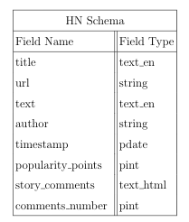
SCHEMA
Title, text, comments and author are indexed (searchable).

Slide 13
SCHEMA
CUSTOMIZATION
To the field title I added an attribute omitTermFreqAndPositions since I don't want that term frequency is used in this field to boost the score. Trade-off -> Cannot search for phrase queries.
I created a new field type that is not included by default in Solr. This field is called text_html and has the same characteristics as text_en but adds a filter for HTML tags.
WHY TEXT_EN ?
Basically it provides all the tools I need to use to parse English text:
  A stop words filter.
  A case folding filter.
  An English possessive nouns filter.
  A Porter stemming filter.
  A synonyms filter (query time).

Slide 14
RELEVANCE
3

Slide 15
RELEVANCE
Each time a user issues a query in Solr, the search engine tries to match it against certain fields in the schema:
  Title: The title of the story. Is usually very short and provides a considerably short description of the topic of the story.
  Description: A brief description or opinion stated by the user. This field is usually empty or null.
  Comments: All comments issued by the users. As I am going to detail later, all comments are strictly moderated in order to assure good quality in every story.
But a match in a field like title should be weighted more than in the field comment.
title^1.4 text^0.3 comments^0.4

Slide 16
RELEVANCE
If there is a match in title, I am going to boost it by 40% of its original value.
Using R I was able to generate some statistics and identify that 94.7% of the records do not contain any value in this field. Therefore a higher boost would give an enormous advantage to the stories that have a value for text.
Regarding the comments, the same idea applies, only 22.50% of the stories have comments. So, in this case, I am only taking the 40% of its score for the final value of the field.
title^1.4 text^0.3 comments^0.4

Slide 17
RELEVANCE
Next step is developing a ranking formula that considers three characteristics of a story:
Popularity: In this context, a story can be up-voted, meaning that it is found interesting by a person. Therefore, the more popularity points a story has the more quality it may have.
Freshness: A user of a news website may find more relevant a document that is relatively new than a document that is many years old.
Number of Comments: HN moderates the comments of every story that has been posted in order to guarantee high quality discussions. Therefore I make the assumption that stories with more comments are stories that can be more helpful to the user that is searching for some particular topic.

Slide 18
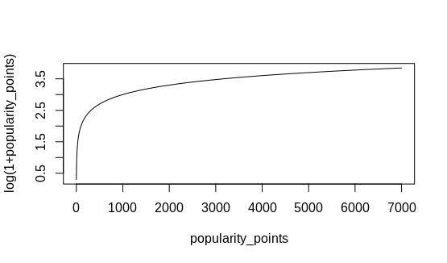
RELEVANCE
POPULARITY
A story that contains more popularity points gets a better score.
Logarithmic Function seems a good option:
f(x) = log(1 + x)

Slide 19
RELEVANCE
Evaluating:
f(0) = log(1 + 0) = 0
f(6015) = log(1 + 6015) = 3.78
The function grows unbounded as the input grows unbounded.
Therefore, it favors very popular posts.
If we use Solr’s stats component we can see that the average popularity points is about 13.60 (I am rounding it to 14).
Using R I identified that around 3.58% of the stories in our dataset have no popularity points at all, and 90.20% have a score lower than 14. So a post with 200 votes will have a very big boost and it does not seem fair. I need another function.

Slide 20

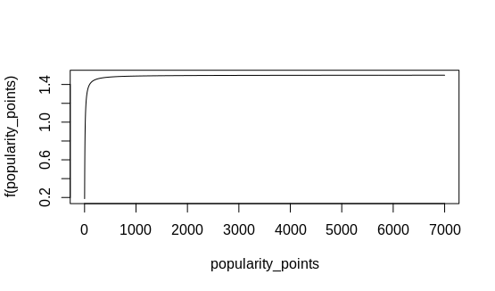
RELEVANCE
A better formula:

Slide 21



RELEVANCE
Evaluating:
The function grows bounded as the input grows unbounded.
For a very high value such as 6015, the boost is not that big, therefore this function seems fair to less popular docs.
In Solr we can write this as: sum(recip( 'popularity_points', 0.071428571, -0.75, 0.5), 1.5)

Slide 22
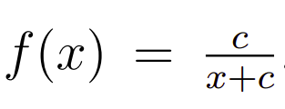

RELEVANCE
FRESHNESS
A fresh story (low age) is going to have a better score than an old one.
The reciprocal of a function seems a good option.
I also need to define a horizon, which in this case is 12 years since HN started on February 19 of 2007. Since Solr handles milliseconds, the value is of: 3.78E11.
The value of c should be one tenth of the horizon.

Slide 23

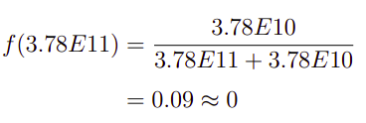
RELEVANCE
Evaluating:
If the age is of 0, the function returns 1. If we value it in the horizon it returns approximately 0.

Slide 24

RELEVANCE
NUMBER OF COMMENTS
Same situation faced with popularity.
In this case the average is of 6.22 (my horizon).
The formula is the same used with popularity but with different horizon.

Slide 25
RELEVANCE
IMPLEMENTING MY FUNCTIONS
Since we are using multiplicative boosting and each of the ranking functions are mostly returning value in the range of [0, 1] (timestamp) or [0, 1.5] (popularity points and number of comments) we are adding a 1 to this range in order to get a value between [1, 2] and therefore avoid the possible scenario of multiplying the Solr score by a zero.
Popularity/Number of Comments → [1, 2.5]
Freshness→ [1, 2]

Slide 26

RELEVANCE
IMPLEMENTING MY FUNCTIONS
I need to combine the values returned from each function and weight them accordingly. I want to compute a value using the following formula:
Where f, p, and c represent freshness, popularity and number of comments. The w are weights and the s are the scores for each variable. S_{s} is the score returned by Solr.

Slide 27

RELEVANCE
IMPLEMENTING MY FUNCTIONS
I started with the following consideration:
Based on this, I tried with different values until I reached the final weights. So my final formula is:

Slide 28
SOLR CONFIGURATIONS
3

Slide 29
SOLR
Every configuration that I mentioned in the previous sections is going to be included into Solr in the form of a Request Handler.
This way a client don’t need to add the functions and other params in the query string. And will just fetch my core using the /hnselect route.
I can have multiple different request handler for different context.
Some observations:
  I am using edismax parser to parse the queries.
  Given the title, text and comments, edismax by default will return the maximum of those three different scores (disjunction max query). To avoid this I added a tie param with a value of 1.0 to the request handler.

Slide 30
SOLR
<requestHandler name="/hnselect" class="solr.SearchHandler">
<lst name="defaults">
<str name="defType">edismax</str>
<str name="qf">title^1.4 text^0.3 comments^0.4</str>
<str name="q.alt">*:*</str>
<str name="mm">2</str>
<str name="echoParams">explicit</str>
<str name="wt">json</str>
<str name="indent">true</str>
<str name="tie">1.0</str>
<str name="hl">true</str>
<str name="hl.method">unified</str>
<str name="hl.tag.ellipsis">... </str>
<str name="hl.fragsize">200</str>
<str name="hl.fl">text comments</str>
<int name="hl.snippets">3</int>
<str name="hl.tag.ellipsis">... </str>
</lst>
...

Slide 31
SOLR
...
<lst name="appends">
<str name="boost">
sum(
product(2, sum(recip(comments_number,0.7143,-0.75,0.5),1.5,1)),
product(10, sum(recip(ms(NOW/DAY,timestamp),1,3.78E10,3.78E10),1.5,$
product(5, sum(recip(popularity_points,0.07142,-0.75,0.5),1.5,1))
)
</str>
</lst>
</requestHandler>

Slide 32
USER INTERFACE
4

Slide 33
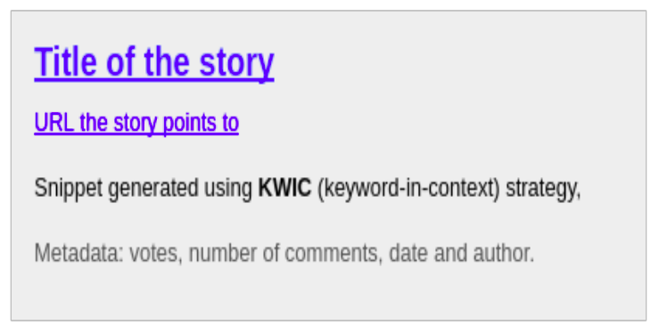
UI
I developed my UI using ReactJS and SemanticUI. The main characteristics are:
The results are presented in a vertical list.
The results are paginated, with a page size of 10 hits.
Each result will have the standard style and the elements we can see in the following figure:

Slide 34
UI
SNIPPET
Generated over the text and comments fields.
The snippet has a size of 200 characters and is generated by Solr using the unified highlighting component.
It displays a contiguous series of sentence fragments separated by ellipses (”...”).
Query terms are in bold.

Slide 35
ADDITIONAL NOTES
5

Slide 36
UI
I also wanted to consider the authority of the author of a post in the ranking function:
First I tried to measure it by calculating its average number of votes (total number of votes/total number of posts). This does not consider its productivity (number of posts).
I found a metric called h-index which basically considers both the author’s productivity and its impact. Basically it means that a particular author has published n posts that have each voted at least n times.
To implement this I created a new core called hn_authors_core. The h-index was calculated using Java and then indexed along the authors name and other attributes.

Slide 37
UI
I used Solr’s JOIN function to filter the results based on a minimum h-index of the author of a post.
Results were not why expected, I was discarding many interesting results.
Another option was to add it somehow to my ranking function. However, after playing a little I abandon the idea of working with this measure.
I realised that in this context it does not matter how much the author has contributed to the community but how interesting the posts are.

Slide 38
UI
A problem is that the snippets are not descriptive enough because the stories are not enough self descriptive and some lines from the comments do not reflect the main topic in most cases.
94.7% of the posts do not contain text that gives additional information to the title.
Could create a snippet from the URL a story points to.
But 9.67% of the posts do not possess a URL, so in those cases we should consider to avoid displaying a snippet at all.

Slide 39
DEMO & QUESTIONS
6

