Slide 1
Finding the best place to open a restaurant

Slide 2
Problem
Understanding the best place to open a restaurant is critical to the future success of the business.
Choosing the wrong place can make it a failure as not many customers will come in.
Stakeholders have an interest to know the best location in order to maximize profits.

Slide 3
Data sources
Median income data from the National Statistics Institute - Neighborhoods income
Population data from the National Statistics Institute - Neighborhoods population
Number of restaurants and their type and location in every neighborhood from Foursquare API
Segmentation of the neighborhoods within the city from a JSON file on GitHub

Slide 4
Analysis
We directed our efforts on finding a neighborhood in this city that has:
  a high median income
  a high population
  a low number of food venues.
  We limited our analysis to areas 800 meters around the neighborhood center .

Slide 5
Results
We can see the clusters of food venues locations in the selected neighborhood:

Slide 6
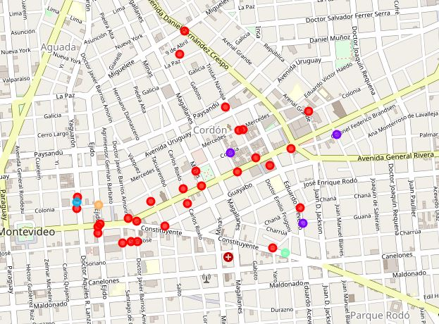

Slide 7
Conclusion
Calculated the best neighborhood by using population and income statistical data and the Foursquare API.
Used machine learning to cluster the food venues in the chosen neighborhood.
Final decision will be made by stakeholders based on their criteria.

