Slide 1
Classifying ZIP Codes by Cancer Rate
Lake County, Illinois Public Health Data
Andrew Gutierrez
Kent State MSBA MIS-64060-002
Objective
Lake County, Illinois is annexing a previously-unincorporated community just beyond current county borders.
The Lake County Department of Health leadership is concerned about cancer rates in the new community, and would like to perform a deeper analysis on how cancer prevalence in the new community compares to the current county-wide picture of cancer rates.

Slide 2
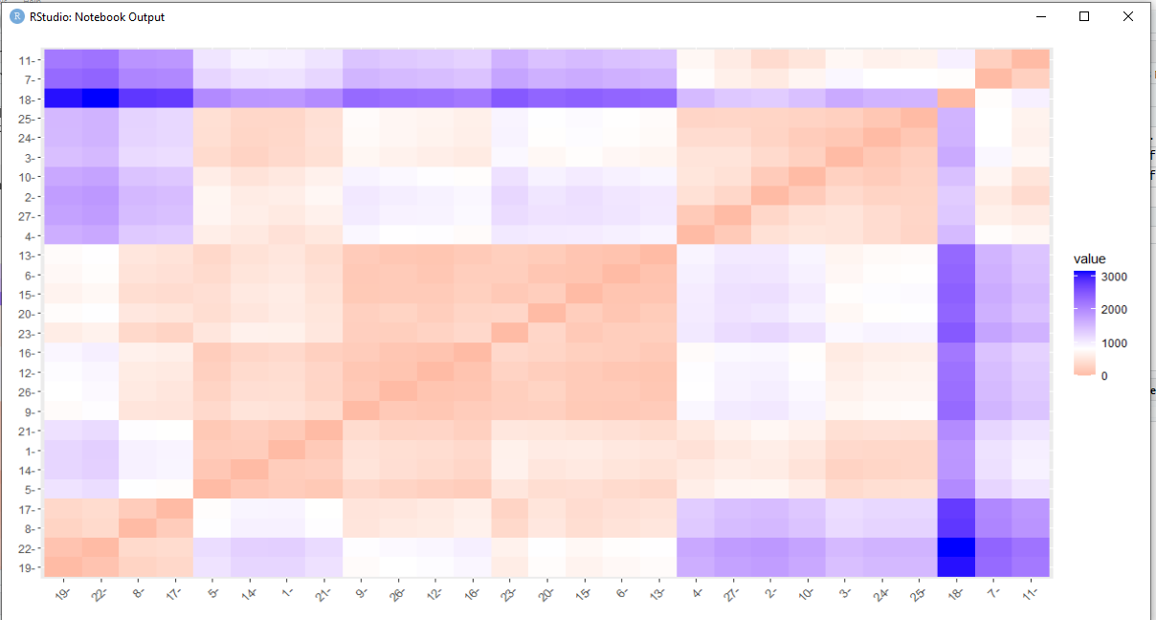
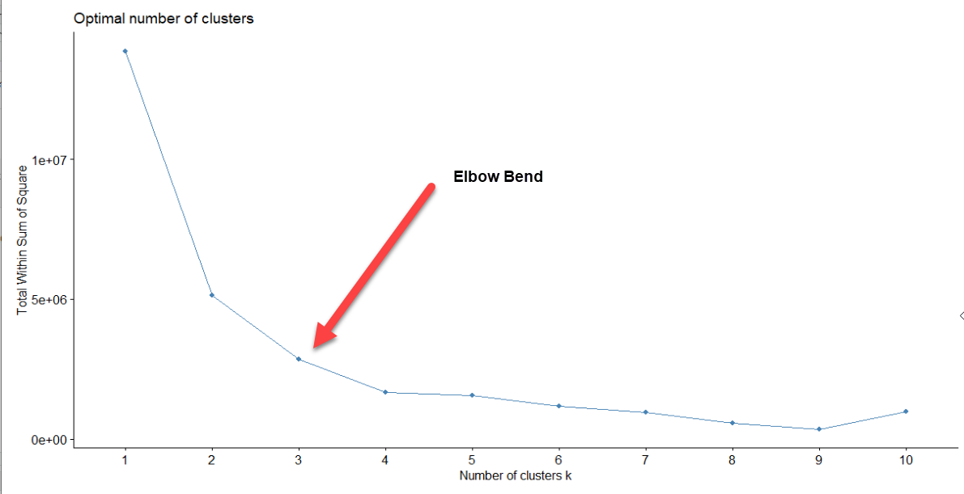
Methodology
Utilize publicly-available dataset of Lake County cancer rates by ZIP code
27 ZIP codes total
Group ZIP codes by cancer rates using cluster analysis
Calculate Euclidean distance between all ZIP code data points
Lack of outliers and constant scale for all numerical variables makes Euclidean distance appropriate
Utilize elbow method to determine the ideal number of clusters (k)
Perform kmeans algorithm on dataset using Euclidean distances and k
Euclidean distances between ZIP codes

Slide 3
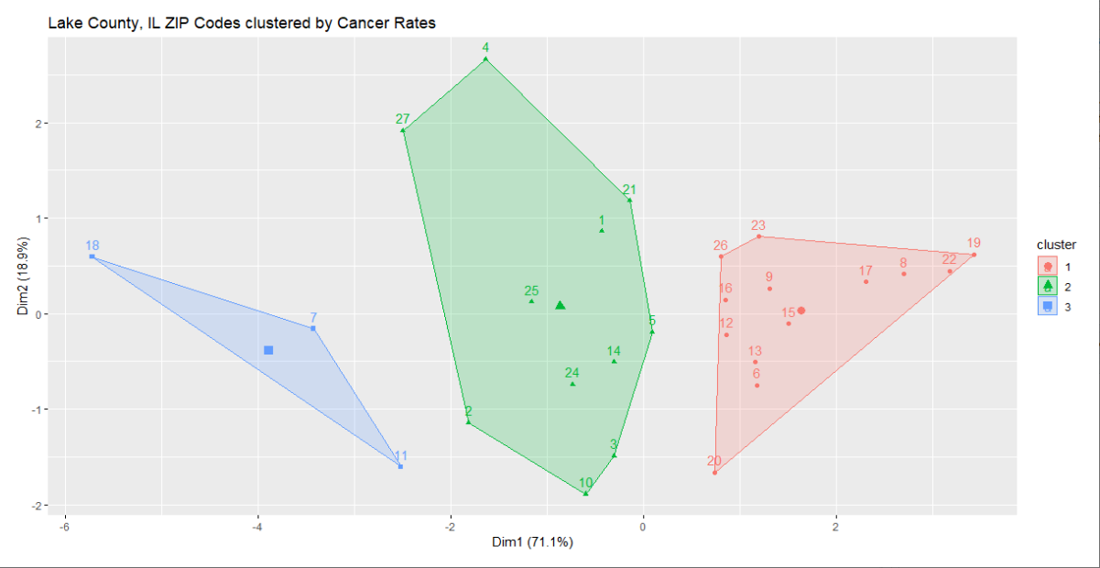
Clustering Results
Cluster 2
“Medium-Cancer Rate ZIP Codes"
11 ZIP codes
Center: 2,924 cancer cases per 100,000 people
Cluster 3
"High-Cancer Rate ZIP Codes"
3 ZIP codes
Center: 3,959 cancer cases per 100,000 people
Cluster 1
“Low-Cancer Rate ZIP Codes"
13 ZIP codes
Center: 2,070 cancer cases per 100,000 people

Slide 4
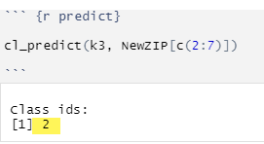
Conclusion – Where does the new community fall?
The new communities’ cancer rates per 100,000 people were collected below:
Using the k-means cluster model of the 27 ZIP codes already part of Lake County, we can predict the cluster placement of the new community:
What the Lake County, Illinois Department of Health has learned about the new annexation is that the community falls within Cluster 2, “Medium-Cancer Rate ZIP Codes”
With an overall cancer rate of 3,010 cases per 100,000, the 60100 ZIP code would actually have the 21st highest cancer rate of the now-28 ZIP codes in Lake County
Although, that rate is actually closer to the middle of the pack than its numerical order would imply, as the communities with the highest cancer rates in the County are much further away distance-wise from the ZIP codes in Cluster 2

