Slide 1
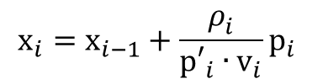









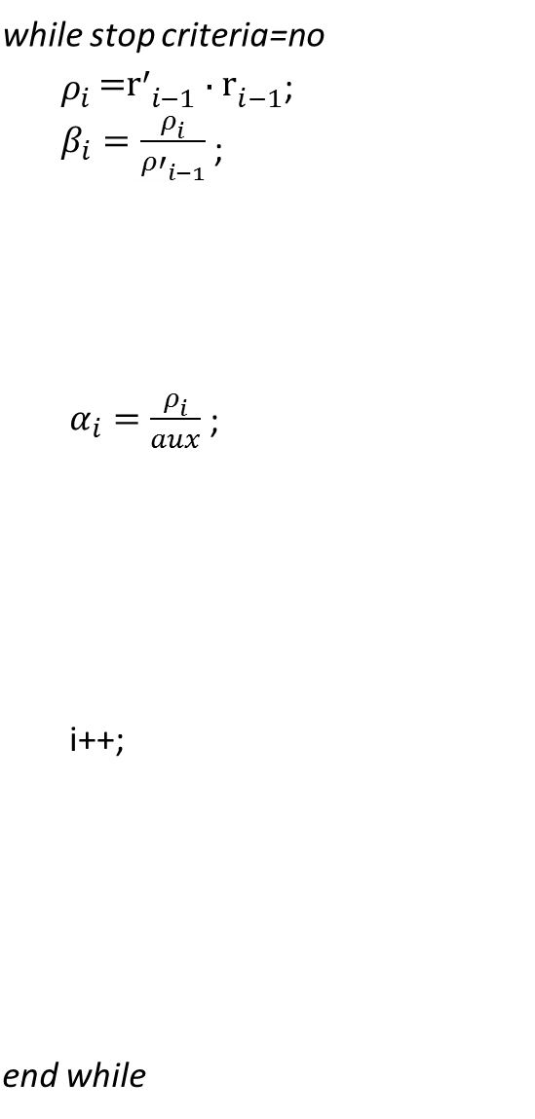











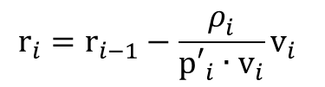


𝑩𝑪𝑮
$$Init i_th \text{Iteration}$$
$$BCG without fusion$$
$${\text{p}}_{i}={\text{r}}_{i−1}+\frac{ρ_{i}^{}}{{ρ′}_{i−1}^{}}{\text{p}}_{i−1}$$
while stop criteria=no
${ρ_{i }\text{=}\text{r}′}_{i−1}∙{\text{r}}_{i−1}$;
$β_{i}=\frac{ρ_{i}^{}}{{ρ′}_{i−1}^{}}$ ;
$α_{i}=\frac{ρ_{i}^{}}{aux}$ ;
i++;
end while
$${\text{p}′}_{i}={\text{r}′}_{i−1}{+\frac{ρ_{i}^{}}{{ρ′}_{i−1}^{}}}_{i}{\text{p}′}_{i−1}$$
saxpy
${\text{p}}_{i}={\text{r}}_{i−1}{+β}_{i}{\text{p}}_{i−1}$;
$${{\text{v}}_{i}\text{=}\text{Ap}}_{i}$$
${\text{p}′}_{i}={\text{r}′}_{i−1}{+β}_{i}{\text{p}′}_{i−1}$;
SpMVs
$${{\text{w}}_{i}\text{=}{\text{A}}^{T}\text{p}′}_{i}$$
${{\text{v}}_{i}\text{=}\text{Ap}}_{i}$;
${aux\text{=}\text{p}′}_{i}∙{\text{v}}_{i}$;
$${\text{r}}_{i}={\text{r}}_{i−1}−\frac{ρ_{i}^{}}{{\text{p}′}_{i}∙{\text{v}}_{i}}{\text{v}}_{i}$$
$${\text{x}}_{i}={\text{x}}_{i−1}+\frac{ρ_{i}^{}}{{\text{p}′}_{i}∙{\text{v}}_{i}}{\text{p}}_{i}$$
${\text{x}}_{i}={\text{x}}_{i−1}+α_{i}{\text{p}}_{i}$;
saxpy
${\text{r}}_{i}={\text{r}}_{i−1}{−α}_{i}{\text{v}}_{i}$;
$${\text{r}′}_{i}={\text{r}′}_{i−1}−\frac{ρ_{i}^{}}{{\text{p}′}_{i}∙{\text{v}}_{i}}{\text{w}}_{i}$$
${\text{r}′}_{i}={\text{r}′}_{i−1}{−α}_{i}{\text{w}}_{i}$;
$${{\text{w}}_{i}\text{=}{\text{A}}^{T}\text{p}′}_{i};$$
$$\text{∆}\text{=}\sqrt{{\text{r}}_{i}∙{\text{r}}_{i}}$$
$\text{∆}\text{=}\sqrt{{\text{r}}_{i}∙{\text{r}}_{i}}$;
dot
$${ρ_{i+1}\text{=}\text{r}′}_{i}∙{\text{r}}_{i}$$
$$Stop$$
${\text{x}}_{i}=$ output
yes
no
$${{ρ′}_{i}\text{=}ρ}_{i}$$
$$Stop Criteria?$$
$$Init (i+1)_th \text{Iteration}$$

Slide 2










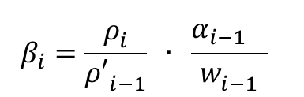
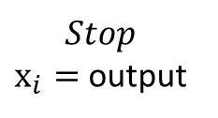
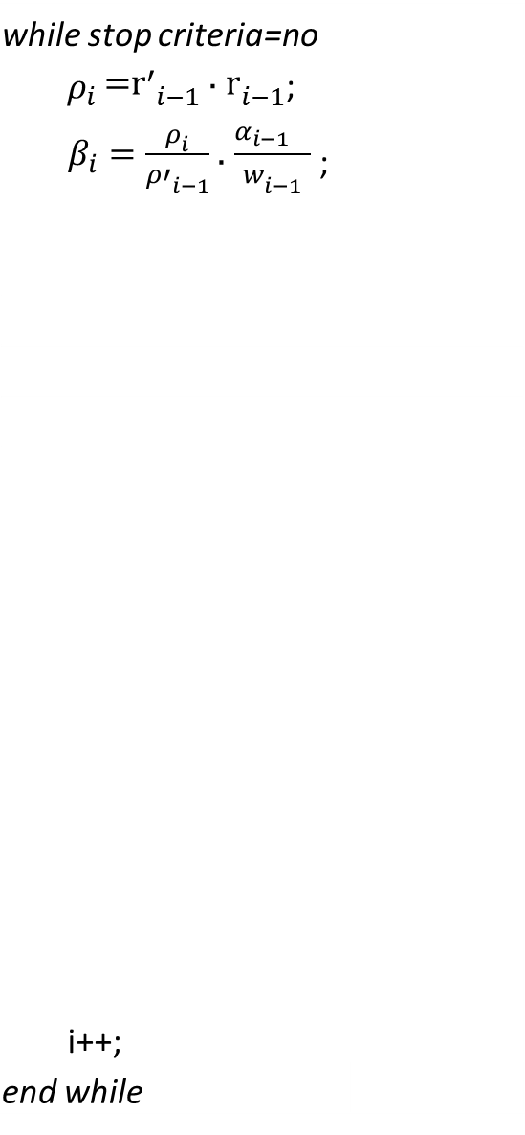





















$$BCG stabilized with fusion$$
$$BCG stabilized without fusion$$
$$Init i_th \text{Iteration}$$
$$β_{i}=\frac{ρ_{i}^{}}{{ρ′}_{i−1}^{}} ∙ \frac{{α_{i−1}}_{}^{}}{w_{i−1}^{}}$$
while stop criteria=no
${{ ρ}_{i }\text{=}\text{r}′}_{i−1}∙{\text{r}}_{i−1}$;
$β_{i}=\frac{ρ_{i}^{}}{{ρ′}_{i−1}^{}}$ $∙$ $\frac{{α_{i−1}}_{}^{}}{w_{i−1}^{}}$ ;
i++;
end while
$${\text{p}}_{i}={\text{r}}_{i−1}\text{+ (}{\text{p}}_{i−1} \text{−} {\text{v}}_{i−1}∙{\text{w}}_{i−1}\text{)}∙β_{i}$$
$${{\text{v}}_{i}\text{=}\text{Ap}}_{i}$$
$${\text{p}}_{i}={\text{r}}_{i−1}\text{+ (}{\text{p}}_{i−1} \text{−} {\text{v}}_{i−1}∙{\text{w}}_{i−1}\text{)}∙β_{i}\text{;}$$
${{\text{v}}_{i}\text{=}\text{Ap}}_{i}$;
$${aux\text{=}\text{r}′}_{i}∙{\text{v}}_{i}$$
${aux\text{=}\text{r}′}_{i}∙{\text{v}}_{i}$;
$α_{i}=\frac{ρ_{i}^{}}{aux}$
$α_{i}=\frac{ρ_{i}^{}}{aux}$ ;
$${\text{s}}_{i}={\text{r}}_{i−1}−α_{i}{∙ \text{v}}_{i}$$
${\text{s}}_{i}={\text{r}}_{i−1}−α_{i}{\text{v}}_{i}$;
$${\text{t}}_{i}=A {∙\text{s}}_{i}$$
${\text{t}}_{i}=A {∙\text{s}}_{i}$;
Fusion 1
$$aux={\text{t}}_{i}{∙s}_{i}$$
$$aux2={\text{t}}_{i}{∙t}_{i}$$
2dot
$aux={\text{t}}_{i}{∙s}_{i}$;
$aux2={\text{t}}_{i}{∙t}_{i}$;
$${{\text{w}}_{i}\text{=}\frac{aux}{aux2}}_{}$$
$${{\text{w}}_{i}\text{=}\frac{aux}{aux2}}_{}$$
Fusion 2
$${\text{x}}_{i}+={α_{i}\text{p}}_{i}{+ w}_{i}s_{i}$$
$${\text{r}}_{i}={\text{s}}_{i}− {\text{w}}_{i}{∙\text{t}}_{i}$$
2saxpy
${\text{x}}_{i}+={α_{i}\text{p}}_{i}{+ s}_{i}{\text{w}}_{i}$;
Fusion 3
${\text{r}}_{i}={\text{s}}_{i}− {\text{w}}_{i}{∙\text{t}}_{i}$;
$\text{∆}\text{=}\sqrt{{\text{r}}_{i}∙{\text{r}}_{i}}$;
$${ρ_{i+1}\text{=}\text{r}′}_{i}∙{\text{r}}_{i}$$
2dot
$\text{∆}\text{=}\sqrt{{\text{r}}_{i}∙{\text{r}}_{i}}$;
$$Stop Criteria?$$
no
$${{ρ′}_{i}\text{=}ρ}_{i}$$
$$Init (i+1)_th \text{Iteration}$$
yes
$$Stop$$
${\text{x}}_{i}=$ output

Slide 3



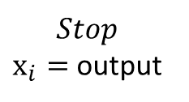



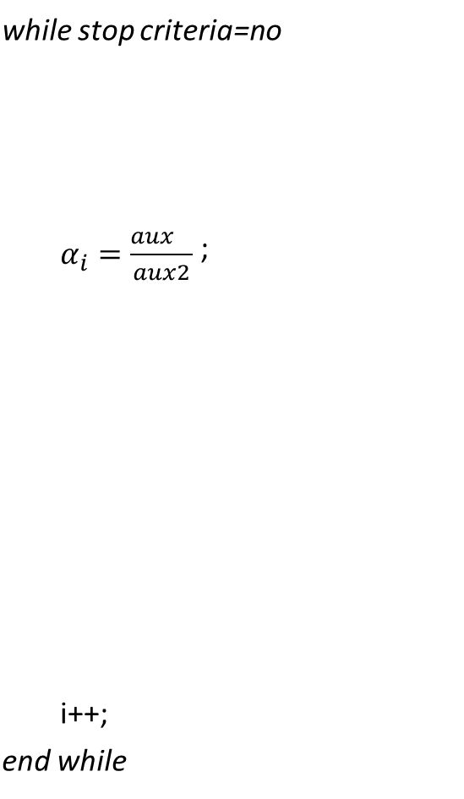














𝑪𝑮 𝒘𝒊𝒕𝒉 𝒇𝒖𝒔𝒊𝒐𝒏
$$Init i_th \text{Iteration}$$
$$CG without fusion$$
Fusion 1
$$aux={rT}_{i−1}^{}{∙ \text{r}}_{i−1};$$
aux2$={pT}_{i−1}^{}{∙\text{Ap}}_{i−1};$
2dot
while stop criteria=no
$α_{i}=\frac{{aux}_{}^{}}{aux2}$ ;
i++;
end while
$$aux={rT}_{i−1}^{}{∙ \text{r}}_{i−1};$$
$α_{i−1}=\frac{{aux}_{}^{}}{aux2}$ ;
aux2$={pT}_{i−1}^{}{∙\text{Ap}}_{i−1};$
Fusion 2
${\text{x}}_{i}={\text{x}}_{i−1}+α_{i}∙{\text{p}}_{i−1}$;
$${\text{r}}_{i}={\text{r}}_{i−1}{−α}_{i }{∙\text{Ap}}_{i−1};$$
2saxpy
$$aux2={rT}_{i}^{}{∙ \text{r}}_{i};$$
${\text{x}}_{i}={\text{x}}_{i−1}+α_{i}{∙ \text{p}}_{i−1}$;
$${\text{r}}_{i}={\text{r}}_{i−1}{−α}_{i}{ ∙\text{Ap}}_{i−1};$$
$β_{i}=\frac{aux2}{aux}$ ;
$$aux2={rT}_{i}^{}{∙ \text{r}}_{i};$$
$$\text{∆}\text{=}\sqrt{{\text{r}}_{i}∙{\text{r}}_{i}}$$
$${\text{p}}_{i}={\text{r}}_{i}+β_{i}{\text{p}}_{i}$$
Fusion 3
dot+saxpy
$β_{i}=\frac{aux2}{aux}$ ;
${\text{p}}_{i}={\text{r}}_{i}+β_{i}{\text{p}}_{i}$;
$$Stop Criteria?$$
$$Init (i+1)_th \text{Iteration}$$
$\text{∆}\text{=}\sqrt{{\text{r}}_{i}∙{\text{r}}_{i}}$;
yes
$$Stop$$
${\text{x}}_{i}=$ output

Slide 4
wi and vi are exachanged using communication with neighbors (meanwhile and after) SpMV
Vi first using synchronous comm
wi using asynchrounous comm
Dots are typically a binomial tree reduction with height log_2(P)
Processor idling during all reduce latency (not to scale)
P1
P2
P3
P4
exchage wi and v_i
+
+
+
+
+
+
2Saxpy 2Spmv dot reduction b-cast 3Saxpy 2dot reduction b-cast
Notes:
Sparse Matrix-Vector product (Only communication with neighbors, Good scaling)

Slide 5
Algorithm 2 Using multiple GPU devices and cores.
INPUT
numberCPUcores /* number of CPU cores to work in the problem*/
numberGPUs /* number of GPUs to work in the problem */
sizeGPU /* size of the work assigned to each GPU */
problemSize /* the total size of the problem, to be divided between CPU and GPU */
OUTPUT
/*Surface that better adjusts to the points in the dispersion diagram. An estimate elevation function of those points.*/
1: nthreads = numberCPUcores + numberGPUs;
2: sizeCPU = (problemSize-numberGPUs*sizeGPU)/numberCPUcores;
3: omp_set_num_threads(nthreads);
4: #pragma omp parallel
5: {
6: thread_id = omp_get_thread_num();
7 if(thread_id < numberGPUs) { /* GPU computing */
8: first = thread_id * sizeGPU;
9: cudaSetDevice(thread_id);
10: matrixGPU(thread_id, first, sizeGPU);
11: } else { /* CPU computing */
12: first = numberGPU*sizeGPU + (thread_id-numberGPU)*sizeCPU;
13: matrixCPU(thread_id, first, sizeCPU);
14: }
15: }

