Slide 1
Cache₁
Cache₂
Cache_{n}
P₁
P₂
P_{n}
BUS
RAM

Slide 2
Cache₁
Cache₂
Cache_{n}
RAM₁
RAM₂
RAM_{n}
P₁
P₂
P_{n}
Interconnection network

Slide 3
RAM
RAM
RAM
RAM
RAM
RAM
GPU₁
GPU₂
GPU₁
GPU₂
GPU₁
GPU₂
P₁
P₂
P_{n}
Core₁
Core₂
Core₁
Core₂
Core₁
Core₂
Core₃
Core₄
Core₃
Core₄
Core₃
Core₄
Cache₁
Cache₂
Cache_{n}
RAM₁
RAM₂
RAM_{n}
Interconnection network

Slide 4
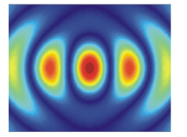
HPC techniques and architectures
MPI Communications
CUDA, OPENCL
RAM
RAM
RAM
RAM
RAM
RAM
GPU
Optimizations
GPU₁
GPU₂
GPU₁
GPU₂
GPU₁
GPU₂
P₁
P₂
P_{n}
C, C++,
OPENMP
C₁
C₂
C₁
C₂
C₁
C₂
C₃
C₄
C₃
C₄
C₃
C₄
Physical problem to simulate
CPU
Optimizations
Cache₁
Cache₂
Cache_{n}
RAM₁
RAM₂
RAM_{n}
Interconnection network

Slide 5
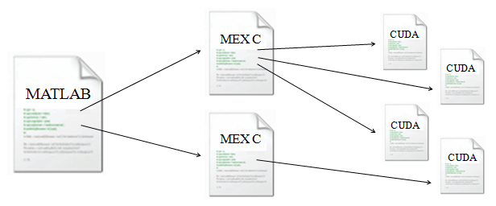
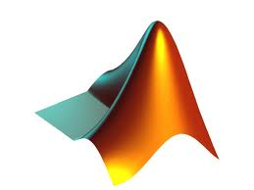

Physical problem to simulate
MATLAB
GPU₁
Mex-file
GPU₂
P₁
C₁
C₂
C₃
C₄
Mex-file

Slide 6
P₁
C₁
C₂
C₉
C₁₀
MATLAB
C₃
C₄
C₁₁
C₁₂
C₅
C₆
C₁₃
C₁₄
Mex-file
C₇
C₈
C₁₅
C₁₆
NSGA-II
Mex-file
GPU₂

Slide 7
CUDA
MPI Communications
RAM
RAM
RAM
RAM
GPU₁
GPU₂
GPU₁
GPU₂
Problem
to simulate
Node 1
Node n
C₁
C₂
C₁
C₂
C
C₃
C₄
C₃
C₄
Cache₁
Cache_{n}
I/O
system
RAM₁
I/O
system
RAM_{n}
Interconnection network

Slide 8
CUDA
MPI Communications
RAM
RAM
RAM
RAM
GPU₁
GPU₂
GPU₁
GPU₂
Node 1
Node 4
…
C₁
C₁
…
C
C₁₆
C₄
Cache₁
Cache_{n}
I/O
system
RAM₁
I/O
system
RAM_{n}
Interconnection network

Slide 9
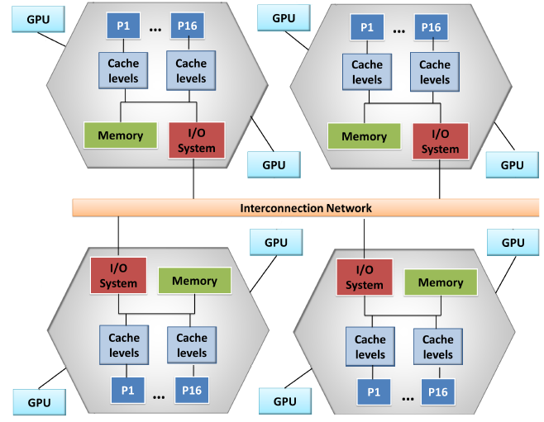

Slide 10
Gflop/s(AI) = min
Peak Gflop/s
StreamBW * AI
64
32
peak floating-point
performance
16
Peak memory
bandwidth (stream)
8
attainable GFlop/s
4
Operational Intensity 1
(memory-bound)
Operational Intensity 2
(compute-bound)
2
1
¹/₂
¹/₄
¹/₂
1
2
4
8
16
Operational Intensity (Flops/Byte)

