Slide 1
Analysis of Big Data Job postings
CS5530- Principles of Data science
University of Missouri-Kansas City
Harika Thippireddy(16328121)
Sathvik Reddy Anumasu(16336266)
Gopi Venkata Sudheer Arikatla(16336237)
Durga Akhila Bhuvaneshwari Eripina(16342213)

Slide 2
Abstract
Examining the challenge that human resources departments face globally in locating exceptional talent in the field of big data. By conducting a big data analysis on online job postings, valuable information can be extracted.
Identifying distinct Big Data work families, persistently in-demand skill clusters, and job family-level competency requirements for each skill set.
Implementing machine learning methodologies, such as k-nearest Neighbours, Linear Regression, Ridge Regression, Lasso Regression, and Logistic Regression, among others, are utilised.
Comprises fictitious work class criteria in addition to specific attributes such as job family identification number, job class identification number, job description, education, experience, organisational impact, problem-solving capability, degree of supervision, degree of communication, financial constraints, and pay grade in numerical form.
Leveraging the statistical attributes of large-scale data sets to enable human resources departments to make more deliberate and well-informed hiring choices.
By employing various models, including the Random Forest Classifier, k-nearest Neighbours, Linear Regression, Ridge Regression, Lasso Regression, and Logistic Regression, a comprehensive evaluation of the dataset can be achieved.
It illuminates the correlation between job characteristics and salary tiers, thereby facilitating comprehension and prediction of compensation for diverse categories of positions.
Notes:
In this research, we look into the global challenge faced by HR in finding the best people for big data jobs. Our approach involves checking job ads online, gathering useful information, and identifying key job categories and skills. To predict salaries, we use smart computer methods like regression models and k-nearest neighbors, even considering some made-up factors. Thanks to this detailed study, HR teams can now easily find the right people for big data jobs by matching job requirements to suitable salary levels.
.

Slide 3

Problem Statement
The study proposes a solution to the global challenge HR departments face in identifying the most qualified candidates for big data projects: employ a big data strategy, analyse online job postings, and utilise machine learning algorithms to predict salary grades according to job characteristics.
Notes:
This research helps companies worldwide in Human Resources by making it easier to find the best candidates for big data jobs.

Slide 4
Introduction
Human resources departments face a significant international obstacle in the form of locating exceptional personnel for the swiftly growing field of big data. This hinders the effective management of the workforce.
Based on an analysis of several online job listings, this introduction proposes a course of action employing advanced machine learning techniques in tandem with a Big Data initiative.
The primary goals of this project are to identify different types of Big Data work families, identify persistent skill sets that are in great demand, and detail the competencies needed for each kind of skill set at the level of the job family.
Human resources departments have the potential to enhance their recruitment procedures through the utilisation of statistical attributes of Big Data. This would enable them to identify candidates who possess the necessary qualifications for job openings in Big Data.
Among the made-up characteristics for job classes included in the dataset are job family and class IDs, level of education, years of experience, organisational influence, problem-solving abilities, level of supervision, communication, budgetary constraints, and pay grades.
This task aims to generate pay grades numerically and designate pay-level alphanumeric titles, thereby providing a practical instrument for understanding and forecasting compensation for various job categories.
Notes:
This introduction focuses on the worldwide problem in Human Resources: finding excellent professionals for big data jobs. It suggests using both big data and machine learning to study job ads online. The main goals of the project are to explain skills, spot wanted talents, and define groups of big data jobs. The statistics in the dataset help HR recruiters by giving them specific pay levels and names for different job categories.

Slide 5
Objective
To explore distinct Big Data work families by examining online job postings.
To identify enduring aggregations of exceedingly desirable Big Data competencies.
To specify the prerequisites for each identified skill set at the level of competency for the job family.
To demonstrate the necessary resources to engage in more informed and reflective candidate selection processes for Big Data positions.
To offer valuable insights for compensation predictions, construct a model that utilises machine learning techniques to depict the correlation between numerical pay grades and job attributes.
Notes:
By checking job websites, we will make a list of different types of big data jobs, figure out which skills are highly wanted, and set standards for those skills. Using machine learning will make it better at picking the right applicants for big data jobs and predicting their salaries.

Slide 6
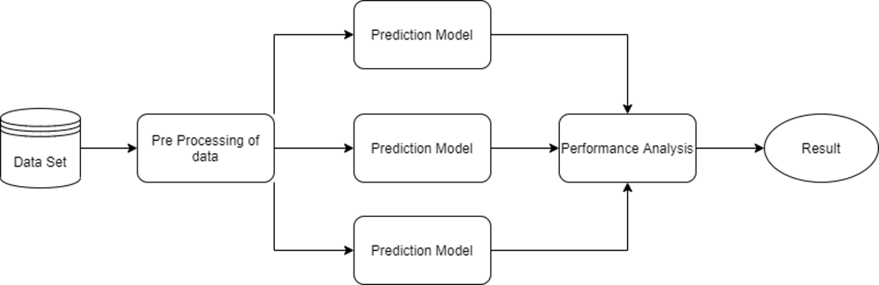
Conceptual Diagram
Notes:
Compatibility detection, analysis of online job postings, and machine learning for salary forecasts are depicted in the conceptual diagram as interdependent components of our method. A graphical depiction of the all-encompassing strategy to enhance human resources processes within the framework of big data is also presented.

Slide 7
Data Set
Fictional job class specifications extracted from online job postings are utilised to generate the dataset.
The utilisation of distinct identifiers for each record in the compilation enables the monitoring and examination of individual data points.
Includes the description and job family ID, which provides a framework for classifying the different occupations in the collection.
The job description and class ID are included, furnishing specific information regarding the characteristics of the position.
The numerical pay grade assigned to each job class provides a measurable indication of the remuneration linked to specific positions.
Several elements contribute to the increased comprehensiveness of the dataset, encompassing educational attainment, professional experience, organisational influence, aptitude for problem-solving, level of supervision, communication proficiency, and financial limitations.
The dataset comprises a multitude of attributes that are utilised as input variables by machine learning algorithms in order to predict pay grades.
A unique alphanumeric name is assigned to each job class in order to provide greater meaning to the remuneration system.
The primary purpose of the dataset is to facilitate algorithmic approaches in machine learning, specifically in elucidating the relationship between job attributes and pay grades.
Enables human resources departments to assess and make informed decisions about compensation and recruiting practices by providing a thorough grasp of job requirements.
Notes:
Each item in this dataset has a unique identifier, and the data comes from made-up job classes found in online job ads. By include crucial elements like the family ID, pay grades in numbers, and job description, it adds to the whole information. These variables education, experience, and organisational influence can be used as machine learning algorithm inputs to facilitate pay grade prediction. Alphanumeric identifiers assigned to the job classifications enhance the interpretability of the dataset, thereby empowering human resources departments to make more informed decisions regarding hiring and compensation.

Slide 8
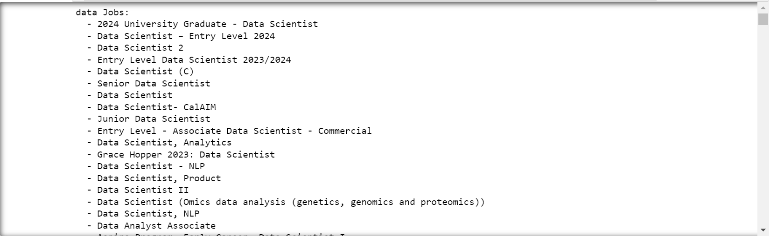
Task - 1 Identify various Big Data job families in the given dataset

Slide 9
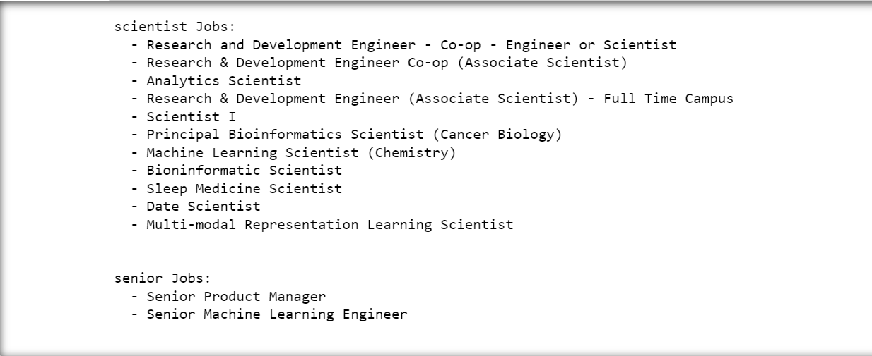

Slide 10
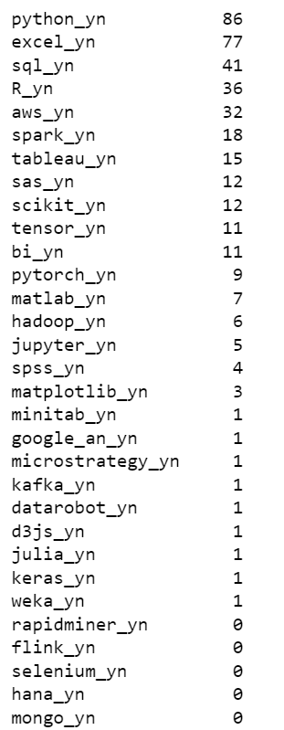
Task - 2 Identify homogeneous groups of Big Data skills that are highly valued by companies

Slide 11
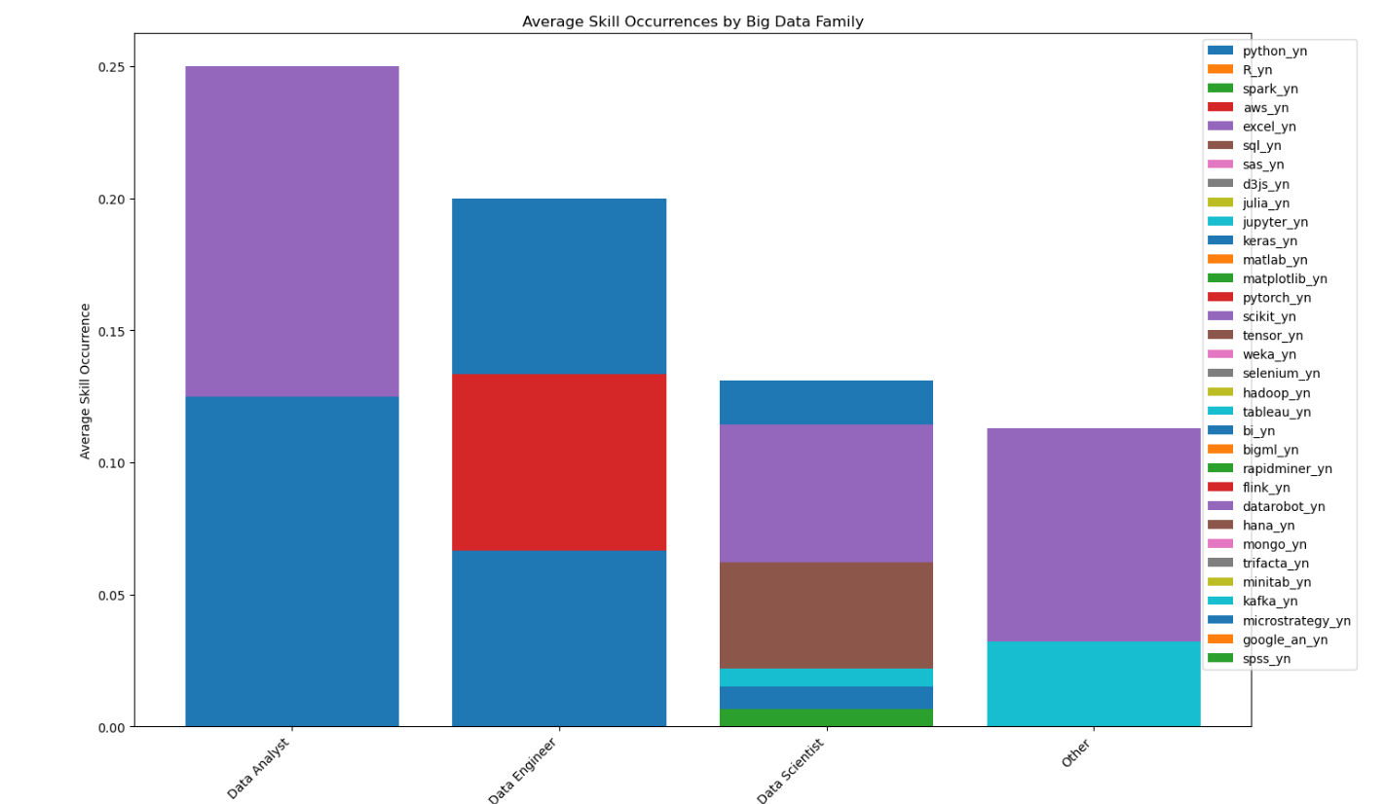
Task – 3 Characterize each Big Data job family according to the level of competence required for each Big Data skill set

Slide 12
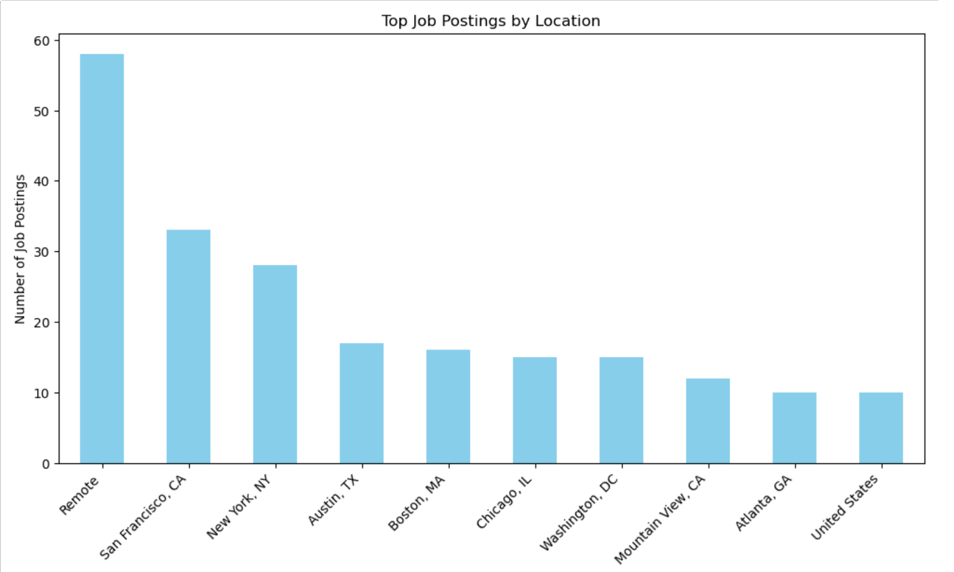
Job Postings by Location

Slide 13
Conclusion
The Big Data Talent Analytics project, in conclusion, offers an in-depth response to the problems that human resources has while hiring for Big Data jobs.
The project successfully differentiates between various employment families, unearths highly sought-after skill sets, and characterizes each task according to the required competence levels by utilizing sophisticated data analysis approaches.
The Human Resources team is finally able to arrive at better judgments because of the useful information furnished by interactive visualizations and a suggestion engine, which enhance the effectiveness and efficacy of Big Data HR procedures.
By putting talent acquisition methods closer to the dynamic requirements of the changing Big Data job market, this initiative represents a major step forward.
Provided valuable data for salary projections, enhanced employment processes, and human resources decisions.
Utilising innovative methods, the study tackled the global human resources issue of acquiring big data talent.
Notes:
Utilising innovative methods, the study tackled the global human resources issue of acquiring big data talent. Work families, critical skills, and competence criteria were ascertained through an analysis of online job advertisements and the implementation of diverse machine learning algorithms. Model assessments evaluated the accuracy of predictions, whereas visualisations presented a concise synopsis. The results facilitate HR decision-making, enhance recruiting processes, and forecast compensation. Additionally, they offer valuable insights for navigating the dynamic market of talent acquisition for big data. The Big Data Talent Analytics project, in conclusion, offers an in-depth response to the problems that human resources has while hiring for Big Data jobs. The project successfully differentiates between various employment families, unearths highly sought-after skill sets, and characterizes each task according to the required competence levels by utilizing sophisticated data analysis approaches. The Human Resources team is finally able to arrive at better judgments because of the useful information furnished by interactive visualizations and a suggestion engine, which enhance the effectiveness and efficacy of Big Data HR procedures. By putting talent acquisition methods closer to the dynamic requirements of the changing Big Data job market, this initiative represents a major step forward.

Slide 14
References
Hariri, R.H., Fredericks, E.M. and Bowers, K.M., 2019. Uncertainty in big data analytics: survey, opportunities, and challenges. Journal of Big Data, 6(1), pp.1-16.
Sestino, A., Prete, M.I., Piper, L. and Guido, G., 2020. Internet of Things and Big Data as enablers for business digitalization strategies. Technovation, 98, p.102173.
Brown, P. and Souto-Otero, M., 2020. The end of the credential society? An analysis of the relationship between education and the labour market using big data. Journal of Education Policy, 35(1), pp.95-118.
Ikotun, A.M., Ezugwu, A.E., Abualigah, L., Abuhaija, B. and Heming, J., 2023. K-means clustering algorithms: A comprehensive review, variants analysis, and advances in the era of big data. Information Sciences, 622, pp.178-210.
Reddy, G.T., Reddy, M.P.K., Lakshmanna, K., Kaluri, R., Rajput, D.S., Srivastava, G. and Baker, T., 2020. Analysis of dimensionality reduction techniques on big data. Ieee Access, 8, pp.54776-54788.
Deepa, N., Pham, Q.V., Nguyen, D.C., Bhattacharya, S., Prabadevi, B., Gadekallu, T.R., Maddikunta, P.K.R., Fang, F. and Pathirana, P.N., 2022. A survey on blockchain for big data: Approaches, opportunities, and future directions. Future Generation Computer Systems, 131, pp.209-226.
Dai, H.N., Wang, H., Xu, G., Wan, J. and Imran, M., 2020. Big data analytics for manufacturing internet of things: opportunities, challenges and enabling technologies. Enterprise Information Systems, 14(9-10), pp.1279-1303.

Slide 15
Thank You

