Slide 1
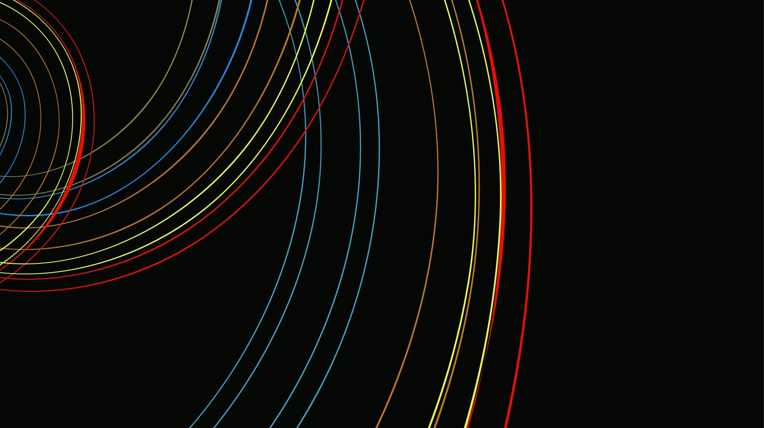
Generative Adversarial Nets
Created by Ian Goodfellow, Jean Pouget-Abadie, Mehdi Mirza, Bing Xu, David Warde-Farley, Sherjil Ozair, Aaron Courville, Yoshua Bengio.
Presented by Arijit Ganguly and Sindhuja Reddy
Notes:
Hi Everyone,
Today, Sindhuja and I , Arijit , will be presenting Generative Adversarial Nets by Ian Goodfellow and his team. This framework was invented by Ian Goodfellow in a bar in Montreal. If someone asks you proof for the positive affects of alcohol, this is it. This is a fairly advanced framework, so let me start by giving a background on the this framework.

Slide 2

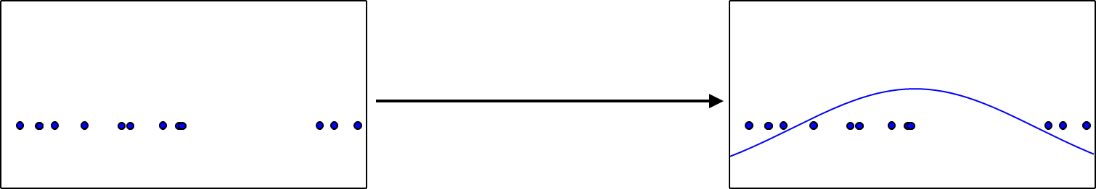
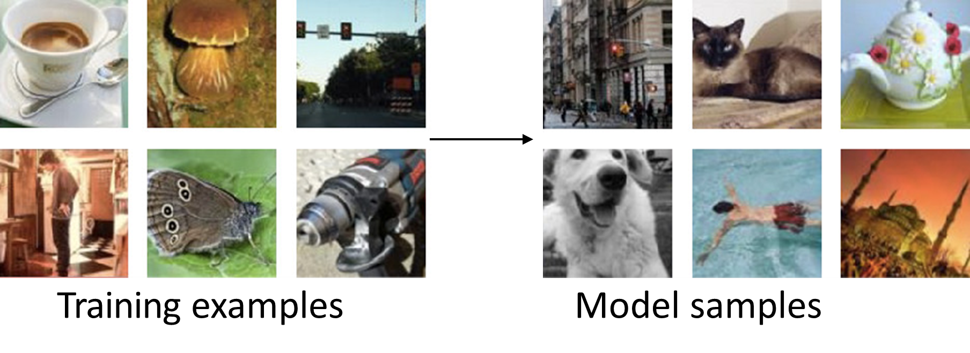
Generative Modelling
Density estimation
Models that can generate new data instances
Applications:
Take a bunch of points and infer a density function that describes probability distribution
Use some training examples to generate more examples from the same distribution
Sample generation
Notes:
As mentioned in the name, this is a one of the Generative models. What is generative modelling? Simply put machine learning models that can generate new instances of data from previous instances are called the Generative Modelling. It can be applied to real life projects in 2 ways – First is to use a density function that describes probability function. Second to use existing training examples to generate more examples from the same distribution.

Slide 3
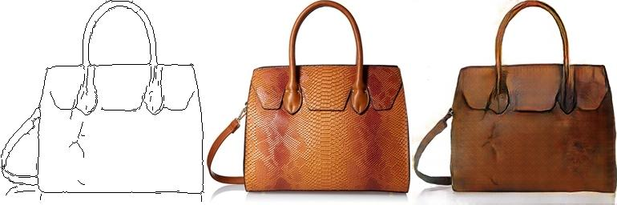
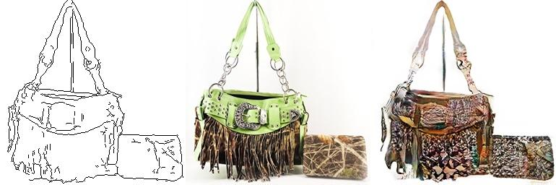
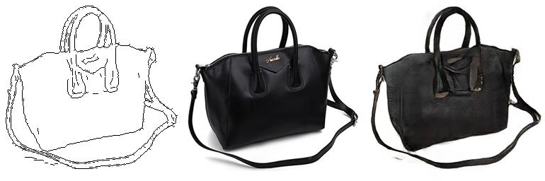
Why Generative Modelling?
Taking sketches and turning them into photos
Ability to handle missing data
Multi-nodal operations
Simulate possible futures
Notes:
You must be asking, if we have so much data that is being generated, why create more data that is obviously not real data? I can assure you from experience of working on SAP systems, there is always going to be missing data. Generative models provide the ability to handle missing data. It gives Multi-nodal operations which means one input can have many answers. In the stock markets, if you use a linear regression to get price points, you will lose money. It is always better to get a range. Another reason for using Generative models is that they can simulate possible future outcomes. This is why generative models are so popular.

Slide 4
Adversarial Training
Phrase whose usage is in flux
An agent playing against a copy of itself in a board game
Usage in paper: Training in worst case scenario, with inputs chosen by an adversary
Training Neural Networks on Adversarial examples
Notes:
Moving on to what adversarial means. This phrase has had a lot of meaning over time. Before it was used to refer to models that would be trained on adversarial examples and then predict. Now it can be used with examples like an agent playing a game with itself like Samuel’s checker’s player in the 1950. In the context of this paper , Generative Adversarial Networks, it is used where there are 2 players and both of them are neural networks. Combining both these frameworks, Generative Models and Adversarial Training, we get Generative Adversarial Nets.

Slide 5
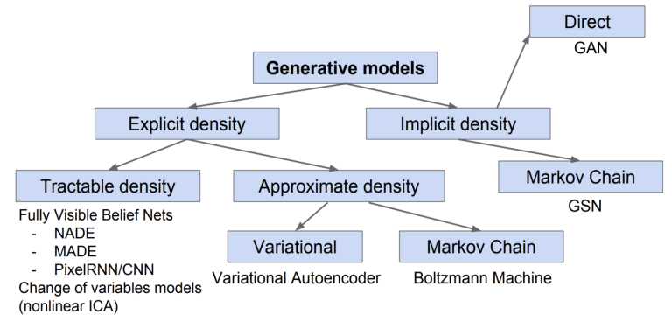
Taxonomy of Generative Models
Implicit density based generative model
Explicit density – estimates true probability density function
Implicit density – Generates function that can draw samples from the true distribution
Notes:
This is the taxonomy of for the Generative models. Generative Adversarial Nets are a type of Implicit density based Generative model. What it means is that it generates a function that draw samples from the true distribution.

Slide 6
Generative Adversarial Networks
Generative model pitted against a Discriminative Model
Discriminative model learns to determine actual data and data generated from distribution
Police and Counterfeiters example
Both players are neural networks
Worst case input for one network is produced by another network

Slide 7
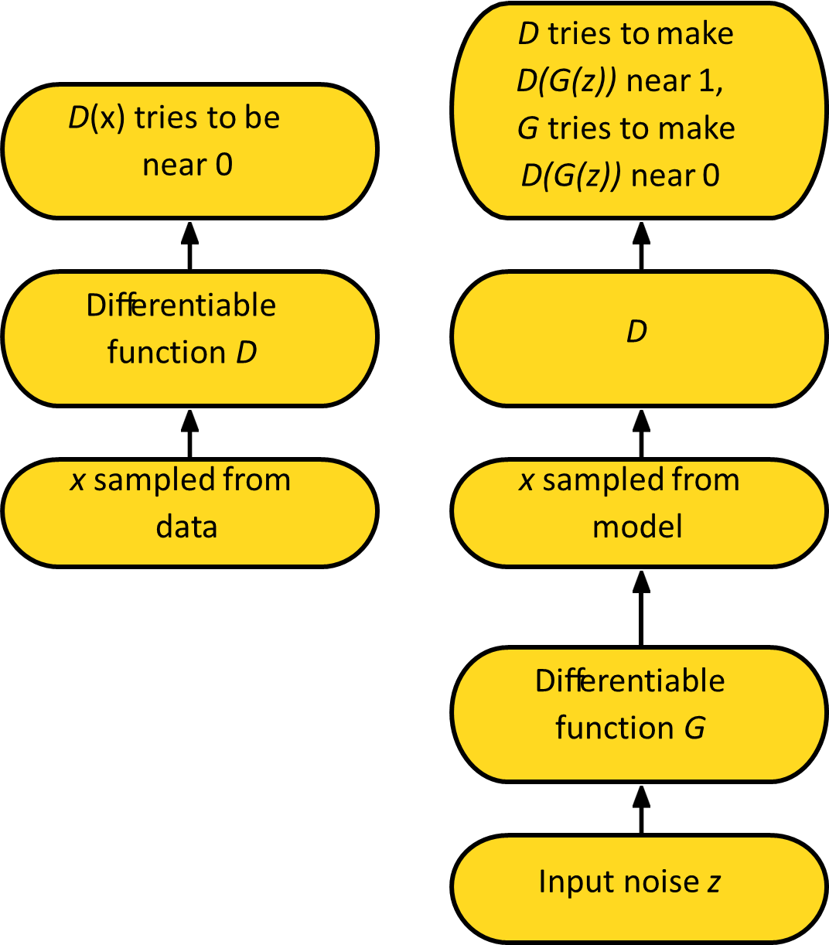
Adversarial Nets Framework
D – Discriminator Function
G – Generative model
Training procedure of G is to maximize the probability of D making a mistake.
Accomplished using Minmax Game

Slide 8
Generator Network
x = G(z; θ_{g})
Must be differentiable
No invertibility requirement
Trainable for any size of z
Some guarantees require z to have higher dimension than x
Can make x conditionally Gaussian given z but need not do so

Slide 9

Minimax Game
In other words, D and G play the following two-player minimax game with value function V (G, D):
Equilibrium is a saddle point of the discriminator loss
Resembles Jensen-Shannon divergence
Generator minimizes the log-probability of the discriminator being correct

Slide 10
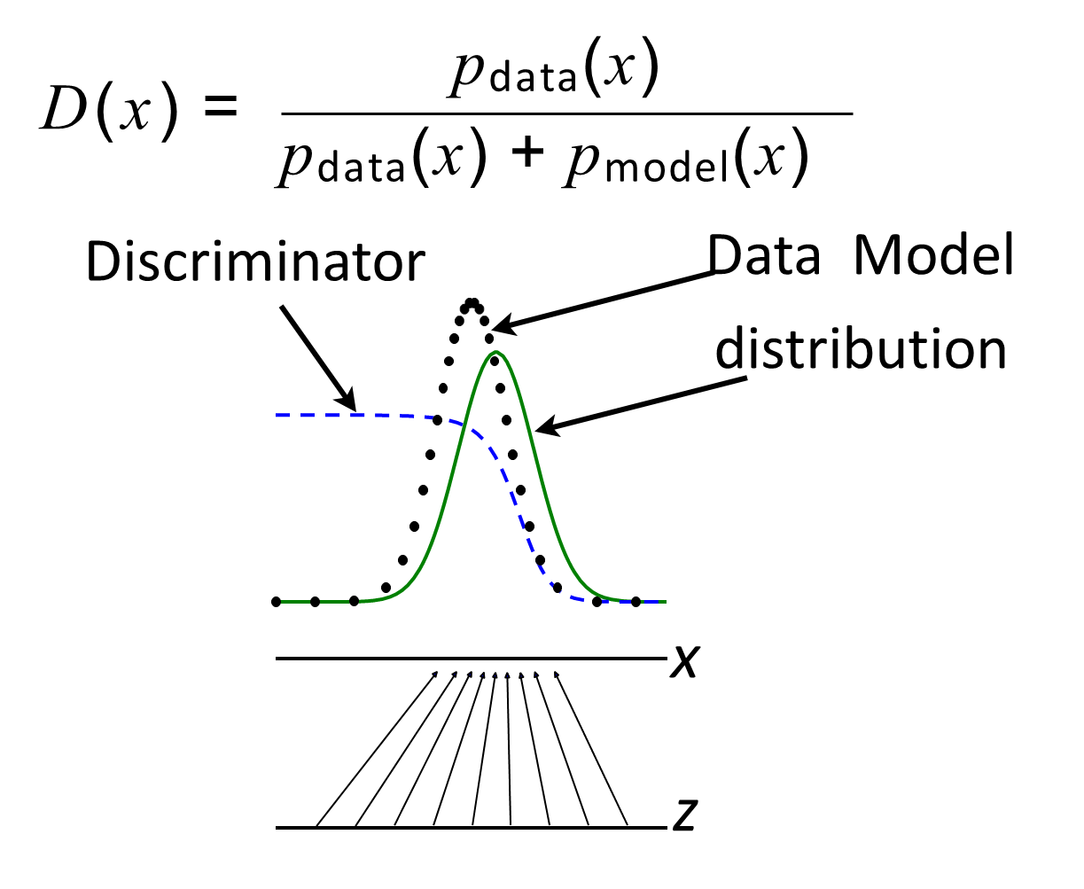
Discriminator Strategy
Estimating this ratio using supervised learning is the key approximation mechanism used by GANs

Slide 11
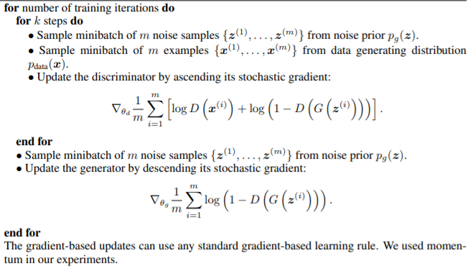
Algorithm Used

Slide 12


Proposition 1
For G fixed, the optimal discriminator D
The training criterion for the discriminator D, given any generator G, is to maximize the quantity V (G, D)

Slide 13

Proposition 2
If G and D have enough capacity, and at each step of Algorithm 1, the discriminator is allowed to reach its optimum given G, and p_{g} is updated so as to improve the criterion.
Then P_{g} converges to P_{data}

Slide 14
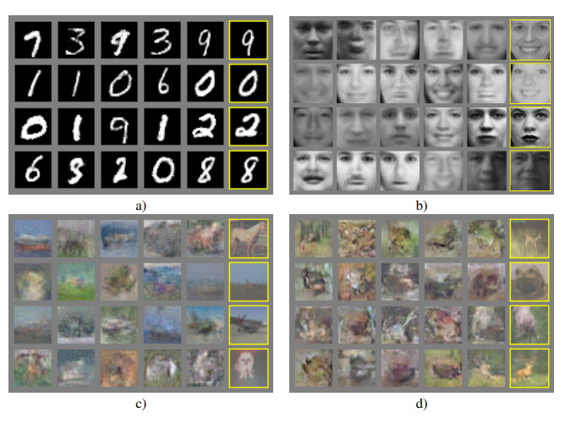
Experiments
Notes:
MNIST dataset
TFD dataset
CIFAR-10 -> fully connected model
CIFAR-10 -> Convolutional discriminator and “deconvolutional” generator

Slide 15
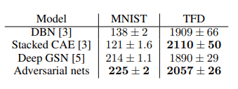
Experiment Results
Parzen window based log likelihood estimates
DBN – Deep Belief Networks
Stacked CAE – Stacked contractive auto-encoder
Deep GSN – Deep Stochastic Networks
Notes:
Since we are generating samples and there is no Y labels to cross reference against, the team has used Parzen window based log likelihood estimates to calculate the likelihood of the generated data. The comparison is between multiple generative models. For MNIST data, they have taken the distribution over the whole sample set meanwhile for the TFD set they have calculated the estimates across the folds of the dataset
Deep Belief Networks
Stacked Contractive Auto-Encoder
Deep Generative Stochastic Networks.
You can see that the Adversarial nets provide the best likelihood estimates except on TFD where Stacked CAE outperforms by a bit. However the std error is much lower on Adversarial nets.

Slide 16
Advantages of GANs
Use of Latent code – unlike fully visible belief nets
Asymptotically consistent – Advantage over variational methods
No Markov Chains needed
Often regarded as producing the best samples
Notes:
Now, let me provide why at all to use Generative Adversarial Networks? Use of Latent code, which is basically transforming our input space into latent space that allows dimension reduction. Unlike Fully visible belief nets, we can have reduces number of features. To provide an example, Imagine running this model for 4K image, which basically has over 4000 pixels, each of these pixels become a feature in your NN. Training all these features will require a very high compute power.
Second advantage is that GANs are asymptotically consistent, when we solve the minmax game for this network, it is guaranteed that we have the distribution that is equal to the sample distribution.
Third advantage is that GANs do not require the Markov chains. They tend to hold back Boltzmann machines because methods based on Boltzmann machines require that the distribution be somewhat blurry in order for the chains to be able to mix between modes. This is the primary motivation for the team to invent GANs.
Fourth would be because of the multi-nodal output, we can get multiple local minimas, which is usually the case for a lot of machine learning scenarios. This provides confidence to the users of GANs model and is regarded as producing the best samples.

Slide 17
Limitations
Cannot model discrete data
No method to check if the generated samples are better than other methods.
Produces higher variance
Does not perform well in high dimensional spaces
There is no explicit representation of p_{g}(x) – probability distribution of x samples
D must be synchronized well with G during training
Notes:
As is everything in life, GANs have their limitations.
Cannot model discrete data (require differentiation through the visible units)
As they are used majorly for images, there is no way prove the generated samples are better than those produced by other models
Produces a higher variances
Because of this higher variance, it does not perform well in the high dimensional spaces. However, the use of latent code or latent space can reduce the affects of this limitation
No explicit representation of probability distribution of x
Discriminator D must be well in sync with Generator G during the training process as this is an adversarial system.

Slide 18
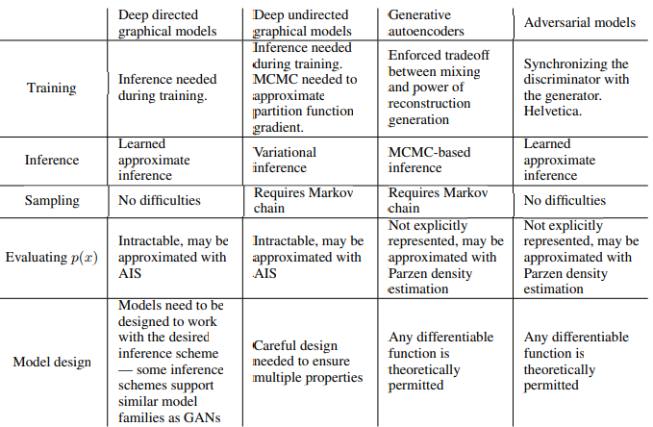
Comparison of Challenges with Other Frameworks
Notes:
Moving on to the challenges that various algorithms face in various stages of the ML lifecycle.

Slide 19
References
Introduction to GANs - Ian Goodfellow – OpenAI
Generative Adversarial Nets Research paper
Ian Goodfellow - GANs – Github
Parzen window explanation reference link
Better Mixing via Deep Representations - Reference Paper
Notes:
If you would like to understand more about the Generative Adversarial Nets, we have added some links in our presentation that gives the background around GANs

Slide 20
Thank you!

