Slide 1

Generative Adversarial Nets
Created by Ian Goodfellow, Jean Pouget-Abadie, Mehdi Mirza, Bing Xu, David Warde-Farley, Sherjil Ozair, Aaron Courville, Yoshua Bengio.
Presented by Arijit Ganguly and Sindhuja Reddy

Slide 2
Generative Modeling
Models that can generate new data instances
Applications:
Take a bunch of points and infer a density function that describes probability distribution
Use some training examples to generate more examples from the same distribution

Slide 3

Adversarial Training
Phrase whose usage is in flux
An agent playing against a copy of itself in a board game
Usage in paper: Training in worst case scenario, with inputs chosen by an adversary
Training Neural Networks on Adversarial examples

Slide 4
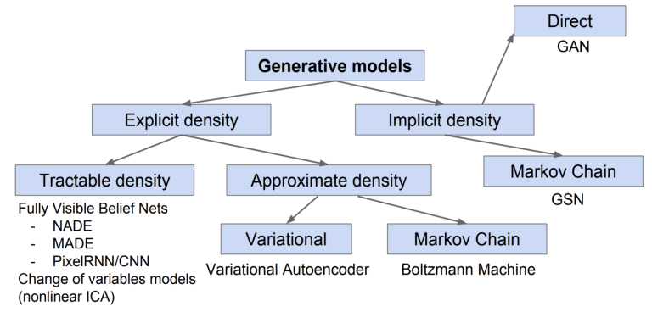
Taxonomy of Generative Models
Implicit density based generative model

Slide 5
Generative Adversarial Networks
Generative model pitted against a Discriminative Model
Discriminative model learns to determine actual data and data generated from distribution
Police and Counterfeiters example
Both players are neural networks
Worst case input for one network is produced by another network

Slide 6
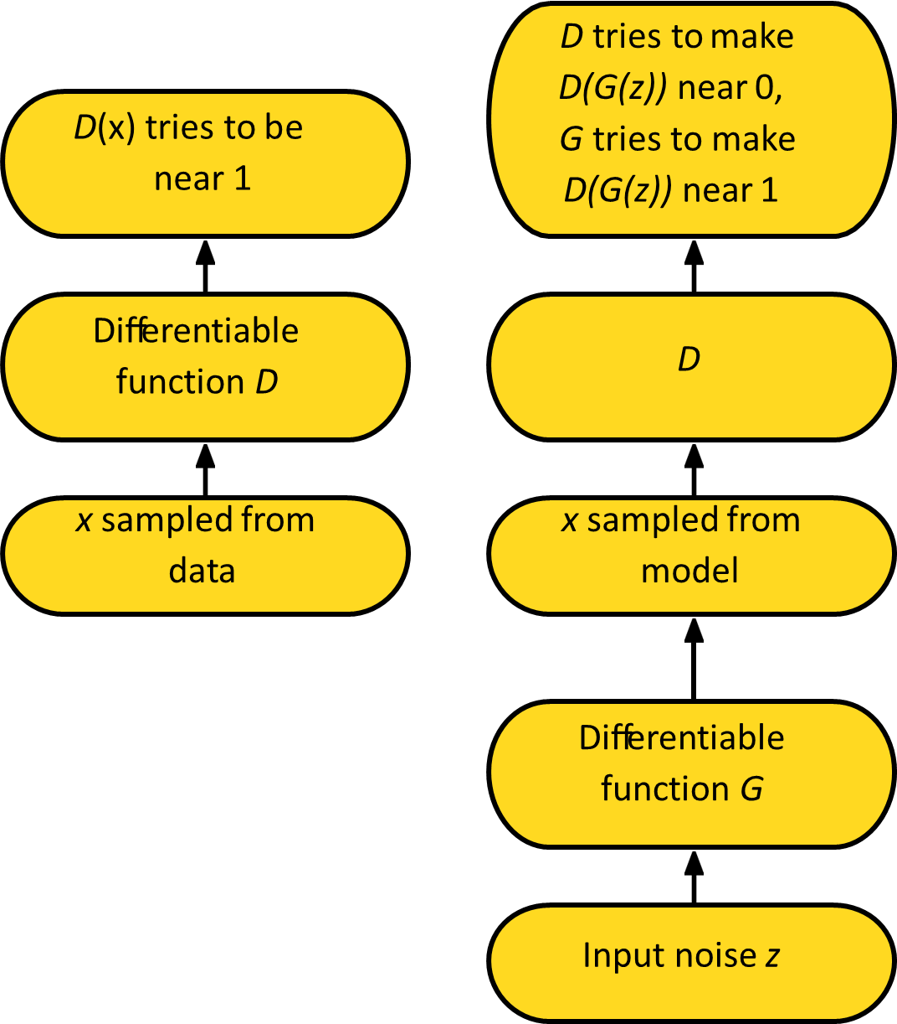
Adversarial Nets Framework
D – Discriminator Function
G – Generative model
Training procedure of G is to maximize the probability of D making a mistake.
Accomplished using Minmax Game

Slide 7
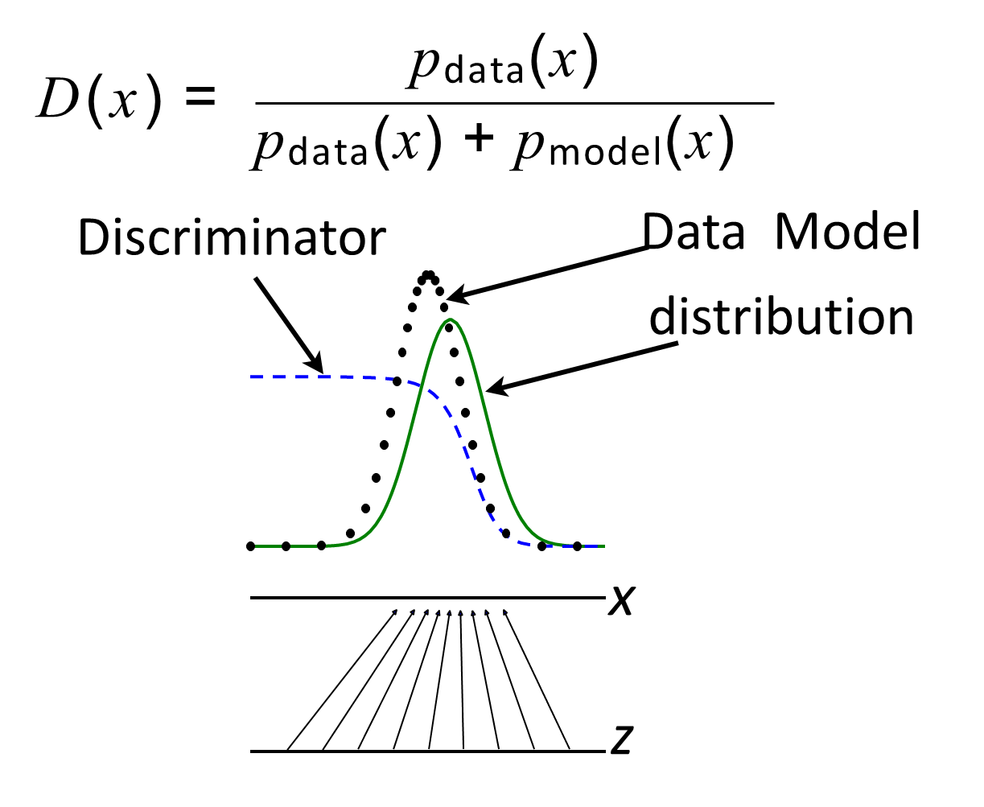
Discriminator Strategy
Estimating this ratio using supervised learning is the key approximation mechanism used by GANs

Slide 8
Advantages
Use of Latent code – unlike fully visible belief nets
Asymptotically consistent – Advantage over variational methods
No Markov Chains needed
Often regarded as producing the best samples

Slide 9
Comparison with Other Frameworks

Slide 10
Thank you!

