Slide 1
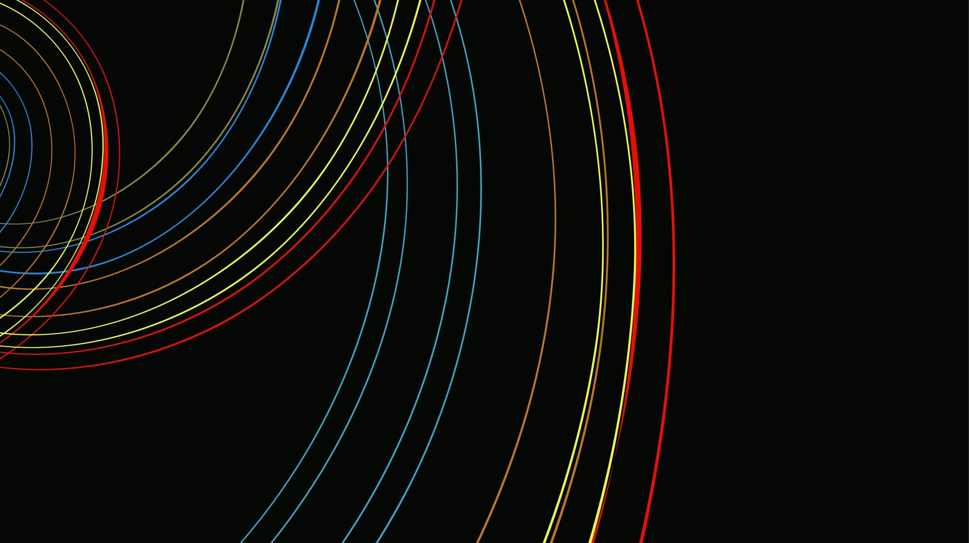
Generative Adversarial Nets
Created by Ian Goodfellow, Jean Pouget-Abadie, Mehdi Mirza, Bing Xu, David Warde-Farley, Sherjil Ozair, Aaron Courville, Yoshua Bengio.
Presented by Arijit Ganguly and Sindhuja Reddy

Slide 2
Generative Modeling

