Slide 1
TensorFlow
Created By:
Arijit Ganguly
1001871460
Notes:
Hi All,
I am here today to help you to understand TensorFlow. It was originally only a library for Python built by Google to allow everyday developers to build Machine Learning models for solving their everyday problems. It is now a platform that can be used for various machine learning models working in sync with other Platforms as well.
TensorFlow APIs are based on the Keras API standard for defining and training neural networks. (In case, you don’t know what Keras is, it is a deep learning library developed by Google with ability to switch out back end – Use TensorFlow, or Theano or CNTK , Microsoft’s Cognitive Toolkit)

Slide 2
What is TensorFlow?
End-to-end Open Source Platform for Machine Learning
Uses Keras API standard for TF neural networks
Used by many companies – Airbnb, Airbus, GE Healthcare
Airbnb – Use images posted by vendors to guide a user on their search journey by extracting information from the images.
Airbus – Use Satellite Images to deliver valuable insights to their clients
GE Healthcare – They have trained a Neural Network anatomy on MRIs
Unique Personal Projects – Piano Assistant,
Notes:
Google defines TensorFlow as their End-to-end Platform for Machine Learning. Many big companies like Airbnb, Airbus, GE healthcare use TensorFlow to analyse data and build Machine Learning models for them. A few of the case studies include –
Airbnb – Uses photos to guide the guest’s search journey on the website. It finds information that is conveyed in the images and uses that to optimize searches. They also use Generative ML models like creating new labels by using existing image labels for unlabelled images. They are known to use a ResNet50 for their image classification which is a 50-layer deep Convolutional Neural Network.
Airbus – Uses Satellite Images to deliver valuable insights to clients
GE Healthcare – They have trained a neural network using TensorFlow to identify the anatomy on MRIs.
People have also created unique projects of their own using TensorFlow like the Piano Assistant which listens to the tune you play on your piano and plays complementary notes to it

Slide 3
How can we use TensorFlow?
TensorFlow can be used in the below mentioned configurations:
Computer – Python : as a TensorFlow library
Web Applications – TensorFlow.js
Mobile – TensorFlow Lite
Notes:
As I mentioned earlier TensorFlow can be used with other platforms as well. The most used one is the Python Package – install on a system or a server and we can start using it.
The second one is the TensorFlow.js which allows to integrate ML models in the front end and back end of web applications.
TensorFlow Lite allows to run ML model on the mobile phones directly. We can train the models on servers or computers and deploy said models on mobile phones.

Slide 4
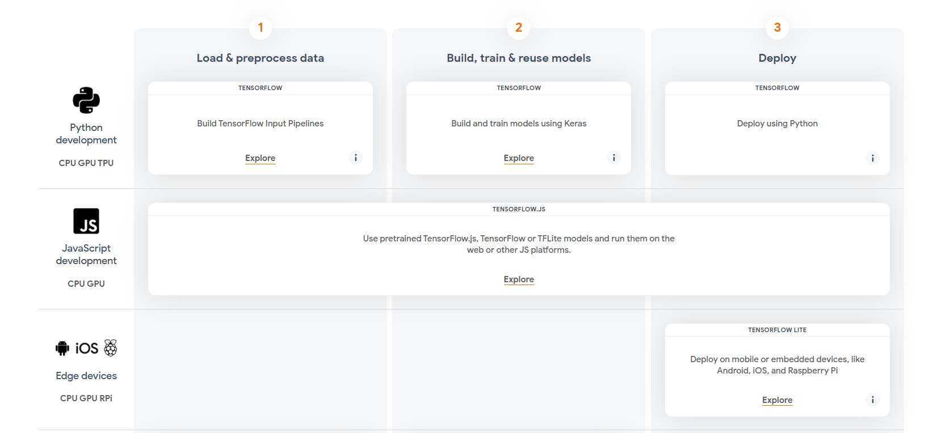
Variations Available

Slide 5
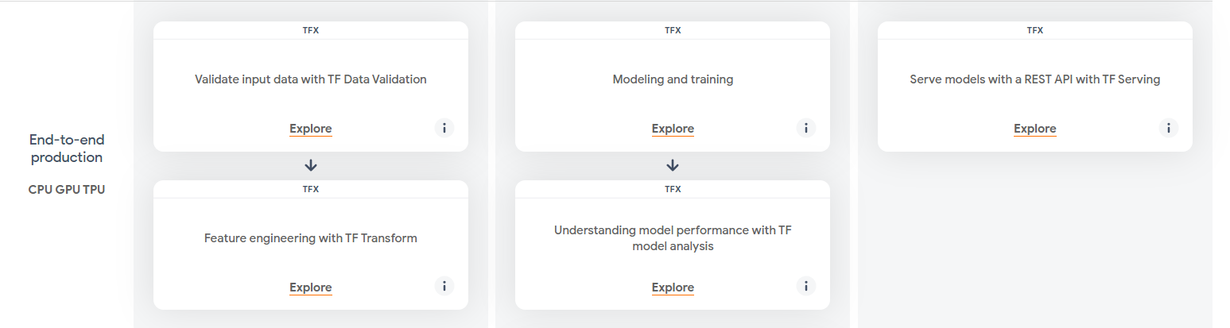
TensorFlow for Production
Notes:
If you are working in a company or doing research using TensorFlow, most likely you will be using the TensorFlow for Production. Obviously, this is much more advanced than deploying on the library on your computers as it supports.
Input Validation
Feature Engineering
Model and Training’
Model Analysis
Serve Models with a REST API

Slide 6
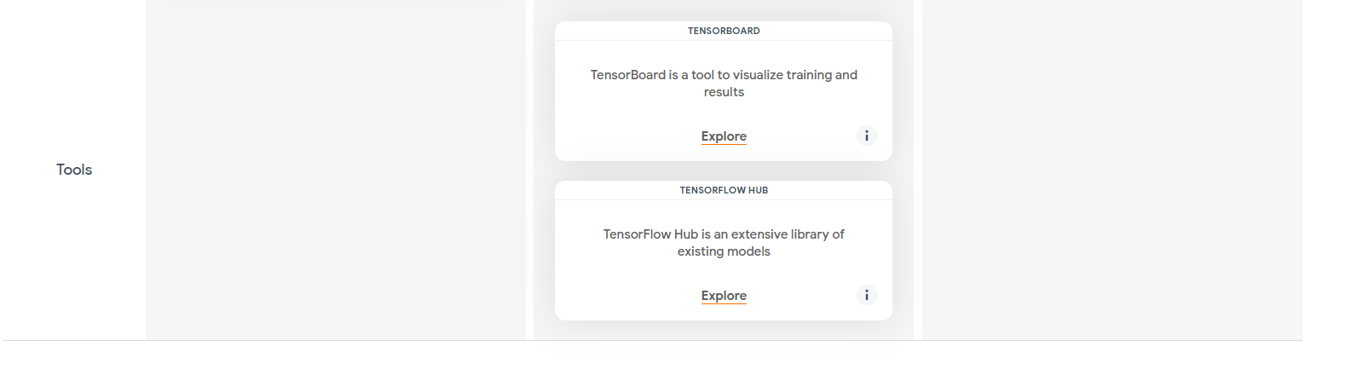
Additonal Tools
Notes:
Some additional tools provided by the developers of TensorFlow are
TensorBoard – a Data visualization tool
TensorFlow Hub – it is a library of existing models

Slide 7
How to Install the Library
To upgrade the latest pip : requirement pip install --upgrade pip Current stable release for CPU and GPU pip install tensorflow
pip install tensorflow-gpu
Anaconda package distribution
conda install -c conda-forge tensorflow conda install -c anaconda tensorflow-gpu
Notes:
Since, we are limited to only my system here which is an old Windows system. We’ll focus on the computer version of the TensorFlow using Python.
You need upgraded pip package. It is used to install libraries on systems

Slide 8
Dependencies
Windows
Python 3.6–3.9
Windows 7 or later with C++ redistributable
Linux
Ubuntu 16.04 or later
Mac OS
macOS 10.12.6 (Sierra) or later
No GPU support
Notes:
Couple of things to remember about the TensorFlow library. Since this is a high level APU, it has a lot of dependencies based on the versions, which is why I was recommending the Anaconda distribution package. It makes your life easier.

Slide 9
How to use the library?
All the above mentioned methods can be used to implement the machine learning models
Focus on the Python Library for Computers
Best way to understand the use is via an example.
Implement Linear Regression using the TensorFlow.
Notes:
Now that we have installed the library, the question arises, how do we use it? As mentioned in my previous slides, we can use all the methods to utilize as is required. Since , I only have an old Windows laptop available, we focus on the Python Library setup for Windows systems.
Best way to understand how to use it is using an example.

Slide 10

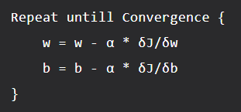
Linear Regression using TensorFlow
Linear Regression hypothesis:
Cost Function:
Gradient Descent Optimizer:
Notes:
And here I bring everybody back to the Linear Regression. Our hypothesis is ….. Which we will use to predict our Y values.
Our cost function gives the linear line we run through the data to use for predicting the future data points, which we need to minimize to reduce our error rate. Here I am using a Mean squared error.
Optimizer the function that we will use to eventually reach the minima of the function. We are using the simple gradient descent algorithm.

Slide 11
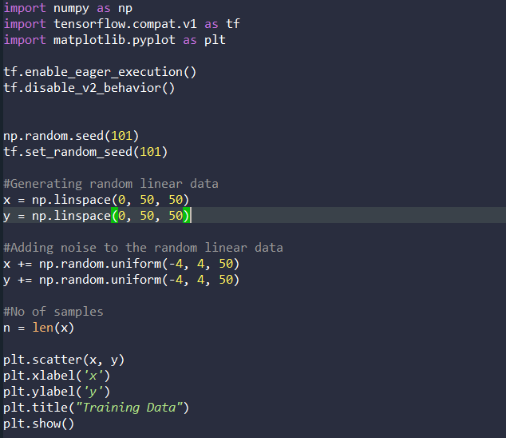
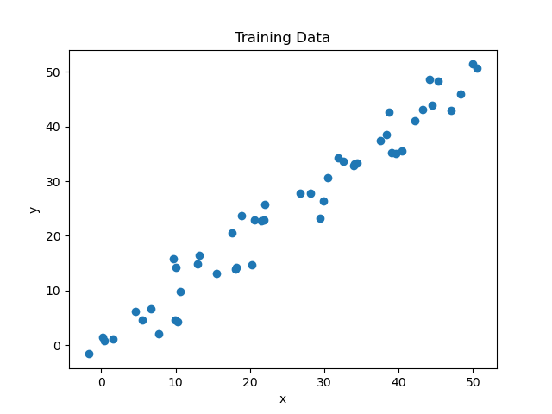
Initialization of the data
Notes:
Here is the code for Initialization of the data.
I am using tensorflow v2.0 which is why I had part of the code to work like v1.0 to be better able to help you understand the code.
As you can see the data generated and we can estimate where the line is going to be.

Slide 12


Building the model
API conventions need to be used
Use placeholders for defining the dataset
Use variables for defining the trainable data
Placeholders – for static data
Variables – for trainable data
Notes:
We use placeholders for the data x and y so that we can feed our training examples x and y into the optimizer during the training processes.
Now we define the TensorFlow variables for the Weights and Bias and initialize them randomly

Slide 13

Defining the Hyperparameters
Learning rate - the rate at which it will reach the local minima
Epochs – no of times the data is trained
Notes:
After that we define the Hyperparameters of the model, Learning rate is the rate which it will reach the minima. Higher the value , bigger the step and lower the value , smaller the step.

Slide 14
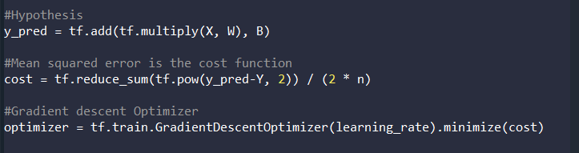
Building the Model - 2
Building the hypothesis, cost function and the optimizer.
For optimizer, we use the in-built Gradient Descent functions
Notes:
Only things remain with the Hypothesis, cost function and the optimizer. We define the hypothesis and the cost function but we are going to use the TensorFlow built–in optimizer to minimize our cost function.

Slide 15
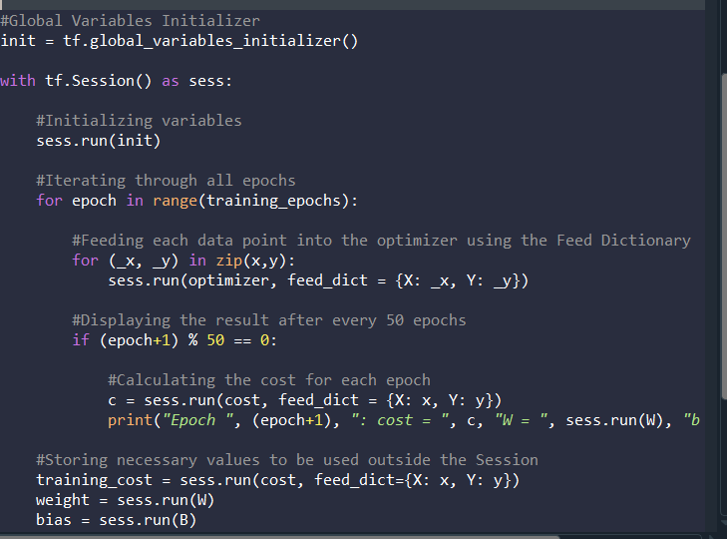
We Are Ready!
Notes:
Now the model has been defined and we can use this model to build the prediction line.
Over here, I am initializing the global variables for the model. The TensorFlow will automatically take care of what needs to defined globally and what’s not.
Then we run a TensorFlow session. We are using the command with because all of the objects and variables we built are compute heavy. If you are not careful, it will cause a crash in your system, especially if you have an old system like mine.
Then inside each epoch we feed the data into the optimizer as a dictionary.
What I am doing here is generating the weight value, bias after every 50 epochs.

Slide 16
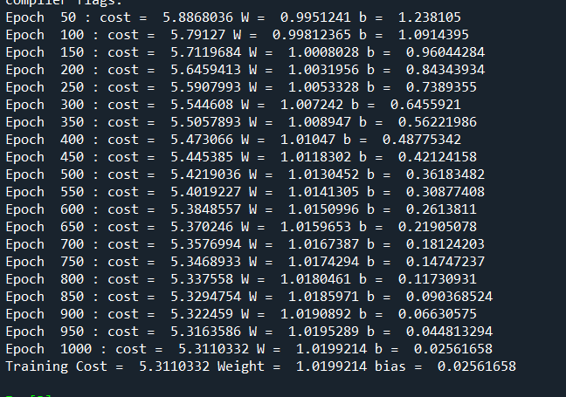
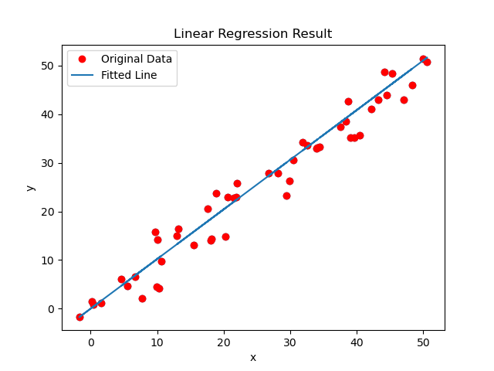
Results
Notes:
As you can see the results, after each epoch the cost is reducing, while the weights are increasing.
Finally, we get the values of training cost, weight and bias which we use on the existing x axis to get the fitted line.

Slide 17
Getting an accurate model
Hyperparameter tuning – learning rate and epochs
Using a different optimizer – Adam, Adagrad, Base Keras Optmizer
Use better values of instead of random values for weights and bias
Use the GPU version of the Tensorflow – faster results

Slide 18
References
https://github.com/agx01/tf_presentation
https://www.geeksforgeeks.org/linear-regression-using-tensorflow/
https://www.tensorflow.org/tutorials/customization/custom_training_walkthrough
https://www.tensorflow.org/resources/tools

Slide 19
Thank You!

