Slide 1
Hyper-parameter tuning
using VRS model
黃奕滔 蕭瑞昕 姚恩雋

Slide 2
Agenda
Motivation
Experiment design
Algorithm explaination
Filter inefficient parameter set
Determine searching space
Grid search
Numerical analysis
Conclusion

Slide 3
Motivation
When training machine learning models, hyperparameters can be treated as input resources and metrics can be treated as output:
Every model with different hyper-parameter set is a DMU.
Input:
Model complexity (Computing resources)
Dataset size
Output:
Precision
Recall

Slide 4
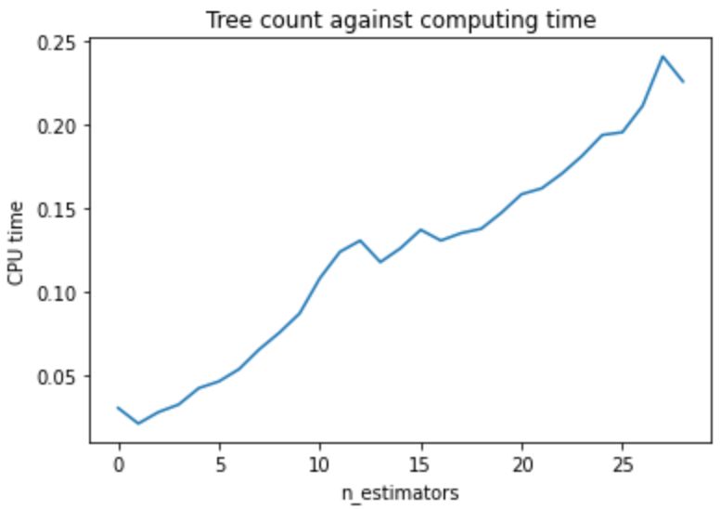
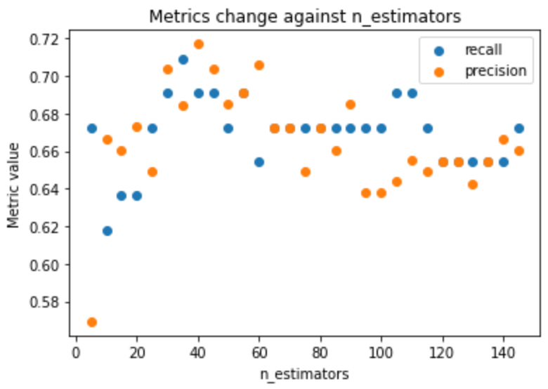
Motivation validation
Computing time increase while n_estimators grows.
Metrics of each parameter set do not dominate others except for input congestion cases (n_estimators > 60).
So as max_depth and training set size.

Slide 5
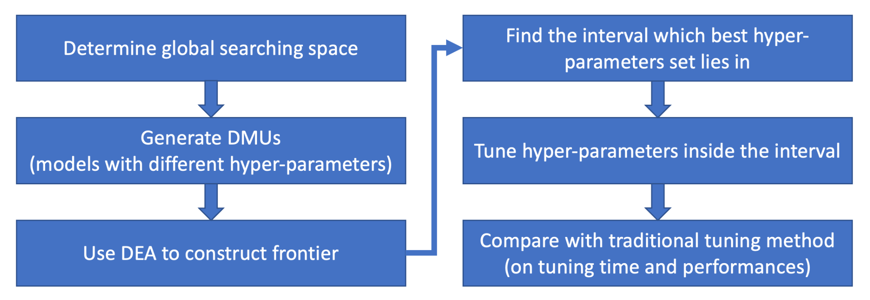
Experiment design

Slide 6
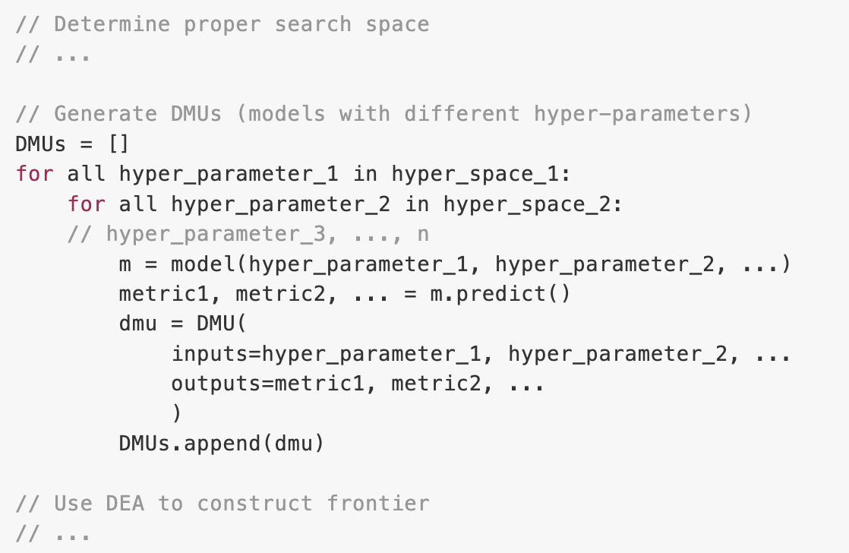
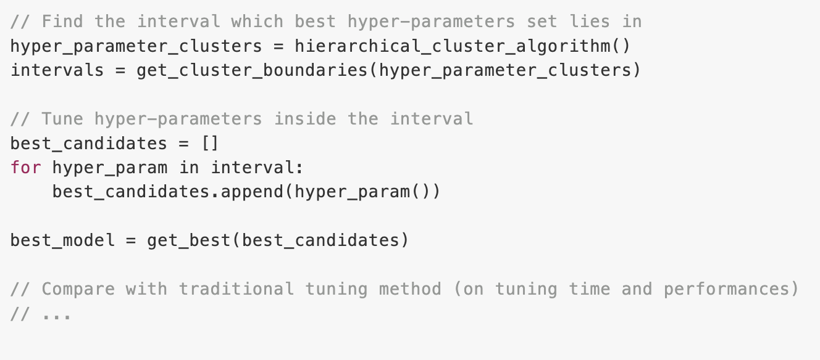

Slide 7
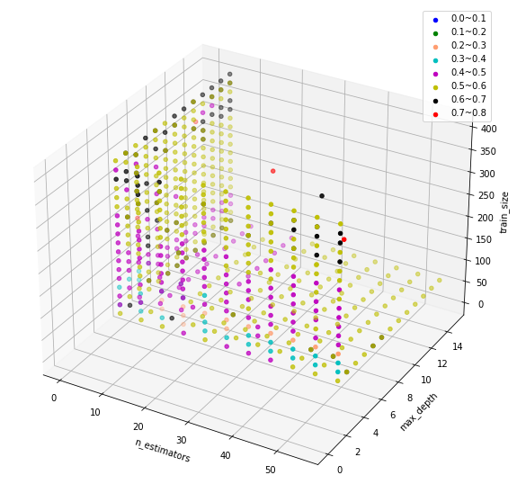
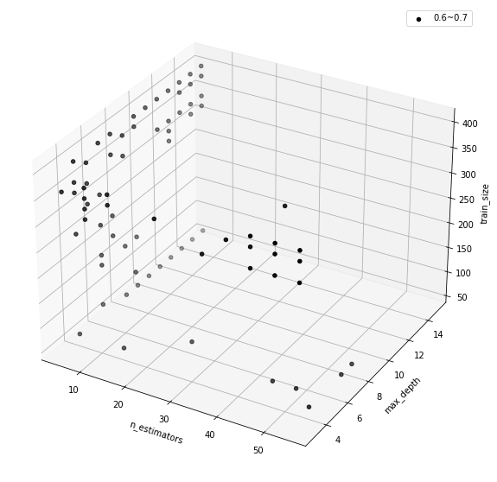
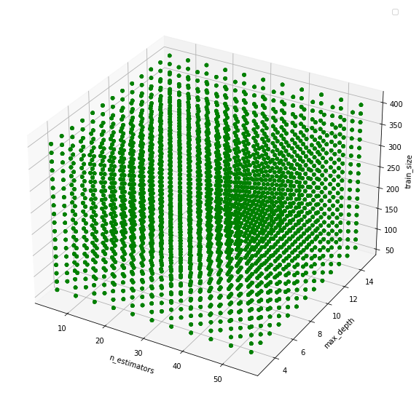
Algorithm explanation
Filter inefficient parameter set
Three hyperparameters: n_estimators, max_depth and train_size
Data points with all possible hyperparameters combinations
Data points on efficient frontier
Data points on efficiency frontier with better recall

Slide 8
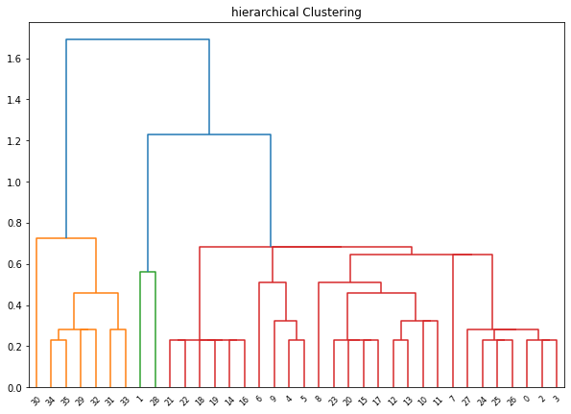
Algorithm explanation
2. Determine searching space
After standardization the data points, we will conduct hierarchical clustering on the remaining 36 data points
Split the data into three clusters
Find upper and lower bound of each cluster
Euclidean distance
Data Points

Slide 9
Algorithm explanation
3. Grid search
Use the upper and lower bound of hyperparameters which found in the previous clustering procedure to conduct grid search.
After grid search, relative better hyperparameters set will be found. (optional: other searching methods)

Slide 10
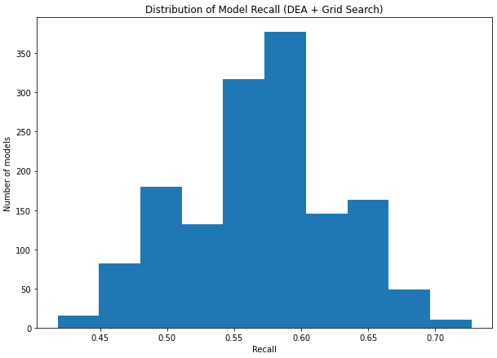
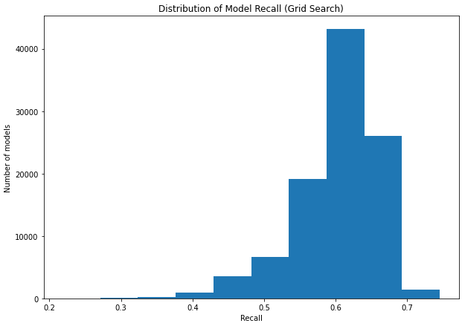
Numerical analysis – Diabetes dataset
 | Grid Search | DEA + Grid Search
Total model trained | 110,376 | 2,255
Total training time | > 3 hours | 2m 55s
Best recall | 0.745 | 0.727
n_estimators | 9 | 11
max_depth | 9 | 8
Data size | 401 | 361

Slide 11
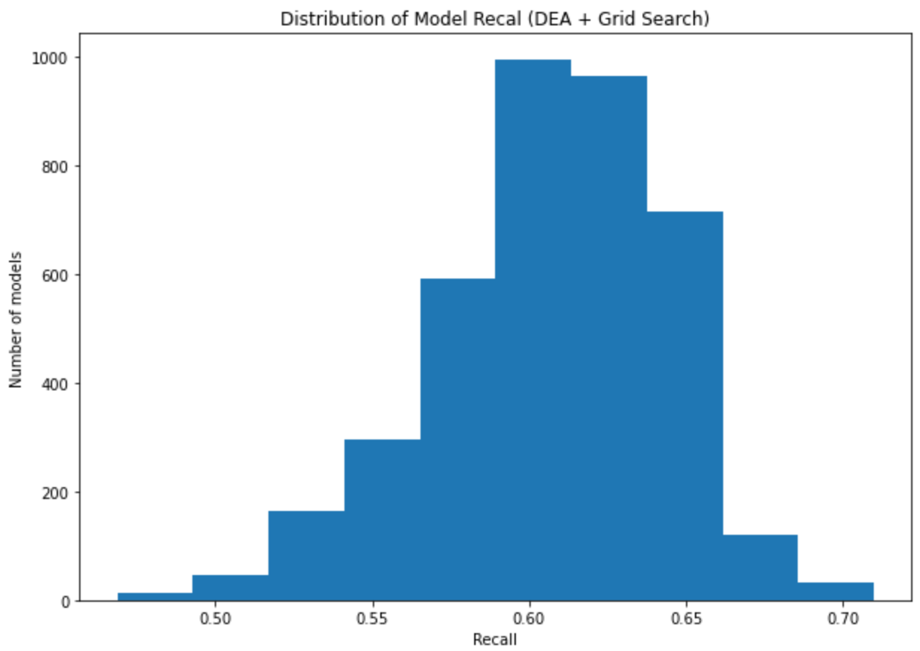
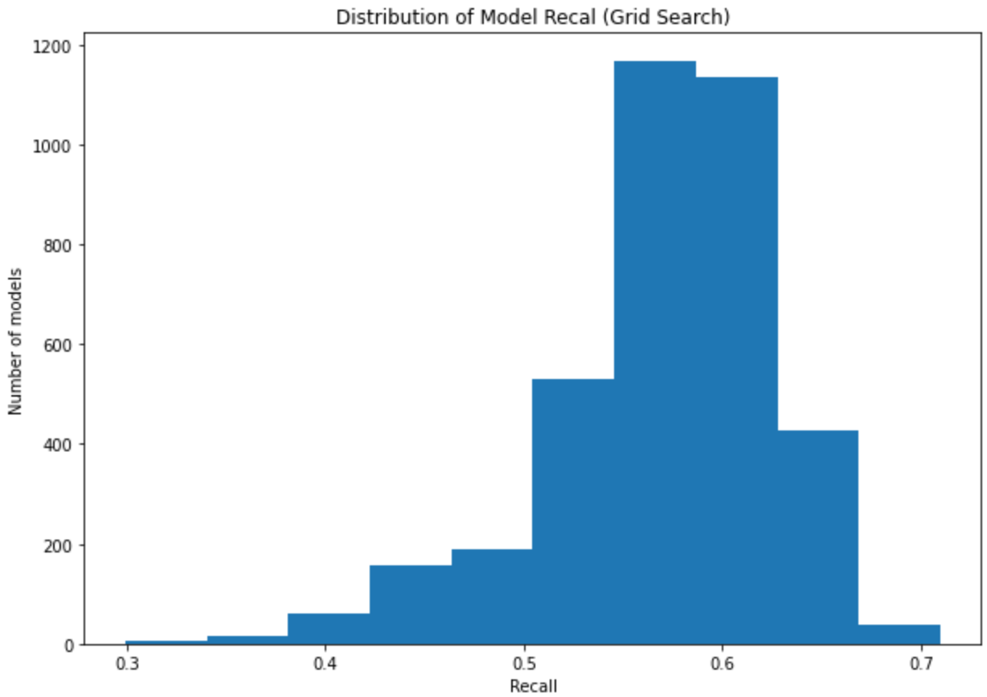
Numerical analysis – Smoking dataset
 | Grid Search | DEA + Grid Search
Total model trained | 43362 | 5936
Total training time | > 2 hours | 4m 55s
Best recall | 0.713 | 0.710
n_estimators | 18 | 17
max_depth | 8 | 6
Data size | 1040 | 940

Slide 12
Conclusion
The hyperparameter tuning method of VRS model with grid search embedded
Help us find the relative better hyperparameter combination with less computing resources.
Better resource allocation on training machine learning models.

