Slide 1




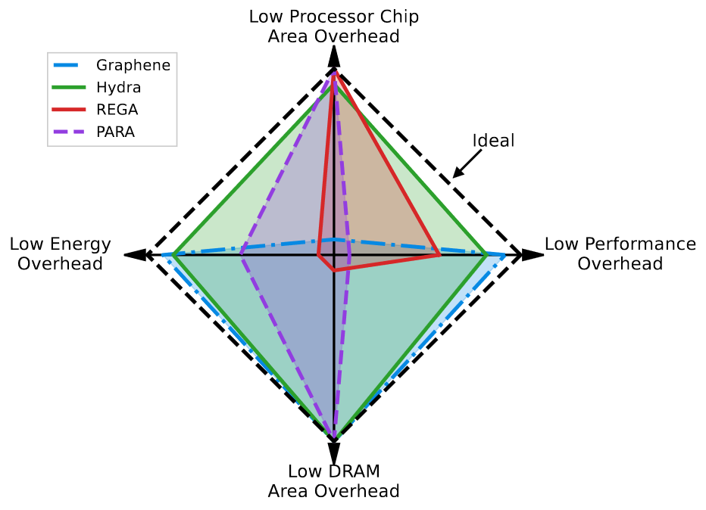
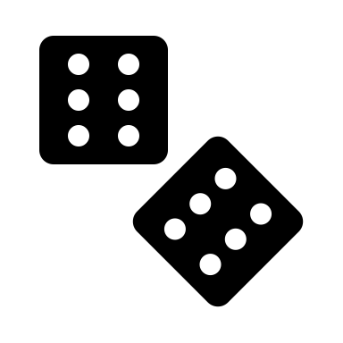

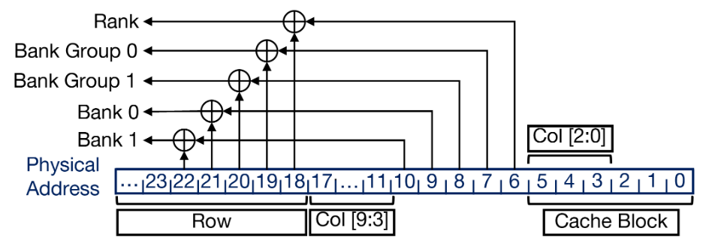
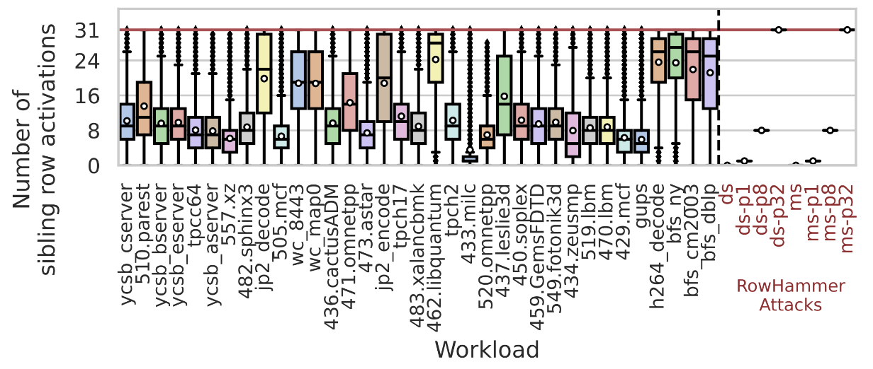
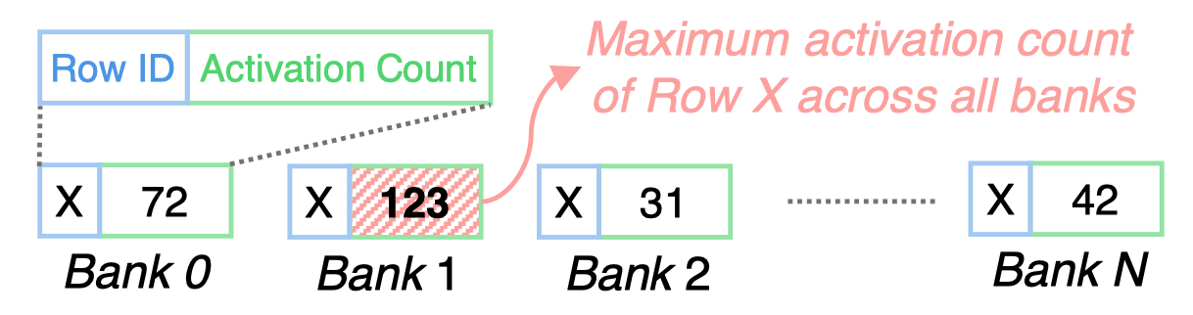
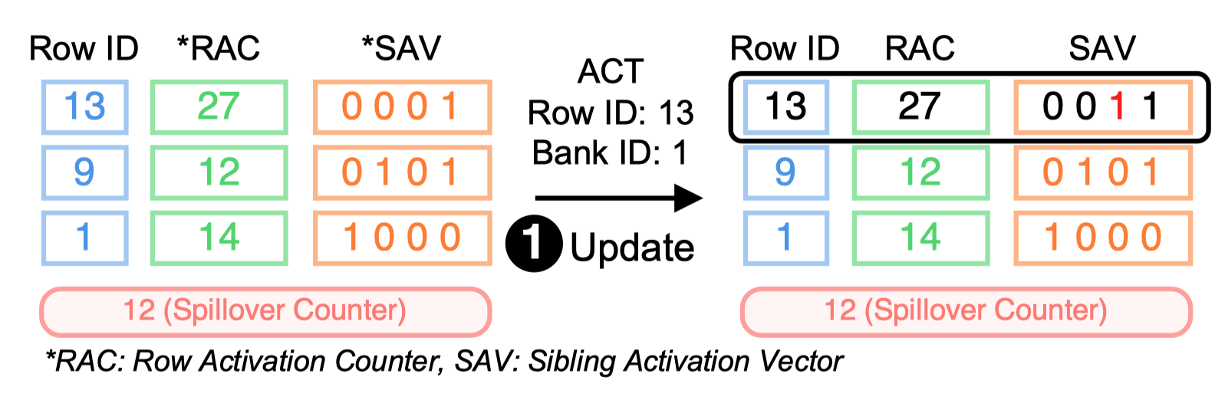
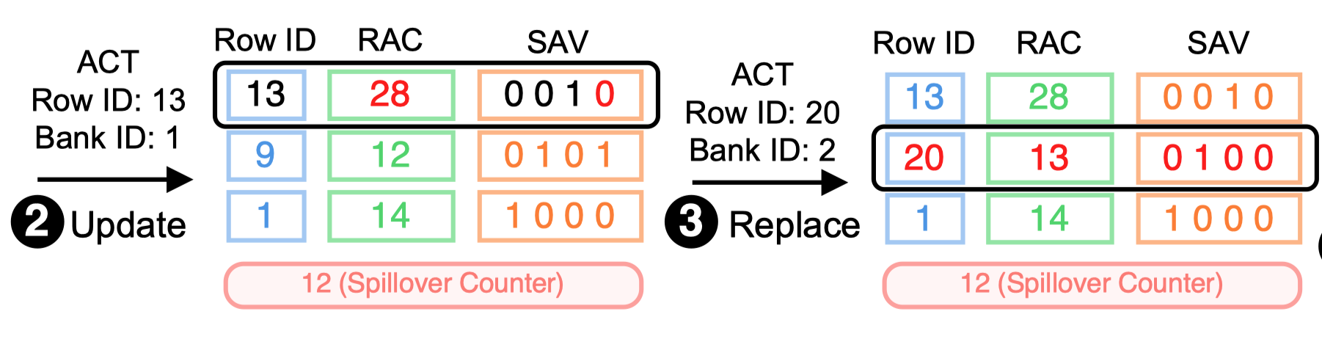
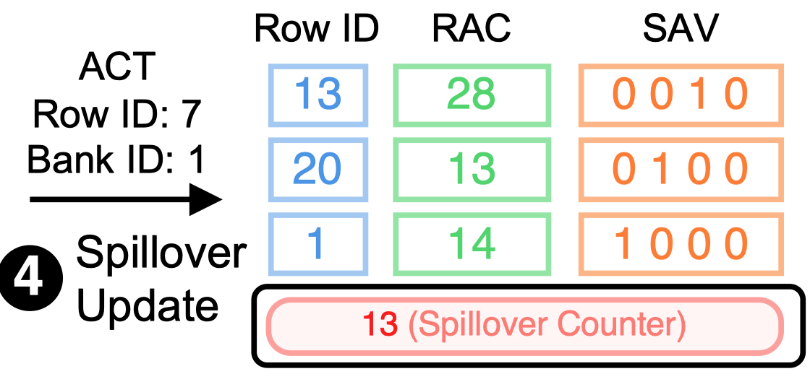
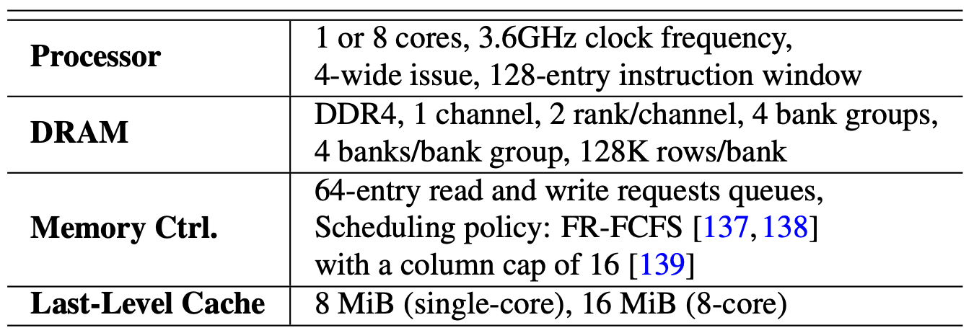
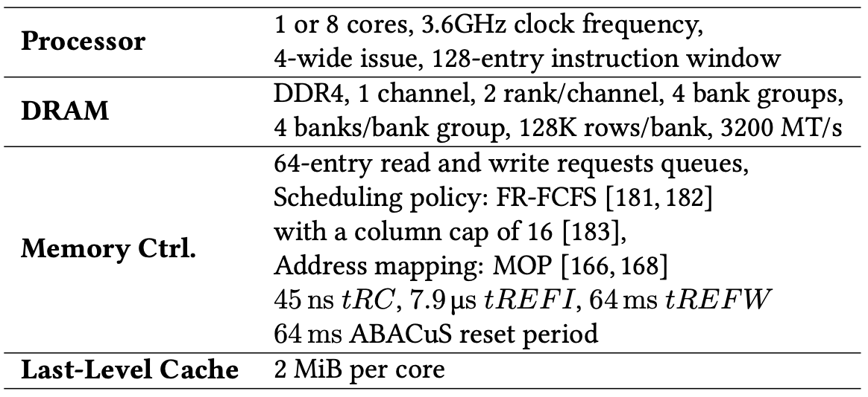
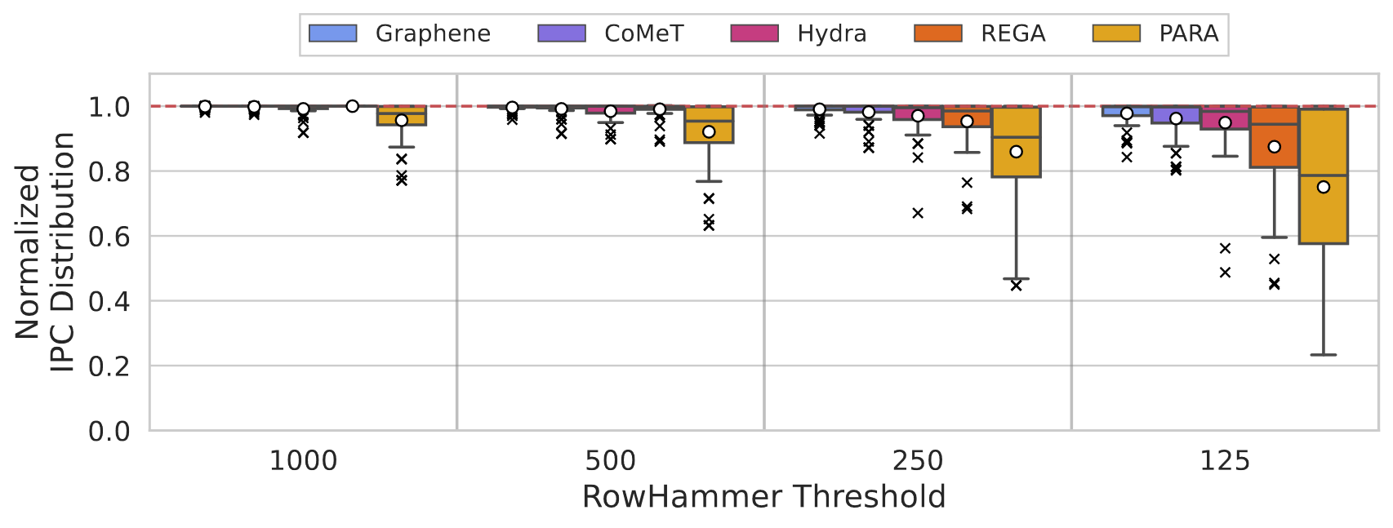
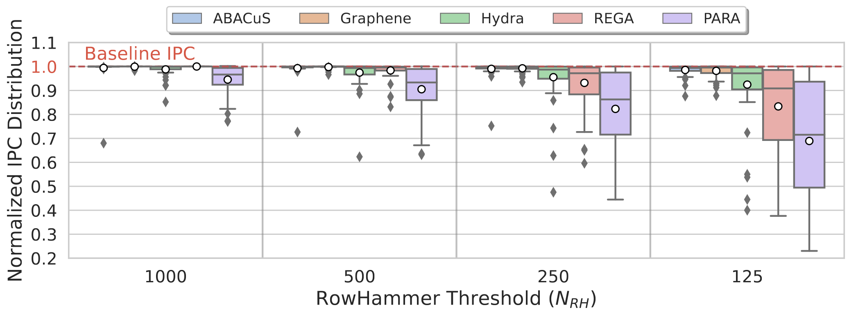
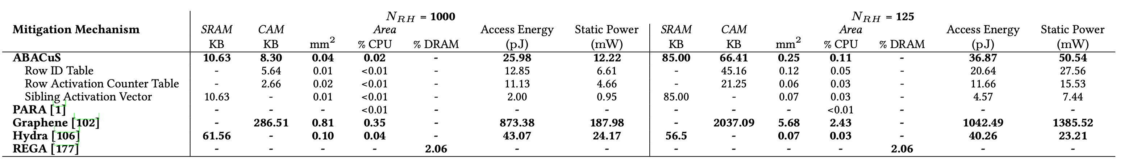


CoMeT Count-Min-Sketch-based Row Tracking to Mitigate RowHammer at Low Cost
Scalable and Low Overhead DRAM Read Disturbance Mitigation
CoMeT
ABACuS
Nisa Bostanci Ataberk Olgun Giray Yaglikci Geraldo de Oliveira Yahya Tugrul
Haocong Luo Ismail Yuksel Konstantinos Kanellopoulos Mohammad Sadrosadati Onur Mutlu
1: DRAM Organization
2: Read Disturbance Vulnerabilities
DRAM Subarray
DRAM chips are more vulnerable to read disturbance today
Read disturbance bitflips occur at much lower activation counts (more than two orders of magnitude decrease in less than a decade):
Row 0
Row 0
DRAM Chip
Victim Row
Row 1
Row 1
Row 1
Victim Row
Row 2
Row 2
Row 2
Row 2
open
closed
Aggressor Row
N_{RH} = ∞
(all good)
N_{RH} = 1
Row 3
Row 3
Row 3
. . .
Bitline
Victim Row
…
Bank
Subarray
DRAM Cell
Wordline
Row 4
139K
[Kim+, ISCA’14]
9.6K
[Kim+, ISCA’20]
<1K
[Luo+, ISCA’23]
Row 4
Chip I/O
DRAM Row
…
Victim Row
…
…
…
…
…
…
Repeatedly activating and precharging a DRAM row causes RowHammer bitflips in nearby cells
Mitigation techniques against read disturbance attacks need to be effective and efficient for highly vulnerable systems
DRAM Chip
Row Buffer
DRAM Bank
DRAM Subarray
The minimum number of activations that causes a bitflip is called the RowHammer threshold
3: Limitations of Existing Mitigations
4: Goal
DRAM
Processor Chip
Processor Chip
Processor Chip
Prevent RowHammer bitflips with low area, performance, and energy overheads in highly RowHammer-vulnerable DRAM-based systems
(e.g., a RowHammer threshold of 125)
Row A
Counter A
Tag A
Counter A
Shared Counters
Row B
Counter B
Tag B
Counter B
Tag A
Counter A
Row C
Counter C
Tag C
Counter C
Tag B
Counter B
Row D
Counter D
One ACT counter
per DRAM row
One ACT counter per aggressor row
<1 counter per DRAM row
Performance & Energy Costs
VERY LOW
LOW
HIGH
Area Cost
VERY HIGH
HIGH
LOW
Many DRAM rows
(e.g., 128K per bank)
# of aggressor rows
increases significantly
High DRAM bandwidth consumption
No existing mitigation technique prevents RowHammer bitflips at low area, performance and energy costs
CAM-based implementation
5: CoMeT’s Key Observation and Key Idea
7: ABACuS’s Key Observation and Key Idea
Key Observation
Key Idea
1
Address mappings distribute consecutive cache blocks to different banks (but to the same row ID)
Hash-based counters are low-cost:
can be implemented with low-cost structures and
can aggregate many rows' activation counts together
1
Track most DRAM rows’ activations with low area cost
Workloads tend to access cache blocks in close proximity at around the same time
DRAM
1
Hash Function
(Example)
Counters
2
Row 0
Row 0
2
Row 1
0
1
2
3
Row 2
H₀(ID) = ID % 4
Many workloads access the same row ID in different banks at around the same time
Row 3
Row 4
Row 4
Mapping without tags
Fixed number of counters
Sibling rows: Rows with the same ID across all banks
Key Idea: Sibling rows can share one hardware counter
Reduce the number of counters by a factor of the number of banks in the chip
Tag-based counters are highly accurate:
Each one tracks one row's activation count
2
Track a small set of hot rows accurately
Tag
Counter
HIGH ACCURACY
Row 0
Row 0
…
Counter Table (CT):
Maps each DRAM row to a group of low-cost hash-based counters by employing the Count-Min Sketch technique
Triggers a preventive refreshes when the aggressor's counter group reaches an activation threshold
Tracks DRAM row activations at low area cost
Key Mechanism: ABACuS Track the maximum (worst) activation count of sibling rows using one counter
Recent Aggressor Table (RAT):
Allocates highly accurate per-DRAM-row counters for only a small set of DRAM rows that are activated many times
Reduces performance penalties by increasing tracking accuracy
6: CoMeT’s Evaluation and Conclusion
Cycle-level simulations using Ramulator
Workloads:
62 1- & 8-core workloads
Four different very low nRH values: 1000, 500, 250, 125
Four state-of-the-art mitigation mechanisms
Graphene, Hydra, PARA, REGA
8: ABACuS’s Evaluation and Conclusion
Cycle-level simulations using Ramulator
Workloads:
62 1- & 8-core workloads
Four different very low nRH values: 1000, 500, 250, 125
Four state-of-the-art mitigation mechanisms
Graphene, Hydra, PARA, REGA
Performance and DRAM Energy Analysis across single-core applications
5.4×
0.89
74.2×
4.89
4.01%
2.07%
CoMeT achieves a good trade-off between area, performance and energy costs - incurs significantly less area overhead (74.2×)
- outperforms the state-of-the-art (by up to 39.1%)
Lower overhead than all evaluated state-of-the-art mechanisms
Open-sourced: https://github.com/CMU-SAFARI/CoMeT
Artifact available, functional, and reproduced
Open-sourced: https://github.com/CMU-SAFARI/ABACuS
Bostanci et al., "CoMeT: Count-Min-Sketch-based Row Tracking to Mitigate RowHammer at Low Cost,” in HPCA, 2024
Olgun et al., “ABACuS: All-Bank Activation Counters for Scalable and Low Overhead RowHammer Mitigation,” in USENIX Security, 2024

