Slide 1
EDES 301 PCB Project
Aiden Hwang
Due 05/05/2025 @ 11:59pm

Slide 2
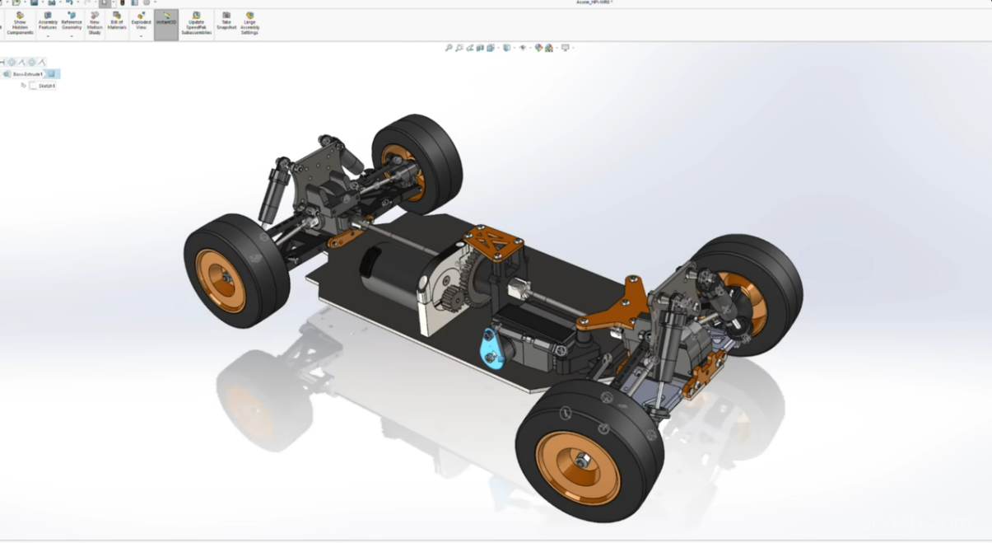
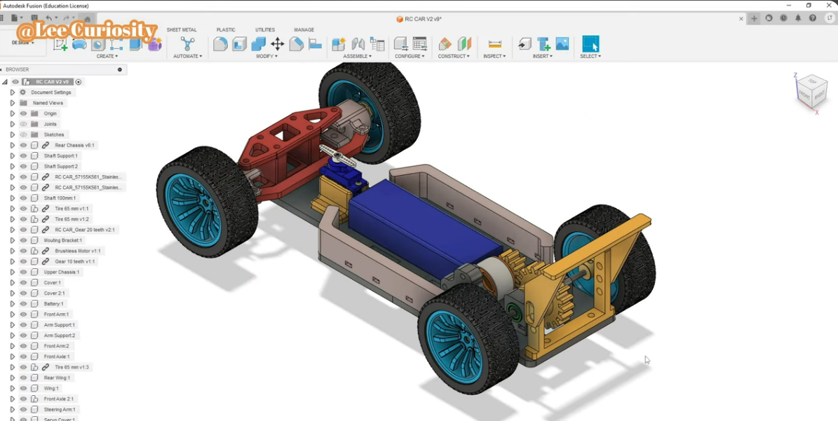
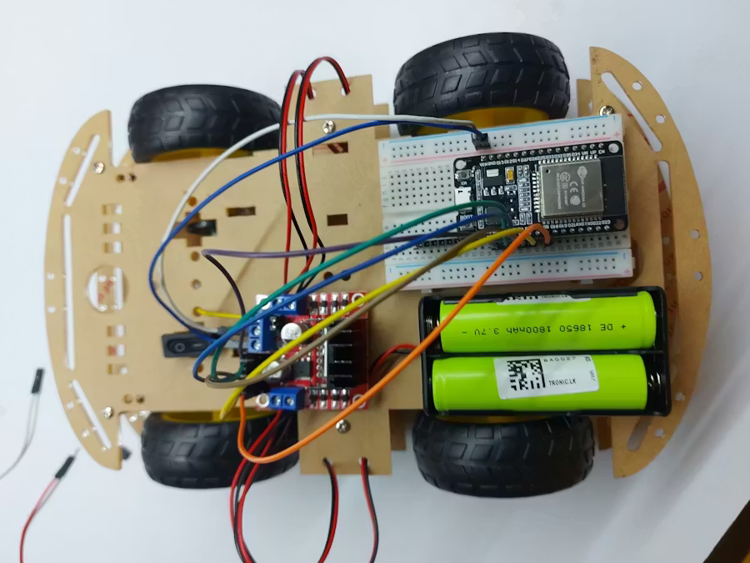
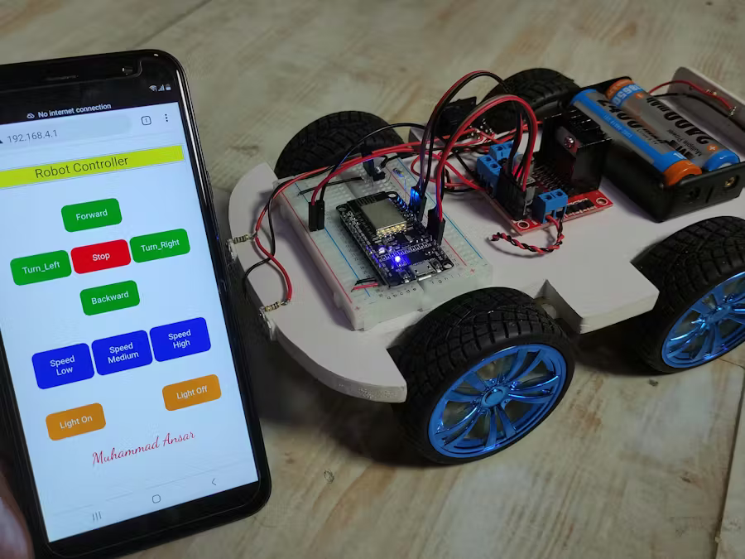
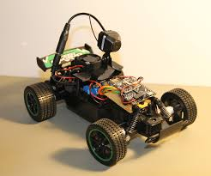
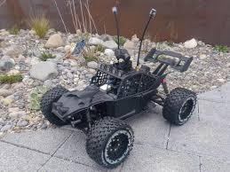
Project Proposal
A realistic looking and wifi controlled fpv car.
3D Printed RC Cars
Missing: Not wifi controlled, use of stock wheels
Wifi Controlled Car
Missing: Slow, don’t look realistic
FPV Cars
Missing: No cockpit view, not traditional cars

Slide 3
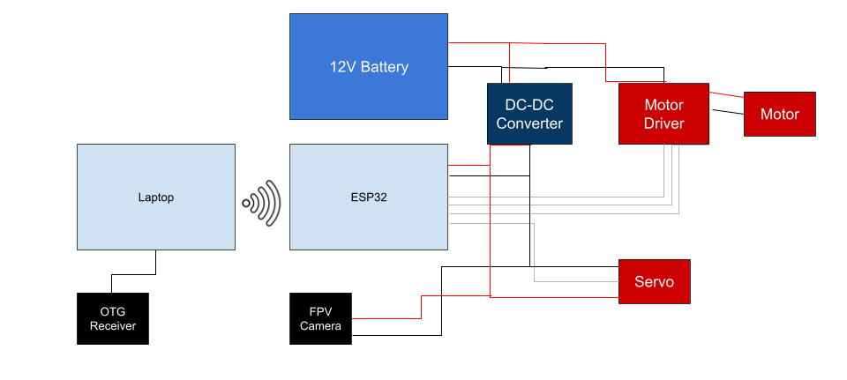
SPD Block Diagram with a New Development Board (ESP32)

Slide 4
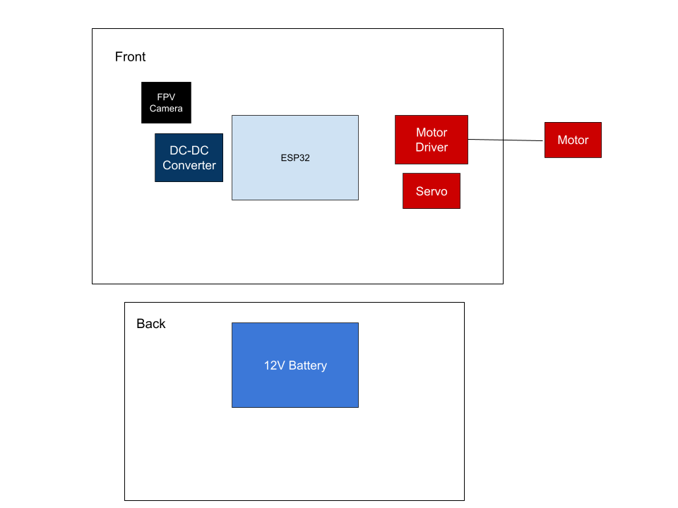
Mechanical Drawing

