Slide 1

Module 14: Transport Layer
Instructor Materials
Introduction to Networks v7.0 (ITN)

Slide 2
Instructor Materials – Module 14 Planning Guide
This PowerPoint deck is divided in two parts:
Instructor Planning Guide
Information to help you become familiar with the module
Teaching aids
Instructor Class Presentation
Optional slides that you can use in the classroom
Begins on slide # 10
Note: Remove the Planning Guide from this presentation before sharing with anyone.
For additional help and resources go to the Instructor Home Page and Course Resources for this course. You also can visit the professional development site on netacad.com, the official Cisco Networking Academy Facebook page, or Instructor Only FB group.
Notes:
2

Slide 3
What to Expect in this Module
To facilitate learning, the following features within the GUI may be included in this module:
Feature | Description
Animations | Expose learners to new skills and concepts.
Videos | Expose learners to new skills and concepts.
Check Your Understanding(CYU) | Per topic online quiz to help learners gauge content understanding.
Interactive Activities | A variety of formats to help learners gauge content understanding.
Syntax Checker | Small simulations that expose learners to Cisco command line to practice configuration skills.
PT Activity | Simulation and modeling activities designed to explore, acquire, reinforce, and expand skills.

Slide 4
What to Expect in this Module (Cont.)
To facilitate learning, the following features may be included in this module:
Feature | Description
Hands-On Labs | Labs designed for working with physical equipment.
Class Activities | These are found on the Instructor Resources page. Class Activities are designed to facilitate learning, class discussion, and collaboration.
Module Quizzes | Self-assessments that integrate concepts and skills learned throughout the series of topics presented in the module.
Module Summary | Briefly recaps module content.

Slide 5
Check Your Understanding
Check Your Understanding activities are designed to let students quickly determine if they understand the content and can proceed, or if they need to review.
Check Your Understanding activities do not affect student grades.
There are no separate slides for these activities in the PPT. They are listed in the notes area of the slide that appears before these activities.
Notes:
5

Slide 6
Module 14: Activities
What activities are associated with this module?
Page # | Activity Type | Activity Name | Optional?
14.1.7 | Check Your Understanding | Transportation of Data | Recommended
14.2.5 | Check Your Understanding | TCP Overview | Recommended
14.3.5 | Check Your Understanding | UDP Overview | Recommended
14.4.5 | Check Your Understanding | Port Numbers | Recommended
14.5.5 | Video | TCP 3- Handshake | Recommended
14.5.6 | Check Your Understanding | TCP Communication Process | Recommended
14.6.2 | Video | TCP Reliability- Sequence Numbers and Acknowledgments | Recommended
14.6.4 | Video | TCP Reliability – Reliability and Flow control | Recommended
14.6.8 | Check Your Understanding | Reliability and Flow Control | Recommended
14.7.5 | Check Your Understanding | UDP Communication | Recommended
14.8.1 | Packet Tracer | Packet Tracer - TCP and UDP Communications | Recommended
Notes:
6

Slide 7
Module 14: Best Practices
Prior to teaching Module 14, the instructor should:
Review the activities and assessments for this module.
Try to include as many questions as possible to keep students engaged during classroom presentation.
Topic 14.1
Ask the students or have a class discussion
How do we ensure reliable receipt of the data we send?
What applications do we use TCP or UDP with and why do we choose them?
Topic 14.2
Ask the students or have a class discussion
What features of TCP are most important?
Why are the flags so important and how do we use them?
Notes:
7

Slide 8
Module 14: Best Practices (Cont.)
Topic 14.3
Ask the students or have a class discussion
What is the advantage of UDP over TCP?
What applications do we use daily that make use of UCP?
Topic 14.4
Ask the students or have a class discussion
What’s the difference between a socket and a port?
What common ports are most important to remember?
Topic 14.5
Ask the students or have a class discussion
What is the three-way handshake and how does it work?
How is a session closed?
Notes:
8

Slide 9
Module 14: Best Practices (Cont.)
Topic 14.6
Ask the students or have a class discussion
Why are sequence numbers so important?
How do window size and MSS relate to each other?
Topic 14.7
Ask the students or have a class discussion
Why is UDP an advantage over TCP?
What would happen if TCP were used instead of UDP for some applications
that use UDP?
Notes:
9

Slide 10
Module 14: Transport Layer
Introduction to Networks v7.0 (ITN)

Slide 11
Module Objectives
Module Title: Transport Layer
Module Objective: Compare the operations of transport layer protocols in supporting end-to-end communication.
Topic Title | Topic Objective
Transportation of Data | Explain the purpose of the transport layer in managing the transportation of data in end-to-end communication.
TCP Overview | Explain characteristics of TCP.
UDP Overview | Explain characteristics of UDP.
Port Numbers | Explain how TCP and UDP use port numbers.
TCP Communication Process | Explain how TCP session establishment and termination processes facilitate reliable communication.
Reliability and Flow Control | Explain how TCP protocol data units are transmitted and acknowledged to guarantee delivery.
UDP Communication | Compare the operations of transport layer protocols in supporting end-to-end communication.
Notes:
11
14- Transport Layer
14.0.2 – What will I learn to do in this module?

Slide 12
14.1 Transportation of Data
Notes:
14 –Transport Layer
14.1 - Transportation of Data

Slide 13
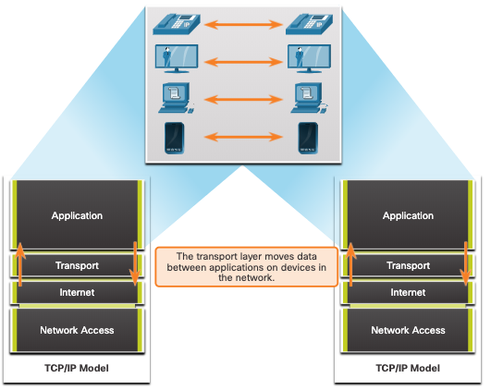
Transportation of Data Role of the Transport Layer
The transport layer is:
responsible for logical communications between applications running on different hosts.
The link between the application layer and the lower layers that are responsible for network transmission.
Notes:
14 –Transport Layer
14.1 - Transportation of Data
14.1.1 – Role of the Transport Layer

Slide 14
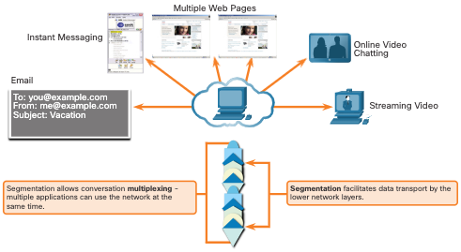
Transportation of Data Transport Layer Responsibilities
The transport layer has the following responsibilities:
Tracking individual conversations
Segmenting data and reassembling segments
Adds header information
Identify, separate, and manage multiple conversations
Uses segmentation and multiplexing to enable different communication conversations to be interleaved on the same network
Notes:
14 –Transport Layer
14.1 - Transportation of Data
14.1.2 – Transport Layer Responsibilities

Slide 15
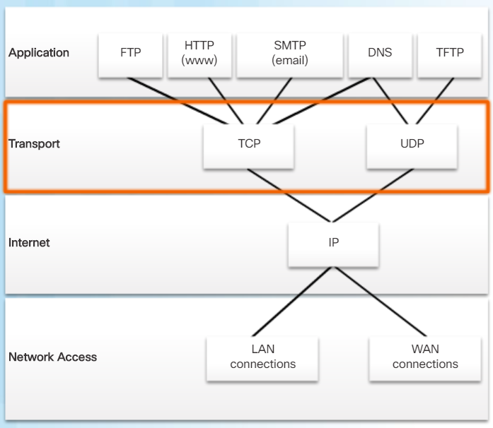
Transportation of Data Transport Layer Protocols
IP does not specify how the delivery or transportation of the packets takes place.
Transport layer protocols specify how to transfer messages between hosts, and are responsible for managing reliability requirements of a conversation.
The transport layer includes the TCP and UDP protocols.
Notes:
14 –Transport Layer
14.1 - Transportation of Data
14.1.3 – Transport Layer Protocols

Slide 16
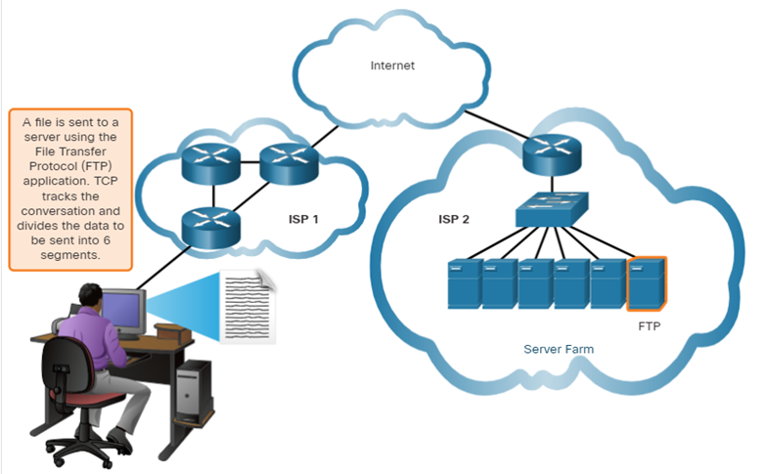
Transportation of Data Transmission Control Protocol
TCP provides reliability and flow control. TCP basic operations:
Number and track data segments transmitted to a specific host from a specific application
Acknowledge received data
Retransmit any unacknowledged data after a certain amount of time
Sequence data that might arrive in wrong order
Send data at an efficient rate that is acceptable by the receiver
Notes:
14 –Transport Layer
14.1 - Transportation of Data
14.1.4 – Transmission Control Protocol (TCP)

Slide 17
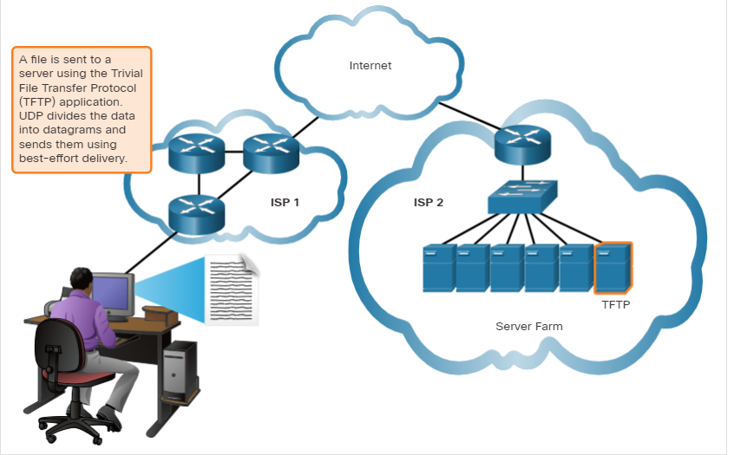
Transportation of Data User Datagram Protocol (UDP)
UDP provides the basic functions for delivering datagrams between the appropriate applications, with very little overhead and data checking.
UDP is a connectionless protocol.
UDP is known as a best-effort delivery protocol because there is no acknowledgment that the data is received at the destination.
Notes:
14 –Transport Layer
14.1 - Transportation of Data
14.1.5 – User Datagram Protocol (UDP)

Slide 18
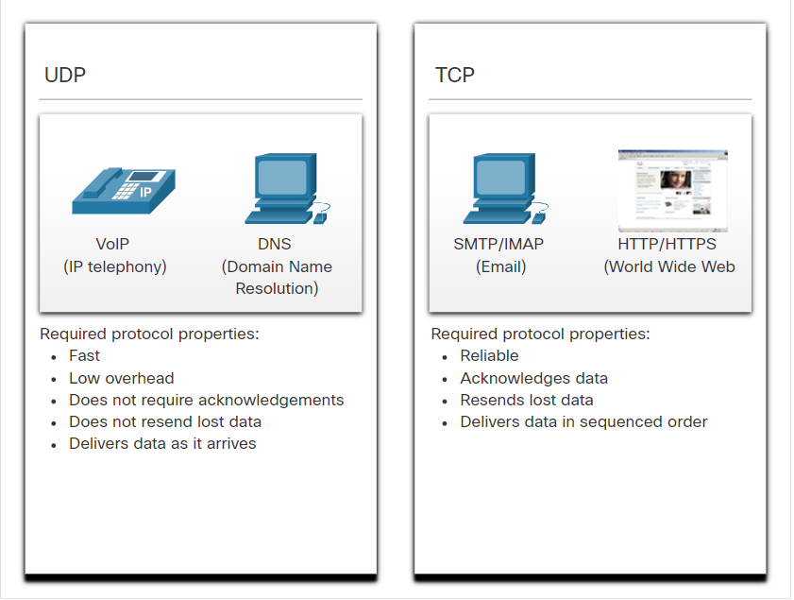
Transportation of Data The Right Transport Layer Protocol for the Right Application
UDP is also used by request-and-reply applications where the data is minimal, and retransmission can be done quickly.
If it is important that all the data arrives and that it can be processed in its proper sequence, TCP is used as the transport protocol.
Notes:
14 –Transport Layer
14.1 - Transportation of Data
14.1.6 – The Right Transport Layer Protocol for the Right Application
14.1.7 – Check your Understanding- Transportation of Data

Slide 19
14.2 TCP Overview
Notes:
14 – Transport Layer
14.2 – TCP Overview

Slide 20
TCP Overview TCP Features
Establishes a Session - TCP is a connection-oriented protocol that negotiates and establishes a permanent connection (or session) between source and destination devices prior to forwarding any traffic.
Ensures Reliable Delivery - For many reasons, it is possible for a segment to become corrupted or lost completely, as it is transmitted over the network. TCP ensures that each segment that is sent by the source arrives at the destination.
Provides Same-Order Delivery - Because networks may provide multiple routes that can have different transmission rates, data can arrive in the wrong order.
Supports Flow Control - Network hosts have limited resources (i.e., memory and processing power). When TCP is aware that these resources are overtaxed, it can request that the sending application reduce the rate of data flow.
Notes:
14 – Transport Layer
14.2 – TCP Overview
14.2.1 – TCP Features

Slide 21
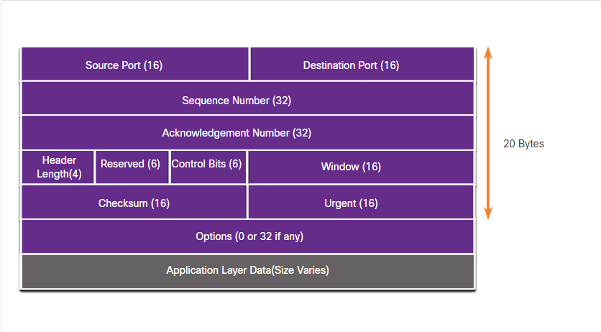
TCP Overview TCP Header
TCP is a stateful protocol which means it keeps track of the state of the communication session.
TCP records which information it has sent, and which information has been acknowledged.
Notes:
14 – Transport Layer
14.2 – TCP Overview
14.2.2 – TCP Header

Slide 22
TCP Overview TCP Header Fields
TCP Header Field | Description
Source Port | A 16-bit field used to identify the source application by port number.
Destination Port | A 16-bit field used to identify the destination application by port number.
Sequence Number | A 32-bit field used for data reassembly purposes.
Acknowledgment Number | A 32-bit field used to indicate that data has been received and the next byte expected from the source.
Header Length | A 4-bit field known as ʺdata offsetʺ that indicates the length of the TCP segment header.
Reserved | A 6-bit field that is reserved for future use.
Control bits | A 6-bit field used that includes bit codes, or flags, which indicate the purpose and function of the TCP segment.
Window size | A 16-bit field used to indicate the number of bytes that can be accepted at one time.
Checksum | A 16-bit field used for error checking of the segment header and data.
Urgent | A 16-bit field used to indicate if the contained data is urgent.
Notes:
14 – Transport Layer
14.2 – TCP Overview
14.2.3 – TCP Header

Slide 23
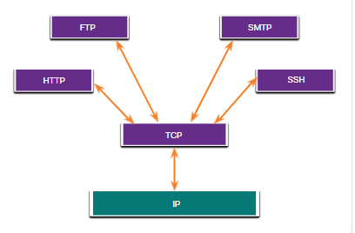
TCP Overview Applications that use TCP
TCP handles all tasks associated with dividing the data stream into segments, providing reliability, controlling data flow, and reordering segments.
Notes:
14 – Transport Layer
14.2 – TCP Overview
14.2.4 – Applications that use TCP
14.2.5 Check your Understanding – TCP Overview

Slide 24
14.3 UDP Overview
Notes:
14 – Transport Layer
14.3 – UDP Overview

Slide 25
UDP Overview UDP Features
UDP features include the following:
Data is reconstructed in the order that it is received.
Any segments that are lost are not resent.
There is no session establishment.
The sending is not informed about resource availability.
Notes:
14 – Transport Layer
14.3 – UDP Overview
14.3.1 – UDP Features

Slide 26
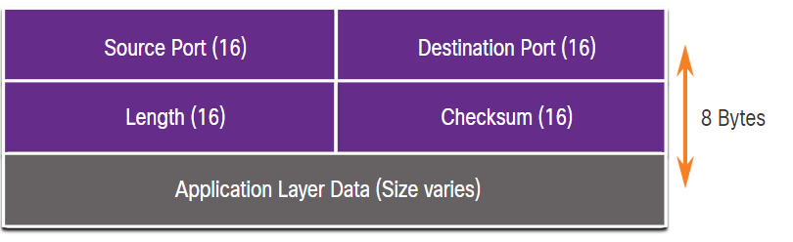
UDP Overview UDP Header
The UDP header is far simpler than the TCP header because it only has four fields and requires 8 bytes (i.e. 64 bits).
Notes:
14 – Transport Layer
14.3 – UDP Overview
14.3.2 – UDP Header

Slide 27
UDP Overview UDP Header Fields
The table identifies and describes the four fields in a UDP header.
UDP Header Field | Description
Source Port | A 16-bit field used to identify the source application by port number.
Destination Port | A 16-bit field used to identify the destination application by port number.
Length | A 16-bit field that indicates the length of the UDP datagram header.
Checksum | A 16-bit field used for error checking of the datagram header and data.
Notes:
14 – Transport Layer
14.3 – UDP Overview
14.3.3 - UDP Header Fields

Slide 28
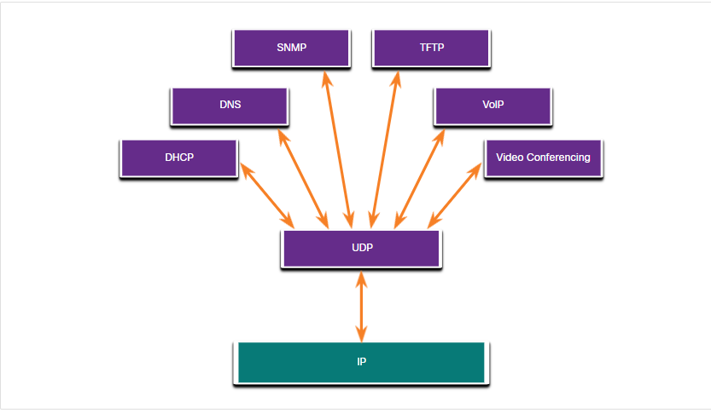
UDP Overview Applications that use UDP
Live video and multimedia applications - These applications can tolerate some data loss but require little or no delay. Examples include VoIP and live streaming video.
Simple request and reply applications - Applications with simple transactions where a host sends a request and may or may not receive a reply. Examples include DNS and DHCP.
Applications that handle reliability themselves - Unidirectional communications where flow control, error detection, acknowledgments, and error recovery is not required, or can be handled by the application. Examples include SNMP and TFTP.
Notes:
14 – Transport Layer
14.3 – UDP Overview
14.3.4 – Applications that use UDP
14.3.5 - Check Your Understanding – UDP Overview

Slide 29
14.4 Port Numbers
Notes:
14 – Transport Layer
14.4 – Port Numbers

Slide 30
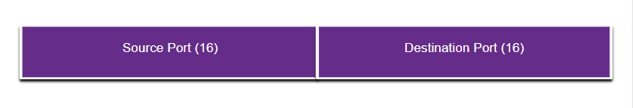
Port Numbers Multiple Separate Communications
TCP and UDP transport layer protocols use port numbers to manage multiple, simultaneous conversations.
The source port number is associated with the originating application on the local host whereas the destination port number is associated with the destination application on the remote host.
Notes:
14 – Transport Layer
14.4 – Port Numbers
14.4.1 - Multiple Separate Communications

Slide 31
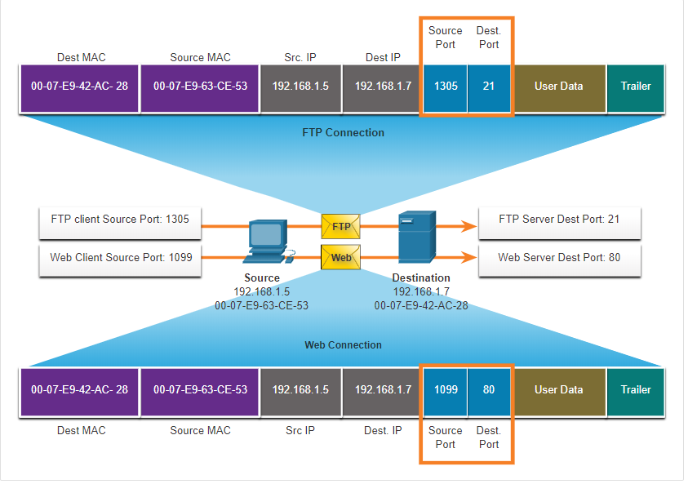
Port numbers Socket Pairs
The source and destination ports are placed within the segment.
The segments are then encapsulated within an IP packet.
The combination of the source IP address and source port number, or the destination IP address and destination port number is known as a socket.
Sockets enable multiple processes, running on a client, to distinguish themselves from each other, and multiple connections to a server process to be distinguished from each other.
Notes:
14 – Transport Layer
14.4 – Port Numbers
14.4.2 – Socket Pairs

Slide 32
Port Numbers Port Number Groups
Port Group | Number Range | Description
Well-known Ports | 0 to 1,023 | These port numbers are reserved for common or popular services and applications such as web browsers, email clients, and remote access clients. Defined well-known ports for common server applications enables clients to easily identify the associated service required.
Registered Ports | 1,024 to 49,151 | These port numbers are assigned by IANA to a requesting entity to use with specific processes or applications. These processes are primarily individual applications that a user has chosen to install, rather than common applications that would receive a well-known port number. For example, Cisco has registered port 1812 for its RADIUS server authentication process.
Private and/or Dynamic Ports | 49,152 to 65,535 | These ports are also known as ephemeral ports. The client’s OS usually assign port numbers dynamically when a connection to a service is initiated. The dynamic port is then used to identify the client application during communication.
Notes:
14 – Transport Layer
14.4 – Port Numbers
14.4.3 - Port Number Groups

Slide 33
Port Numbers Port Number Groups (Cont.)
Well-Known Port Numbers
Port Number | Protocol | Application
20 | TCP | File Transfer Protocol (FTP) - Data
21 | TCP | File Transfer Protocol (FTP) - Control
22 | TCP | Secure Shell (SSH)
23 | TCP | Telnet
25 | TCP | Simple Mail Transfer Protocol (SMTP)
53 | UDP, TCP | Domain Name Service (DNS)
67 | UDP | Dynamic Host Configuration Protocol (DHCP) - Server
68 | UDP | Dynamic Host Configuration Protocol - Client
69 | UDP | Trivial File Transfer Protocol (TFTP)
80 | TCP | Hypertext Transfer Protocol (HTTP)
110 | TCP | Post Office Protocol version 3 (POP3)
143 | TCP | Internet Message Access Protocol (IMAP)
161 | UDP | Simple Network Management Protocol (SNMP)
443 | TCP | Hypertext Transfer Protocol Secure (HTTPS)
Notes:
14 – Transport Layer
14.4 – Port Numbers
14.4.3 - Port Number Groups (Cont.)

Slide 34
Port Numbers The netstat Command
Unexplained TCP connections can pose a major security threat. Netstat is an important tool to verify connections.
C:\> netstat
Active Connections
Proto Local Address Foreign Address State
TCP 192.168.1.124:3126 192.168.0.2:netbios-ssn ESTABLISHED
TCP 192.168.1.124:3158 207.138.126.152:http ESTABLISHED
TCP 192.168.1.124:3159 207.138.126.169:http ESTABLISHED
TCP 192.168.1.124:3160 207.138.126.169:http ESTABLISHED
TCP 192.168.1.124:3161 sc.msn.com:http ESTABLISHED
TCP 192.168.1.124:3166 www.cisco.com:http ESTABLISHED
Notes:
14 – Transport Layer
14.4 – Port Numbers
14.4.4 - The netstat Command
14.4.5 – Check Your Understanding – Port Numbers

Slide 35
14.5 TCP Communication Process
Notes:
14 – Transport Layer
14.5 – TCP Communication Process

Slide 36
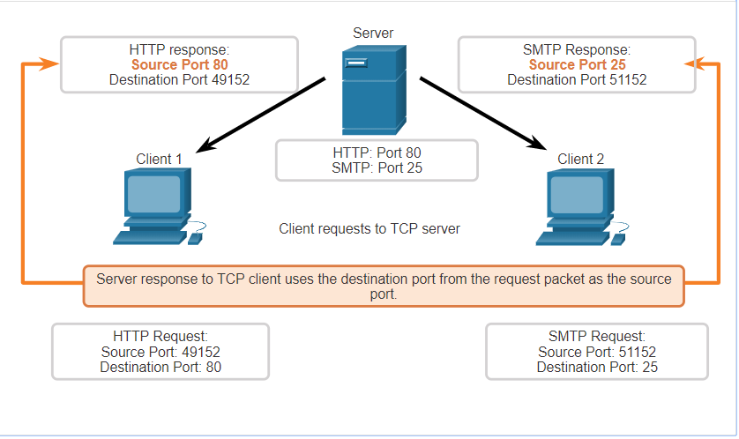
TCP Communication Process TCP Server Processes
Each application process running on a server is configured to use a port number.
An individual server cannot have two services assigned to the same port number within the same transport layer services.
An active server application assigned to a specific port is considered open, which means that the transport layer accepts, and processes segments addressed to that port.
Any incoming client request addressed to the correct socket is accepted, and the data is passed to the server application.
Notes:
14 – Transport Layer
14.5 – TCP Communication Process
14.5.1 – TCP Server Processes

Slide 37
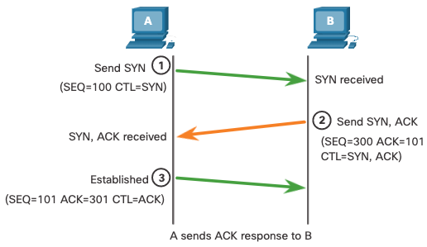
TCP Communication Process TCP Connection Establishment
Step 1: The initiating client requests a client-to-server communication session with the server.
Step 2: The server acknowledges the client-to-server communication session and requests a server-to-client communication session.
Step 3: The initiating client acknowledges the server-to-client communication session.
Notes:
14 – Transport Layer
14.5 – TCP Communication Process
14.5.2 – TCP Connection Establishment

Slide 38
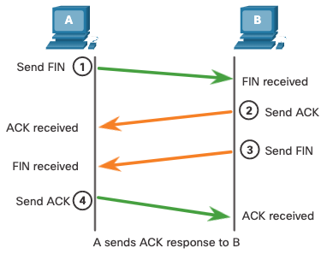
TCP Communication Process Session Termination
Step 1: When the client has no more data to send in the stream, it sends a segment with the FIN flag set.
Step 2: The server sends an ACK to acknowledge the receipt of the FIN to terminate the session from client to server.
Step 3: The server sends a FIN to the client to terminate the server-to-client session.
Step 4: The client responds with an ACK to acknowledge the FIN from the server.
Notes:
14 – Transport Layer
14.5 – TCP Communication Process
14.5.3 – Session Termination

Slide 39
TCP Communication Process TCP Three-Way Handshake Analysis
Functions of the Three-Way Handshake:
It establishes that the destination device is present on the network.
It verifies that the destination device has an active service and is accepting requests on the destination port number that the initiating client intends to use.
It informs the destination device that the source client intends to establish a communication session on that port number.
After the communication is completed the sessions are closed, and the connection is terminated. The connection and session mechanisms enable TCP reliability function.
Notes:
14 – Transport Layer
14.5 – TCP Communication Process
14.5.4 – Three-way Handshake Establishment

Slide 40
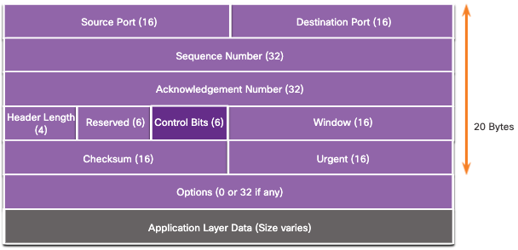
TCP Communication Process TCP Three-Way Handshake Analysis (Cont.)
The six control bit flags are as follows:
URG - Urgent pointer field significant
ACK - Acknowledgment flag used in connection establishment and session termination
PSH - Push function
RST - Reset the connection when an error or timeout occurs
SYN - Synchronize sequence numbers used in connection establishment
FIN - No more data from sender and used in session termination
Notes:
14 – Transport Layer
14.5 – TCP Communication Process
14.5.4 – Three-way Handshake Analysis

Slide 41
TCP Communication Process Video TCP 3-Way Handshake
The video covers the following:
TCP 3-Way Handshake
Termination of a TCP conversation
Notes:
14 – Transport Layer
14.5 – TCP Communication Process
14.5.5 – Video - TCP Three Way Handshake
14.5.6 – Check your Understanding - TCP Communication Process

Slide 42
14.6 Reliability and Flow Control
Notes:
14 – Transport Layer
14.6 – Reliability and Flow Control

Slide 43
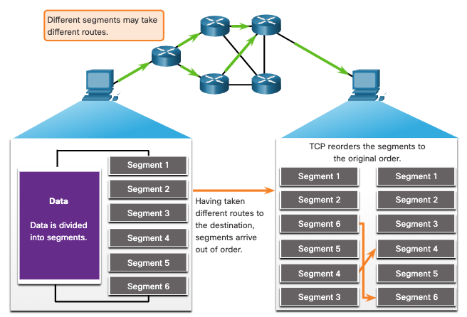
Reliability and Flow Control TCP Reliability- Guaranteed and Ordered Delivery
TCP can also help maintain the flow of packets so that devices do not become overloaded.
There may be times when TCP segments do not arrive at their destination or arrive out of order.
All the data must be received and the data in these segments must be reassembled into the original order.
Sequence numbers are assigned in the header of each packet to achieve this goal.
Notes:
14 – Transport Layer
14.6 – Reliability and Flow Control
14.6.1 – TCP Reliability – Guaranteed and Ordered Delivery

Slide 44
Reliability and Flow Control Video -TCP Reliability- Sequence Numbers and Acknowledgments
This video depicts a simplified example of the TCP operations.
Notes:
14 – Transport Layer
14.6 – Reliability and Flow Control
14.6.2 – Video –TCP Reliability – Sequence Numbers and Acknowledgements

Slide 45
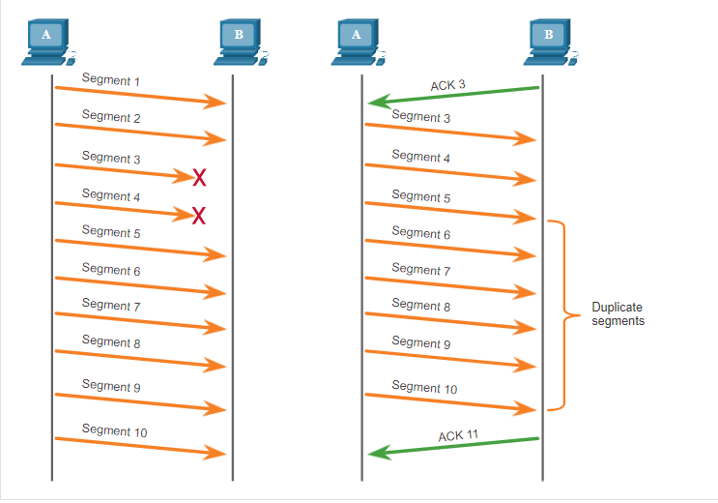
Reliability and Flow Control TCP Reliability – Data Loss and Retransmission
No matter how well designed a network is, data loss occasionally occurs.
TCP provides methods of managing these segment losses. Among these is a mechanism to retransmit segments for unacknowledged data.
Notes:
14 – Transport Layer
14.6 – Reliability and Flow Control
14.6.3 TCP Reliability – Data Loss and Transmission

Slide 46
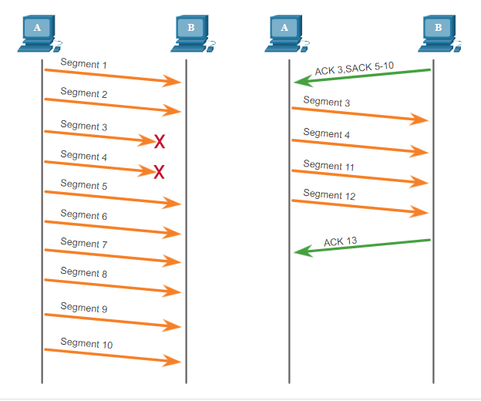
Reliability and Flow Control TCP Reliability – Data Loss and Retransmission (Cont.)
Host operating systems today typically employ an optional TCP feature called selective acknowledgment (SACK), negotiated during the three-way handshake.
If both hosts support SACK, the receiver can explicitly acknowledge which segments (bytes) were received including any discontinuous segments.
Notes:
14 – Transport Layer
14.6 – Reliability and Flow Control
14.6.3 TCP Reliability – Data Loss and Transmission (Cont.)

Slide 47
Reliability and Flow Control Video - TCP Reliability – Data Loss and Retransmission
This video shows the process of resending segments that are not initially received by the destination.
Notes:
14 – Transport Layer
14.6 – Reliability and Flow Control
14.6.4 – Video –TCP-Reliability – Data Loss and Retransmission

Slide 48
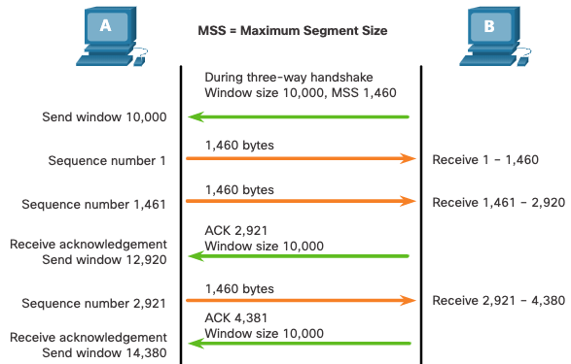
Reliability and Flow Control TCP Flow Control – Window Size and Acknowledgments
TCP also provides mechanisms for flow control as follows:
Flow control is the amount of data that the destination can receive and process reliably.
Flow control helps maintain the reliability of TCP transmission by adjusting the rate of data flow between source and destination for a given session.
Notes:
14 – Transport Layer
14.6 – Reliability and Flow Control
14.6.5 – TCP Flow Control – Window Size and Acknowledgments

Slide 49
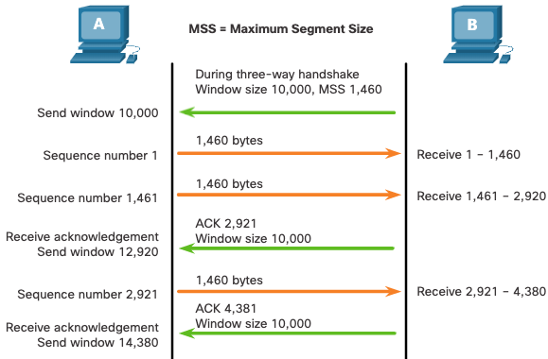
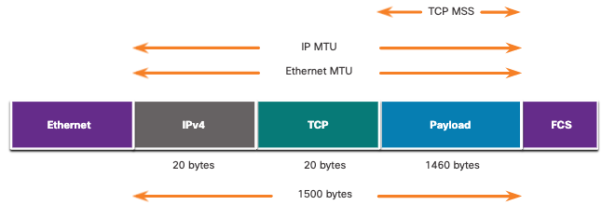
Reliability and Flow Control TCP Flow Control – Maximum Segment Size
Maximum Segment Size (MSS) is the maximum amount of data that the destination device can receive.
A common MSS is 1,460 bytes when using IPv4.
A host determines the value of its MSS field by subtracting the IP and TCP headers from the Ethernet maximum transmission unit (MTU), which is 1500 bytes be default.
1500 minus 60 (20 bytes for the IPv4 header and 20 bytes for the TCP header) leaves 1460 bytes.
Notes:
14 – Transport Layer
14.6 – Reliability and Flow Control
14.6.6 – TCP Flow Control – Maximum Segment Size (MSS)

Slide 50
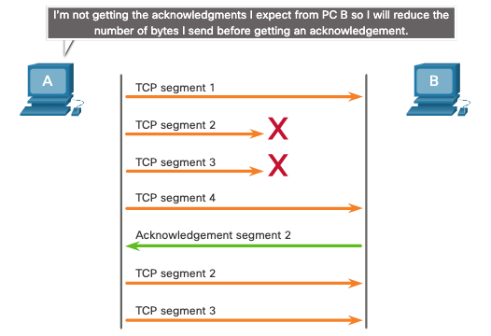
Reliability and Flow Control TCP Flow Control – Congestion Avoidance
When congestion occurs on a network, it results in packets being discarded by the overloaded router.
To avoid and control congestion, TCP employs several congestion handling mechanisms, timers, and algorithms.
Notes:
14 – Transport Layer
14.6 – Reliability and Flow Control
14.6.7 – TCP Flow Control – Congestion Avoidance
14.6.8 – Check you Understanding – Reliability and Flow Control

Slide 51
14.7 UDP Communication
Notes:
14 – Transport Layer
14.7 UDP Communication

Slide 52
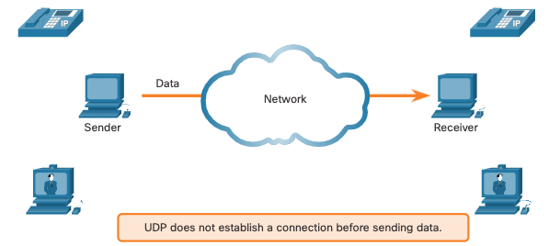
UDP Communication UDP Low Overhead versus Reliability
UDP does not establish a connection. UDP provides low overhead data transport because it has a small datagram header and no network management traffic.
Notes:
14 – Transport Layer
14.7 - UDP Communication
14.7.1 - UDP Low Overhead versus Reliability

Slide 53
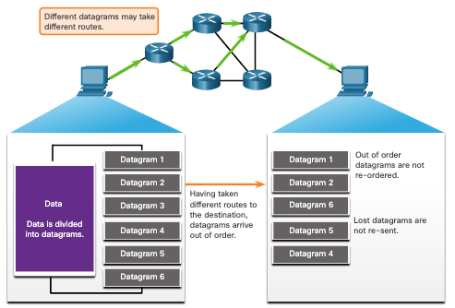
UDP Communication UDP Datagram Reassembly
UDP does not track sequence numbers the way TCP does.
UDP has no way to reorder the datagrams into their transmission order.
UDP simply reassembles the data in the order that it was received and forwards it to the application.
Notes:
14 – Transport Layer
14.7 - UDP Communication
14.7.2 – UDP Datagram Reassembly

Slide 54
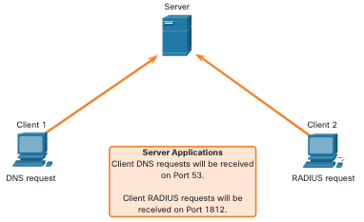
UDP Communication UDP Server Processes and Requests
UDP-based server applications are assigned well-known or registered port numbers.
UDP receives a datagram destined for one of these ports, it forwards the application data to the appropriate application based on its port number.
Notes:
14 – Transport Layer
14.7 - UDP Communication
14.7.3 – UDP Server Processes and Requests

Slide 55
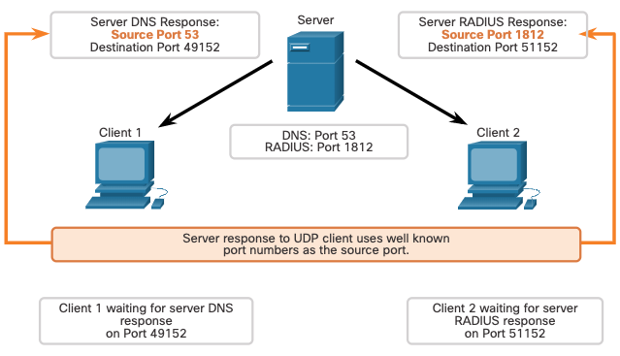
UDP Communication UDP Client Processes
The UDP client process dynamically selects a port number from the range of port numbers and uses this as the source port for the conversation.
The destination port is usually the well-known or registered port number assigned to the server process.
After a client has selected the source and destination ports, the same pair of ports are used in the header of all datagrams in the transaction.
Notes:
14 – Transport Layer
14.7 - UDP Communication
14.7.4 – UDP Client Processes
14.7.5 Check Your Understanding – UDP Communication

Slide 56
14.8 Module Practice and Quiz
Notes:
14 – Transport Layer
14.8 – Module Practice and Quiz

Slide 57
Module Practice and Quiz Packet Tracer - TCP and UDP Communications
In this Packet Tracer, you will do the following:
Generate Network Traffic in Simulation Mode.
Examine the Functionality of the TCP and UDP Protocols.
Notes:
14 – Transport Layer
14.8 – Modules Practice and Quiz
14.8.1 – Packet Tracer – TCP and UDP Communications

Slide 58
Module Practice and Quiz What did I learn in this module?
The transport layer is the link between the application layer and the lower layers that are responsible for network transmission.
The transport layer includes TCP and UDP.
TCP establishes sessions, ensures reliability, provides same-order delivery, and supports flow control.
UDP is a simple protocol that provides the basic transport layer functions.
UDP reconstructs data in the order it is received, lost segments are not resent, no session establishment, and UPD does not inform the sender of resource availability.
The TCP and UDP transport layer protocols use port numbers to manage multiple simultaneous conversations.
Each application process running on a server is configured to use a port number.
The port number is either automatically assigned or configured manually by a system administrator.
For the original message to be understood by the recipient, all the data must be received and the data in these segments must be reassembled into the original order.
Notes:
14 – Transport Layer
14.8 – Modules Practice and Quiz
14.8.2 – What did I learn this module?

Slide 59
Module Practice and Quiz What did I learn in this module (Cont.)?
Sequence numbers are assigned in the header of each packet.
Flow control helps maintain the reliability of TCP transmission by adjusting the rate of data flow between source and destination.
A source might be transmitting 1,460 bytes of data within each TCP segment. This is the typical MSS that a destination device can receive.
The process of the destination sending acknowledgments as it processes bytes received and the continual adjustment of the source’s send window is known as sliding windows.
To avoid and control congestion, TCP employs several congestion handling mechanisms.
Notes:
14 – Transport Layer
14.8 – Modules Practice and Quiz
14.8.2 – What did I learn this module? (Cont.)
14.8.3 - Module Quiz - Transport Layer

Slide 60
Module 14: Transport Layer New Terms and Commands
Conversation Multiplexing
Segments
Datagrams
Connection-Oriented Protocol
Connectionless Protocol
Stateless Protocol
Flow Control
Same-Order Delivery
Socket Pairs
netstat
Three-Way Handshake
SYN
ACK
FIN
URG
PSH
RST
Initial Sequence Number (ISN)
Selective Acknowledgement (SACK)
Sliding Window
Maximum Segment Size (MSS)
Maximum Transmission Unit (MTU)
Congestion Avoidance

