Slide 1

Module 16: Network Security Fundamentals
Instructor Materials
Introduction to Networks v7.0 (ITN)

Slide 2
Instructor Materials – Module 16 Planning Guide
This PowerPoint deck is divided in two parts:
Instructor Planning Guide
Information to help you become familiar with the module
Teaching aids
Instructor Class Presentation
Optional slides that you can use in the classroom
Begins on slide # 10
Note: Remove the Planning Guide from this presentation before sharing with anyone.
For additional help and resources go to the Instructor Home Page and Course Resources for this course. You also can visit the professional development site on netacad.com, the official Cisco Networking Academy Facebook page, or Instructor Only FB group.
Notes:
2

Slide 3
What to Expect in this Module
To facilitate learning, the following features within the GUI may be included in this module:
Feature | Description
Animations | Expose learners to new skills and concepts.
Videos | Expose learners to new skills and concepts.
Check Your Understanding(CYU) | Per topic online quiz to help learners gauge content understanding.
Interactive Activities | A variety of formats to help learners gauge content understanding.
Syntax Checker | Small simulations that expose learners to Cisco command line to practice configuration skills.
PT Activity | Simulation and modeling activities designed to explore, acquire, reinforce, and expand skills.

Slide 4
What to Expect in this Module (Cont.)
To facilitate learning, the following features may be included in this module:
Feature | Description
Hands-On Labs | Labs designed for working with physical equipment.
Class Activities | These are found on the Instructor Resources page. Class Activities are designed to facilitate learning, class discussion, and collaboration.
Module Quizzes | Self-assessments that integrate concepts and skills learned throughout the series of topics presented in the module.
Module Summary | Briefly recaps module content.

Slide 5
Check Your Understanding
Check Your Understanding activities are designed to let students quickly determine if they understand the content and can proceed, or if they need to review.
Check Your Understanding activities do not affect student grades.
There are no separate slides for these activities in the PPT. They are listed in the notes area of the slide that appears before these activities.
Notes:
5

Slide 6
Module 16: Activities
What activities are associated with this module?
Page # | Activity Type | Activity Name | Optional?
16.1.4 | Check Your Understanding | Security Threats and Vulnerabilities | Recommended
16.2.5 | Check Your Understanding | Network Attacks | Recommended
16.2.6 | Lab | Research Network Security Threats | Recommended
16.3.8 | Check Your Understanding | Network Attack Mitigations | Recommended
16.4.6 | Packet Tracer | Configure Secure Passwords and SSH | Recommended
16.4.7 | Lab | Configure Network Devices with SSH | Recommended
16.5.1 | Packet Tracer | Secure Network Devices | Recommended
16.5.2 | Lab | Secure Network Devices | Recommended
Notes:
6

Slide 7
Module 16: Best Practices
Prior to teaching Module 16, the instructor should:
Review the activities and assessments for this module.
Try to include as many questions as possible to keep students engaged during classroom presentation.
Topic 16.1
Ask the students or have a class discussion
What is another threat that you can think of?
Have you ever seen or experienced a lapse In physical security? Share your experience, if you can.
Topic 16.2
Ask the students or have a class discussion
What methods might you use to protect yourself against reconnaissance attacks?
Can you think of any other ways a Denial of Service (DoS) attack could be carried out, and what the impact might be?
Notes:
7

Slide 8
Module 16: Best Practices (Cont.)
Topic 16.1
Ask the students or have a class discussion
What is another threat that you can think of?
Have you ever seen or experienced a lapse In physical security? Share your experience.
Topic 16.2
Ask the students or have a class discussion
What methods might you use to protect yourself against reconnaissance attacks?
Can you think of any other ways a Denial of Service (DoS) attack could be carried out, and what the impact might be?
Notes:
8

Slide 9
Module 16: Best Practices (Cont.)
Topic 16.3
Ask the students or have a class discussion
How might the Defense-in-Depth approach to security be applied in a home network scenario?
How do you think the Accounting part of AAA helps to provide security?
Topic 16.4
Ask the students or have a class discussion
What other methods of supplying a password do you know of?
Is remote terminal services all that can be done with SSH? Research the protocol capabilities and discuss.
Notes:
9

Slide 10
Module 16: Network Security Fundamentals
Introduction to Networks v7.0 (ITN)
Notes:
Cisco Networking Academy Program
Introduction to Networks v7.0 (ITN)
Module 16: Network Security Fundamentals

Slide 11
Module Objectives
Module Title: Network Security Fundamentals
Module Objective: Configure switches and routers with device hardening features to enhance security.
Topic Title | Topic Objective
Security Threats and Vulnerabilities | Explain why basic security measure are necessary on network devices.
Network Attacks | Identify security vulnerabilities.
Network Attack Mitigation | Identify general mitigation techniques.
Device Security | Configure network devices with device hardening features to mitigate security threats.
Notes:
11
16- Network Security Fundamentals
16.0.2- What will I learn to do in this module?

Slide 12
16.1 Security Threats and Vulnerabilities
Notes:
16.0 Network Security Fundamentals
16.1 Security Threats and Vulnerabilities

Slide 13
Security Threats and Vulnerabilities Types of Threats
Attacks on a network can be devastating and can result in a loss of time and money due to damage, or theft of important information or assets. Intruders can gain access to a network through software vulnerabilities, hardware attacks, or through guessing someone's username and password. Intruders who gain access by modifying software or exploiting software vulnerabilities are called threat actors.
After the threat actor gains access to the network, four types of threats may arise:
Information Theft
Data Loss and manipulation
Identity Theft
Disruption of Service
Notes:
16 – Network Security Fundamentals
16.1 – Security Threats and Vulnerabilities
16.1.1 – Types of Threats

Slide 14
Security Threats and Vulnerabilities Types of Vulnerabilities
Vulnerability is the degree of weakness in a network or a device. Some degree of vulnerability is inherent in routers, switches, desktops, servers, and even security devices. Typically, the network devices under attack are the endpoints, such as servers and desktop computers.
There are three primary vulnerabilities or weaknesses:
Technological Vulnerabilities might include TCP/IP Protocol weaknesses, Operating System Weaknesses, and Network Equipment weaknesses.
Configuration Vulnerabilities might include unsecured user accounts, system accounts with easily guessed passwords, misconfigured internet services, unsecure default settings, and misconfigured network equipment.
Security Policy Vulnerabilities might include lack of a written security policy, politics, lack of authentication continuity, logical access controls not applied, software and hardware installation and changes not following policy, and a nonexistent disaster recovery plan.
All three of these sources of vulnerabilities can leave a network or device open to various attacks, including malicious code attacks and network attacks.
Notes:
16 – Network Security Fundamentals
16.1 – Security Threats and Vulnerabilities
16.1.2 – Types of Vulnerabilities

Slide 15
Security Threats and Vulnerabilities Physical Security
If network resources can be physically compromised, a threat actor can deny the use of network resources. The four classes of physical threats are as follows:
Hardware threats - This includes physical damage to servers, routers, switches, cabling plant, and workstations.
Environmental threats - This includes temperature extremes (too hot or too cold) or humidity extremes (too wet or too dry).
Electrical threats - This includes voltage spikes, insufficient supply voltage (brownouts), unconditioned power (noise), and total power loss.
Maintenance threats - This includes poor handling of key electrical components (electrostatic discharge), lack of critical spare parts, poor cabling, and poor labeling.
A good plan for physical security must be created and implemented to address these issues.
Notes:
16 – Network Security Fundamentals
16.1 – Security Threats and Vulnerabilities
16.1.3 – Physical Security
16.1.4 – Check Your Understanding – Security Threats and Vulnerabilities

Slide 16
16.2 Network Attacks
Notes:
16.0 Network Security Fundamentals
16.2 Network Attacks

Slide 17
Network Attacks Types of Malware
Malware is short for malicious software. It is code or software specifically designed to damage, disrupt, steal, or inflict “bad” or illegitimate action on data, hosts, or networks. The following are types of malware:
Viruses - A computer virus is a type of malware that propagates by inserting a copy of itself into, and becoming part of, another program. It spreads from one computer to another, leaving infections as it travels.
Worms - Computer worms are similar to viruses in that they replicate functional copies of themselves and can cause the same type of damage. In contrast to viruses, which require the spreading of an infected host file, worms are standalone software and do not require a host program or human help to propagate.
Trojan Horses - It is a harmful piece of software that looks legitimate. Unlike viruses and worms, Trojan horses do not reproduce by infecting other files. They self-replicate. Trojan horses must spread through user interaction such as opening an email attachment or downloading and running a file from the internet.
Notes:
16 – Network Security Fundamentals
16.2 – Network Attacks
16.2.1 – Types of Malware

Slide 18
Network Attacks Reconnaissance Attacks
In addition to malicious code attacks, it is also possible for networks to fall prey to various network attacks. Network attacks can be classified into three major categories:
Reconnaissance attacks - The discovery and mapping of systems, services, or vulnerabilities.
Access attacks - The unauthorized manipulation of data, system access, or user privileges.
Denial of service - The disabling or corruption of networks, systems, or services.
For reconnaissance attacks, external threat actors can use internet tools, such as the nslookup and whois utilities, to easily determine the IP address space assigned to a given corporation or entity. After the IP address space is determined, a threat actor can then ping the publicly available IP addresses to identify the addresses that are active.
Notes:
16 – Network Security Fundamentals
16.2 – Network Attacks
16.2.2 – Reconnaissance Attacks

Slide 19
Network Attacks Access Attacks
Access attacks exploit known vulnerabilities in authentication services, FTP services, and web services to gain entry to web accounts, confidential databases, and other sensitive information.
Access attacks can be classified into four types:
Password attacks - Implemented using brute force, trojan horse, and packet sniffers
Trust exploitation - A threat actor uses unauthorized privileges to gain access to a system, possibly compromising the target.
Port redirection: - A threat actor uses a compromised system as a base for attacks against other targets. For example, a threat actor using SSH (port 22) to connect to a compromised host A. Host A is trusted by host B and, therefore, the threat actor can use Telnet (port 23) to access it.
Man-in-the middle - The threat actor is positioned in between two legitimate entities in order to read or modify the data that passes between the two parties.
Notes:
16 – Network Security Fundamentals
16.2 – Network Attacks
16.2.3 – Access Attacks

Slide 20
Network Attacks Denial of Service Attacks
Denial of service (DoS) attacks are the most publicized form of attack and among the most difficult to eliminate. However, because of their ease of implementation and potentially significant damage, DoS attacks deserve special attention from security administrators.
DoS attacks take many forms. Ultimately, they prevent authorized people from using a service by consuming system resources. To help prevent DoS attacks it is important to stay up to date with the latest security updates for operating systems and applications.
DoS attacks are a major risk because they interrupt communication and cause significant loss of time and money. These attacks are relatively simple to conduct, even by an unskilled threat actor.
A DDoS is similar to a DoS attack, but it originates from multiple, coordinated sources. For example, a threat actor builds a network of infected hosts, known as zombies. A network of zombies is called a botnet. The threat actor uses a command and control (CnC) program to instruct the botnet of zombies to carry out a DDoS attack.
Notes:
16 – Network Security Fundamentals
16.2 – Network Attacks
16.2.4 – Denial-of-Service Attacks
16.2.5 – Check You Understanding – Network Attacks

Slide 21
Network Attacks Lab – Research Network Security Threats
In this lab, you will complete the following objectives:
Part 1: Explore the SANS Website
Part 2: Identify Recent Network Security Threats
Part 3: Detail a Specific Network Security Threat
Notes:
16 – Network Security Fundamentals
16.2 – Network Attacks
16.2.6 – Lab – Research Network Security Threats

Slide 22
16.3 Network Attack Mitigations
Notes:
16.0 Network Security Fundamentals
16.3 Network Attack Mitigations

Slide 23
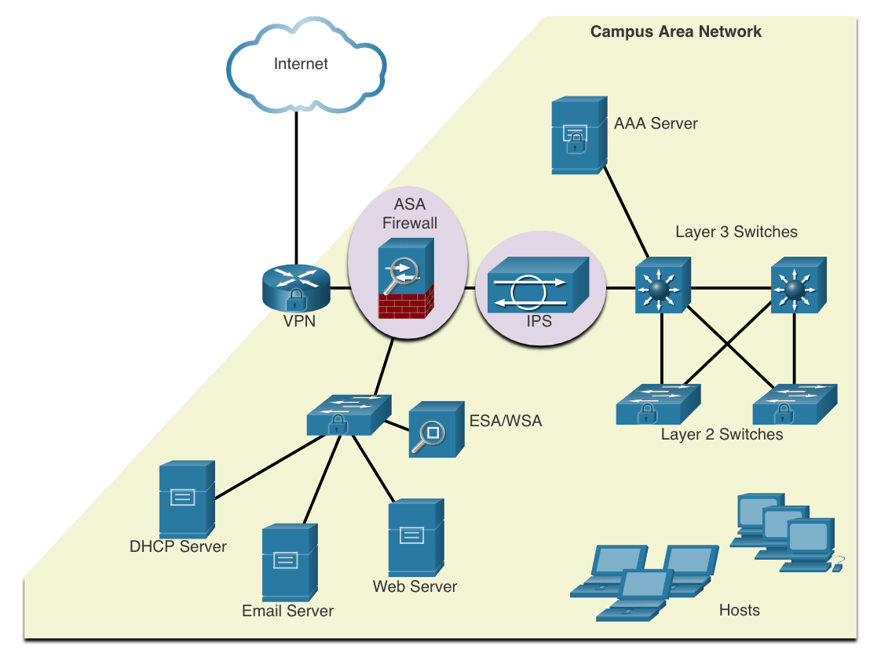
Network Attack Mitigations The Defense-in-Depth Approach
To mitigate network attacks, you must first secure devices including routers, switches, servers, and hosts. Most organizations employ a defense-in-depth approach (also known as a layered approach) to security. This requires a combination of networking devices and services working in tandem.
Several security devices and services are implemented to protect an organization’s users and assets against TCP/IP threats:
VPN
ASA Firewall
IPS
ESA/WSA
AAA Server
Notes:
16 – Network Security Fundamentals
16.3 – Network Attack Mitigations
16.3.1 – The Defense-in-Depth Approach

Slide 24
Network Attack Mitigations Keep Backups
Backing up device configurations and data is one of the most effective ways of protecting against data loss. Backups should be performed on a regular basis as identified in the security policy. Data backups are usually stored offsite to protect the backup media if anything happens to the main facility.
The table shows backup considerations and their descriptions.
Consideration | Description
Frequency | Perform backups on a regular basis as identified in the security policy. Full backups can be time-consuming, therefore perform monthly or weekly backups with frequent partial backups of changed files.
Storage | Always validate backups to ensure the integrity of the data and validate the file restoration procedures.
Security | Backups should be transported to an approved offsite storage location on a daily, weekly, or monthly rotation, as required by the security policy.
Validation | Backups should be protected using strong passwords. The password is required to restore the data.
Notes:
16 – Network Security Fundamentals
16.3 – Network Attack Mitigations
16.3.2 Keep Backups

Slide 25
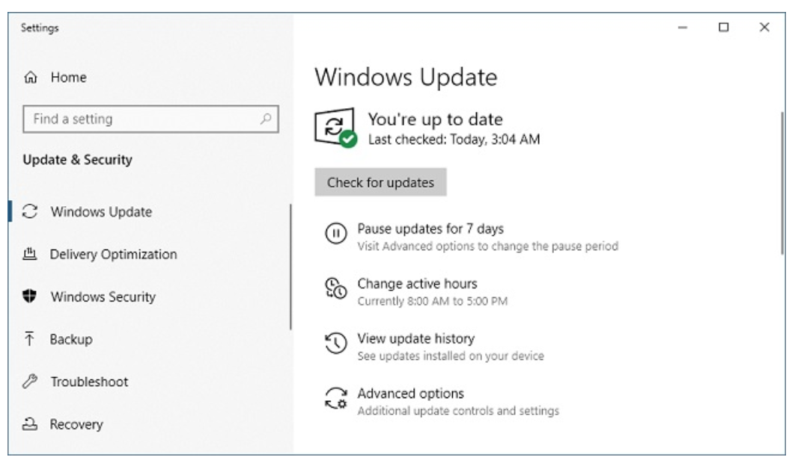
Network Attack Mitigations Upgrade, Update, and Patch
As new malware is released, enterprises need to keep current with the latest versions of antivirus software.
The most effective way to mitigate a worm attack is to download security updates from the operating system vendor and patch all vulnerable systems.
One solution to the management of critical security patches is to make sure all end systems automatically download updates.
Notes:
16 – Network Security Fundamentals
16.3 – Network Attack Mitigations
16.3.3 – Upgrade, Update, and Patch

Slide 26
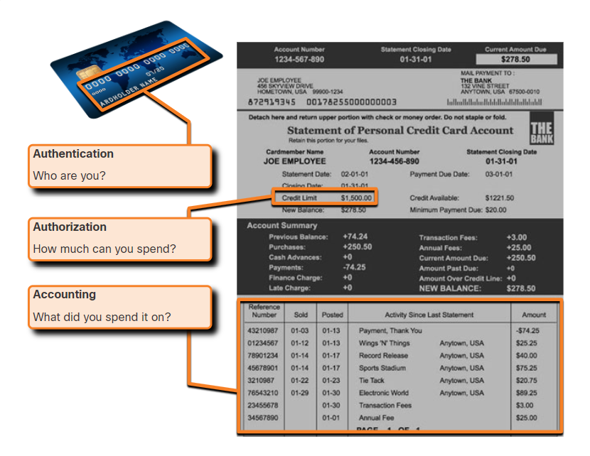
Network Attack Mitigations Authentication, Authorization, and Accounting
Authentication, authorization, and accounting (AAA, or “triple A”) network security services provide the primary framework to set up access control on network devices.
AAA is a way to control who is permitted to access a network (authenticate), what actions they perform while accessing the network (authorize), and making a record of what was done while they are there (accounting).
The concept of AAA is similar to the use of a credit card. The credit card identifies who can use it, how much that user can spend, and keeps account of what items the user spent money on.
Notes:
16 – Network Security Fundamentals
16.3 – Network Attack Mitigations
16.3.4 – Authentication, Authorization, and Accounting

Slide 27
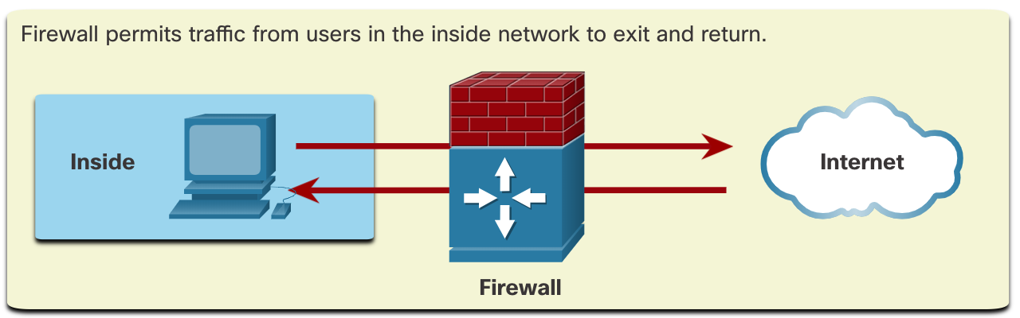
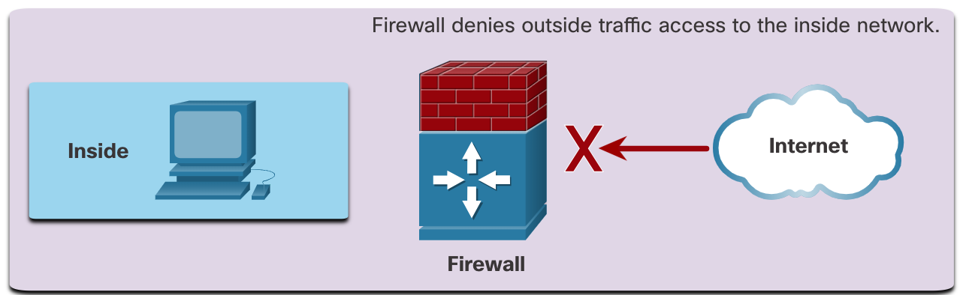
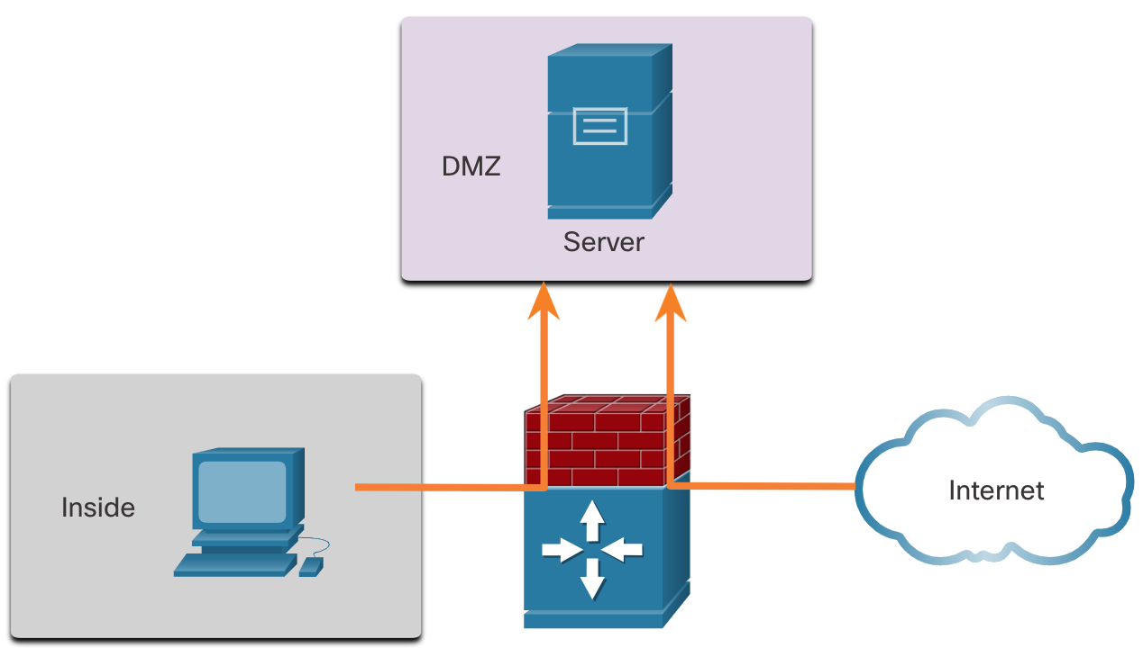
Network Attack Mitigations Firewalls
Network firewalls reside between two or more networks, control the traffic between them, and help prevent unauthorized access.
A firewall could allow outside users controlled access to specific services. For example, servers accessible to outside users are usually located on a special network referred to as the demilitarized zone (DMZ). The DMZ enables a network administrator to apply specific policies for hosts connected to that network.
Notes:
16 – Network Security Fundamentals
16.3 – Network Attack Mitigations
16.3.5 - Firewalls

Slide 28
Network Attack Mitigations Types of Firewalls
Firewall products come packaged in various forms. These products use different techniques for determining what will be permitted or denied access to a network. They include the following:
Packet filtering - Prevents or allows access based on IP or MAC addresses
Application filtering - Prevents or allows access by specific application types based on port numbers
URL filtering - Prevents or allows access to websites based on specific URLs or keywords
Stateful packet inspection (SPI) - Incoming packets must be legitimate responses to requests from internal hosts. Unsolicited packets are blocked unless permitted specifically. SPI can also include the capability to recognize and filter out specific types of attacks, such as denial of service (DoS).
Notes:
16 – Network Security Fundamentals
16.3 – Network Attack Mitigations
16.3.6 – Types of Firewalls

Slide 29
Network Attack Mitigations Endpoint Security
An endpoint, or host, is an individual computer system or device that acts as a network client. Common endpoints are laptops, desktops, servers, smartphones, and tablets.
Securing endpoint devices is one of the most challenging jobs of a network administrator because it involves human nature. A company must have well-documented policies in place and employees must be aware of these rules.
Employees need to be trained on proper use of the network. Policies often include the use of antivirus software and host intrusion prevention. More comprehensive endpoint security solutions rely on network access control.
Notes:
16 – Network Security Fundamentals
16.3 – Network Attack Mitigations
16.3.7 – Endpoint Security
16.3.8 – Check Your Understanding – Network Attack Mitigation

Slide 30
16.4 Device Security
Notes:
16.0 Network Security Fundamentals
16.4 Device Security

Slide 31
Device Security Cisco AutoSecure
The security settings are set to the default values when a new operating system is installed on a device. In most cases, this level of security is inadequate. For Cisco routers, the Cisco AutoSecure feature can be used to assist securing the system.
In addition, there are some simple steps that should be taken that apply to most operating systems:
Default usernames and passwords should be changed immediately.
Access to system resources should be restricted to only the individuals that are authorized to use those resources.
Any unnecessary services and applications should be turned off and uninstalled when possible.
Often, devices shipped from the manufacturer have been sitting in a warehouse for a period of time and do not have the most up-to-date patches installed. It is important to update any software and install any security patches prior to implementation.
Notes:
16 – Network Security Fundamentals
16.4 – Device Security
16.4.1 – Cisco AutoSecure

Slide 32
Device Security Passwords
To protect network devices, it is important to use strong passwords. Here are standard guidelines to follow:
Use a password length of at least eight characters, preferably 10 or more characters.
Make passwords complex. Include a mix of uppercase and lowercase letters, numbers, symbols, and spaces, if allowed.
Avoid passwords based on repetition, common dictionary words, letter or number sequences, usernames, relative or pet names, biographical information, such as birthdates, ID numbers, ancestor names, or other easily identifiable pieces of information.
Deliberately misspell a password. For example, Smith = Smyth = 5mYth or Security = 5ecur1ty.
Change passwords often. If a password is unknowingly compromised, the window of opportunity for the threat actor to use the password is limited.
Do not write passwords down and leave them in obvious places such as on the desk or monitor.
On Cisco routers, leading spaces are ignored for passwords, but spaces after the first character are not. Therefore, one method to create a strong password is to use the space bar and create a phrase made of many words. This is called a passphrase. A passphrase is often easier to remember than a simple password. It is also longer and harder to guess.
Notes:
16 – Network Security Fundamentals
16.4 – Device Security
16.4.2 - Passwords

Slide 33
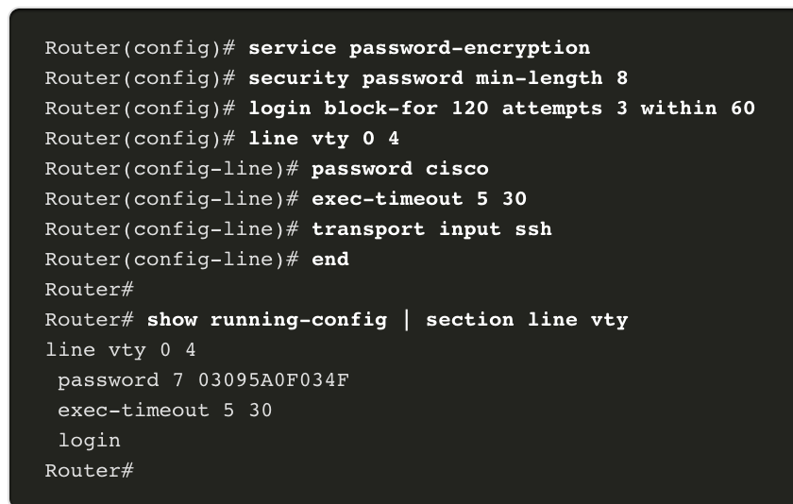
Device Security Additional Password Security
There are several steps that can be taken to help ensure that passwords remain secret on a Cisco router and switch including these:
Encrypt all plaintext passwords with the service password-encryption command.
Set a minimum acceptable password length with the security passwords min-length command.
Deter brute-force password guessing attacks with the login block-for # attempts # within # command.
Disable an inactive privileged EXEC mode access after a specified amount of time with the exec-timeout command.
Notes:
16 – Network Security Fundamentals
16.4 – Device Security
16.4.3 – Additional Password Security

Slide 34
Device Security Enable SSH
It is possible to configure a Cisco device to support SSH using the following steps:
Configure a unique device hostname. A device must have a unique hostname other than the default.
Configure the IP domain name. Configure the IP domain name of the network by using the global configuration mode command ip-domain name.
Generate a key to encrypt SSH traffic. SSH encrypts traffic between source and destination. However, to do so, a unique authentication key must be generated by using the global configuration command crypto key generate rsa general-keys modulus bits. The modulus bits determines the size of the key and can be configured from 360 bits to 2048 bits. The larger the bit value, the more secure the key. However, larger bit values also take longer to encrypt and decrypt information. The minimum recommended modulus length is 1024 bits.
Verify or create a local database entry. Create a local database username entry using the username global configuration command.
Authenticate against the local database. Use the login local line configuration command to authenticate the vty line against the local database.
Enable vty inbound SSH sessions. By default, no input session is allowed on vty lines. You can specify multiple input protocols including Telnet and SSH using the transport input [ssh | telnet] command.
Notes:
16 – Network Security Fundamentals
16.4 – Device Security
16.4.4 - Enable SSH

Slide 35
Device Security Disable Unused Services
Cisco routers and switches start with a list of active services that may or may not be required in your network. Disable any unused services to preserve system resources, such as CPU cycles and RAM, and prevent threat actors from exploiting these services.
The type of services that are on by default will vary depending on the IOS version. For example, IOS-XE typically will have only HTTPS and DHCP ports open. You can verify this with the show ip ports all command.
IOS versions prior to IOS-XE use the show control-plane host open-ports command.
Notes:
16 – Network Security Fundamentals
16.4 – Device Security
16.4.5 – Disable Unused Services

Slide 36
Device Security Packet Tracer – Configure Secure Passwords and SSH
In this Packet Tracer, you will configure passwords and SSH:
The network administrator has asked you to prepare RTA and SW1 for deployment. Before they can be connected to the network, security measures must be enabled.
Notes:
16 – Network Security Fundamentals
16.4 – Device Security
16.4.6 – Packet Tracer – Configure Secure Passwords and SSH

Slide 37
Device Security Lab – Configure Network Devices with SSH
In this lab, you will complete the following objectives:
Part 1: Configure Basic Device Settings
Part 2: Configure the Router for SSH Access
Part 3: Configure the Switch for SSH Access
Part 4: SSH from the CLI on the Switch
Notes:
16 – Network Security Fundamentals
16.4 – Device Security
16.4.7 – Lab – Configure Network Devices with SSH

Slide 38
16.5 Module Practice and Quiz
Notes:
16.0 Network Security Fundamentals
16.5 Module Practice and Quiz

Slide 39
Module Practice and Quiz Packet Tracer – Secure Network Devices
In this activity you will configure a router and a switch based on a list of requirements.
Notes:
16 – Network Security Fundamentals
16.5 – Module Practice and Quiz
16.5.1 – Packet Tracer – Secure Network Devices

Slide 40
Module Practice and Quiz Lab – Secure Network Devices
In this lab, you will complete the following objectives:
Configure Basic Device Settings
Configure Basic Security Measures on the Router
Configure Basic Security Measures on the Switch
Notes:
16 – Network Security Fundamentals
16.5 – Module Practice and Quiz
16.5.2 – Lab – Secure Network Devices

Slide 41
Module Practice and Quiz What Did I Learn In This Module?
After the threat actor gains access to the network, four types of threats may arise: information theft, data loss and manipulation, identity theft, and disruption of service.
There are three primary vulnerabilities or weaknesses: technological, configuration, and security policy.
The four classes of physical threats are: hardware, environmental, electrical, and maintenance.
Malware is short for malicious software. It is code or software specifically designed to damage, disrupt, steal, or inflict “bad” or illegitimate action on data, hosts, or networks. Viruses, worms, and Trojan horses are types of malware.
Network attacks can be classified into three major categories: reconnaissance, access, and denial of service.
To mitigate network attacks, you must first secure devices including routers, switches, servers, and hosts. Most organizations employ a defense-in-depth approach to security. This requires a combination of networking devices and services working together.
Several security devices and services are implemented to protect an organization’s users and assets against TCP/IP threats: VPN, ASA firewall, IPS, ESA/WSA, and AAA server.
Notes:
16 – Network Security Fundamentals
16.5 – Module Practice and Quiz
16.5.3 – What did I learn in this module?

Slide 42
Module Practice and Quiz What Did I Learn In This Module? (Cont.)
Infrastructure devices should have backups of configuration files and IOS images on an FTP or similar file server. If the computer or a router hardware fails, the data or configuration can be restored using the backup copy.
The most effective way to mitigate a worm attack is to download security updates from the operating system vendor and patch all vulnerable systems. To manage critical security patches, to make sure all end systems automatically download updates.
AAA is a way to control who is permitted to access a network (authenticate), what they can do while they are there (authorize), and what actions they perform while accessing the network (accounting).
Network firewalls reside between two or more networks, control the traffic between them, and help prevent unauthorized access.
Securing endpoint devices is critical to network security. A company must have well-documented policies in place, which may include the use of antivirus software and host intrusion prevention. More comprehensive endpoint security solutions rely on network access control.
Notes:
16 – Network Security Fundamentals
16.5 – Module Practice and Quiz
16.5.3 – What did I learn in this module? (Cont.)
16.5.4 – Module Quiz – Network Security Fundamentals

Slide 43
Module Practice and Quiz What Did I Learn In This Module? (Cont.)
For Cisco routers, the Cisco AutoSecure feature can be used to assist securing the system. For most OSs default usernames and passwords should be changed immediately, access to system resources should be restricted to only the individuals that are authorized to use those resources, and any unnecessary services and applications should be turned off and uninstalled when possible.
To protect network devices, it is important to use strong passwords. A passphrase is often easier to remember than a simple password. It is also longer and harder to guess.
For routers and switches, encrypt all plaintext passwords, setting a minimum acceptable password length, deter brute-force password guessing attacks, and disable an inactive privileged EXEC mode access after a specified amount of time.
Configure appropriate devices to support SSH, and disable unused services.
Notes:
16 – Network Security Fundamentals
16.5 – Module Practice and Quiz
16.5.3 – What did I learn in this module? (Cont.)
16.5.4 – Module Quiz – Network Security Fundamentals

Slide 44
Module 16: Network Security Fundamentals New Terms and Commands
threat actor
malware
reconnaissance attacks
access attacks
defense-in-depth
authentication, authorization, and accounting (AAA)
demilitarized zone (DMZ)
Cisco AutoSecure
passphrase
service password-encryption
security passwords min-length
login block-for
exec-timeout
crypto key generate rsa general-keys modulus
username password | secret
login local
transport input ssh
show ip ports all
show control-plan host open-ports

