Slide 1

Module 5: Number Systems
Instructor Materials
Introduction to Networks v7.0 (ITN)
Notes:
Cisco Networking Academy Program
Introduction to networks v7.0 (ITN)
Module 5: Number Systems

Slide 2
Instructor Materials – Module 5 Planning Guide
This PowerPoint deck is divided in two parts:
Instructor Planning Guide
Information to help you become familiar with the module
Teaching aids
Instructor Class Presentation
Optional slides that you can use in the classroom
Begins on slide # 8
Note: Remove the Planning Guide from this presentation before sharing with anyone.
For additional help and resources go to the Instructor Home Page and Course Resources for this course. You also can visit the professional development site on netacad.com, the official Cisco Networking Academy Facebook page, or Instructor Only FB group.
Notes:
2

Slide 3
What to Expect in this Module
To facilitate learning, the following features within the GUI may be included in this module:
Feature | Description
Animations | Expose learners to new skills and concepts.
Videos | Expose learners to new skills and concepts.
Check Your Understanding(CYU) | Per topic online quiz to help learners gauge content understanding.
Interactive Activities | A variety of formats to help learners gauge content understanding.
Syntax Checker | Small simulations that expose learners to Cisco command line to practice configuration skills.
PT Activity | Simulation and modeling activities designed to explore, acquire, reinforce, and expand skills.

Slide 4
What to Expect in this Module (Cont.)
To facilitate learning, the following features may be included in this module:
Feature | Description
Hands-On Labs | Labs designed for working with physical equipment.
Class Activities | These are found on the Instructor Resources page. Class Activities are designed to facilitate learning, class discussion, and collaboration.
Module Quizzes | Self-assessments that integrate concepts and skills learned throughout the series of topics presented in the module.
Module Summary | Briefly recaps module content.

Slide 5
Check Your Understanding
Check Your Understanding activities are designed to let students quickly determine if they understand the content and can proceed, or if they need to review.
Check Your Understanding activities do not affect student grades.
There are no separate slides for these activities in the PPT. They are listed in the notes area of the slide that appears before these activities.
Notes:
5

Slide 6
Module 5: Activities
What activities are associated with this module?
Page # | Activity Type | Activity Name | Optional?
5.1.2 | Video | Converting Between Binary and Decimal Numbering Systems | Recommended
5.1.4 | Check Your Understanding | Binary Number System | Recommended
5.1.6 | Activity | Binary to Decimal Conversions | Recommended
5.1.9 | Activity | Decimal to Binary Conversions | Recommended
5.1.10 | Activity | Binary Game | Recommended
5.2.2 | Video | Converting Between Hexadecimal and Decimal Numbering Systems | Recommended
5.2.5 | Check Your Understanding | Hexadecimal Numbering System | Recommended
Notes:
6

Slide 7
Module 5: Best Practices
Prior to teaching Module 5, the instructor should:
Review the activities and assessments for this module.
Try to include as many questions as possible to keep students engaged during classroom presentation.
Topic 5.1
Give your students plenty of practice and additional exercises until they have mastered the binary numbering system.
Ask the students or have a class discussion
What kinds of tips or tricks have you learned to help remember the conversion process between binary and decimal?
Topic 5.2
Give your students plenty of practice and additional exercises until they have mastered the hexadecimal numbering system.
Ask the students or have a class discussion
What kinds of tips or tricks have you learned to help remember the conversion process between hexadecimal and decimal?
Notes:
7

Slide 8
Module 5: Number Systems
Introduction to Networks v7.0 (ITN)
Notes:
Cisco Networking Academy Program
Introduction to Networks v7.0 (ITN)
Module 5: Number Systems

Slide 9
Module Objectives
Module Title: Number Systems
Module Objective: Calculate numbers between decimal, binary, and hexadecimal systems.
Topic Title | Topic Objective
Binary Number System | Calculate numbers between decimal and binary systems.
Hexadecimal Number System | Calculate numbers between decimal and hexadecimal systems.
Notes:
9
5.0- Introduction
5.0.2 – What will I learn in this module?

Slide 10
5.1 Binary Number System
Notes:
5 -Number Systems
5.1 Binary Number System

Slide 11
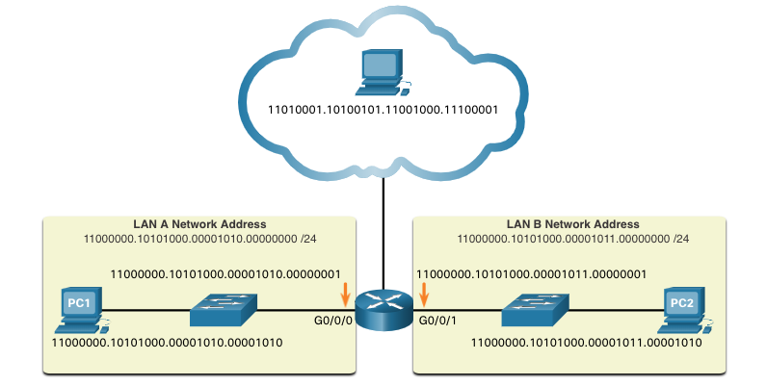
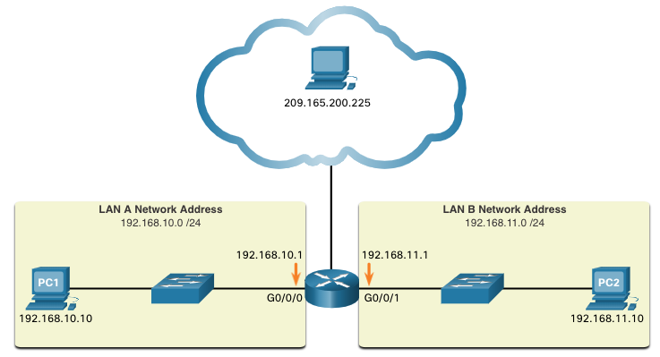
Binary Number System Binary and IPv4 Addresses
Binary numbering system consists of 1s and 0s, called bits
Decimal numbering system consists of digits 0 through 9
Hosts, servers, and network equipment using binary addressing to identify each other.
Each address is made up of a string of 32 bits, divided into four sections called octets.
Each octet contains 8 bits (or 1 byte) separated by a dot.
For ease of use by people, this dotted notation is converted to dotted decimal.
Notes:
5 – Number Systems
5.1 – Binary Number Systems
5.1.1 – Binary and IPv4 Addresses

Slide 12
Binary Number System Video – Convert Between Binary and Decimal Numbering Systems
This video will cover the following:
Positional notation review
Powers of 10 review
Decimal – base 10 numbering review
Binary – base 2 numbering review
Convert an P address in binary to decimal numbering
Notes:
5 – Number Systems
5.1 – Binary Number Systems
5.1.2 – Video – Convert Between Binary and Decimal Numbering Systems

Slide 13
Binary Number System Binary Positional Notation
Positional notation means that a digit represents different values depending on the “position” the digit occupies in the sequence of numbers.
The decimal positional notation system operates as shown in the tables below.
 | Thousands | Hundreds | Tens | Ones
Positional Value | 1000 | 100 | 10 | 1
Decimal Number (1234) | 1 | 2 | 3 | 4
Calculate | 1 x 1000 | 2 x 100 | 3 x 10 | 4 x 1
Add them up… | 1000 | + 200 | + 30 | + 4
Result | 1,234
Radix | 10 | 10 | 10 | 10
Position in Number | 3 | 2 | 1 | 0
Calculate | (10³) | (10²) | (10¹) | (10⁰)
Position Value | 1000 | 100 | 10 | 1
Notes:
5 – Number Systems
5.1 – Binary Number Systems
5.1.3 – Binary Positional Notation

Slide 14
Binary Number System Binary Positional Notation (Cont.)
The binary positional notation system operates as shown in the tables below.
Radix | 2 | 2 | 2 | 2 | 2 | 2 | 2 | 2
Position in Number | 7 | 6 | 5 | 4 | 3 | 2 | 1 | 0
Calculate | (2⁷) | (2⁶) | (2⁵) | (2⁴) | (2³) | (2²) | (2¹) | (2⁰)
Position Value | 128 | 64 | 32 | 16 | 8 | 4 | 2 | 1
Positional Value | 128 | 64 | 32 | 16 | 8 | 4 | 2 | 1
Binary Number (11000000) | 1 | 1 | 0 | 0 | 0 | 0 | 0 | 0
Calculate | 1x128 | 1x64 | 0x32 | 0x16 | 0x8 | 0x4 | 0x2 | 0x1
Add Them Up… | 128 | + 64 | + 0 | + 0 | + 0 | + 0 | + 0 | + 0
Result | 192
Notes:
5 – Number Systems
5.1 – Binary Number Systems
5.1.3 – Binary Positional Notation
5.1.4 – Check Your Understanding – Binary Number System

Slide 15
Binary Number System Convert Binary to Decimal
Convert 11000000.10101000.00001011.00001010 to decimal.
Positional Value | 128 | 64 | 32 | 16 | 8 | 4 | 2 | 1
Binary Number (11000000) | 1 | 1 | 0 | 0 | 0 | 0 | 0 | 0
Calculate | 1x128 | 1x64 | 0x32 | 0x16 | 0x8 | 0x4 | 0x2 | 0x1
Add Them Up… | 128 | + 64 | + 0 | + 0 | + 0 | + 0 | + 0 | + 0
Binary Number (10101000) | 1 | 0 | 1 | 0 | 1 | 0 | 0 | 0
Calculate | 1x128 | 0x64 | 1x32 | 0x16 | 1x8 | 0x4 | 0x2 | 0x1
Add Them Up… | 128 | + 0 | + 32 | + 0 | + 8 | + 0 | + 0 | + 0
Binary Number (00001011) | 0 | 0 | 0 | 0 | 1 | 0 | 1 | 1
Calculate | 0x128 | 0x64 | 0x32 | 0x16 | 1x8 | 0x4 | 1x2 | 1x1
Add Them Up… | 0 | + 0 | + 0 | + 0 | + 8 | + 0 | + 2 | + 1
Binary Number (00001010) | 0 | 0 | 0 | 0 | 1 | 0 | 1 | 0
Calculate | 0x128 | 0x64 | 0x32 | 0x16 | 1x8 | 0x4 | 1x2 | 0x1
Add Them Up… | 0 | + 0 | + 0 | + 0 | + 8 | + 0 | + 2 | + 0
192
168
192.168.11.10
11
10
Notes:
5 – Number Systems
5.1 – Binary Number Systems
5.1.5 - Convert Binary to Decimal
5.1.6 – Activity – Binary to Decimal Conversions

Slide 16
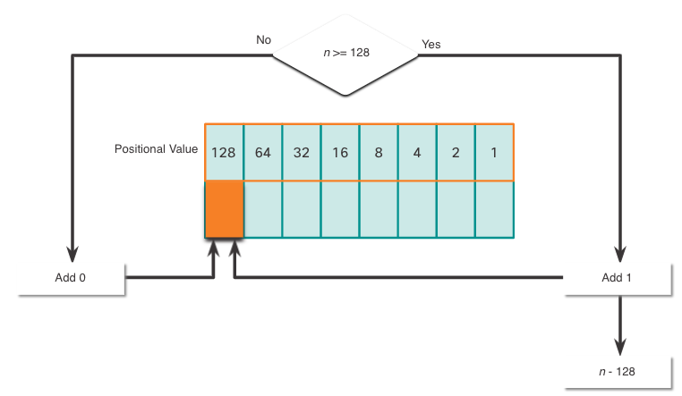
Binary Number System Decimal to Binary Conversion
The binary positional value table is useful in converting a dotted decimal IPv4 address to binary.
Start in the 128 position (the most significant bit). Is the decimal number of the octet (n) equal to or greater than 128?
If no, record a binary 0 in the 128 positional value and move to the 64 positional value.
If yes, record a binary 1 in the 128 positional value, subtract 128 from the decimal number, and move to the 64 positional value.
Repeat these steps through the 1 positional value.
Notes:
5 – Number Systems
5.1 – Binary Number Systems
5.1.7 – Decimal to Binary Conversion

Slide 17
Binary Number System Decimal to Binary Conversion Example
Convert decimal 168 to binary
Is 168 > 128?
Yes, enter 1 in 128 position and subtract 128 (168-128=40)
Is 40 > 64?
No, enter 0 in 64 position and move on
Is 40 > 32?
Yes, enter 1 in 32 position and subtract 32 (40-32=8)
Is 8 > 16?
No, enter 0 in 16 position and move on
Is 8 > 8?
Equal. Enter 1 in 8 position and subtract 8 (8-8=0)
No values left. Enter 0 in remaining binary positions
128 | 64 | 32 | 16 | 8 | 4 | 2 | 1
1 | 0 | 1 | 0 | 1 | 0 | 0 | 0
Decimal 168 is written as 10101000 in binary
Notes:
5 – Number Systems
5.1 – Binary Number Systems
5.1.8 – Decimal to Binary Conversion Example
5.1.9 - Activity – Decimal to Binary Conversions
5.1.10 – Activity – Binary Game

Slide 18
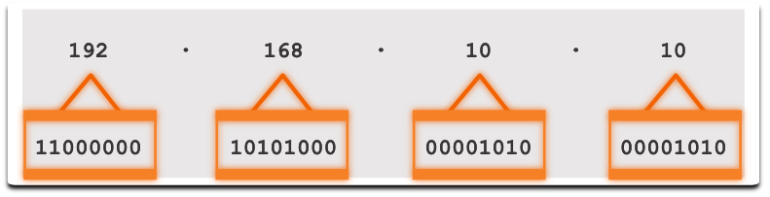
Binary Number System IPv4 Addresses
Routers and computers only understand binary, while humans work in decimal. It is important for you to gain a thorough understanding of these two numbering systems and how they are used in networking.
Notes:
5 – Number Systems
5.1 – Binary Number Systems
5.1.11 – IPv4 Addresses

Slide 19
5.2 Hexadecimal Number System
Notes:
5- Number Systems
5.2 - Hexadecimal Number System

Slide 20
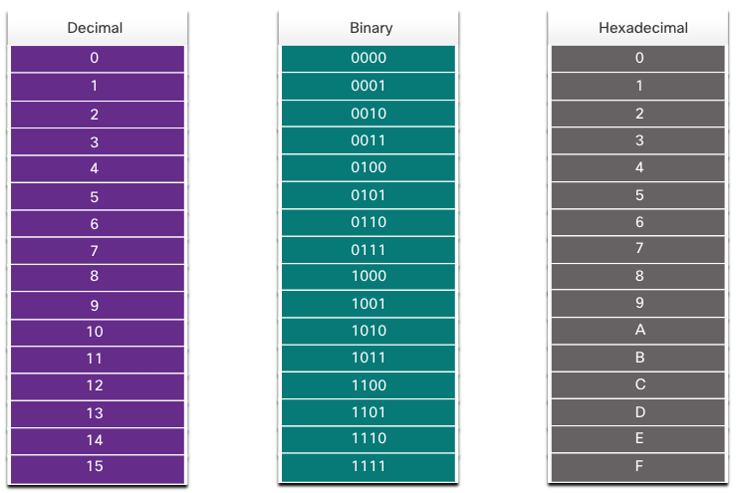
Hexadecimal Number System Hexadecimal and IPv6 Addresses
To understand IPv6 addresses, you must be able to convert hexadecimal to decimal and vice versa.
Hexadecimal is a base sixteen numbering system, using the digits 0 through 9 and letters A to F.
It is easier to express a value as a single hexadecimal digit than as four binary bit.
Hexadecimal is used to represent IPv6 addresses and MAC addresses.
Notes:
5 – Number Systems
5.2 – Hexadecimal Number Systems
5.2.1– Hexadecimal and IPv6 Addresses

Slide 21
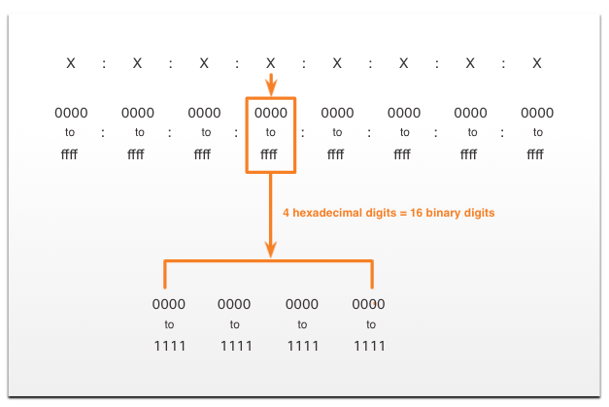
Hexadecimal Number System Hexadecimal and IPv6 Addresses (Cont.)
IPv6 addresses are 128 bits in length. Every 4 bits is represented by a single hexadecimal digit. That makes the IPv6 address a total of 32 hexadecimal values.
The figure shows the preferred method of writing out an IPv6 address, with each X representing four hexadecimal values.
Each four hexadecimal character group is referred to as a hextet.
Notes:
5 – Number Systems
5.2 – Hexadecimal Number Systems
5.2.1– Hexadecimal and IPv6 Addresses

Slide 22
Hexadecimal Number System Video – Converting Between Hexadecimal and Decimal Numbering Systems
This video will cover the following:
Characteristics of the Hexadecimal System
Convert from Hexadecimal to Decimal
Convert from Decimal to Hexadecimal
Notes:
5 – Number Systems
5.2 – Hexadecimal Number Systems
5.2.2 – Video – Converting Between Hexadecimal and Decimal Numbering Systems

Slide 23
Hexadecimal Number System Decimal to Hexadecimal Conversions
Follow the steps listed to convert decimal numbers to hexadecimal values:
Convert the decimal number to 8-bit binary strings.
Divide the binary strings in groups of four starting from the rightmost position.
Convert each four binary numbers into their equivalent hexadecimal digit.
For example, 168 converted into hex using the three-step process.
168 in binary is 10101000.
10101000 in two groups of four binary digits is 1010 and 1000.
1010 is hex A and 1000 is hex 8, so 168 is A8 in hexadecimal.
Notes:
5 – Number Systems
5.2 – Hexadecimal Number Systems
5.2.3 – Decimal to Hexadecimal Conversions

Slide 24
Hexadecimal Number System Hexadecimal to Decimal Conversions
Follow the steps listed to convert hexadecimal numbers to decimal values:
Convert the hexadecimal number to 4-bit binary strings.
Create 8-bit binary grouping starting from the rightmost position.
Convert each 8-bit binary grouping into their equivalent decimal digit.
For example, D2 converted into decimal using the three-step process:
D2 in 4-bit binary strings is 1110 and 0010.
1110 and 0010 is 11100010 in an 8-bit grouping.
11100010 in binary is equivalent to 210 in decimal, so D2 is 210 is decimal
Notes:
5 – Number Systems
5.2 – Hexadecimal Number Systems
5.2.4 - Hexadecimal to Decimal Conversions
5.2.5 – Check Your Understanding – Hexadecimal Number System

Slide 25
5.3 Module Practice and Quiz
Notes:
5 - Number Systems
5.3 Module Practice and Quiz

Slide 26
Module Practice and Quiz What did I learn in this module?
Binary is a base two numbering system that consists of the numbers 0 and 1, called bits.
Decimal is a base ten numbering system that consists of the numbers 0 through 9.
Binary is what hosts, servers, and networking equipment uses to identify each other.
Hexadecimal is a base sixteen numbering system that consists of the numbers 0 through 9 and the letters A to F.
Hexadecimal is used to represent IPv6 addresses and MAC addresses.
IPv6 addresses are 128 bits long, and every 4 bits is represented by a hexadecimal digit for a total of 32 hexadecimal digits.
To convert hexadecimal to decimal, you must first convert the hexadecimal to binary, then convert the binary to decimal.
To convert decimal to hexadecimal, you must first convert the decimal to binary and then the binary to hexadecimal.
Notes:
5 – Number Systems
5.3 - Module Practice and Quiz
5.3.1 – What Did I Learn In This Module?
5.3.2 – Module Quiz

Slide 27
Module 5: Number Systems New Terms and Commands
dotted decimal notation
positional notation
base 10
base 16
radix
octet
hextet

