Slide 1

Module 8: Network Layer
Instructor Materials
Introduction to Networks v7.0 (ITN)
Notes:
Cisco Networking Academy Program
Introduction to Networks v7.0 (ITN)
Module 8: Protocols and Modules

Slide 2
Instructor Materials – Module 8 Planning Guide
This PowerPoint deck is divided in two parts:
Instructor Planning Guide
Information to help you become familiar with the module
Teaching aids
Instructor Class Presentation
Optional slides that you can use in the classroom
Begins on slide # 10
Note: Remove the Planning Guide from this presentation before sharing with anyone.
For additional help and resources go to the Instructor Home Page and Course Resources for this course. You also can visit the professional development site on netacad.com, the official Cisco Networking Academy Facebook page, or Instructor Only FB group.
Notes:
2

Slide 3
What to Expect in this Module
To facilitate learning, the following features within the GUI may be included in this module:
Feature | Description
Animations | Expose learners to new skills and concepts.
Videos | Expose learners to new skills and concepts.
Check Your Understanding(CYU) | Per topic online quiz to help learners gauge content understanding.
Interactive Activities | A variety of formats to help learners gauge content understanding.
Syntax Checker | Small simulations that expose learners to Cisco command line to practice configuration skills.
PT Activity | Simulation and modeling activities designed to explore, acquire, reinforce, and expand skills.

Slide 4
What to Expect in this Module (Cont.)
To facilitate learning, the following features may be included in this module:
Feature | Description
Hands-On Labs | Labs designed for working with physical equipment.
Class Activities | These are found on the Instructor Resources page. Class Activities are designed to facilitate learning, class discussion, and collaboration.
Module Quizzes | Self-assessments that integrate concepts and skills learned throughout the series of topics presented in the module.
Module Summary | Briefly recaps module content.

Slide 5
Check Your Understanding and What Do You Already Know?
Check Your Understanding activities are designed to let students quickly determine if they understand the content and can proceed, or if they need to review.
Check Your Understanding activities do not affect student grades.
There are no separate slides for these activities in the PPT. They are listed in the notes area of the slide that appears before these activities.
Notes:
5

Slide 6
Module 8: Activities
What activities are associated with this module?
Page # | Activity Type | Activity Name | Optional?
8.1.7 | Check Your Understanding | IP Characteristics | Recommended
8.2.3 | Video | Sample IPv4 Headers in Wireshark | Recommended
8.2.4 | Check Your Understanding | IPv4 Packet | Recommended
8.3.5 | Video | Sample IPv5 Headers in Wireshark | Recommended
8.3.6 | Check Your Understanding | IPv6 Packet | Recommended
8.4.5 | Check Your Understanding | How a Host Routes | Recommended
8.5.5 | Video | IPv4 Routing Router Tables | Recommended
8.5.7 | Check Your Understanding | Introduction to Routing | Recommended
Notes:
6

Slide 7
Module 8: Best Practices
Prior to teaching Module 8, the instructor should:
Review the activities and assessments for this module.
Try to include as many questions as possible to keep students engaged during classroom presentation.
Topic 8.1
Use the mail analogy of regular post to emphasize best effort.
US Mail Analogy:
The sender doesn’t know if the receiver is present, if the letter arrived or if the receiver can read the letter
The receiver doesn’t know when it is coming
Notes:
7

Slide 8
Module 8: Best Practices (Cont.)
Topic 8.2
Discuss the fields of the IPv4 Packet.
Note that the Identification field is not for sequencing like TCP (1 of 5, 2 of 5, etc.).
Topic 8.3
Explain many of the limitations of IPv4.
Compare the IPv6 simplicity to IPv4s complexity.
Explain why certain fields are eliminated and this improves IPv6, such as check sum, fragmentation, etc.
Explain the use of the EH field.
Notes:
8

Slide 9
Module 8: Best Practices (Cont.)
Topic 8.4
Use the mail analogy to explain host routing – three letters (internal – significant other that lives with you, not mailed = 127.0.0.1; local – friend in the same zip code (US), use in-town box = send out interface; remote – friend in a different zip code (US), use out-of-town box = send to DGW.
Explain DGW, consider showing complex network with visible IP addressing on Routers and have students give the DGW for different devices.
Make sure students understand L2 switches also need a DGW.
Topic 8.5
Explain the differences of a host routing table and router routing table.
Explain how a router will build its table and then use it. It may be helpful to remember the L3 routing table has two basic functions to forward or to filter. If a destination makes a match in the routing table it will be forwarded, if there is no match it is discarded.
Compare and contrast static and dynamic routing when learning about remote routes. The strengths of one are the weaknesses of the other and vice versa.
Notes:
9

Slide 10
Module 8: Network Layer
Introduction to Networks v7.0 (ITN)
Notes:
Cisco Networking Academy Program
Introduction to Networks v7.0 (ITN)
Module 8: Network Layer

Slide 11
Module 8: Topics
What will I learn to do in this module?
Topic Title | Topic Objective
Network Layer Characteristics | Explain how the network layer uses IP protocols for reliable communications.
IPv4 Packet | Explain the role of the major header fields in the IPv4 packet.
IPv6 Packet | Explain the role of the major header fields in the IPv6 packet.
How a Host Routes | Explain how network devices use routing tables to direct packets to a destination network.
Router Routing Tables | Explain the function of fields in the routing table of a router.
Notes:
11
8 – Network Layer
8.0 – Introduction
8.0.2 – What will I learn to do in this module?

Slide 12
8.1 Network Layer Characteristics
Notes:
8 – Network Layer
8.1 – Network Layer Characteristics

Slide 13
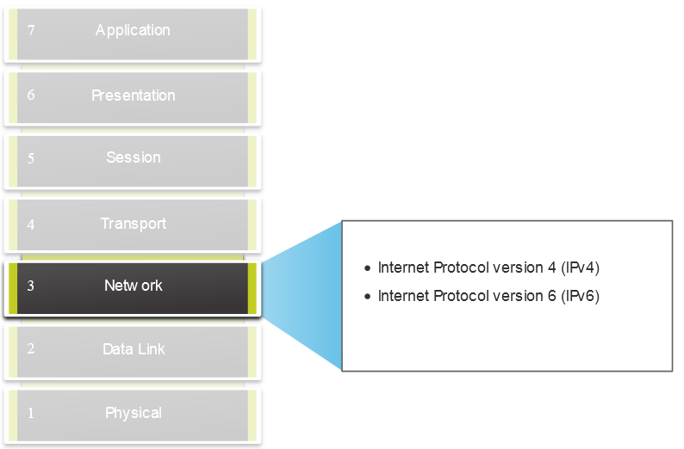
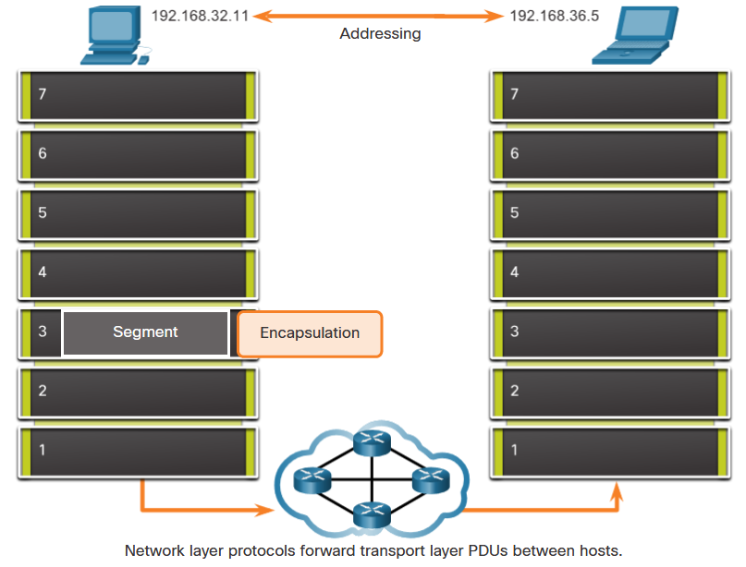
Network Layer Characteristics The Network Layer
Provides services to allow end devices to exchange data
IP version 4 (IPv4) and IP version 6 (IPv6) are the principle network layer communication protocols.
The network layer performs four basic operations:
Addressing end devices
Encapsulation
Routing
De-encapsulation
Notes:
8 – Network Layer
8.1 – Network Layer Characteristics
8.1.1 – The Network Layer

Slide 14
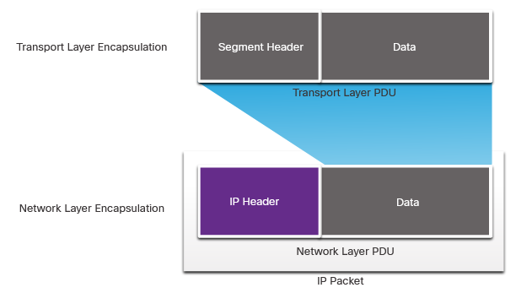
Network Layer Characteristics IP Encapsulation
IP encapsulates the transport layer segment.
IP can use either an IPv4 or IPv6 packet and not impact the layer 4 segment.
IP packet will be examined by all layer 3 devices as it traverses the network.
The IP addressing does not change from source to destination.
Note: NAT will change addressing, but will be discussed in a later module.
Notes:
8 – Network Layer
8.1 – Network Layer Characteristics
8.1.2 – IP Encapsulation

Slide 15
Network Layer Characteristics Characteristics of IP
IP is meant to have low overhead and may be described as:
Connectionless
Best Effort
Media Independent
Notes:
8 – Network Layer
8.1 – Network Layer Characteristics
8.1.3 – Characteristics of IP

Slide 16
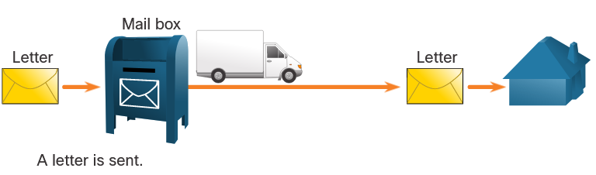
Network Layer Characteristics Connectionless
IP is Connectionless
IP does not establish a connection with the destination before sending the packet.
There is no control information needed (synchronizations, acknowledgments, etc.).
The destination will receive the packet when it arrives, but no pre-notifications are sent by IP.
If there is a need for connection-oriented traffic, then another protocol will handle this (typically TCP at the transport layer).
Notes:
8 – Network Layer
8.1 – Network Layer Characteristics
8.1.4 – Connectionless

Slide 17
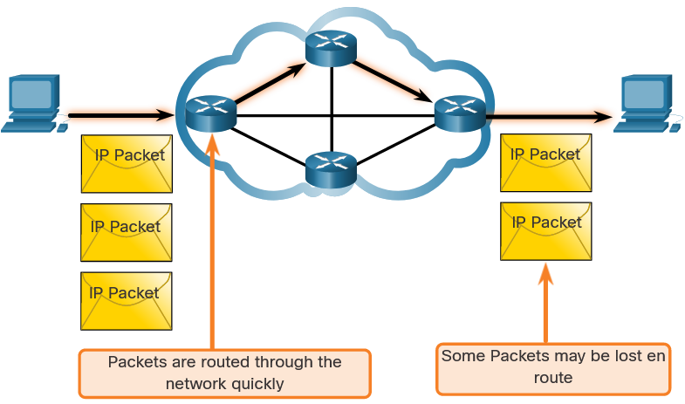
Network Layer Characteristics Best Effort
IP is Best Effort
IP will not guarantee delivery of the packet.
IP has reduced overhead since there is no mechanism to resend data that is not received.
IP does not expect acknowledgments.
IP does not know if the other device is operational or if it received the packet.
Notes:
8 – Network Layer
8.1 – Network Layer Characteristics
8.1.5 – Best Effort

Slide 18
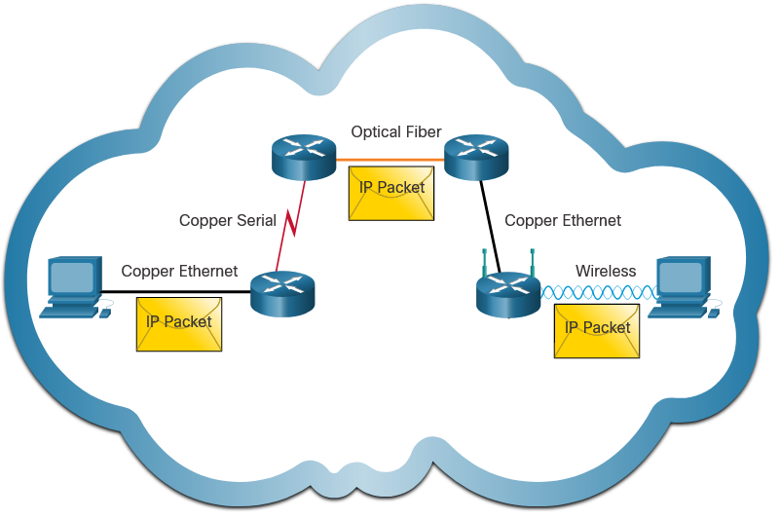
Network Layer Characteristics Media Independent
IP is unreliable:
It cannot manage or fix undelivered or corrupt packets.
IP cannot retransmit after an error.
IP cannot realign out of sequence packets.
IP must rely on other protocols for these functions.
IP is media Independent:
IP does not concern itself with the type of frame required at the data link layer or the media type at the physical layer.
IP can be sent over any media type: copper, fiber, or wireless.
Notes:
8 – Network Layer
8.1 – Network Layer Characteristics
8.1.6 – Media Independent
8.1.7 Check Your Understanding – IP Characteristics

Slide 19
Network Layer Characteristics Media Independent (Contd.)
The network layer will establish the Maximum Transmission Unit (MTU).
Network layer receives this from control information sent by the data link layer.
The network then establishes the MTU size.
Fragmentation is when Layer 3 splits the IPv4 packet into smaller units.
Fragmenting causes latency.
IPv6 does not fragment packets.
Example: Router goes from Ethernet to a slow WAN with a smaller MTU
Notes:
8 – Network Layer
8.1 – Network Layer Characteristics
8.1.6 – Media Independent
8.1.7 Check Your Understanding – IP Characteristics

Slide 20
8.2 IPv4 Packet
Notes:
8 – Network Layer
8.2 – IPv4 Packet

Slide 21
IPv4 Packet IPv4 Packet Header
IPv4 is the primary communication protocol for the network layer.
The network header has many purposes:
It ensures the packet is sent in the correct direction (to the destination).
It contains information for network layer processing in various fields.
The information in the header is used by all layer 3 devices that handle the packet
Notes:
8 – Network Layer
8.2 – IPv4 Packet
8.2.1 – IPv4 Packet Header

Slide 22
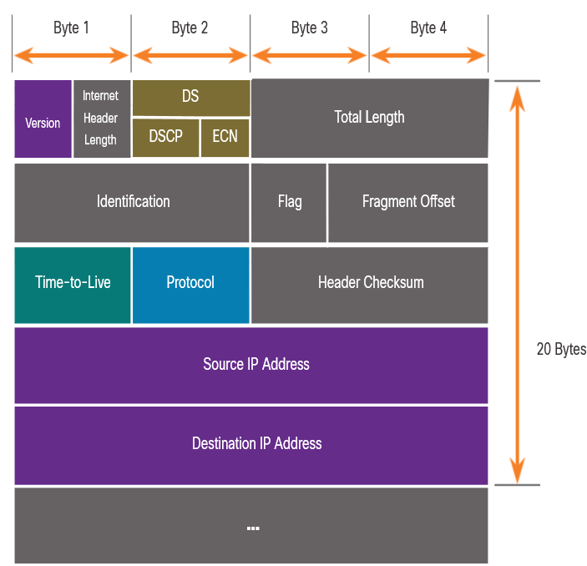
IPv4 Packet IPv4 Packet Header Fields
The IPv4 network header characteristics:
It is in binary.
Contains several fields of information
Diagram is read from left to right, 4 bytes per line
The two most important fields are the source and destination.
Protocols may have may have one or more functions.
Notes:
8 – Network Layer
8.2 – IPv4 Packet
8.2.2 – IPv4 Packet Header Fields

Slide 23
IPv4 Packet IPv4 Packet Header Fields
Significant fields in the IPv4 header:
Function | Description
Version | This will be for v4, as opposed to v6, a 4 bit field= 0100
Differentiated Services | Used for QoS: DiffServ – DS field or the older IntServ – ToS or Type of Service
Header Checksum | Detect corruption in the IPv4 header
Time to Live (TTL) | Layer 3 hop count. When it becomes zero the router will discard the packet.
Protocol | I.D.s next level protocol: ICMP, TCP, UDP, etc.
Source IPv4 Address | 32 bit source address
Destination IPV4 Address | 32 bit destination address
Notes:
8 – Network Layer
8.2 – IPv4 Packet
8.2.2 – IPv4 Packet Header Fields

Slide 24
IPv4 Packet Video – Sample IPv4 Headers in Wireshark
This video will cover the following:
IPv4 Ethernet packets in Wireshark
The control information
The difference between packets
Notes:
8 – Network Layer
8.2 – IPv4 Packet
8.2.3 – Video – Sample IPv4 Headers in Wireshark
8.2.4 – Check Your Understanding – IPv4 Packet

Slide 25
8.3 IPv6 Packets
Notes:
8 – Network Layer
8.3 – IPv6 Packets

Slide 26
IPv6 Packets Limitations of IPv4
IPv4 has three major limitations:
IPv4 address depletion – We have basically run out of IPv4 addressing.
Lack of end-to-end connectivity – To make IPv4 survive this long, private addressing and NAT were created. This ended direct communications with public addressing.
Increased network complexity – NAT was meant as temporary solution and creates issues on the network as a side effect of manipulating the network headers addressing. NAT causes latency and troubleshooting issues.
Notes:
8 – Network Layer
8.3 – IPv6 Packets
8.3.1 – Limitations of IPv4

Slide 27
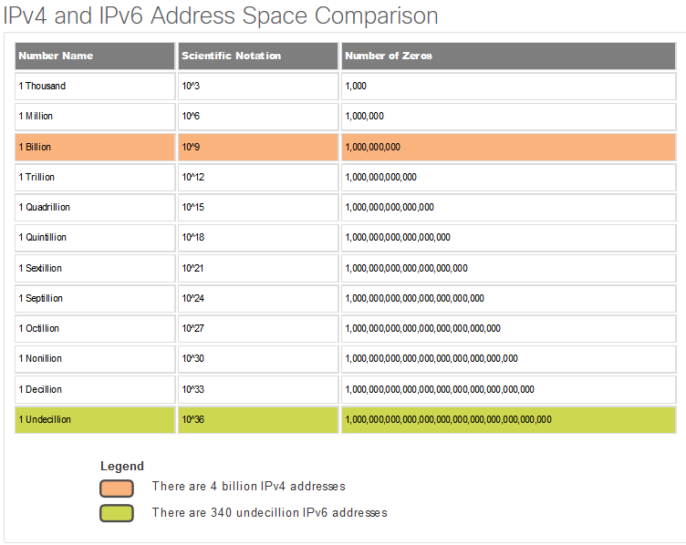
IPv6 Packets IPv6 Overview
IPv6 was developed by Internet Engineering Task Force (IETF).
IPv6 overcomes the limitations of IPv4.
Improvements that IPv6 provides:
Increased address space – based on 128 bit address, not 32 bits
Improved packet handling – simplified header with fewer fields
Eliminates the need for NAT – since there is a huge amount of addressing, there is no need to use private addressing internally and be mapped to a shared public address
Notes:
8 – Network Layer
8.3 – IPv6 Packets
8.3.2 – IPv6 Overview

Slide 28
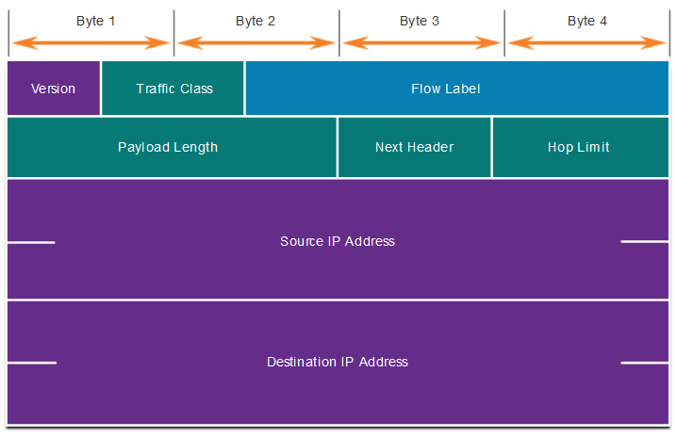
IPv6 Packets IPv4 Packet Header Fields in the IPv6 Packet Header
The IPv6 header is simplified, but not smaller.
The header is fixed at 40 Bytes or octets long.
Several IPv4 fields were removed to improve performance.
Some IPv4 fields were removed to improve performance:
Flag
Fragment Offset
Header Checksum
Notes:
8 – Network Layer
8.3 – IPv6 Packets
8.3.3 – IPv4 Packet Header Fields in the IPv6 Packet Header

Slide 29
IPv6 Packets IPv6 Packet Header
Significant fields in the IPv4 header:
Function | Description
Version | This will be for v6, as opposed to v4, a 4 bit field= 0110
Traffic Class | Used for QoS: Equivalent to DiffServ – DS field
Flow Label | Informs device to handle identical flow labels the same way, 20 bit field
Payload Length | This 16-bit field indicates the length of the data portion or payload of the IPv6 packet
Next Header | I.D.s next level protocol: ICMP, TCP, UDP, etc.
Hop Limit | Replaces TTL field Layer 3 hop count
Source IPv4 Address | 128 bit source address
Destination IPV4 Address | 128 bit destination address
Notes:
8 – Network Layer
8.3 – IPv6 Packets
8.3.4 – IPv6 Packet Header

Slide 30
IPv6 Packets IPv6 Packet Header (Cont.)
IPv6 packet may also contain extension headers (EH).
EH headers characteristics:
provide optional network layer information
are optional
are placed between IPv6 header and the payload
may be used for fragmentation, security, mobility support, etc.
Note: Unlike IPv4, routers do not fragment IPv6 packets.
Notes:
8 – Network Layer
8.3 – IPv6 Packets
8.3.4 – IPv6 Packet Header (Cont.)

Slide 31
IPv6 Packets Video – Sample IPv6 Headers in Wireshark
This video will cover the following:
IPv6 Ethernet packets in Wireshark
The control information
The difference between packets
Notes:
8 – Network Layer
8.3 – IPv6 Packets
8.3.5 – Video – Sample IPv6 Headers in Wireshark
8.3.6 – Check Your Understanding – IPv6 Packets

Slide 32
8.4 How a Host Routes
Notes:
8 – Network Layer
8.4 – How a Host Routes

Slide 33
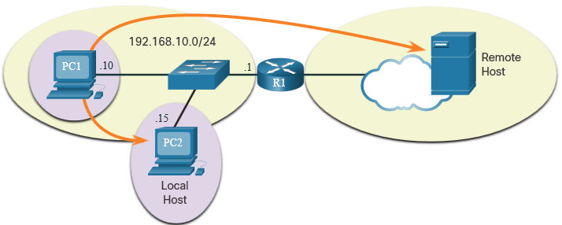
How a Host Routes Host Forwarding Decision
Packets are always created at the source.
Each host devices creates their own routing table.
A host can send packets to the following:
Itself – 127.0.0.1 (IPv4), ::1 (IPv6)
Local Hosts – destination is on the same LAN
Remote Hosts – devices are not on the same LAN
Notes:
8 – Network Layer
8.4 – How a Host Routes
8.4.1 – Host Forwarding Decision

Slide 34
How a Host Routes Host Forwarding Decision (Cont.)
The Source device determines whether the destination is local or remote
Method of determination:
IPv4 – Source uses its own IP address and Subnet mask, along with the destination IP address
IPv6 – Source uses the network address and prefix advertised by the local router
Local traffic is dumped out the host interface to be handled by an intermediary device.
Remote traffic is forwarded directly to the default gateway on the LAN.
Notes:
8 – Network Layer
8.4 – How a Host Routes
8.4.1 – Host Forwarding Decision (Cont.)

Slide 35
How a Host Routes Default Gateway
A router or layer 3 switch can be a default-gateway.
Features of a default gateway (DGW):
It must have an IP address in the same range as the rest of the LAN.
It can accept data from the LAN and is capable of forwarding traffic off of the LAN.
It can route to other networks.
If a device has no default gateway or a bad default gateway, its traffic will not be able to leave the LAN.
Notes:
8 – Network Layer
8.4 – How a Host Routes
8.4.2 – Default Gateway

Slide 36
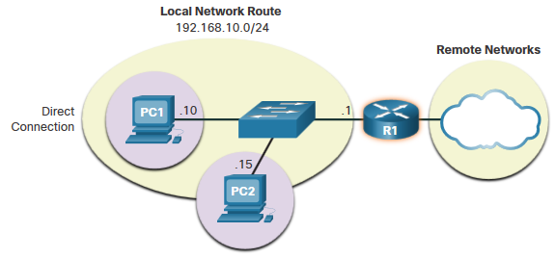
How a Host Routes A Host Routes to the Default Gateway
The host will know the default gateway (DGW) either statically or through DHCP in IPv4.
IPv6 sends the DGW through a router solicitation (RS) or can be configured manually.
A DGW is static route which will be a last resort route in the routing table.
All device on the LAN will need the DGW of the router if they intend to send traffic remotely.
Notes:
8 – Network Layer
8.4 – How a Host Routes
8.4.3 – A Host Routes to the Default Gateway

Slide 37
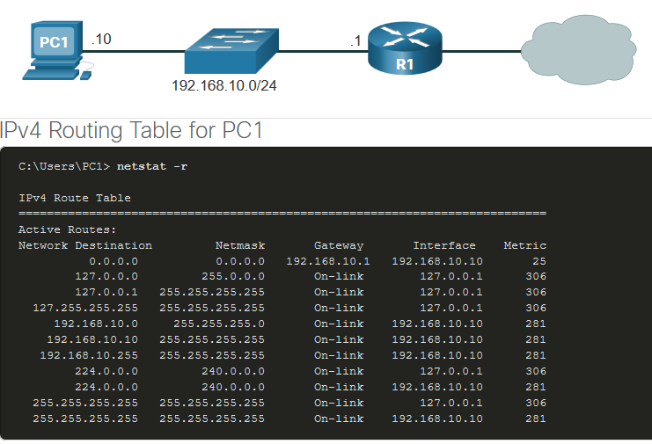
How a Host Routes Host Routing Tables
On Windows, route print or netstat -r to display the PC routing table
Three sections displayed by these two commands:
Interface List – all potential interfaces and MAC addressing
IPv4 Routing Table
IPv6 Routing Table
Notes:
8 – Network Layer
8.4 – How a Host Routes
8.4.4 – Host Routing Tables
8.4.5 – Check Your Understanding – How a Host Routes

Slide 38
8.5 Introduction to Routing
Notes:
8 – Network Layer
8.5 – Introduction to Routing

Slide 39
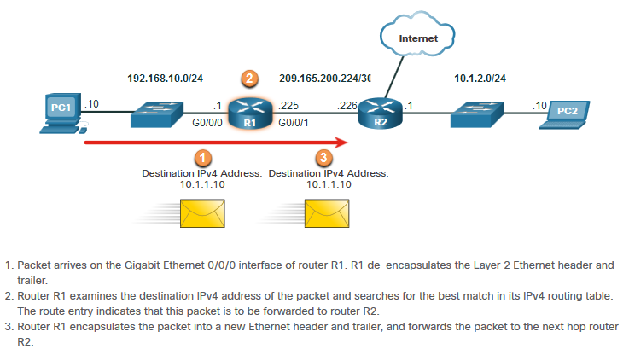
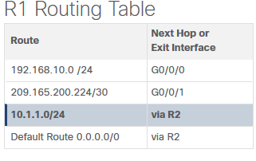
Introduction to Routing Router Packet Forwarding Decision
What happens when the router receives the frame from the host device?
Notes:
8 – Network Layer
8.5 – Introduction to Routing
8.5.1 – Router Packet Forwarding Decision

Slide 40
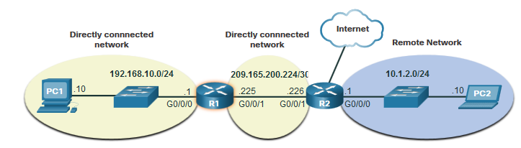
Introduction to Routing IP Router Routing Table
There three types of routes in a router’s routing table:
Directly Connected – These routes are automatically added by the router, provided the interface is active and has addressing.
Remote – These are the routes the router does not have a direct connection and may be learned:
Manually – with a static route
Dynamically – by using a routing protocol to have the routers share their information with each other
Default Route – this forwards all traffic to a specific direction when there is not a match in the routing table
Notes:
8 – Network Layer
8.5 – Introduction to Routing
8.5.2 – IP Router Routing Table

Slide 41
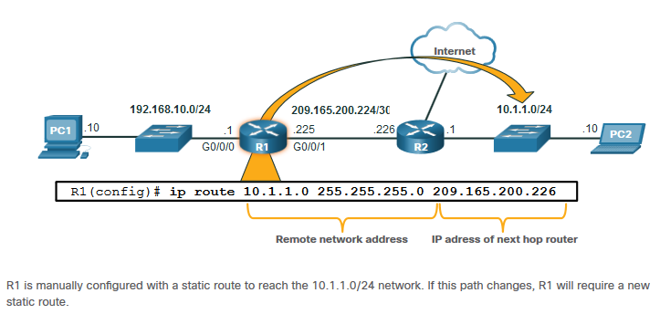
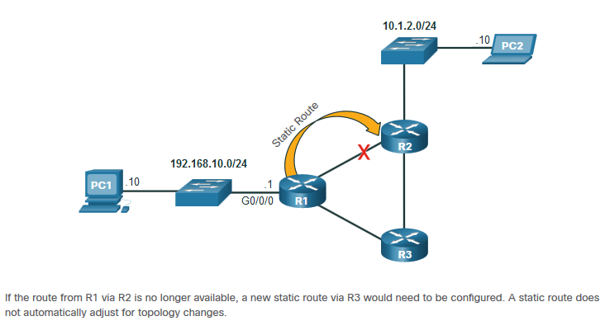
Introduction to Routing Static Routing
Static Route Characteristics:
Must be configured manually
Must be adjusted manually by the administrator when there is a change in the topology
Good for small non-redundant networks
Often used in conjunction with a dynamic routing protocol for configuring a default route
Notes:
8 – Network Layer
8.5 – Introduction to Routing
8.5.3 – Static Routing

Slide 42
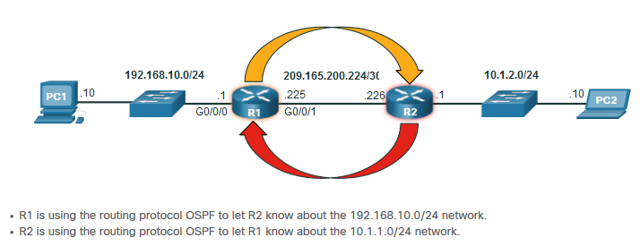
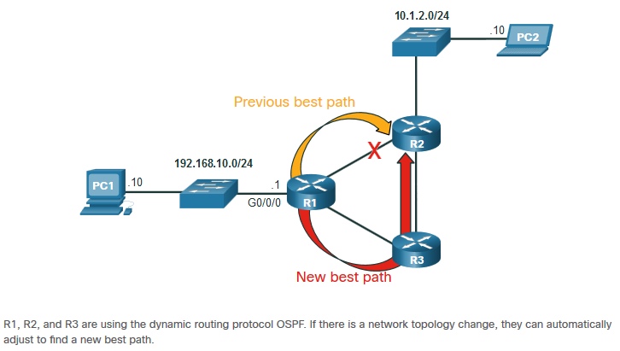
Introduction to Routing Dynamic Routing
Dynamic Routes Automatically:
Discover remote networks
Maintain up-to-date information
Choose the best path to the destination
Find new best paths when there is a topology change
Dynamic routing can also share static default routes with the other routers.
Notes:
8 – Network Layer
8.5 – Introduction to Routing
8.5.4 – Dynamic Routing

Slide 43
Introduction to Routing Video – IPv4 Router Routing Tables
This video will explain the information in the IPv4 router routing table.
Notes:
8 – Network Layer
8.5 – Introduction to Routing
8.5.5 – Video – IPv4 Router Routing Tables

Slide 44
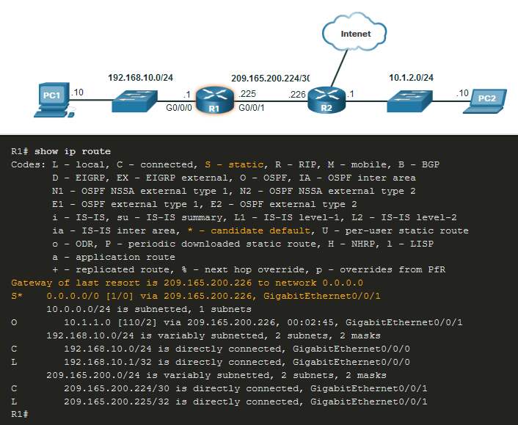
Introduction to Routing Introduction to an IPv4 Routing Table
The show ip route command shows the following route sources:
L - Directly connected local interface IP address
C – Directly connected network
S – Static route was manually configured by an administrator
O – OSPF
D – EIGRP
This command shows types of routes:
Directly Connected – C and L
Remote Routes – O, D, etc.
Default Routes – S*
Notes:
8 – Network Layer
8.5 – Introduction to Routing
8.5.6 – Introduction to an IPv4 Routing Table
8.5.7 – Check Your Understanding – Introduction to Routing

Slide 45
8.6 Module Practice and Quiz
Notes:
8 – Network Layer
8.6 – Module Practice and Quiz

Slide 46
Module Practice and Quiz What did I learn in this module?
IP is connectionless, best effort, and media independent.
IP does not guarantee packet delivery.
IPv4 packet header consists of fields containing information about the packet.
IPv6 overcomes IPv4 lack of end-to-end connectivity and increased network complexity.
A device will determine if a destination is itself, another local host, and a remote host.
A default gateway is router that is part of the LAN and will be used as a door to other networks.
The routing table contains a list of all known network addresses (prefixes) and where to forward the packet.
The router uses longest subnet mask or prefix match.
The routing table has three types of route entries: directly connected networks, remote networks, and a default route.
Notes:
8 – Network Layer
8.6 – Module Practice and Quiz
8.6.1 – What did I learn in this module?

Slide 47
Network Layer New Terms and Commands
Encapsulation
Routing
De-encapsulation
Data payload
Packet
Internet Protocol Version 4 (IPv4)
Internet Protocol Version 6 (IPv6)
Network Layer PDU = IP Packet
IP Header
Best effort delivery
Media independent
Connectionless
Unreliable
Maximum Transmission Unit (MTU)
Version
Differentiated Services (DS)
Time-to-Live (TTL)
Internet Control Message Protocol (ICMP)
Identification, Flags, Fragment Offset fields
Network Address Translation (NAT)
Traffic Class
Flow Label
Payload Length
Next Header
Hop Limit
Extension Headers
Local host
Remote host
Default Gateway
Notes:
New Terms and Commands

Slide 48
Network Layer New Terms and Commands
netstat –r
route print
interface list
IPv4 Route Table
IPv6 Route Table
directly-connected routes
remote routes
default route
show ip route
route source
destination network
outgoing interface
administrative distance
metric
next-hop
route timestamp
Notes:
New Terms and Commands

