Slide 1

Module 9: Address Resolution
Instructor Materials
Introduction to Networks v7.0 (ITN)
Notes:
Cisco Networking Academy Program
Introduction to Networks v7.0 (ITN)
Module 9: Address Resolution

Slide 2
Instructor Materials – Module 9 Planning Guide
This PowerPoint deck is divided in two parts:
Instructor Planning Guide
Information to help you become familiar with the module
Teaching aids
Instructor Class Presentation
Optional slides that you can use in the classroom
Begins on slide # 9
Note: Remove the Planning Guide from this presentation before sharing with anyone.
For additional help and resources go to the Instructor Home Page and Course Resources for this course. You also can visit the professional development site on netacad.com, the official Cisco Networking Academy Facebook page, or Instructor Only FB group.
Notes:
2

Slide 3
What to Expect in this Module
To facilitate learning, the following features within the GUI may be included in this module:
Feature | Description
Animations | Expose learners to new skills and concepts.
Videos | Expose learners to new skills and concepts.
Check Your Understanding(CYU) | Per topic online quiz to help learners gauge content understanding.
Interactive Activities | A variety of formats to help learners gauge content understanding.
Syntax Checker | Small simulations that expose learners to Cisco command line to practice configuration skills.
PT Activity | Simulation and modeling activities designed to explore, acquire, reinforce, and expand skills.

Slide 4
What to Expect in this Module (Cont.)
To facilitate learning, the following features may be included in this module:
Feature | Description
Hands-On Labs | Labs designed for working with physical equipment.
Class Activities | These are found on the Instructor Resources page. Class Activities are designed to facilitate learning, class discussion, and collaboration.
Module Quizzes | Self-assessments that integrate concepts and skills learned throughout the series of topics presented in the module.
Module Summary | Briefly recaps module content.

Slide 5
Check Your Understanding
Check Your Understanding activities are designed to let students quickly determine if they understand the content and can proceed, or if they need to review.
Check Your Understanding activities do not affect student grades.
There are no separate slides for these activities in the PPT. They are listed in the notes area of the slide that appears before these activities.
Notes:
5

Slide 6
Module 9: Activities
What activities are associated with this module?
Page # | Activity Type | Activity Name | Optional?
9.1.3 | Packet Tracer | Identify MAC and IP Addresses | Recommended
9.1.4 | Check Your Understanding | MAC and IP | Recommended
9.2.3 | Video | ARP Operation – ARP Request | Recommended
9.2.4 | Video | ARP Operation – ARP Reply | Recommended
9.2.5 | Video | ARP Role in Remote Communications | Recommended
9.2.9 | Packet Tracer | Examine the ARP Table | Recommended
9.2.10 | Check Your Understanding | ARP | Recommended
9.3.1 | Video | IPv6 Neighbor Discovery | Recommended
9.3.4 | Packet Tracer | IPv6 Neighbor Discovery | Recommended
9.3.5 | Check Your Understanding | IPv6 Neighbor Discovery | Recommended
Notes:
6

Slide 7
Module 9: Best Practices
Prior to teaching Module 9, the instructor should:
Review the activities and assessments for this module.
Try to include as many questions as possible to keep students engaged during classroom presentation.
Topic 9.1
Ask the students or have a class discussion
Have students discuss the IP and MAC addresses from source to destination when there are multiple router hops.
Describe the Layer 2 addresses used when a destination is on the same local network and when the destination is on a remote network.
Topic 9.2
Ask the students or have a class discussion
What impact do ARP requests have on the network and other local devices?
What are some security risks associated with ARP?
Notes:
7

Slide 8
Module 9: Best Practices (Cont.)
Topic 9.3
Ask the students or have a class discussion
Why do you suppose ICMPv6 Neighbor Solicitations are sent as a multicast and not broadcast?
Discuss the similarities and differences between the ARP and the ICMPv6 ND processes.
Notes:
8

Slide 9
Module 9: Address Resolution
Introduction to Networks v7.0 (ITN)
Notes:
Cisco Networking Academy Program
Introduction to Networks v7.0 (ITN)
Module 9: Address Resolution

Slide 10
Module Objectives
Module Title: Address Resolution
Module Objective: Explain how ARP and ND enable communication on a network.
Topic Title | Topic Objective
MAC and IP | Compare the roles of the MAC address and the IP address.
ARP | Describe the purpose of ARP.
Neighbor Discovery | Describe the operation of IPv6 neighbor discovery.
Notes:
10
9 - Address Resolution
9.0.2

Slide 11
9.1 MAC and IP
Notes:
9 - Address Resolution
9.1 MAC and IP

Slide 12
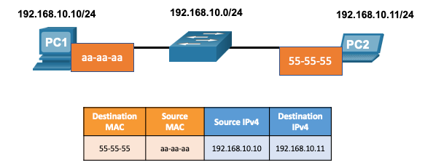
MAC and IP Destination on Same Network
There are two primary addresses assigned to a device on an Ethernet LAN:
Layer 2 physical address (the MAC address) – Used for NIC to NIC communications on the same Ethernet network.
Layer 3 logical address (the IP address) – Used to send the packet from the source device to the destination device.
Layer 2 addresses are used to deliver frames from one NIC to another NIC on the same network. If a destination IP address is on the same network, the destination MAC address will be that of the destination device.
Notes:
9 – Address Resolution
9.1 – MAC and IP
9.1.1 – Destination on Same Network

Slide 13
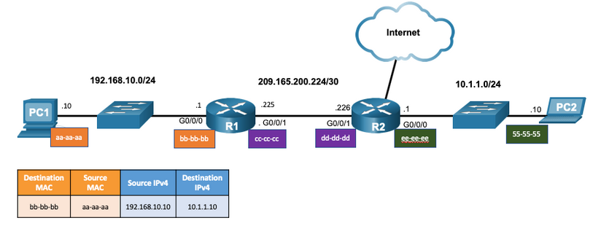
MAC and IP Destination on Remote Network
When the destination IP address is on a remote network, the destination MAC address is that of the default gateway.
ARP is used by IPv4 to associate the IPv4 address of a device with the MAC address of the device NIC.
ICMPv6 is used by IPv6 to associate the IPv6 address of a device with the MAC address of the device NIC.
Notes:
9 – Address Resolution
9.1 – MAC and IP
9.1.2 – Destination on Remote Network

Slide 14
MAC and IP Packet Tracer – Identify MAC and IP Addresses
In this Packet Tracer, you will complete the following objectives:
Gather PDU Information for Local Network Communication
Gather PDU Information for Remote Network Communication
Notes:
9 – Address Resolution
9.1 – MAC and IP
9.1.3 – Packet Tracer Identify MAC and IP Addresses
9.1.4 – Check Your Understanding – MAC and IP

Slide 15
9.2 ARP
Notes:
9 - Address Resolution
9.2 ARP

Slide 16
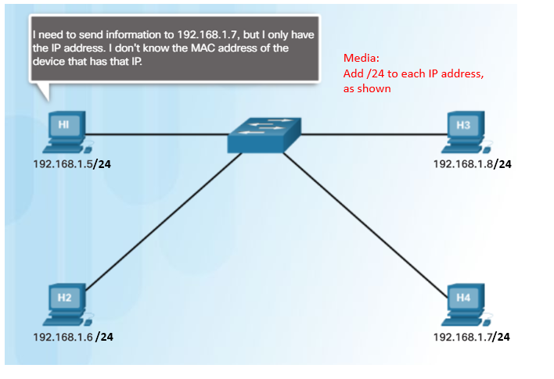
ARP ARP Overview
A device uses ARP to determine the destination MAC address of a local device when it knows its IPv4 address.
ARP provides two basic functions:
Resolving IPv4 addresses to MAC addresses
Maintaining an ARP table of IPv4 to MAC address mappings
Notes:
9 – Address Resolution
9.2 – ARP
9.2.1 – ARP Overview

Slide 17
ARP ARP Functions
To send a frame, a device will search its ARP table for a destination IPv4 address and a corresponding MAC address.
If the packet’s destination IPv4 address is on the same network, the device will search the ARP table for the destination IPv4 address.
If the destination IPv4 address is on a different network, the device will search the ARP table for the IPv4 address of the default gateway.
If the device locates the IPv4 address, its corresponding MAC address is used as the destination MAC address in the frame.
If there is no ARP table entry is found, then the device sends an ARP request.
Notes:
9 – Address Resolution
9.2 – ARP
9.2.2 – ARP Functions

Slide 18
ARP Video - ARP Request
This video will cover an ARP request for a MAC address.
Notes:
9 – Address Resolution
9.2 – ARP
9.2.3 – Video - ARP Request

Slide 19
ARP Video – ARP Operation - ARP Reply
This video will cover an ARP reply in response to an ARP request.
Notes:
9 – Address Resolution
9.2 – ARP
9.2.4 – Video – ARP Operation - ARP Reply

Slide 20
ARP Video - ARP Role in Remote Communications
This video will cover how an ARP request will provide a host the MAC address of the default gateway.
Notes:
9 – Address Resolution
9.2 – ARP
9.2.5 – Video - ARP Role in Remote Communications

Slide 21
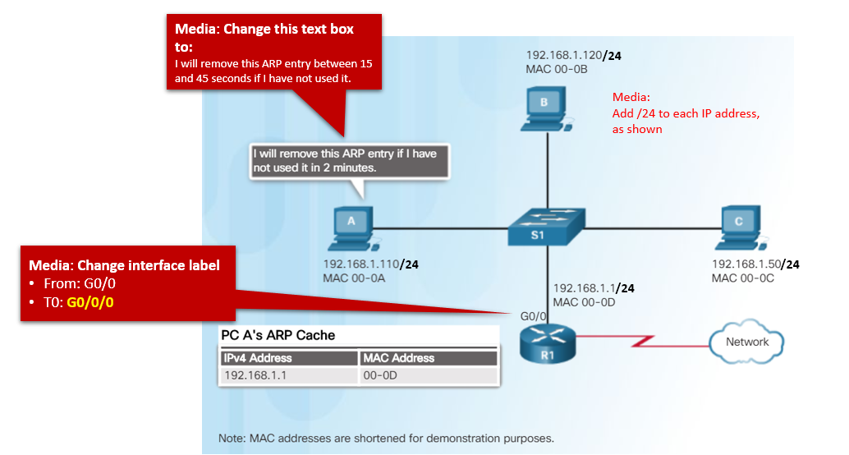
ARP Removing Entries from an ARP Table
Entries in the ARP table are not permanent and are removed when an ARP cache timer expires after a specified period of time.
The duration of the ARP cache timer differs depending on the operating system.
ARP table entries can also be removed manually by the administrator.
Notes:
9 – Address Resolution
9.2 – ARP
9.2.6– Removing Entries from an ARP Table

Slide 22
ARP ARP Tables on Networking Devices
The show ip arp command displays the ARP table on a Cisco router.
The arp –a command displays the ARP table on a Windows 10 PC.
R1# show ip arp
Protocol Address Age (min) Hardware Addr Type Interface
Internet 192.168.10.1 - a0e0.af0d.e140 ARPA GigabitEthernet0/0/0
C:\Users\PC> arp -a
Interface: 192.168.1.124 --- 0x10
Internet Address Physical Address Type
192.168.1.1 c8-d7-19-cc-a0-86 dynamic
192.168.1.101 08-3e-0c-f5-f7-77 dynamic
Notes:
9 – Address Resolution
9.2 – ARP
9.2.7 – ARP Tables on Networking Devices

Slide 23
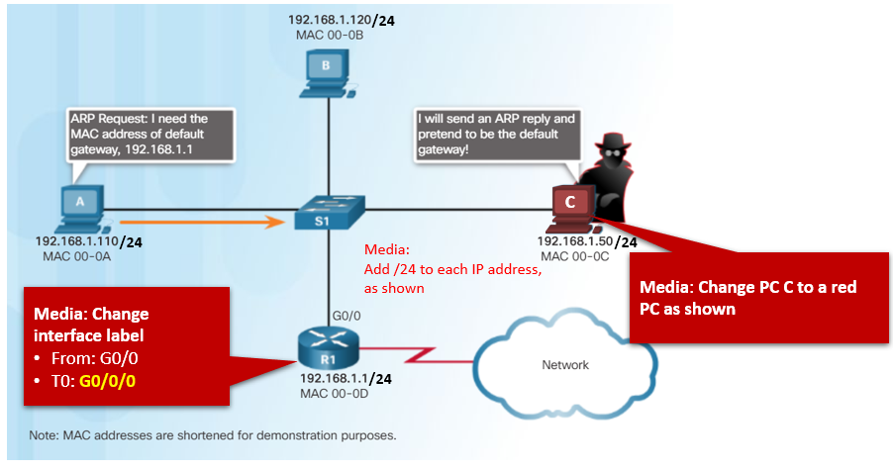
ARP ARP Issues – ARP Broadcasting and ARP Spoofing
ARP requests are received and processed by every device on the local network.
Excessive ARP broadcasts can cause some reduction in performance.
ARP replies can be spoofed by a threat actor to perform an ARP poisoning attack.
Enterprise level switches include mitigation techniques to protect against ARP attacks.
Notes:
9 – Address Resolution
9.2 – ARP
9.2.8 – ARP Issues – ARP Broadcast and ARP Spoofing

Slide 24
ARP Packet Tracer – Examine the ARP Table
In this Packet Tracer, you will complete the following objectives:
Examine an ARP Request
Examine a Switch MAC Address Table
Examine the ARP Process in Remote Communications
Notes:
9 – Address Resolution
9.2 – ARP
9.2.9 – Packet Tracer – Examine the ARP Table
9.2.10 – Check Your Understanding - ARP

Slide 25
9.3 Copper Cabling
Notes:
9 - Address Resolution
9.3 Copper Cabling

Slide 26
IPv6 Neighbor Discovery Video – IPv6 Neighbor Discovery
This video will explain the process of how IPv6 performs address resolution using ICMPv6 neighbor solicitation and neighbor advertisement messages.
Notes:
9 – Address Resolution
9.3 – IPv6 Neighbor Discovery
9.3.1 – Video – IPv6 Neighbor Discovery

Slide 27
IPv6 Neighbor Discovery IPv6 Neighbor Discovery Messages
IPv6 Neighbor Discovery (ND) protocol provides:
Address resolution
Router discovery
Redirection services
ICMPv6 Neighbor Solicitation (NS) and Neighbor Advertisement (NA) messages are used for device-to-device messaging such as address resolution.
ICMTPv6 Router Solicitation (RS) and Router Advertisement (RA) messages are used for messaging between devices and routers for router discovery.
ICMPv6 redirect messages are used by routers for better next-hop selection.
Notes:
9 – Address Resolution
9.3 – IPv6 Neighbor Discovery
9.3.2 – IPv6 Neighbor Discovery Messages

Slide 28
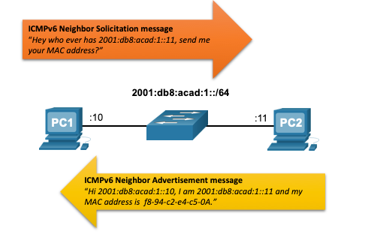
IPv6 Neighbor Discovery IPv6 Neighbor Discovery – Address Resolution
IPv6 devices use ND to resolve the MAC address of a known IPv6 address.
ICMPv6 Neighbor Solicitation messages are sent using special Ethernet and IPv6 multicast addresses.
Notes:
9 – Address Resolution
9.3 – IPv6 Neighbor Discovery
9.3.3 – IPv6 Neighbor Discovery – Address Resolution

Slide 29
IPv6 Neighbor Discovery Packet Tracer – IPv6 Neighbor Discovery
In this Packet Tracer, you will complete the following objectives:
Part 1: IPv6 Neighbor Discovery Local Network
Part 2: IPv6 Neighbor discovery Remote Network
Notes:
9 – Address Resolution
9.3 – IPv6 Neighbor Discovery
9.3.4 – Packet Tracer – IPv6 Neighbor Discovery
9.3.5 – Check Your Understanding – Neighbor Discovery

Slide 30
9.4 Module Practice and Quiz
Notes:
9 - Address Resolution
9.4 Module Practice and Quiz

Slide 31
Module Practice and Quiz What did I learn in this module?
Layer 2 physical addresses (i.e., Ethernet MAC addresses) are used to deliver the data link frame with the encapsulated IP packet from one NIC to another NIC on the same network.
If the destination IP address is on the same network, the destination MAC address will be that of the destination device.
When the destination IP address (IPv4 or IPv6) is on a remote network, the destination MAC address will be the address of the host default gateway (i.e., the router interface).
An IPv4 device uses ARP to determine the destination MAC address of a local device when it knows its IPv4 address.
ARP provides two basic functions: resolving IPv4 addresses to MAC addresses and maintaining a table of IPv4 to MAC address mappings.
After the ARP reply is received, the device will add the IPv4 address and the corresponding MAC address to its ARP table.
For each device, an ARP cache timer removes ARP entries that have not been used for a specified period of time.
IPv6 does not use ARP, it uses the ND protocol to resolve MAC addresses.
An IPv6 device uses ICMPv6 Neighbor Discovery to determine the destination MAC address of a local device when it knows its IPv6 address.
Notes:
9 – Address Resolution
9.4 – Module Practice and Quiz
9.4.1 – What did I learn in this module?
9.4.2 – Module Quiz – Address Resolution

Slide 32
Module 9: Address Resolution New Terms and Commands
Address Resolution Protocol (ARP) ARP table show ip arp arpr -a ICMPv6 Neighbor Discovery protocol (ND) ICMPv6 Neighbor Solicitation (NS) message ICMPv6 Neighbor Advertisement (NA) message ICMPv6 Router Solicitation (RS) message ICMPv6 Router Advertisement (RA) message ICMPv6 Redirect Message

