Slide 1
Data Storyteller
Assignment
September 6, 2022

Slide 2
Overview
In conducting this analysis we will be using Rstudio to analyse data, and RMarkdown to document our findings.
To study the patterns in desktop platform usage, we focused on the following factors:-
Type of development users are involved in
Company size
Role type
Application type
Tool type
Language (Development) type

Slide 3
Overall Usage

Slide 4
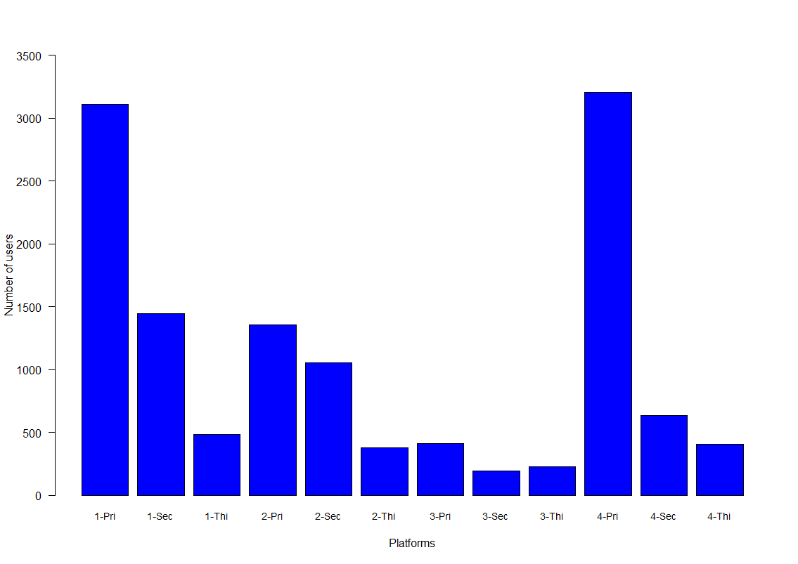
Platform usage analysis
We can see that platform users spent most of their time using Platform 1 and 4. Platform 3 had the lowest usage, with relatively fewer users using it in any capacity.

Slide 5
Type of Development

Slide 6
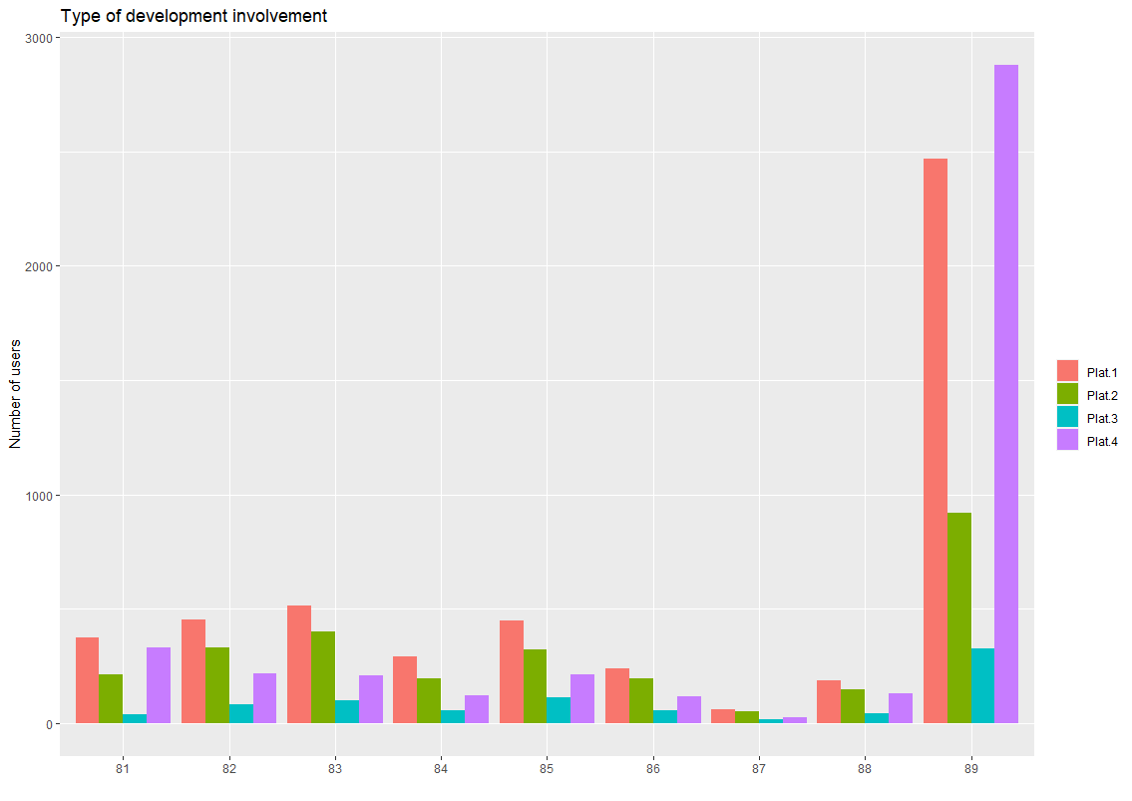
Type of development analysis
We note that most platform users were involved in type 89 development, particularly with platform 1 and 4 users.

Slide 7
Company Size

Slide 8
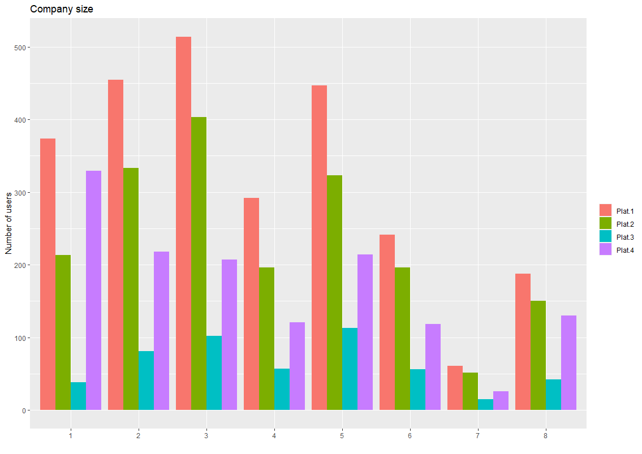
Company size analysis
The Majority of platform users are based in small to mid-sized companies, ranging from 1-5 with platform 1 constituting the largest share of platform usage.
We also note that for larger companies size 7-8, the number of platform users is considerably less.

Slide 9
Type of Role

Slide 10
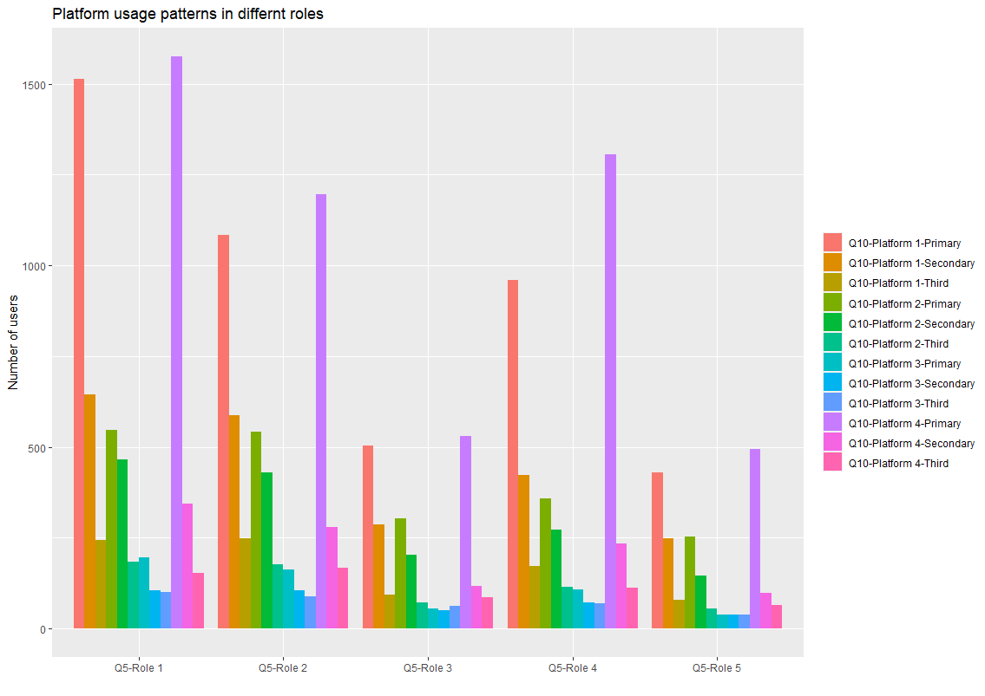
Type of application analysis
There is a clear pattern across all the roles, whereby users spend most of their time working with platform 1 or 4.
We also note, that there is a drop in the number of platform users in roles 3 and 5.

Slide 11
Type of Application

Slide 12
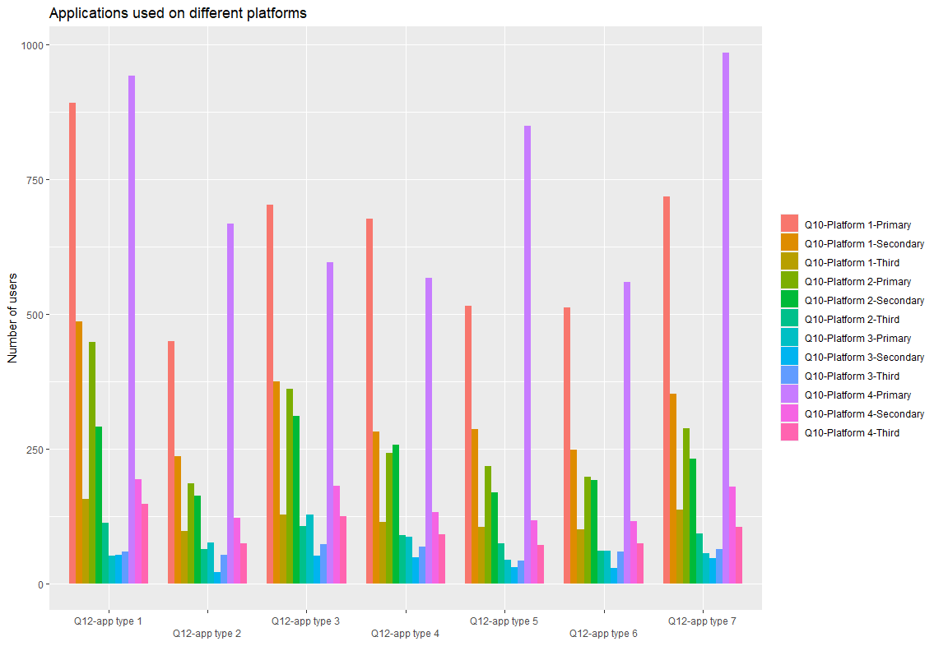
Type of application analysis
Again, a similar pattern to “type of role” data with users spending most of their time on platform 1 and 4 across all application types. In particular, primary users of platform 1 and 4 will most likely choose application type 1 or 7.

Slide 13
Type of Tool

Slide 14
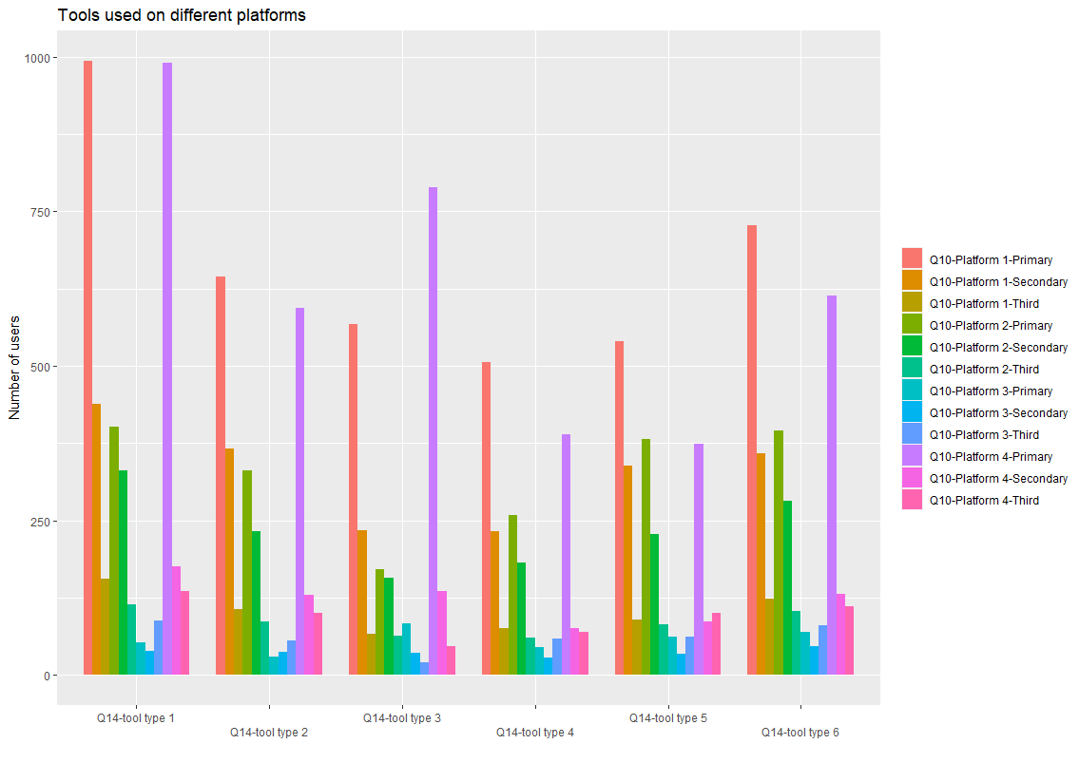
Type of tool analysis
The reocurring pattern of users spending most of their time on platform 1 and 4 across different categories continues.
However, in this case primary users of platform 1 and 4 will most likely choose tool type 1.

Slide 15
Type of Language

Slide 16
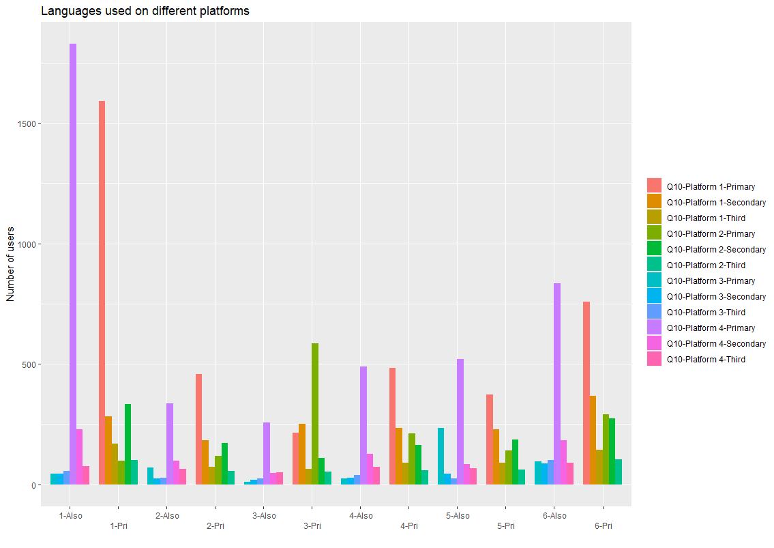
Type of language analysis
The Most notable feature for languages, is the high number of users working with language 1, either as the main language or as a secondary language.

Slide 17
Conclusion
In summary, it appears that platform 1 and 4 usage is consistently high irrespective of the factors listed in our study. It seems that there is no strong relationship between the type of platform used and the factors listed i.e factors will not influence the type of platform used.
Users like using platform 1 and 4, hence why we see the surge across every level of each factor we examined.

