Slide 2

[Portal Name]
AN.090 - Storyboard and Wireframes

Slide 3
[Portal Name]
Storyboard
[Space Name]
Home Page
Search Results
Search
A
B
Page
Page
Page
Page
Page
Content Mgmt
Processes
E-Business Suite
OBIEE Reports
FAQs
Application Navigator
Application Favourites
Application Worklist
OBIEE dashboard
FAQs
WebCenter Content
BPM Task List
C
D
E
F
G

Slide 4

[Portal Name]
B
A
Home Page
Search for content (UC_12)
Logo
Search:
Go
Home | Content Mgmt | Processes | E-Business Suite | OBIEE reports | FAQs
Alan Smith
Preferences
Welcome
<Enter Welcome text.>

Slide 5
[Portal Name]
C
Content Mgmt
Logo
Search:
Go
Home | Content Mgmt | Processes | E-Business Suite | OBIEE reports | FAQs
Alan Smith
Preferences
Maintain content (UC_06)

Slide 6
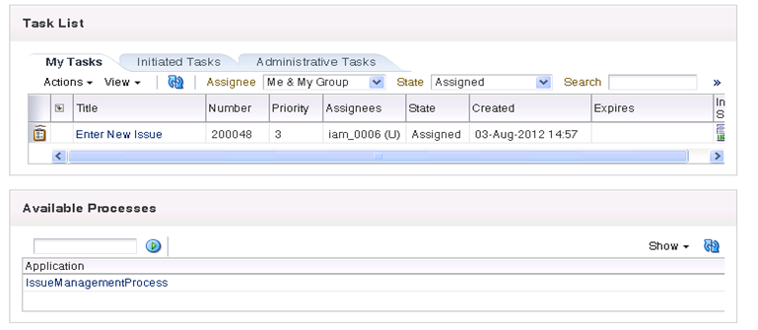
[Portal Name]
D
Processes
Logo
Search:
Go
Home | Content Mgmt | Processes | E-Business Suite | OBIEE reports | FAQs
Alan Smith
Preferences
BPM Integration

Slide 7
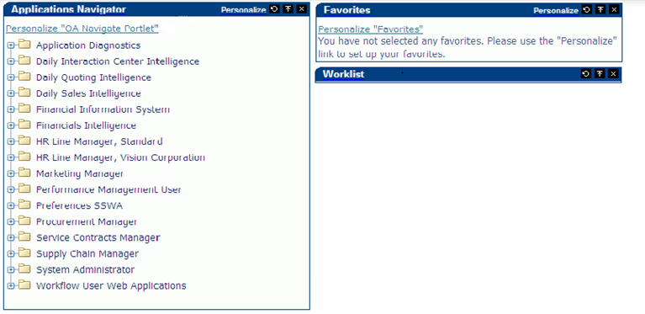
[Portal Name]
E
E-Business Suite
Logo
Search:
Go
Home | Content Mgmt | Processes | E-Business Suite | OBIEE reports | FAQs
Alan Smith
Preferences
E-Business Suite Integration

Slide 8
[Portal Name]
F
OBIEE Reports
Logo
Search:
Go
Home | Content Mgmt | Processes | E-Business Suite | OBIEE reports | FAQs
Alan Smith
Preferences
OBIEE Integration

Slide 9
[Portal Name]
G
FAQs
Logo
Search:
Go
Home | Content Mgmt | Processes | E-Business Suite | OBIEE reports | FAQs
Alan Smith
Preferences
FAQs
FAQ 1 - Text
FAQ2 - Text
FAQ 3 - Text

Slide 10



