Slide 2


Executive Alignment Workshop
<Company Name>
<Project Name>
Presenter’s Name
Presenter’s Title
Organization, Division or Business Unit
Month 00, 2014
Note: The speaker notes for this slide include detailed instructions on how to customize this Title Slide with your own picture.
Tip! Remember to remove this text box.
Notes:
This is a Title Slide with Picture slide ideal for including a picture with a brief title, subtitle and presenter information.
To customize this slide with your own picture:
Right-click the slide area and choose Format Background from the pop-up menu. From the Fill menu, click Picture and texture fill. Under Insert from: click File. Locate your new picture and click Insert.

Slide 3
Executive Alignment Workshop Agenda
Welcome and Objectives of the Workshop
The Project Vision and Goals
Organizational Risks
Project Risks
Sponsorship Program & Reporting Structure

Slide 4
Executive Alignment Workshop Agenda
Project Roles
Steering Committee Roles
Steering Committee – Rules of Engagement
Next Steps – Discussion

Slide 5
Project Vision and Goals

Slide 6
Organizational Risks

Slide 7
Project Risks

Slide 8
Sponsorship Program

Slide 9
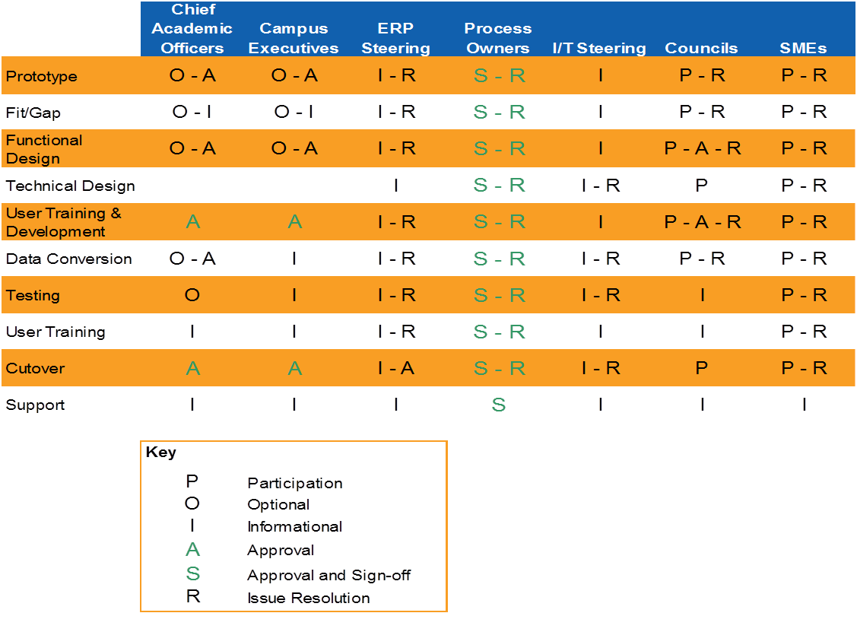
Reporting Structure

Slide 10
Project Roles
Sponsorship Roles (for executives and Steering Committee members)
Steering Committee Charter Roles (for Executives and Steering Committee Members)
Steering Committee Group Operating Norms (for Steering Committee Members Only)
Project Team Environment (for Steering Committee Members Only)
Project Environment (for Steering Committee Members Only)
Communication Roles (for Executives and Steering Committee Members)

Slide 11
Steering Committee Roles
Work with their groups to support the implementation
Make major project decisions
Implement decisions made by the Steering Committee
Set expectations
Build confidence
Push, if required
Raise project risks

Slide 12
Steering Committee – Rules of Engagement
Participate actively in the process
Facilitate open and regular communication
Demonstrate personal commitment
Address issues in an open and timely way
Support those involved in the implementation process

Slide 13
Next Steps
Discussion

