Slide 1
Use Case Model Template
System Name
<<actor>> System Name
UC0001 Verb-Noun (2-4 words)
Actor Name
<<actor>> System Name
Actor Name
Actor Name

Slide 2

Use Case Template
Additional Options
System Name
«extends»
«include»

Slide 3
Actors
Name | Description
Notes:
A list of actors owned by the package, including the name and brief description (role involved) of each actor in this package.

Slide 4
Use Case Brief Descriptions
Use Case Name | Description
UCnnn <Verb-Noun> | This use case begins when the <primary actor> <does something>. The system responds by <doing something>. This use case ends when <something happens
Notes:
A brief description summarizes the purpose of the Use Case to help with understanding and scoping the system. This brief description or is initially done in the RA.023 Develop Use Case Model task. It is further refined in the RA.024 Develop Use Case details by explaining the frequency and usage in the Context of Use section.
·It is all that is needed to scope the system at this early stage
·It can be written as a 2-3 sentence paragraph or a 3-step process

Slide 5
Use Case
Example
Ski Now Financial Systems
«include»
UC006
Apply GL
Validations
UC002
Process
Financial Entries
<<actor>> XYZ System
Customer
«include»
<<actor>>
Legacy
Financials
White box
Transform
Entries to GL
Scheduled Submission
Notes:
This is an example of a use case diagram which indicates that one use case Process Financial Entries is dependent upon two other Use Cases: Apply GL Validations and Transform Entries to GL
It is important to consider this dependent Use Cases when implementing Apply GL Validations and Transform entries to GL
The Arrowhead is always aligned with the dependency. For example, on the current slide, “Process Financial Entries" is dependant on “Apply GL Validations" therefore the arrowhead points to “Apply GL Validations”.
The “includes notation” is important to designate.

Slide 6
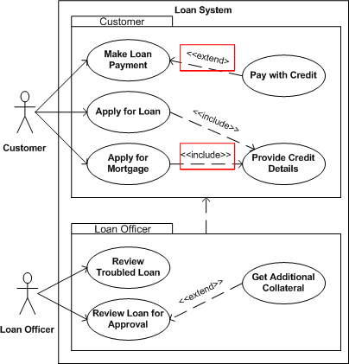
Use Case Model
Example

