Slide 1

Assessing new loan applications using Machine Learning
Exploring machine learning methods for loan assessment
Jeremy Dang

Slide 2
Agenda
Context
Objectives
Data
Understanding - Exploration
Preparation
Understanding - Correlation
Modelling
Models Chosen
Considerations
Methodology
Evaluation
Evaluation metrics
Model performance
Conclusions
Appendices

Slide 3
Context
Loans provide a means of long term finance for several industries, in return, lenders’ profit in the form of interest, payed on top of a loan
However, loans are a huge risk to lenders’, what if the borrower is unable to pay back their agreed loan?
The business would incur a loss and would directly impact revenue streams.
Worse case scenario – A global recession
E.g – Financial crisis of 2007-2008
Predicting if applicants default is an important task!

Slide 4
Objectives
What do applicants who default look like?
What are the factors correlated with default?
How can we assist the analysts’ in minimising the cost of default?

Slide 5
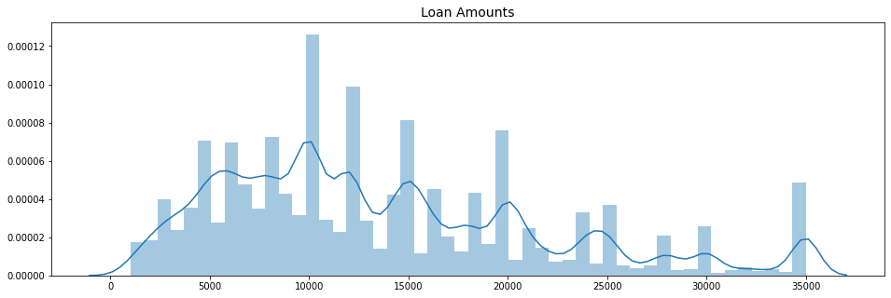
Data Understanding – What are the amounts we’re lending?

Slide 6
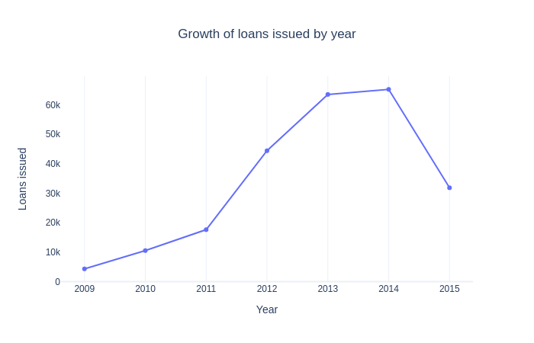
Data Understanding – Growth of loans over time

Slide 7
Data Understanding – What do we mean by default?
For simplicity, three groups are defined on the loan status feature:
Good: An individual who has fully paid their loan back
Bad: An individual who has either defaulted, charged-off or late by more than 90 days
Ongoing: An individual who is still paying back their loan
Charged-off represents a stage where we expect the loan to not be paid back → borrower has defaulted.
Late is grouped according to the definition of default from IRB guidelines (defined by payments late by more than 90 or 180 days)

Slide 8
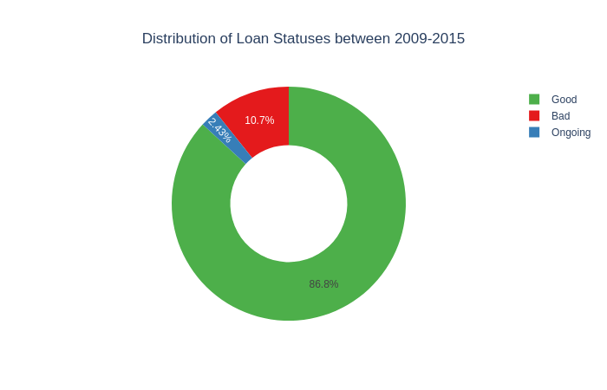
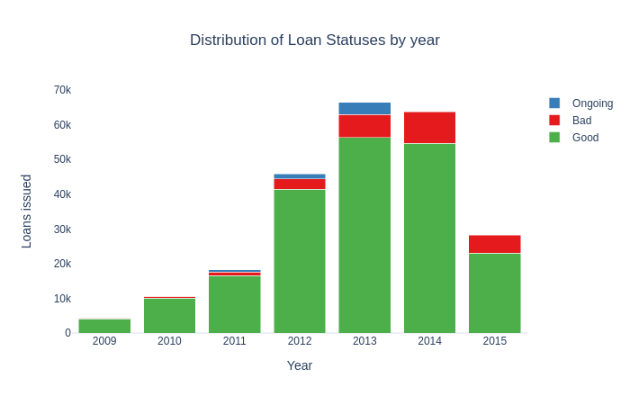
Data Understanding – What do applicants who default look like?

Slide 9
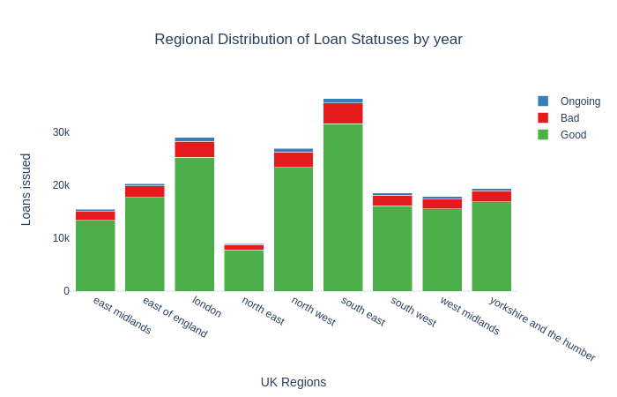
Data Understanding – What do applicants who default look like?
The districts were mapped into regions where possible (82% coverage). See appendix for details.
Regions of largest defaulted applicants: London, North West & South West

Slide 10
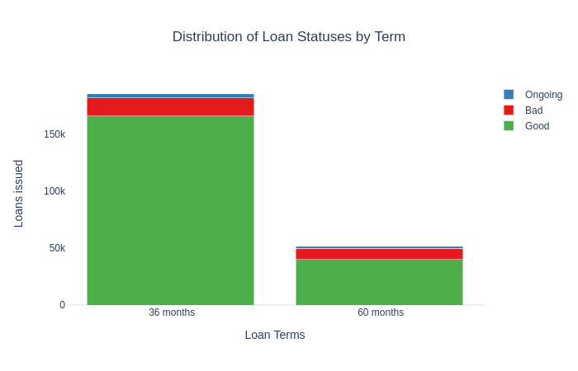
Data Understanding – What do applicants who default look like?
7% of loans defaulted were on 36-month terms
4% of loans defaulted were on 60-month terms

Slide 11
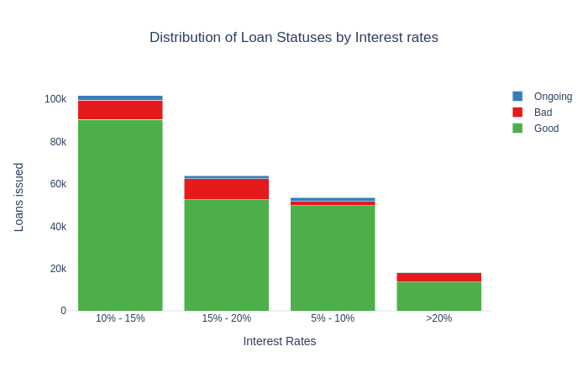
Data Understanding – What do applicants who default look like?
11% of loans which defaulted were paying an interest rate between 10%-20%

Slide 12
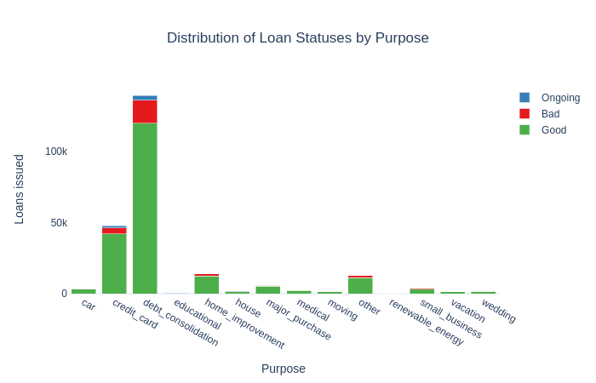
Data Understanding – What do applicants who default look like?
60% of loans were used to finance existing loans
Of which 11% had defaulted

Slide 13
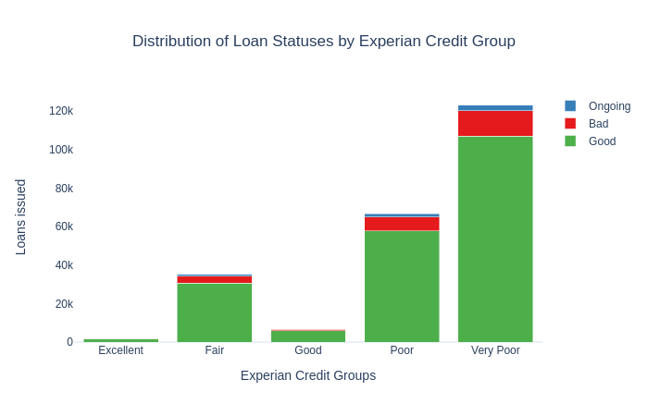
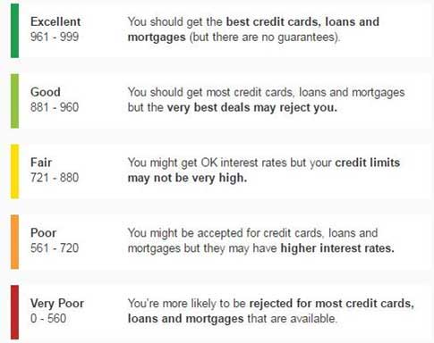
Data Understanding – What do applicants who default look like?
Credit scores were mapped according to Experian Credit bands
Credit score isn’t everything!
Many loans that were given, were fully-paid despite a low score

Slide 14

Data Preparation – Summary of data preparation
Full details are available in the appendix and project files
A binary response variable (named class) was created based slide 8, Ongoing samples were dropped
Features that contributed to data leakage were removed i.e features that logically should not be present when there is a new application (e.g amount payed)
Features that were text-based like description were removed – Natural language processing was not in scope
Features with many groups such as purpose were re-categorised for simplicity and created as dummy variables
Features that were ≥50% empty were removed – due to lack of information
Features that were between 20% and 49% empty such as total current balance were imputed based on the median, segmented by district.
Otherwise, samples were dropped (5% of samples were dropped in total)

Slide 15
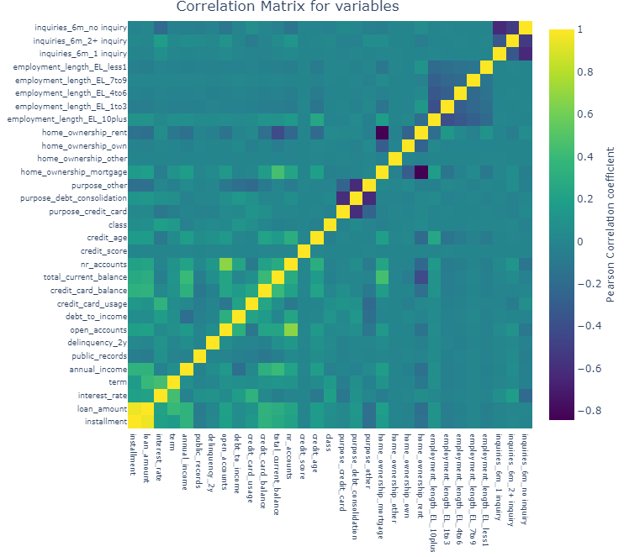
Data Understanding – Correlations
Majority of features seem uncorrelated with each other and the class variable
Some features are correlated such as loan amount & installment
While others are negatively correlated due to the creation of dummy variables (creation of mutually exclusive variables)

Slide 16
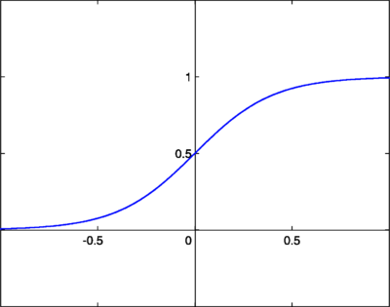
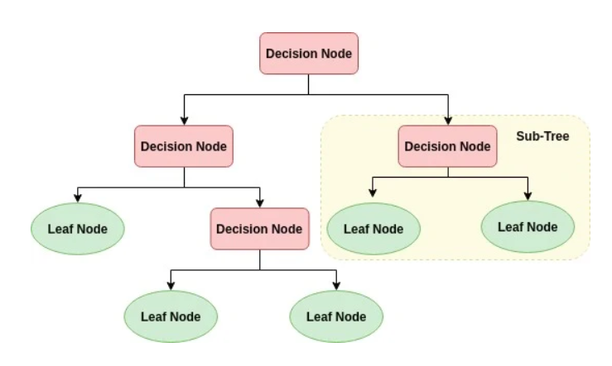
Modelling – Models chosen
Three models were chosen due to their simplicity, ability to obtain a probability of default and practical implementation:
Logistic Regression
Huber Regression
Decision Tree
Notes:
For Huber, think of logistic regression, how logistic regression trains is using cross entropy loss (in linear regression the function which is optimised is least squares / sum of squars)

Slide 17
Modelling – Considerations
Data is highly imbalanced and not equally distributed.
Solution – Use Random Over-sampling
Initial experiments showed that using SMOTE encountered memory errors
Overfitting vs Underfitting → Apply regularisation to reduce overfitting
Method | Advantages | Disadvantages
Random Oversampling | Intuitive Easy to implement No information loss | May cause overfitting due to duplication of minority class
Random Undersampling | Intuitive Easy to implement | May cause underfitting, due to information loss
SMOTE + variants | Overcomes overfitting by creating samples No information loss | Impractical due to the calculations made to create samples Harder to interpret
Notes:
For Huber, think of logistic regression, how logistic regression trains is using cross entropy loss (in linear regression the function which is optimised is least squares / sum of squars)
Underfit would need more time to collect data or use a more complex model which might not be computationally feasible and would not help the anaysts’ understand why a model made a particular decision

Slide 18



Modelling – Methodology
75%
25%
Numerical features were normalised with the IQR method to handle any case of outliers (e.g loan amount)
Samples were shuffled in and minority class was oversampled at random
The data was split into 75% for model training and optimisation
Models were trained and optimised on 75% of the data
Where applicable, Gradient Descent was applied for efficient training and optimisation
To reduce the number of features, Recursive feature elimination (RFE) was used.
Models were evaluated on the remaining 25% of the data
Metrics used to evaluate the model was Accuracy, Recall & Area-under-the-curve (AUC)
Notes:
IQR method = (value - median) / IQR
RFE = train model with all variables, drop the weakest feature to combat collinearity and correlated variables

Slide 19
Evaluation – Evaluation metrics
Accuracy, easy to understand - alone does not provide an adequate evaluation of the task at hand
Recall attempts to answer the following question:
What proportion of loan applicants actually defaulted?
Having a low recall could lead to poor customer experience and decrease in revenue
As a business, recall could help allocate funds to the minimum capital requirements
AUC, visual representation of recall and precision and is a single metric defining how well the model separates defaulted and fully-paid loan applicants
25%
Notes:
Recall allocate funds by putting (1-recall)*loan_balance_from_defaulters into a pot

Slide 20
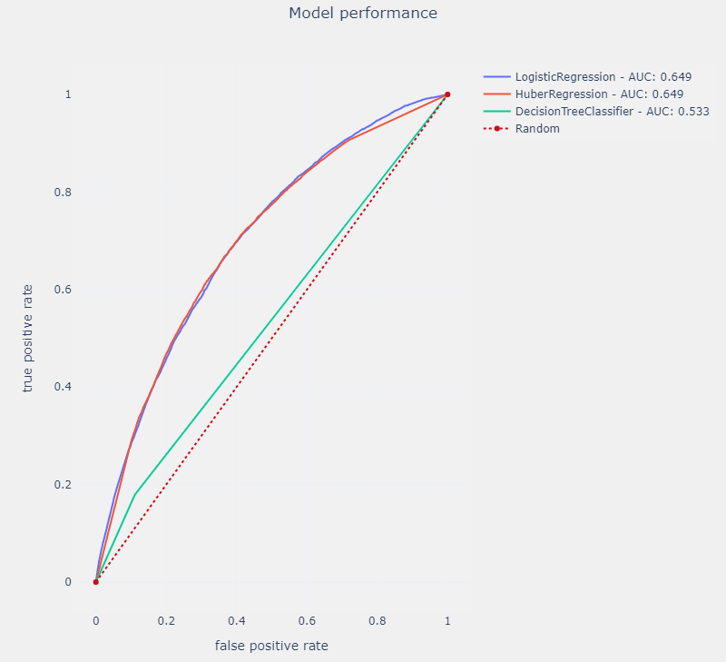
Evaluation – Model performance using all variables
Model | Accuracy | Recall | AUC
Logistic Regression | 65.3% | 65% | 64.91%
Huber Regression | 65.5% | 65% | 64.92%
Decision Tree | 81.3% | 53% | 53.3%
Notes:
IQR method = (value - median) / IQR

Slide 21
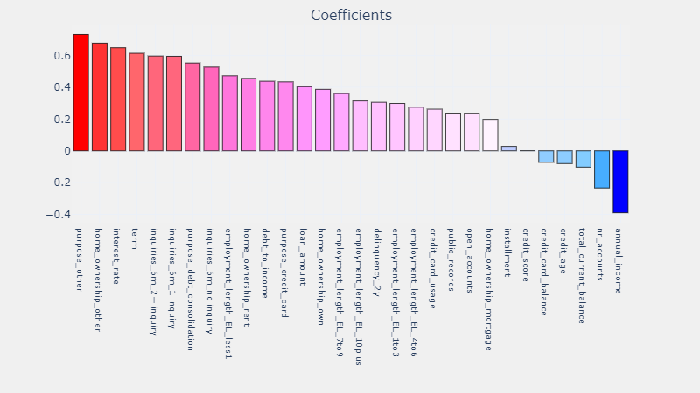
Evaluation – What are the factors correlated with default?
(Huber Regression)
Notes:
IQR method = (value - median) / IQR

Slide 22
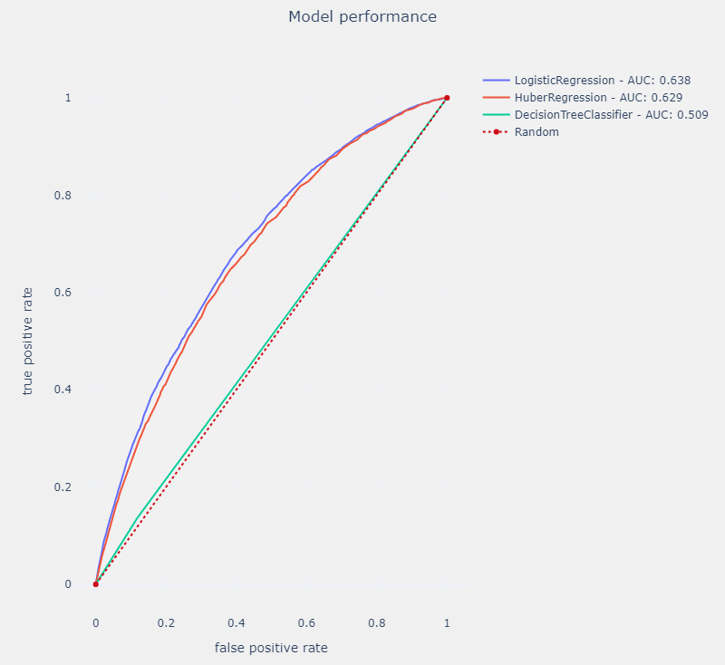
Evaluation – Model performance using five variables
Model | Accuracy | Recall | AUC
Logistic Regression | 65.5% | 64% | 63.83%
Huber Regression | 65.2% | 63% | 62.95%
Decision Tree | 80.3% | 51% | 50.90%
Notes:
IQR method = (value - median) / IQR

Slide 23
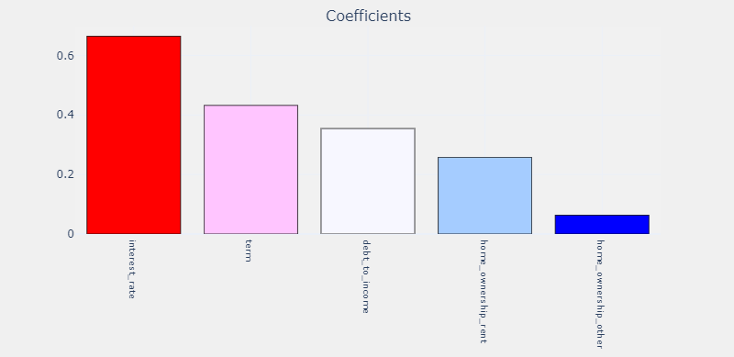
Evaluation – What are the factors correlated with default?
(Logistic Regression)
Notes:
IQR method = (value - median) / IQR

Slide 24
Conclusions – Model to be used
The model that should be used is the simpler model, less is more
Reduction from 31 features to 5 features, that is 83% reduction
From a practical perspective, it is much easier to collect 5 features than 31
Trade-off is 1% pts difference in recall and AUC
# of Variables | Model | Accuracy | Recall | AUC
5 | Logistic Regression | 65.5% | 64% | 63.83%
31 (all variables) | Huber Regression | 65.5% | 65% | 64.92%
Notes:
IQR method = (value - median) / IQR

Slide 25
Conclusions – Next steps
Model should be used in conjunction with credit history of applicants to help the analysts’ make an informed decision
A traffic light system would be able to assist analysts’ by obtaining their input on defining probability of default thresholds on the model
Allowing analysts’ to prioritise applicants
Notes:
IQR method = (value - median) / IQR

Slide 26
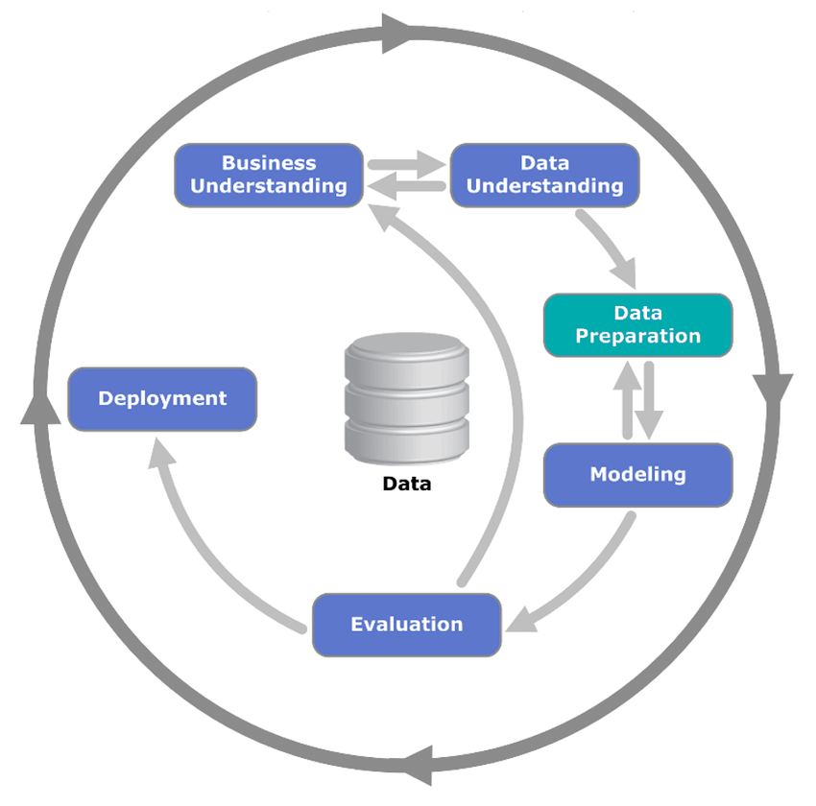
Appendix - Approach
`Cross-industry standard process for data mining` (CRISP-DM).
A process for applying data science methodology to answer business questions

Slide 27
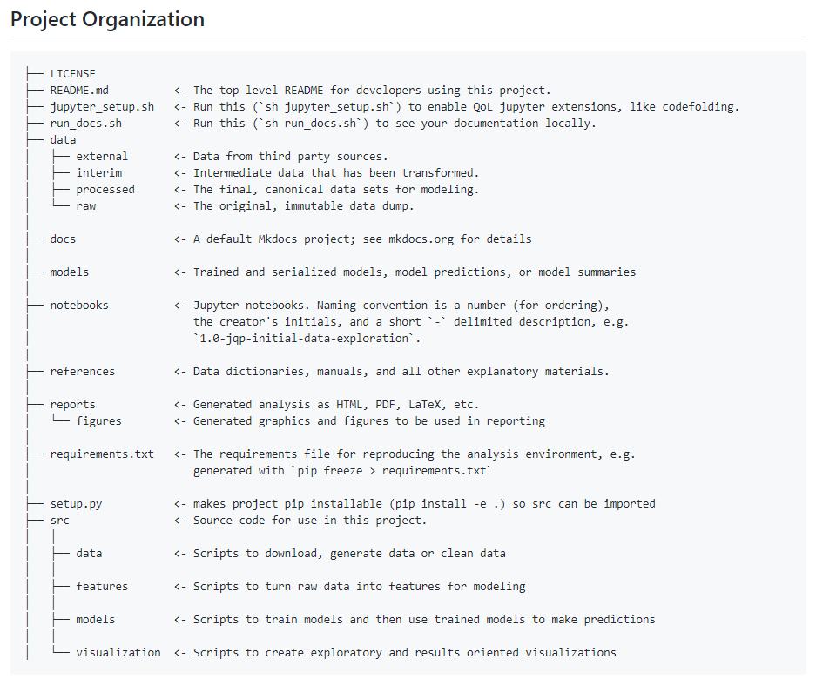
Appendix – Documentation – Project Structure
Notes:
IQR method = (value - median) / IQR

Slide 28
Appendix – Documentation – EDA
Mapping districts to regions:
https://geoportal.statistics.gov.uk/datasets/ward-to-local-authority-district-to-county-to-region-to-country-december-2017-lookup-in-united-kingdom-version-2
Experian Credit Rating groups
https://www.experian.co.uk/consumer/mortgages/guides/credit-and-mortgages.html
Notes:
IQR method = (value - median) / IQR

Slide 29
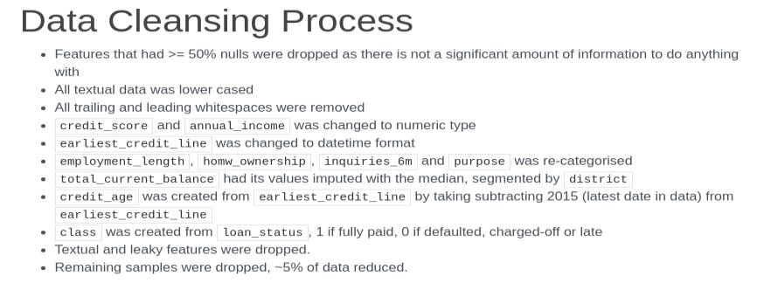
Appendix – Documentation – Data cleansing process
Notes:
IQR method = (value - median) / IQR

Slide 30
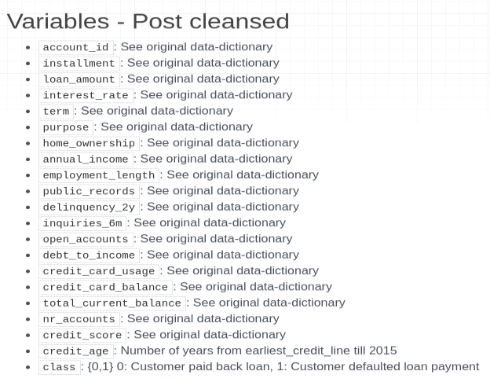
Appendix – Documentation – Variables after data cleansing
Notes:
IQR method = (value - median) / IQR

Slide 31
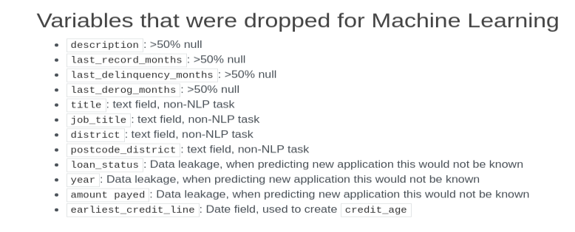
Appendix – Documentation – Variables dropped for Machine Learning
Notes:
IQR method = (value - median) / IQR

Slide 32
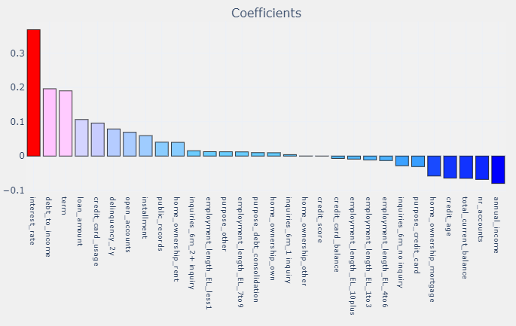
Appendix – Model coefficient using all variables
(Logistic Regression)
See reports/figures/*.html for all interactive reports and metrics
Notes:
IQR method = (value - median) / IQR

Slide 33
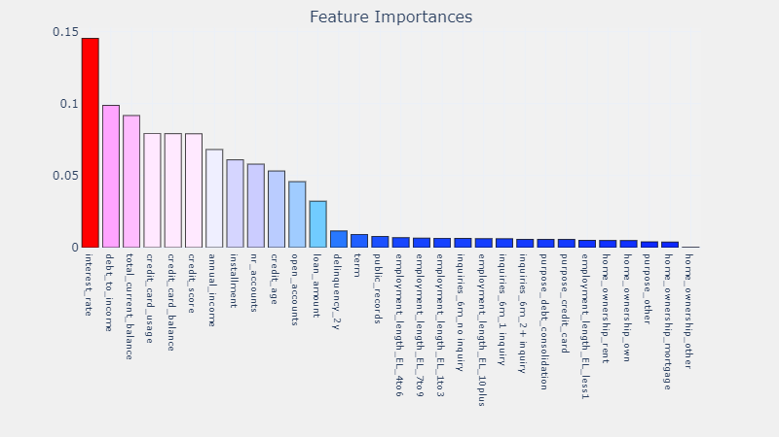
Appendix – Model feature importances using all variables
(Decision Tree)
See reports/figures/*.html for all interactive reports and metrics
Notes:
IQR method = (value - median) / IQR

Slide 34
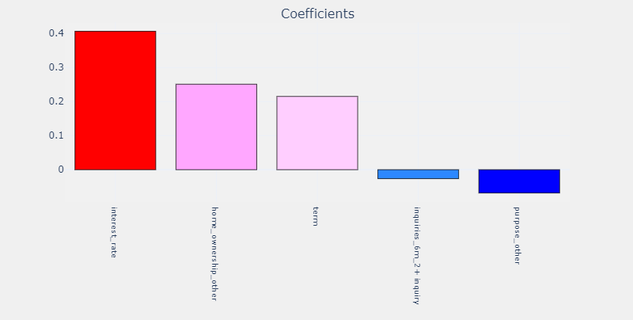
Appendix – Model performance using five variables
Huber Regression
See reports/figures/*.html for all interactive reports and metrics
Notes:
IQR method = (value - median) / IQR

Slide 35
Appendix – Model performance using five variables
Decision Tree
See reports/figures/*.html for all interactive reports and metrics
Notes:
IQR method = (value - median) / IQR

