Slide 1

Assessing new loan applications using Machine Learning
Exploring machine learning methods for loan assessment
Jeremy Dang

Slide 2
Agenda
Approach
Context
Objectives
Data
Understanding - Exploration
Preparation
Understanding - Correlation
Modelling
Evaluation
Appendices

Slide 3
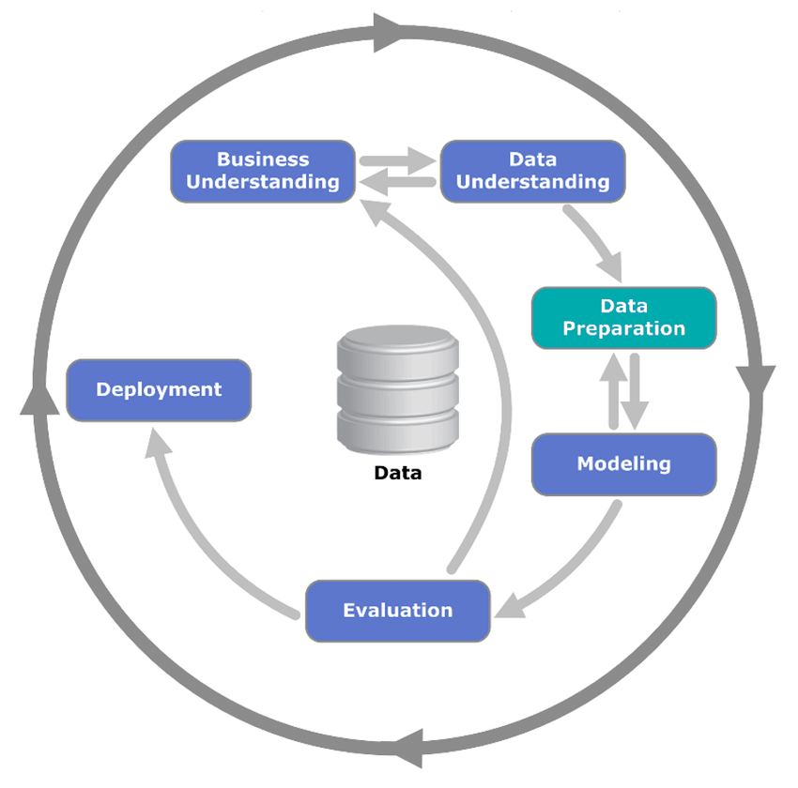
Approach
`Cross-industry standard process for data mining` (CRISP-DM).
A process for applying data science methodology to answer business questions

Slide 4
Context
Loans provide a means of long term finance for several industries, in return, lenders’ profit in the form of interest, payed on top of a loan
However, loans are a huge risk to lenders’, what if the borrower is unable to pay back their agreed loan?
Business would incur a loss and would directly impact revenue streams.
Worse case scenario – A global recession
E.g – Financial crisis of 2007-2008

Slide 5
Objectives
What do applicants who default look like?
What are the factors correlated with default?
How can we assist the analysts’ in minimising the cost of default?

Slide 6
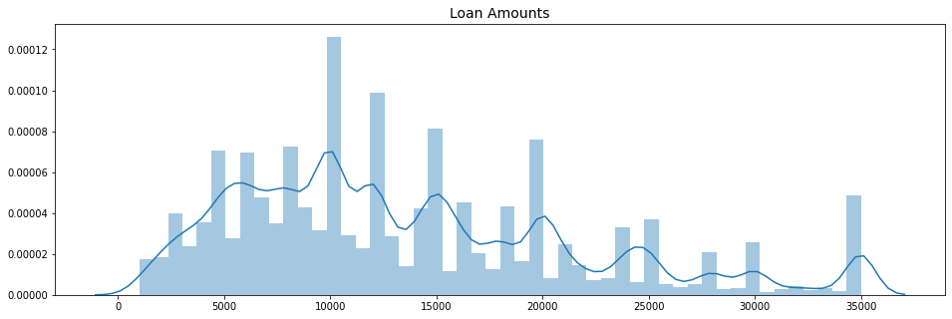
Data Understanding – What are the amounts we’re lending?

Slide 7
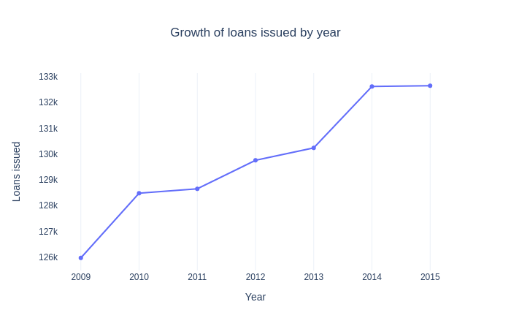
Data Understanding – Growth of loans over time

Slide 8
Data Understanding – What do we mean by default?
For simplicity, three groups are defined on the loan status feature:
Good: An individual who has fully paid their loan back
Bad: An individual who has either defaulted, charged-off or late by more than 90 days
Ongoing: An individual who is still paying back their loan
Charged-off represents a stage where we expect the loan to not be paid back → borrower has defaulted.
Late is grouped according to the definition of default from IRB guidelines (defined by payments late by more than 90 or 180 days)

Slide 9
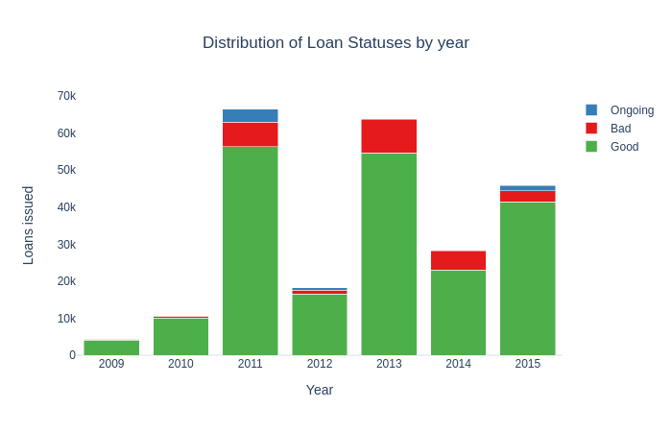
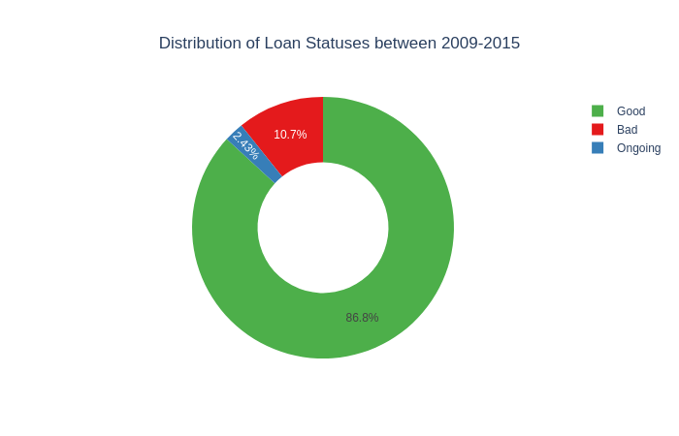
Data Understanding – What do applicants who default look like?

Slide 10
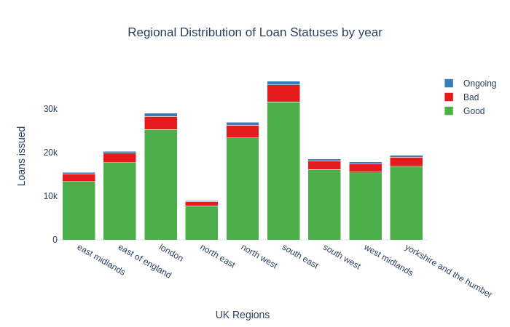
Data Understanding – What do applicants who default look like?
The districts were mapped into regions where possible (82% coverage). See appendix for details.

Slide 11
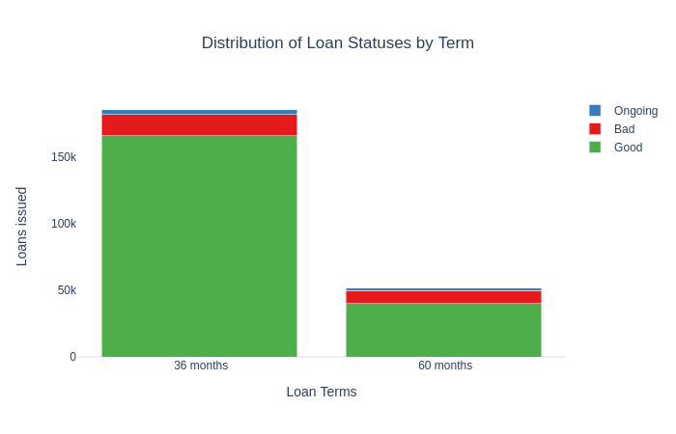
Data Understanding – What do applicants who default look like?
7% of loans defaulted were on 36-month terms
4% of loans defaulted were on 60-month terms

Slide 12
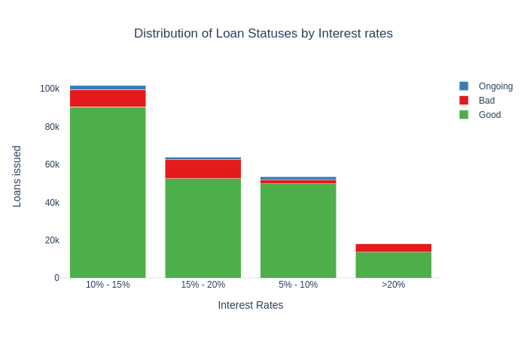
Data Understanding – What do applicants who default look like?
11% of loans which defaulted were paying an interest rate between 10%-20%

Slide 13
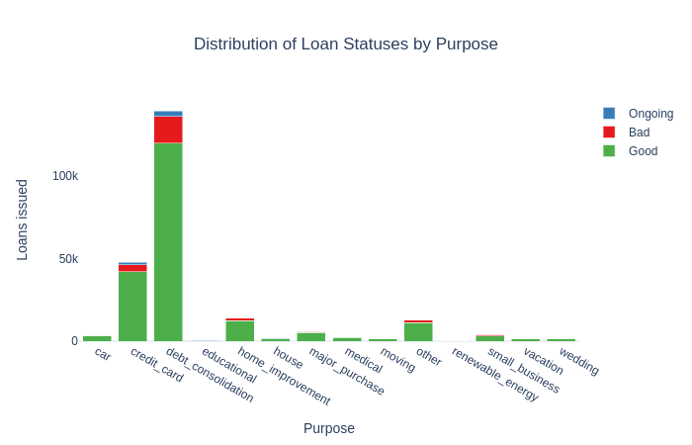
Data Understanding – What do applicants who default look like?
60% of loans were used to finance existing loans
Of which 11% had defaulted

Slide 14
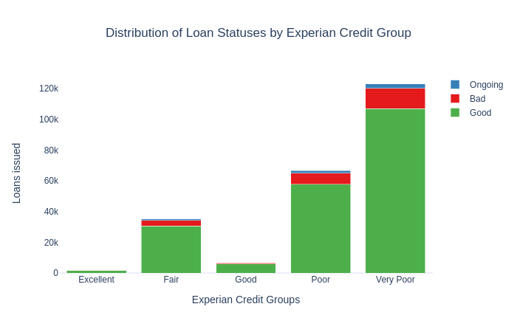
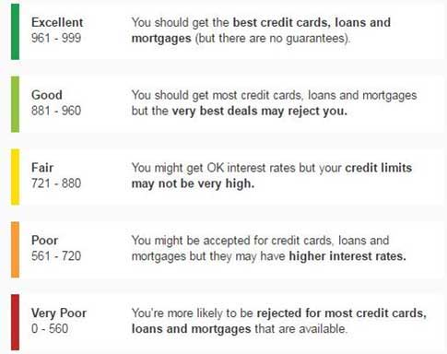
Data Understanding – What do applicants who default look like?
Credit score isn’t everything!
Many loans that were given, were fully-paid despite a low score

Slide 15

Data Preparation – Summary of data preparation
Full details are available in the appendix
A binary response variable (named class) was created based slide 8, Ongoing samples were dropped
Features that were ≥50% empty were removed – due to lack of information
Features that were text based like description were removed – Natural language processing was not in scope
Features with many groups such as purpose were re-categorised for simplicity and created as dummy variables
Features that were between 20% and 49% empty such as total current balance were imputed based on district and the median value.
Otherwise, samples were dropped (5% of the data was dropped in total)

Slide 16
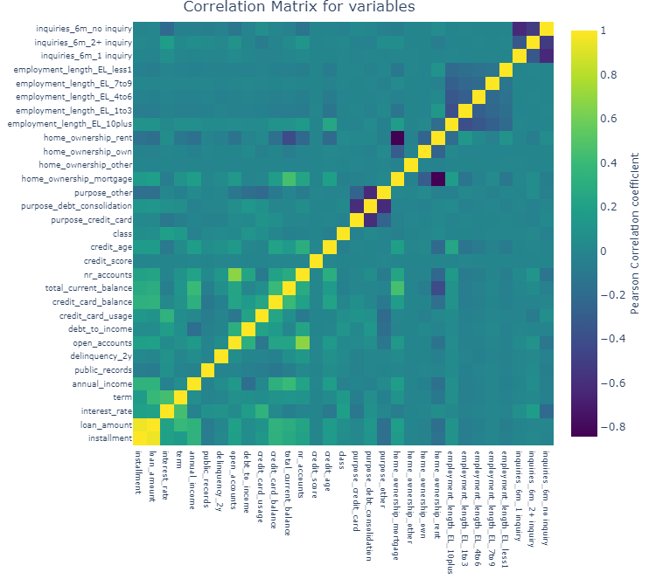
Data Understanding – Correlations
Majority of features seem uncorrelated with others and the class variable
Some features are correlated such as loan amount & installment
While others are negatively correlated due to the creation of dummy variables (creation of mutually exclusive variables)

Slide 17
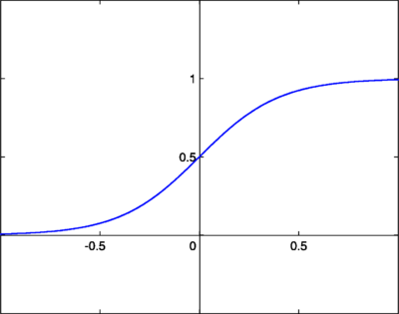
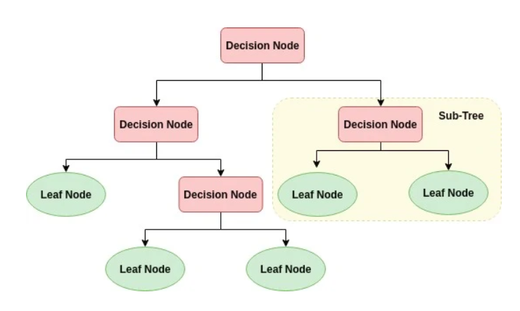
Modelling – Models chosen
Three models were chosen due to their ability their simplicity, obtain a probability of default and practical implementation:
Logistic Regression
Huber Regression
Decision Tree
Notes:
For Huber, think of logistic regression, how logistic regression trains is using cross entropy loss (in linear regression the function which is optimised is least squares / sum of squars)

Slide 18
Modelling – Considerations
Data is highly imbalanced and not equally distributed.
Solution – Use Random Over-sampling
Initial experiments showed that using SMOTE encountered memory errors
Overfitting vs Underfitting → Apply regularisation to reduce overfitting
Method | Advantages | Disadvantages
Random Oversampling | Intuitive Easy to implement No information loss | May cause overfitting due to duplication of minority class
Random Undersampling | Intuitive Easy to implement | May cause underfitting, due to information loss
SMOTE | Overcomes overfitting by creating samples No information loss | Impractical due to the calculations made to create samples Harder to interpret
Notes:
For Huber, think of logistic regression, how logistic regression trains is using cross entropy loss (in linear regression the function which is optimised is least squares / sum of squars)

Slide 19
Modelling – Considerations
Data is highly imbalanced and not equally distributed.
Solution – Use Random Over-sampling
Initial experiments showed that using SMOTE encountered memory errors
Overfitting vs Underfitting → Apply regularisation to reduce overfitting
Method | Advantages | Disadvantages
Random Oversampling | Intuitive Easy to implement No information loss | May cause overfitting due to duplication of minority class
Random Undersampling | Intuitive Easy to implement | May cause underfitting, due to information loss
SMOTE | Overcomes overfitting by creating samples No information loss | Impractical due to the calculations made to create samples Harder to interpret
Notes:
For Huber, think of logistic regression, how logistic regression trains is using cross entropy loss (in linear regression the function which is optimised is least squares / sum of squars)

