Slide 1


Finding a needle in the haystack – Fraud detection
A machine learning based fraud detector
Jeremy Dang

Slide 2
Agenda
Context
Approach & Objectives
Data
Understanding
Preparation
Modelling
Evaluation and Further Work

Slide 3

Context
Important that financial companies are able to recognise fraudulent credit card transactions so that customers are not charged for items they did not purchase.
Risks are often associated with debt and bankruptcy.
Growing importance as contactless payments are widely accepted and can therefore increase the likelihood of fraudulent transactions

Slide 4
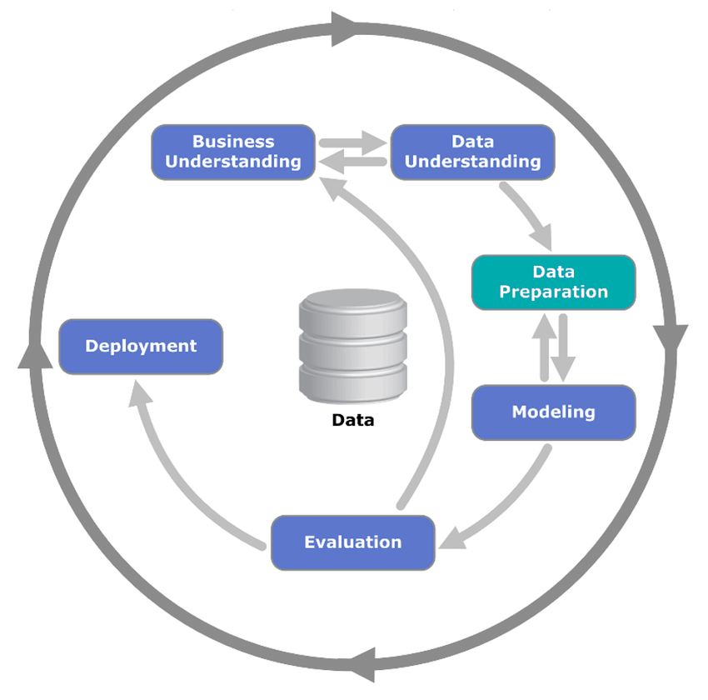
Approach
Cross-industry standard process for data mining (CRISP-DM) is the approach taken in this project.
Allows flexibility during the project.
Creates focus on areas to action upon.

Slide 5
Objectives
What do fraudulent transactions look like?
How much is fraudulent transaction likely to cost {company_name} based on final model selected?

Slide 6
Data - Understanding
284,806 transactions
492 fraudulent transactions
0.17% of transactions were fraudulent

Slide 7
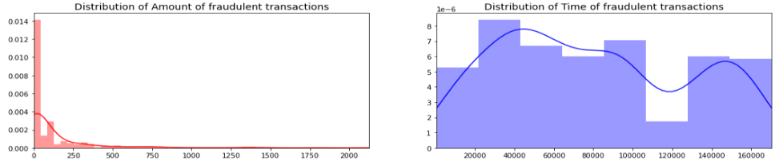
Data - Understanding

Slide 8
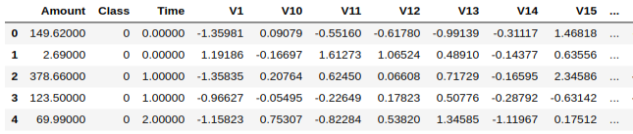
Data - Understanding
There are 30 features in this dataset:
Time; number of seconds elapsed between this transaction and the first transaction in the dataset.
Amount; the transaction amount of some unit of currency.
V1, V2, …, V28 are features as a result of performing PCA, and are not known due to nature of Kaggle and privacy concerns.
Additionally, we also have the Class which tells us if a transaction was fraud or not. A fraudulent transaction is flagged as a 1 else 0.

Slide 9
Data - Understanding
What is PCA?
Principal Components Analysis (PCA) is a method of summarising data, when there are many features, we are able to compress some features together to form new features that tells us the same information in less amount of features. Less is more!

Slide 10
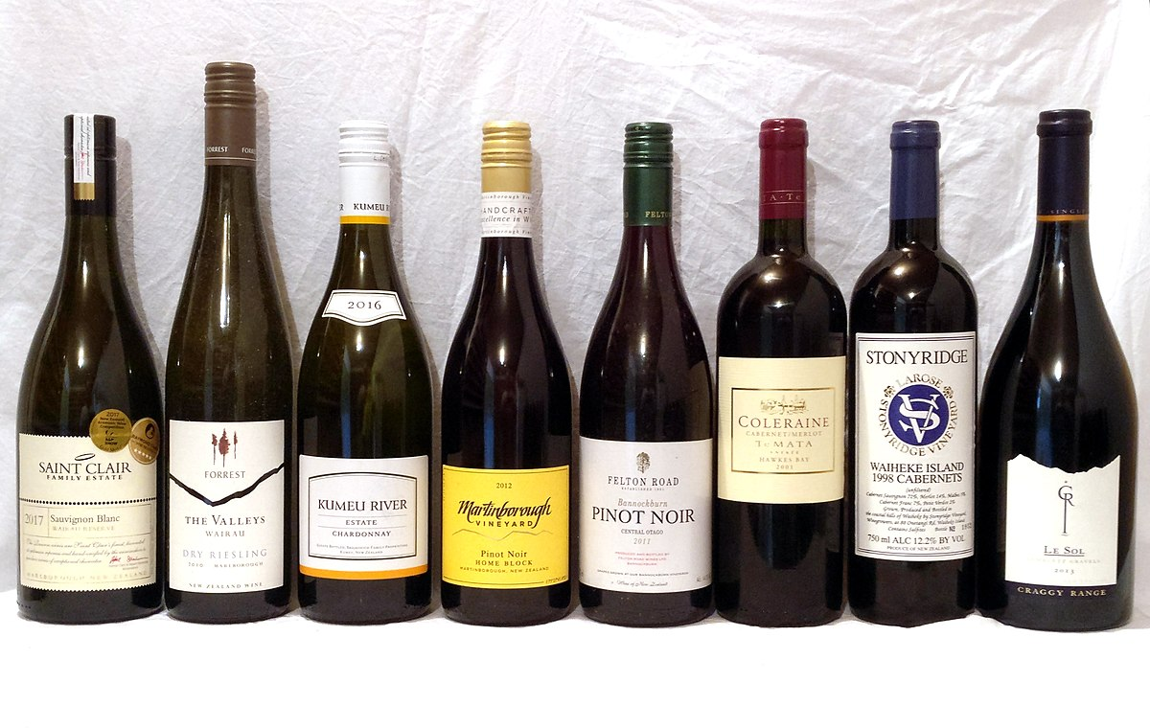

Data - Understanding
PCA Example
Suppose we have some list of wines, we can describe wine by its colour, taste, strength of alcohol, age, country of origin etc.
Many wines will share similar properties and so some properties are redundant as they won’t tell us much from some batch of wines
PCA helps us finds the best possible characteristics that helps summarise our list of wines by
Looking for wine properties that strongly differ across our wines (e.g colour)
Using these new characteristics you are able to reconstruct the original properties. This is called principal components, in our data are labelled V1,V2,…,V28.
This Photo by Unknown Author is licensed under CC BY-SA

Slide 11
Data - Preparation
Check for null values
Either fill with median or remove (if few)
Check the distribution of each variable
Tells us if there are any outliers
And if we need to scale our variables
Tackle the imbalanced problem
Because majority of the variables are transformed, only few variables to check
Hypotheticals
If features weren’t readily available → Check distribution, resolve, apply scaling then apply PCA for dimension reduction
Notes:
Hypotheticals
If features weren’t readily available → Check distribution, resolve, apply scaling then apply PCA for dimension reduction

Slide 12
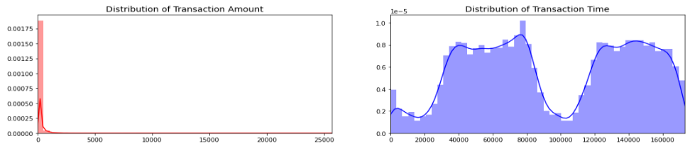
Data - Preparation
Non-Gaussian distribution
Extremely large ranges

Slide 13
Data - Preparation
There are few methods we can use to address imbalanced datasets:
Method | Pros | Cons
Undersampling | Intuitive Easy to implement | May cause underfitting and this is usually worse than overfitting due to discarding samples (loss of information) Sampling bias
Oversampling | Intuitive Easy to implement No information loss | May cause overfitting due to duplication of minority class to match size of majority class
SMOTE | Overcomes overfitting due to creating data points rather than duplicating No loss of information | Impractical when there are large number of dimensions as neighbouring data points can be in different classes Harder to use depending on data meaning
SMOTE was used as features were on a continuous scale
We do not have adequate features to perform a sensible stratified sample representative of transactions

Slide 14
Modelling
For this project 3 models were considered as a baseline before any optimisation:
Logistic Regression
K-nearest neighbours
Decision Trees
These models were chosen for their simplicity and low computational complexity (due to limited computational resources)
Five-fold cross validation was used to benchmark the models as the data was limited in quantity when attempting to use the hold-out method of validation.

Slide 15
Modelling
From the baseline experiment, the best model was the Logistic Regression and was therefore chosen to undergo optimisation.
Details of baseline experiment is in the appendix.
Metric | Score
Accuracy | 0.96
Precision | 0.13
Recall | 0.89
F1 | 0.20

Slide 16
Modelling
Recall was measured at 89%
This means that when the model is able to predict 89% of all fraudulent transactions.
Comparing this to recall at 13%
This means that when the model predicts a transaction is fraudulent, it is correct 13% of the time.
Metric | Score
Precision | 0.13
Recall | 0.89

Slide 17
Evaluation & Further Work
60K worth of transactions was flagged as fraud
The model managed to help identify 54K worth of transactions worth as fraud

Slide 18
Evaluation & Further Work
Given the nature of the dataset, more samples would have been beneficial for model evaluation so that a test set could have been created for further analysis.
This would shed light on the model’s true performance
Recall is an important metric for this project as there are many more transactions which are legitimate and because fraudulent transactions are rare in the data set having a model to accurately detect truly fraudulent transactions should be the objective in the model.

Slide 19
Appendix
All visuals and data are sourced from my GitHub https://github.com/ah12068/kaggle-ccf
Project is laid out in a collaborative templated way for future use

