Slide 1

UoB Engineering Study Space Booking App
User Manual

Slide 2
Introduction
Logging in / out
Navigation
Student Features
Making a booking
Viewing bookings
Cancelling a booking
Administrator Features
Adding a room
Viewing users
Viewing a user’s bookings
Deleting a user
Blacklisting a user
Adding a new user
Viewing all bookings
Viewing statistics

Slide 3
Introduction

Slide 4
The UoB Engineering Study Space Booking App allows students to booking study spaces and meeting rooms on the fly.
Previously, this process was carried out by the Engineering Librarians manually on paper.
The user interface is simple but efficient, allowing quick, easy use. The site was designed with mobile responsiveness in mind and works fluidly on desktop and mobile.
Administrators have the ability to manage the users, rooms and all bookings whereas students are only able to manage their own bookings.
This manual explains how to use the website correctly. Please read and understand thoroughly before using the product. For all further questions please contact the Engineering Department in the Queens Building.
University of Bristol Study Space Booking App - SPE

Slide 5
Logging in / out

Slide 6
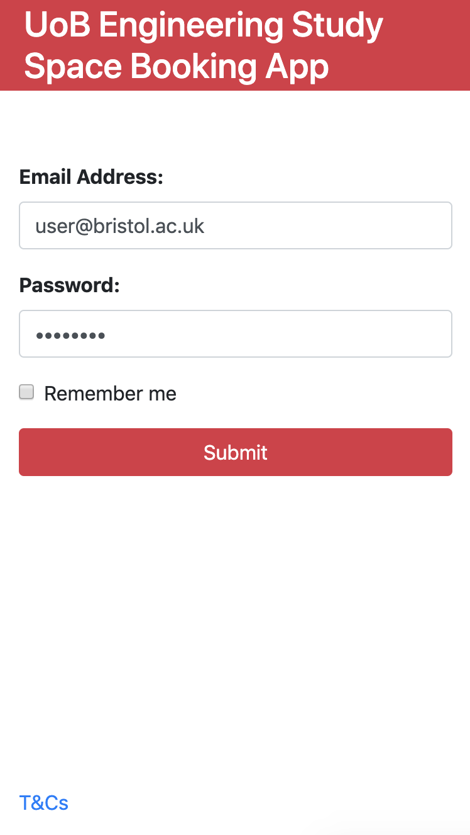
Enter your email address here
Enter your password here
Enabling remember me will automatically log users in on their device. Do not enable if using a shared computer.
Click submit to complete the login
University of Bristol Study Space Booking App - SPE

Slide 7
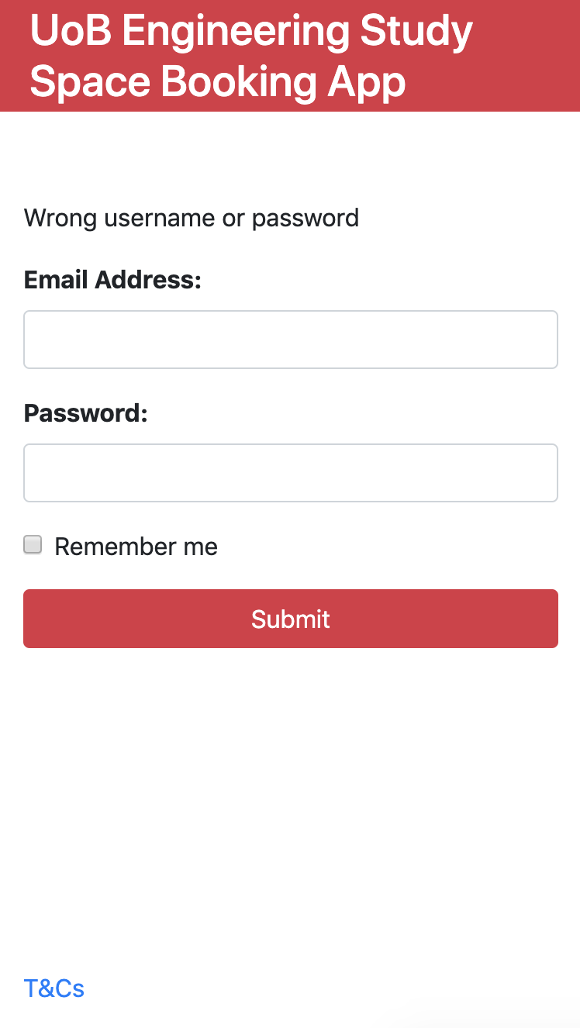
In the event of typing an incorrect email password configuration, please contact an administrator
University of Bristol Study Space Booking App - SPE

Slide 8
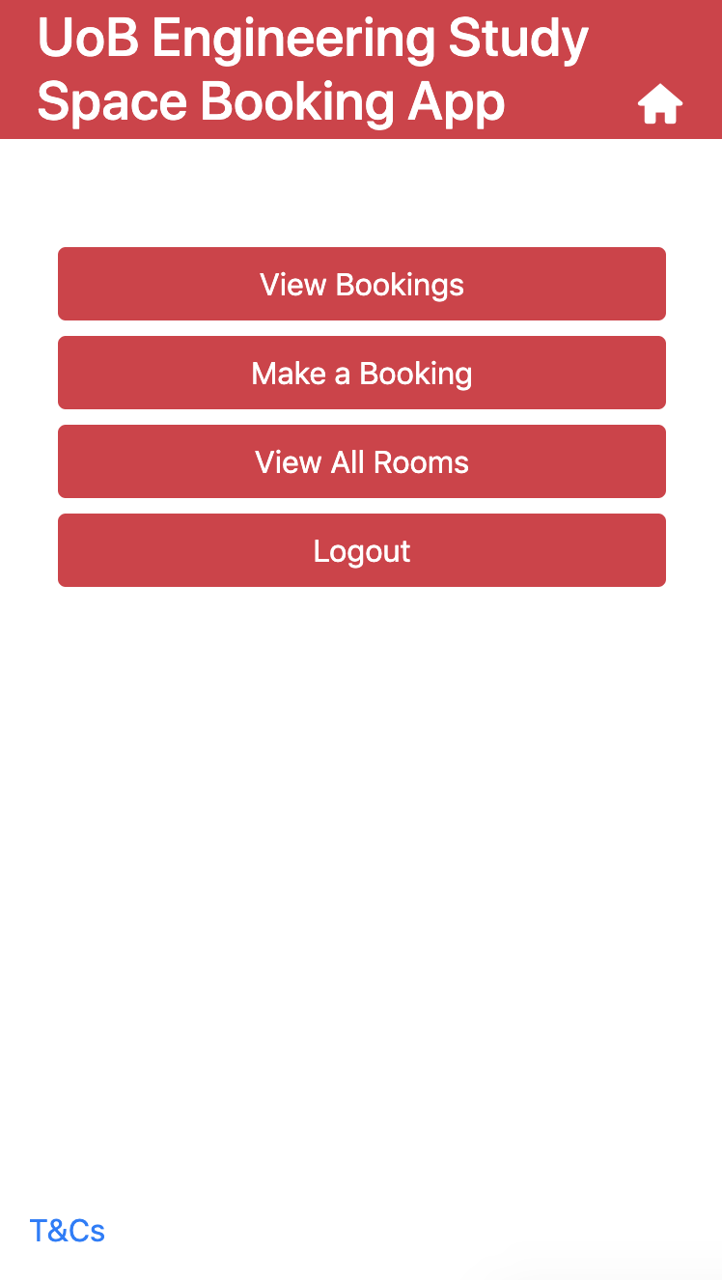
To logout, click the logout button at the bottom of the home page
University of Bristol Study Space Booking App - SPE

Slide 9
Navigation

Slide 10
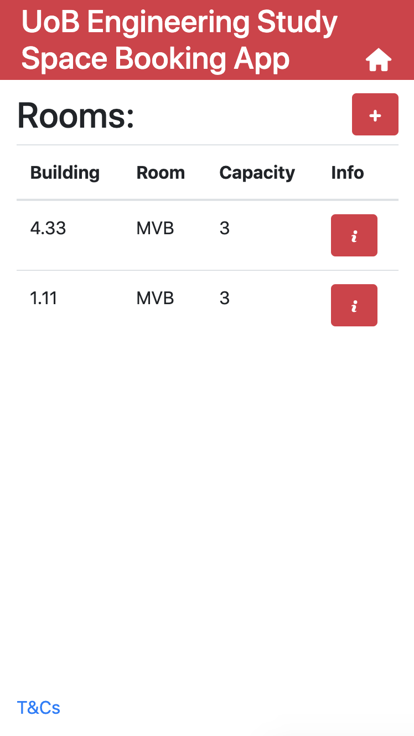
Once logged in, users can navigate back to the home screen by clicking on the home icon in the top right corner of any page
University of Bristol Study Space Booking App - SPE

Slide 11
User Features

Slide 12

The user home screen
University of Bristol Study Space Booking App - SPE

Slide 13
Making a booking

Slide 14
From the home screen, users should select the make a booking button
University of Bristol Study Space Booking App - SPE

Slide 15
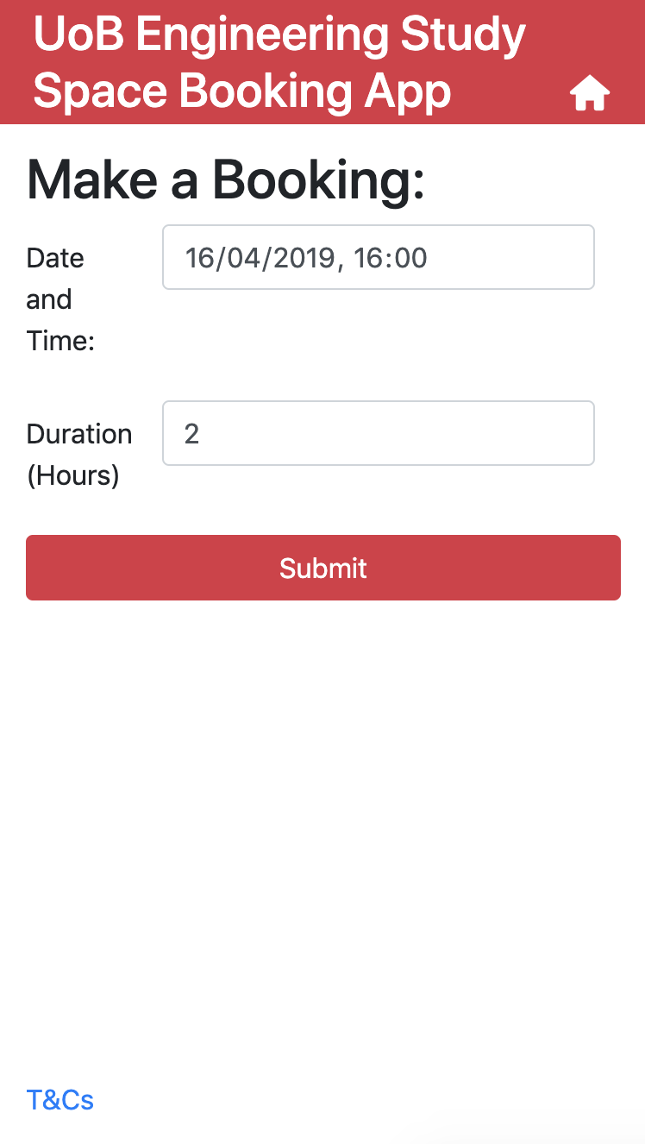
Users should then select the date, time and duration they would like to book.
The date must be in the future, but not more than 2 weeks away.
The duration must be positive but less than 3 hours.
Users should click submit after selecting their preferences.
University of Bristol Study Space Booking App - SPE

Slide 16
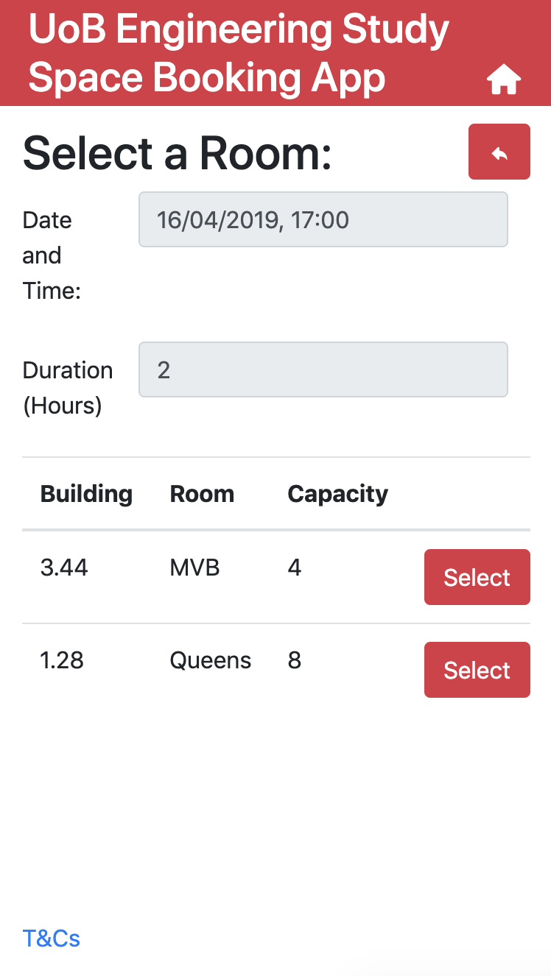
Click here to go back and amend your date, time and duration options.
Here is a list of all the available rooms at that time, click select on the room you want to book
University of Bristol Study Space Booking App - SPE

Slide 17
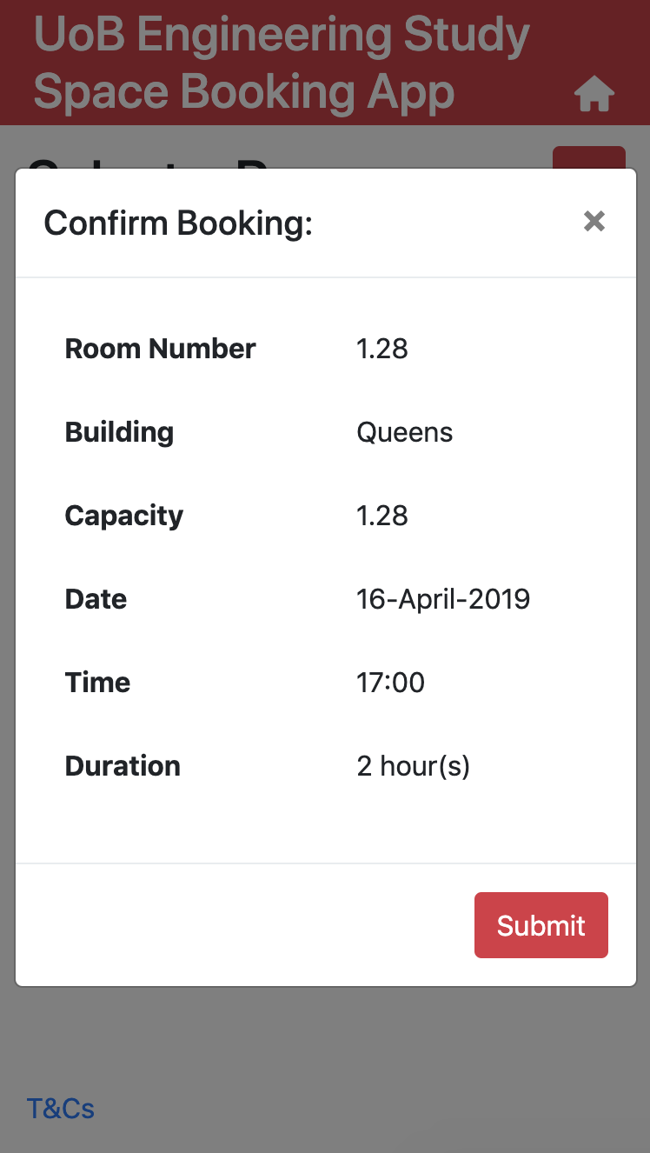
Click the close button to go back and select a different room
This popup displays the details of the booking you’re just about to make.
Click select to confirm the booking
University of Bristol Study Space Booking App - SPE

Slide 18
Viewing bookings

Slide 19
Once you have made some bookings, click view bookings
University of Bristol Study Space Booking App - SPE

Slide 20
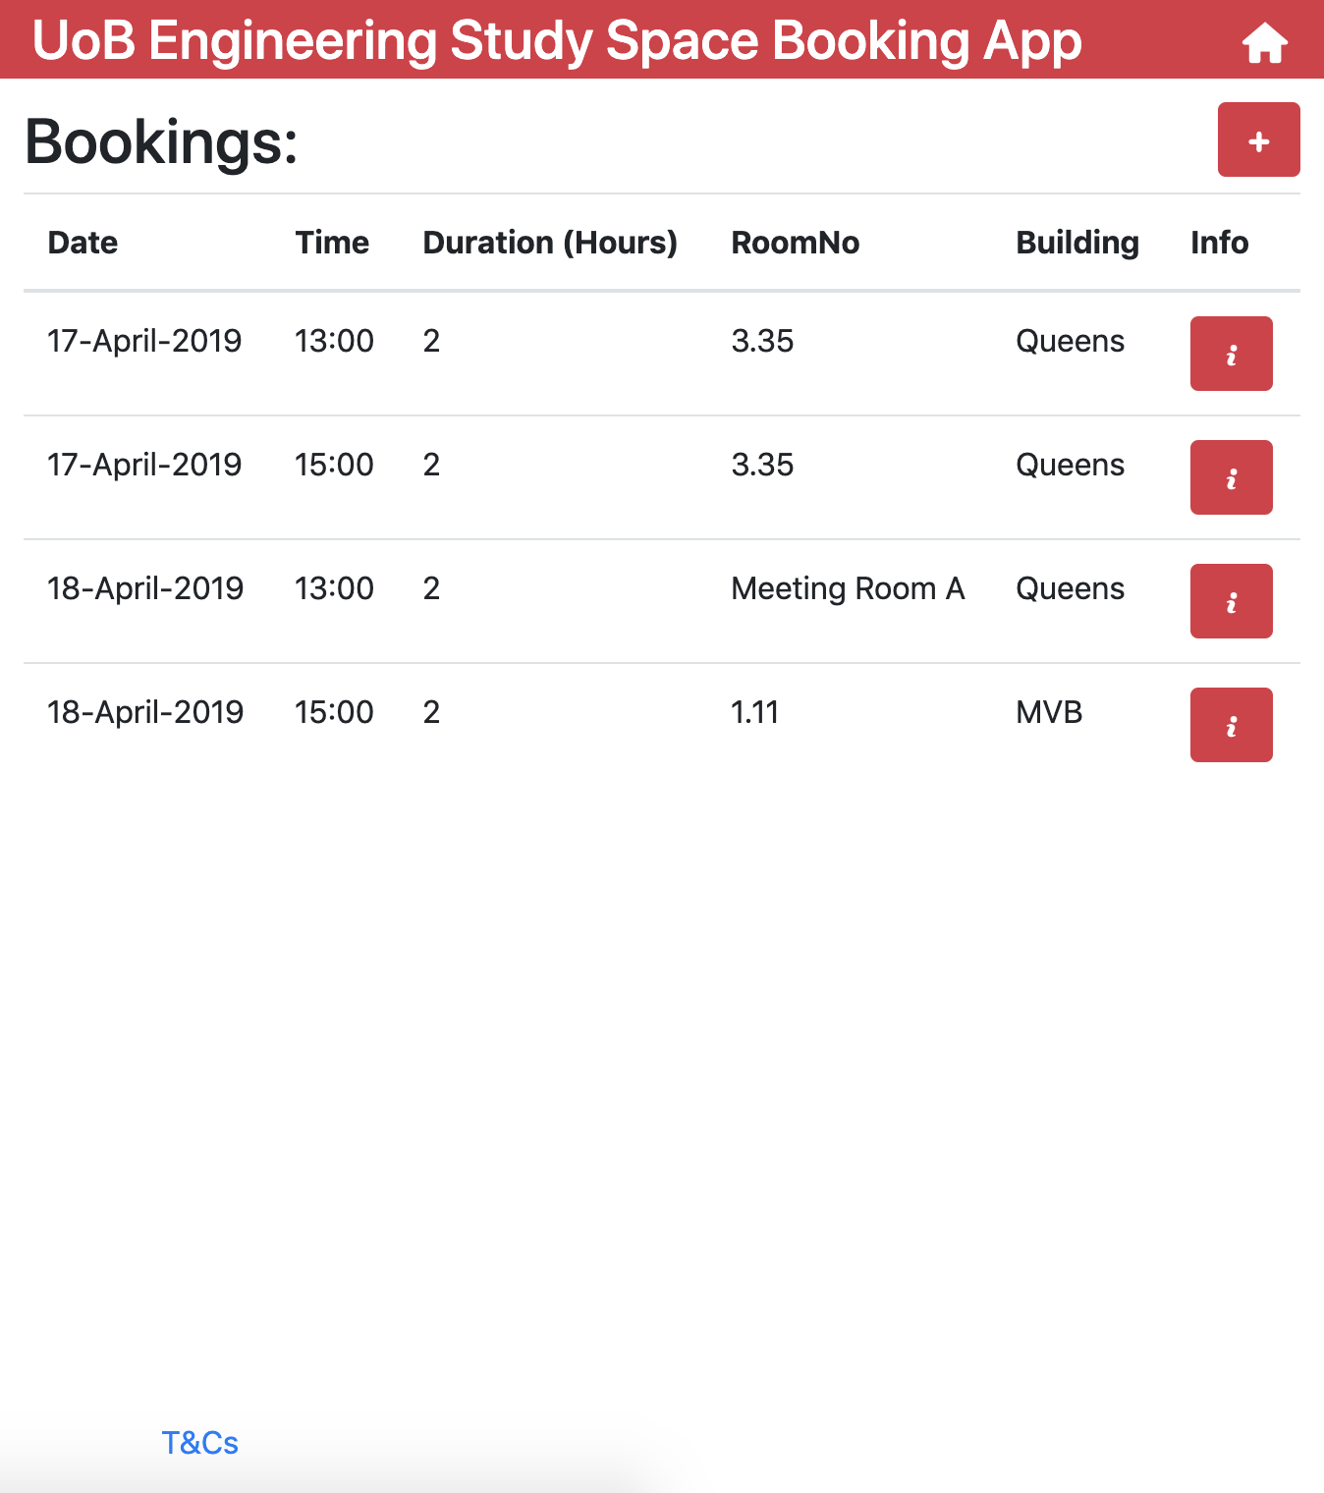
This page displays your future bookings.
Click here to add a new booking
Click here to see more information about a booking.
University of Bristol Study Space Booking App - SPE

Slide 21
Cancelling a booking

Slide 22
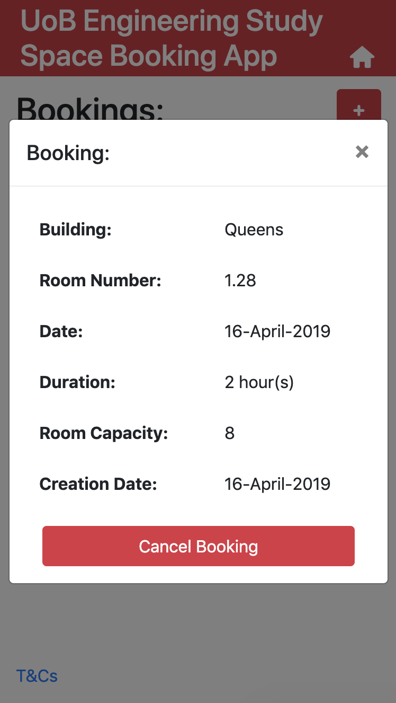
Once a viewing has been selected from the view bookings page, click the cancel booking button
University of Bristol Study Space Booking App - SPE

Slide 23
Administrator Features

Slide 24
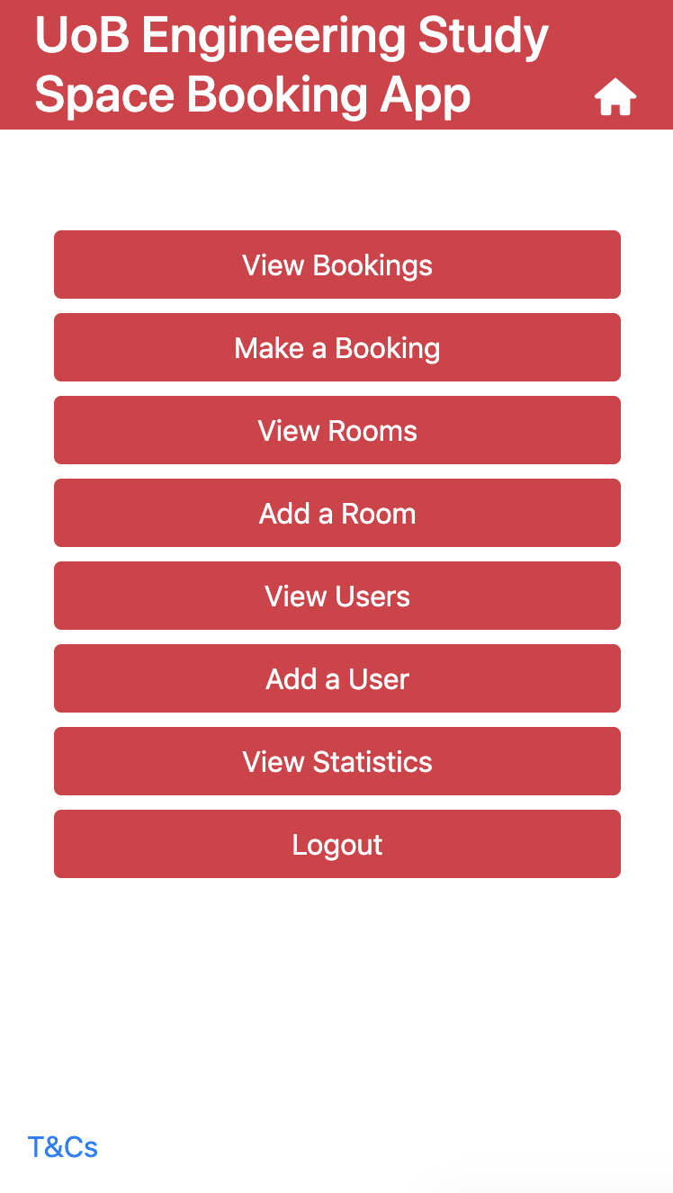
The administrator home screen
University of Bristol Study Space Booking App - SPE

Slide 25
Adding a room

Slide 26
From the administrator home screen, users should click ’add a room’
University of Bristol Study Space Booking App - SPE

Slide 27
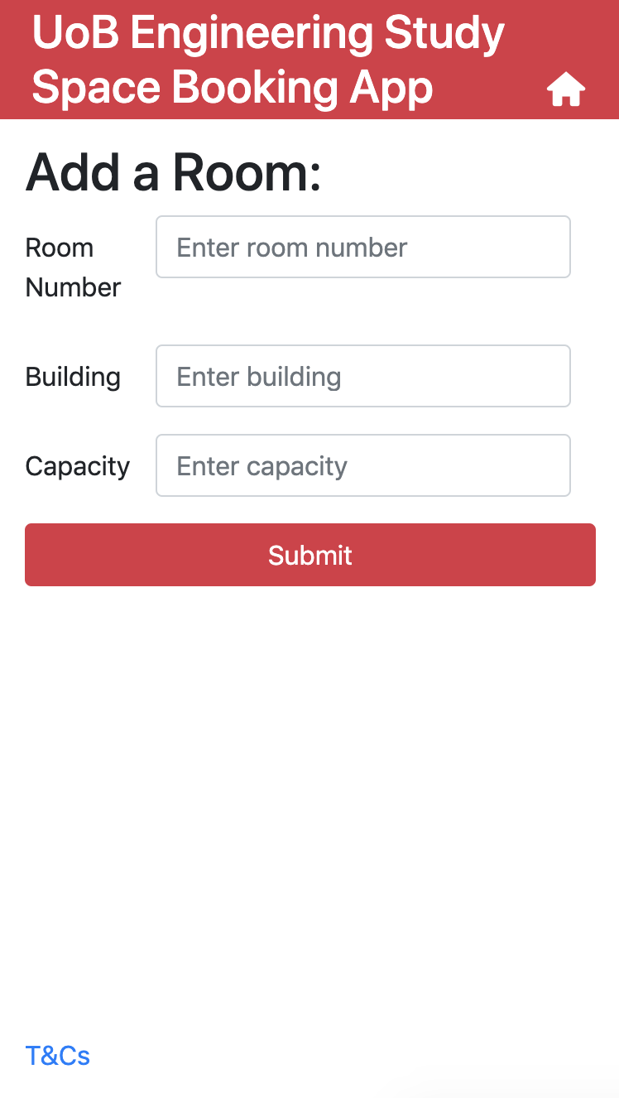
These fields should be filled out with the corresponding information about the room.
Note that capacity must be a number.
To confirm the new room, press submit
University of Bristol Study Space Booking App - SPE

Slide 28
Viewing users
Viewing a user’s bookings
Deleting a user
Blacklisting a user

Slide 29
From the administrator home screen, users should click ‘View Users’
University of Bristol Study Space Booking App - SPE

Slide 30
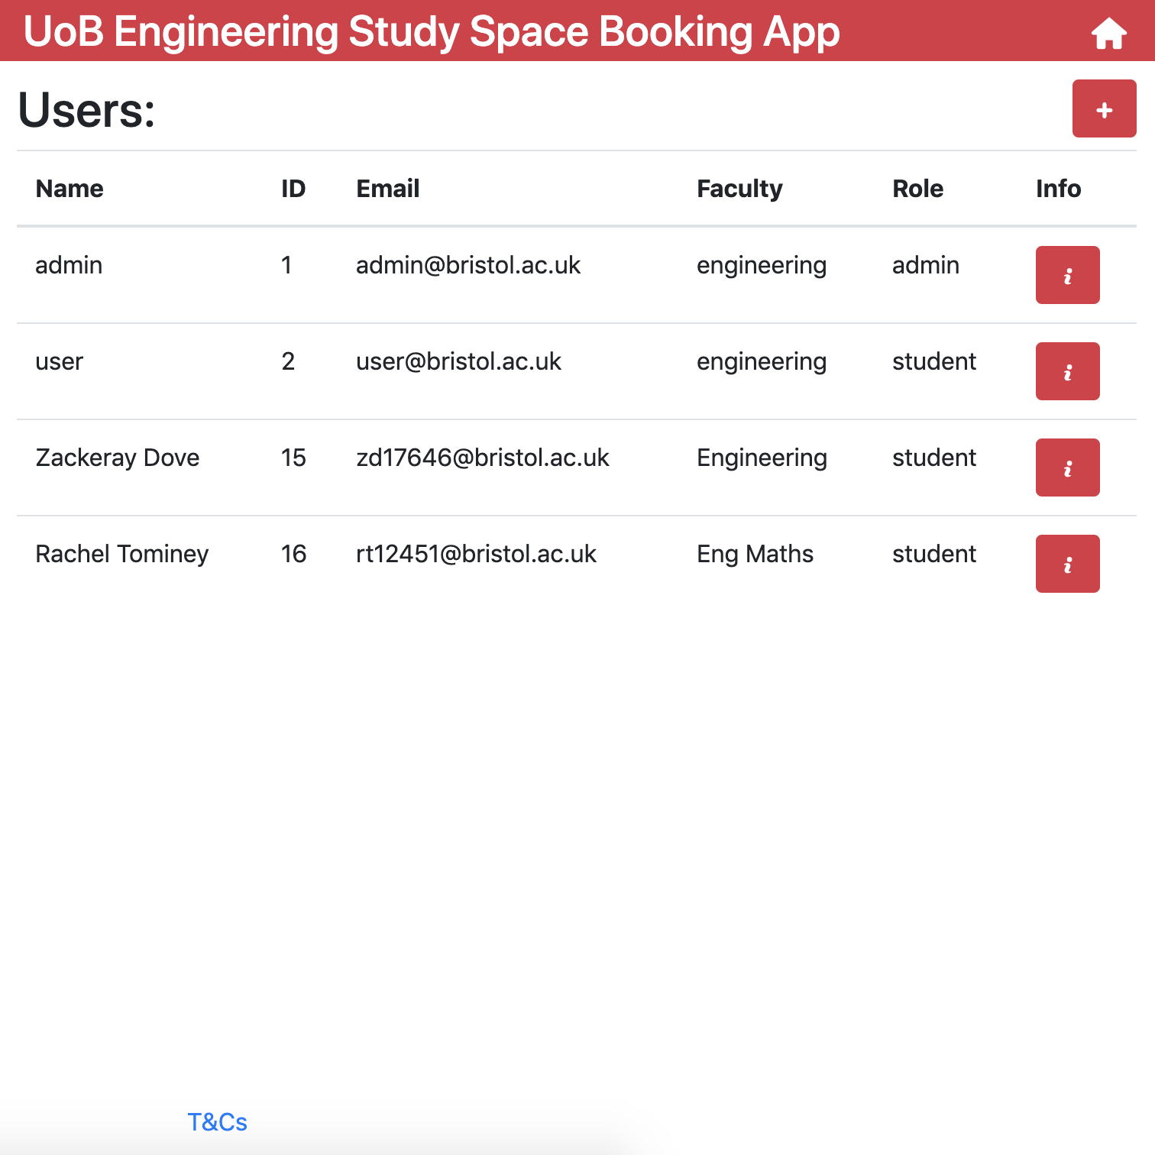
This screen displays all the users registered in the system.
Click here to add a new user
To view more information about a user, click the i button.
University of Bristol Study Space Booking App - SPE

Slide 31
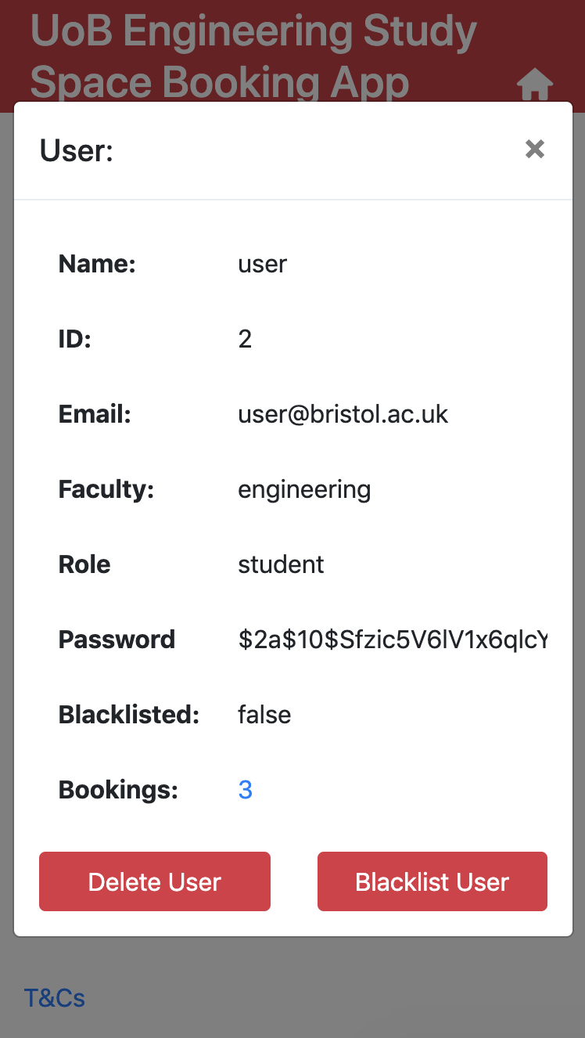
This screen displays information about a specific user
The hashed password is displayed for security reasons. Contact UoB IT Services for password issues.
This displays the number of bookings made by a user. Click to see these bookings, and thus cancel them.
To blacklist or unblacklist the user, click here.
A blacklisted user cannot make bookings.
To permanently delete this user. Click the ‘delete user’ button
University of Bristol Study Space Booking App - SPE

Slide 32
Adding a new user

Slide 33
From the administrator home screen, users should click ‘Add a user’
University of Bristol Study Space Booking App - SPE

Slide 34
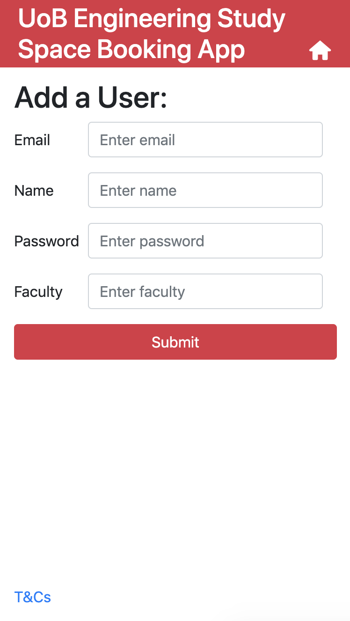
Fill in these fields with the corresponding information, then click submit
University of Bristol Study Space Booking App - SPE

Slide 35
Viewing all bookings

Slide 36
From the administrator home screen, users should click ‘View bookings’
University of Bristol Study Space Booking App - SPE

Slide 37
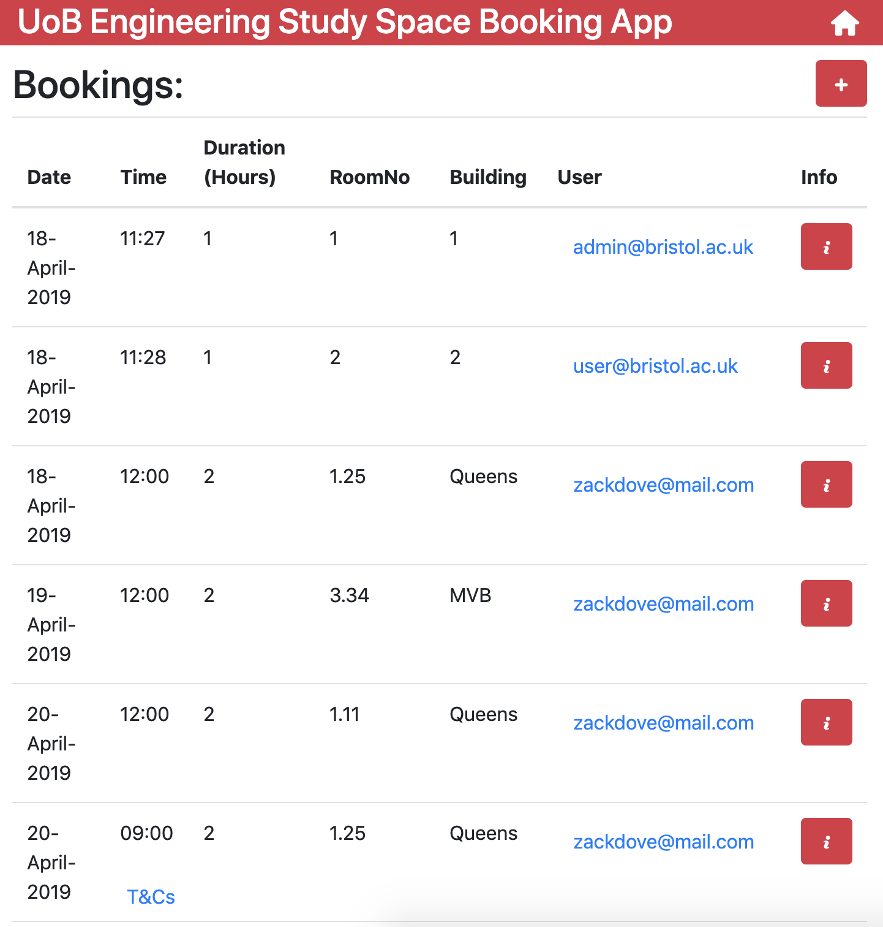
This page displays all users’ future bookings, along with which user made the booking
Click here to see more information about a the user that made the booking
Click here to see more information about a booking. The booking can be cancelled from here
University of Bristol Study Space Booking App - SPE

Slide 38
Viewing statistics

Slide 39
From the administrator home screen, users should click ‘View Statistics’
University of Bristol Study Space Booking App - SPE

Slide 40
For all further enquiries or questions please contact the Engineering Department in the Queens Building.
University of Bristol Study Space Booking App - SPE

