Slide 1
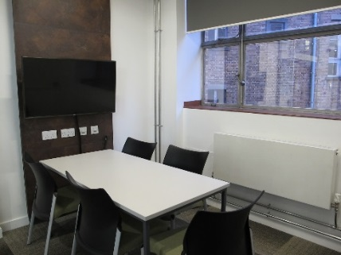
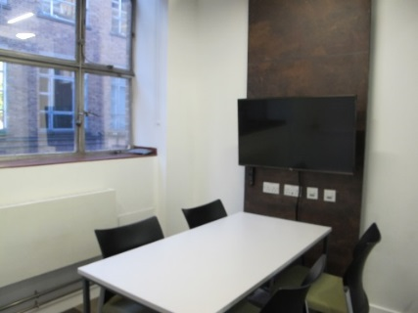
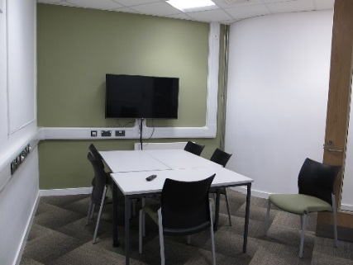
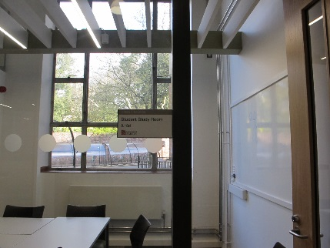
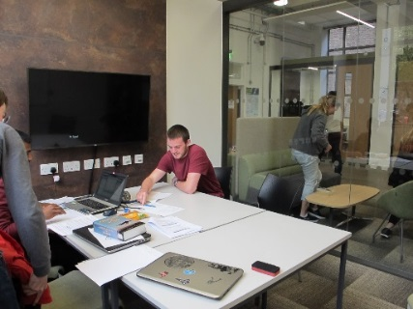

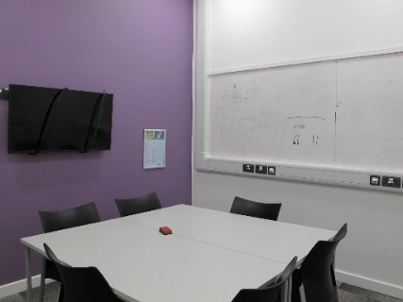
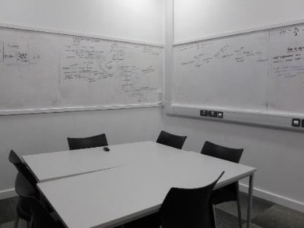
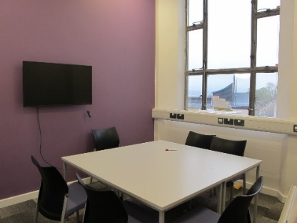
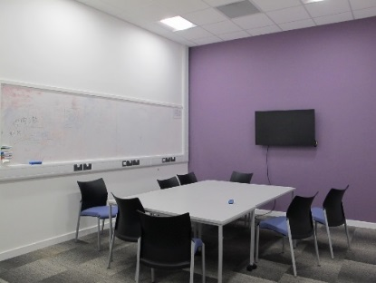
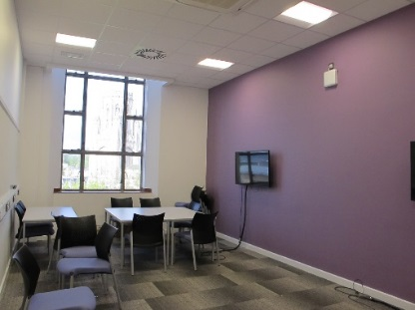
Faculty of Engineering - Queen’s Building Student Study Rooms
Book via the library at lib-queens@bristol.ac.uk or main reception desk
Ground Floor Student Study Rooms – located by Source Cafe
0.18a
0.18b
0.18c
0.18d
0.18e
6
6
6
6
6
First Floor Student Study Rooms – located off corridor leading towards new wing/Bill Brown Design Suite
1.5A
1.5B
1.8A
1.8B
1.8C
6
6
6
6
6
For further information regarding access, parking and the surrounding area, please visit the Queen’s Building page of the DisabledGo website:
https://www.disabledgo.com/access-guide/university-of-bristol/queens-building

