Slide 1

Knowspace
Author: Amir S. Husain
Email: ah3548@nyu.edu

Slide 2
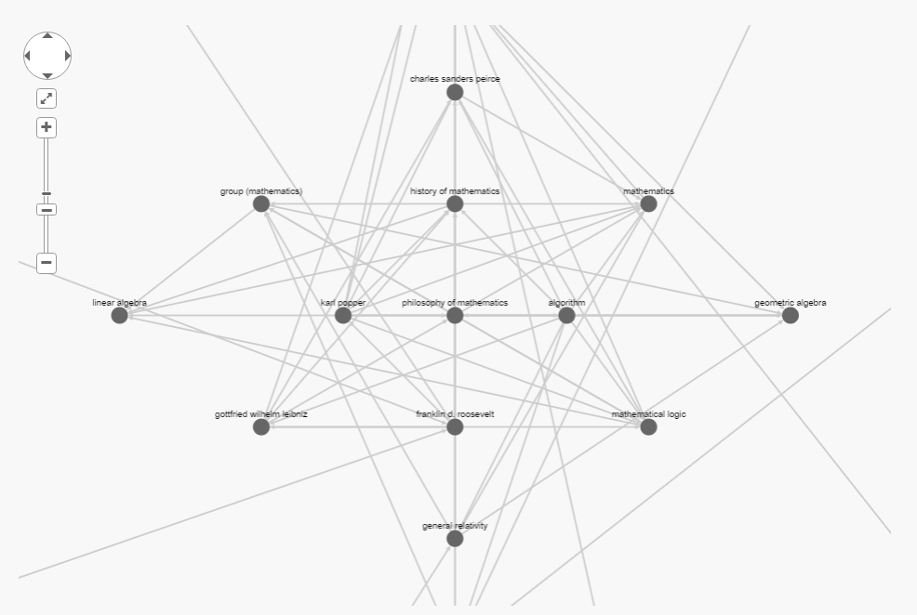
MOTIVATION

Slide 3
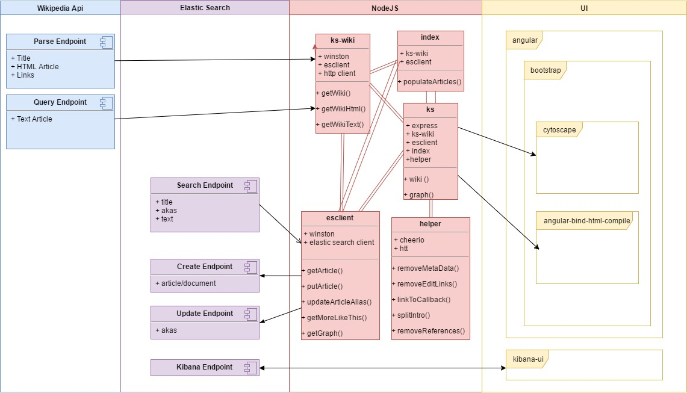
Architecture And Technologies

Slide 4



FuTURE
Future

