Slide 1

Project
Ahmed Nasser Elsayed

Slide 2
Descriptive Statistics
Skewness and kurtosis
01
Some Plots like:
1- Dot Plot
2-Box Plot
3-Stem and Leaf
02
How to Define Skewness type from graph
03

Slide 3
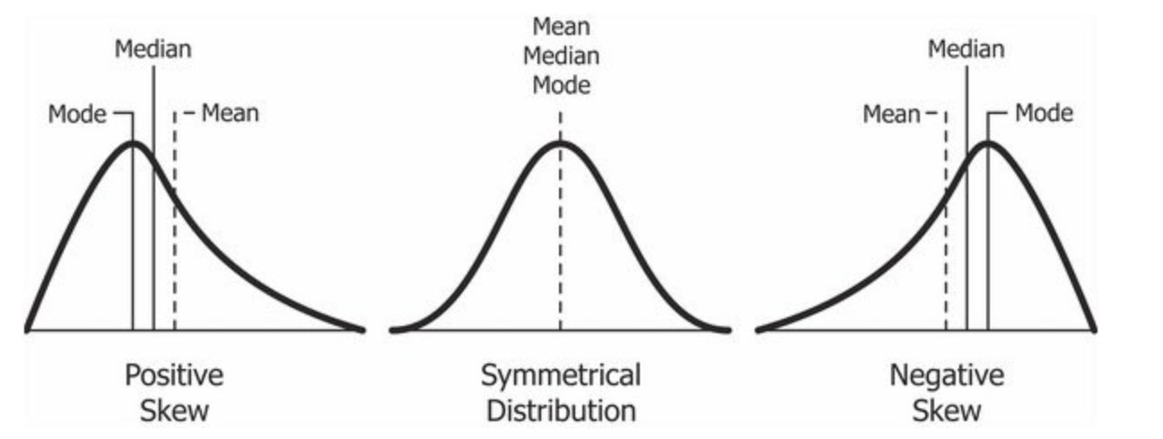
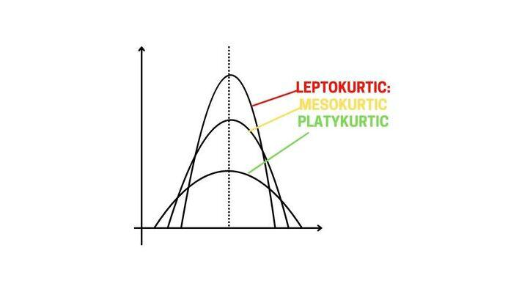
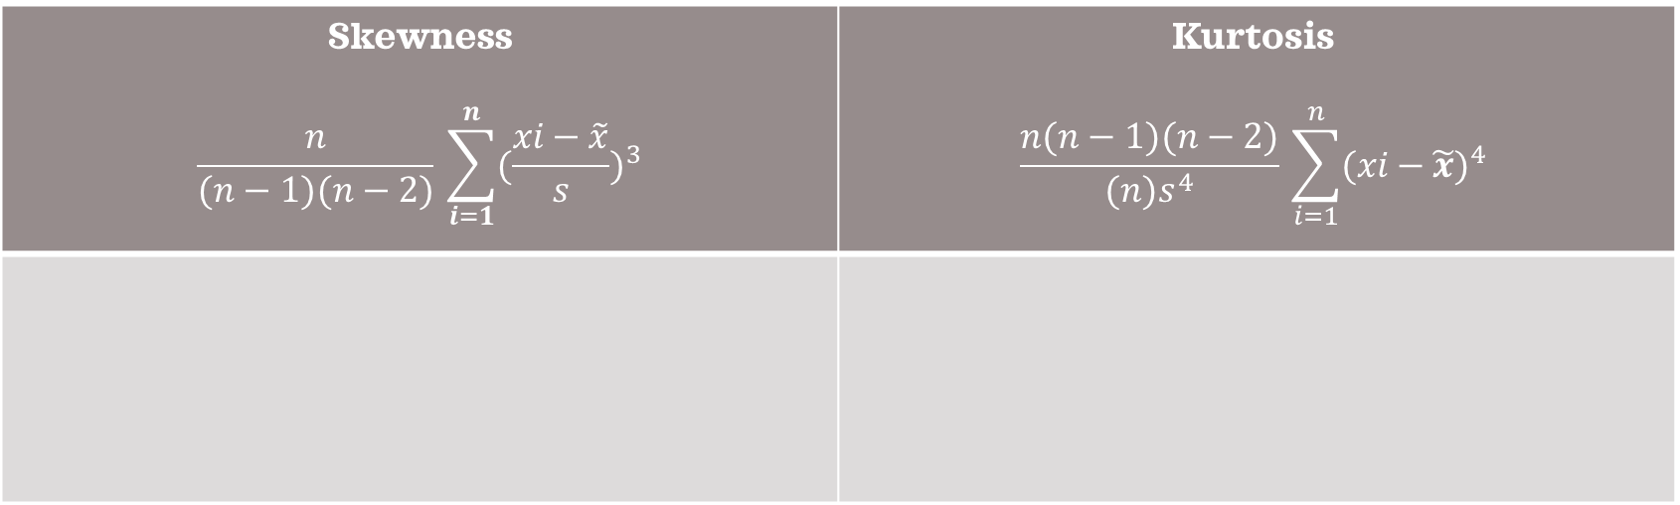
Skewness and Kurtosis
Skewness $$\frac{n}{(n−1)(n−2)}​\sum_{i=1}^{n}{{(\frac{xi​−\tilde{x}}{s})}^{3}}$$ | Kurtosis $$\frac{n(n−1)(n−2)}{(n)s^{4}}​\sum_{i=1}^{n}{{(xi​−\tilde{x})}^{4}}$$

Slide 4
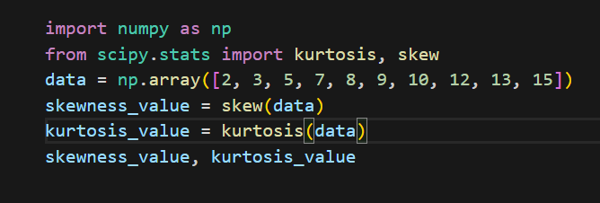
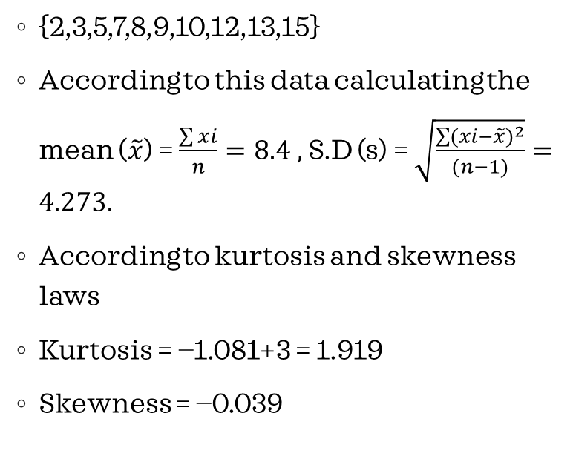
Example for calculating skewness and kurtosis
{2,3,5,7,8,9,10,12,13,15}
According to this data calculating the mean ($\tilde{x}$) = $\frac{\sum{xi}}{n}=8.4 ,$ S.D (s) = $\sqrt{\frac{\sum{{(xi−\tilde{x})}^{2}}}{(n−1)}}=4.273.$
According to kurtosis and skewness laws
Kurtosis = −1.081+3 = 1.919
Skewness = −0.039
We need to now that in denominator in kurtosis law may be you subtract by 3 or not this is for standardization .
Also we add 3 cause in python function it’s subtract by 3 .

Slide 5
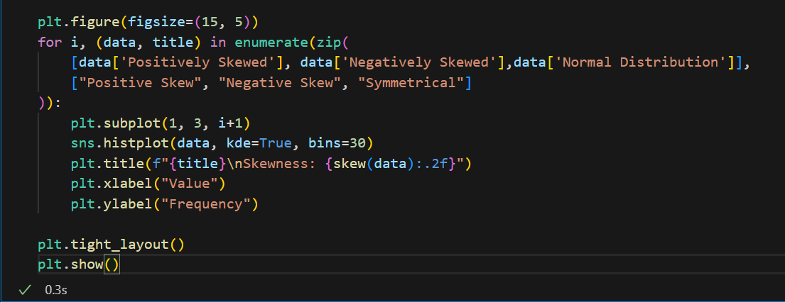
Skewness using python
We need to know that there are three types of skewness:
Left skewed we call it negatively skewed because the mean < median <mode.
Right skewed we call it positively skewed because mean > median > mode.
Normal Distribution doesn’t have skewness it’s approximately zero.

Slide 6
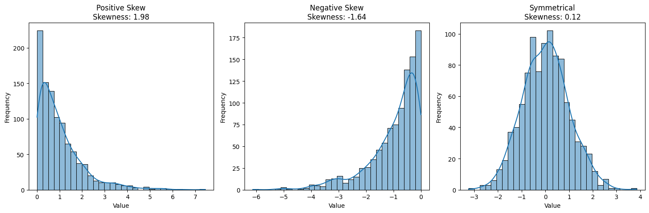
Output

Slide 7
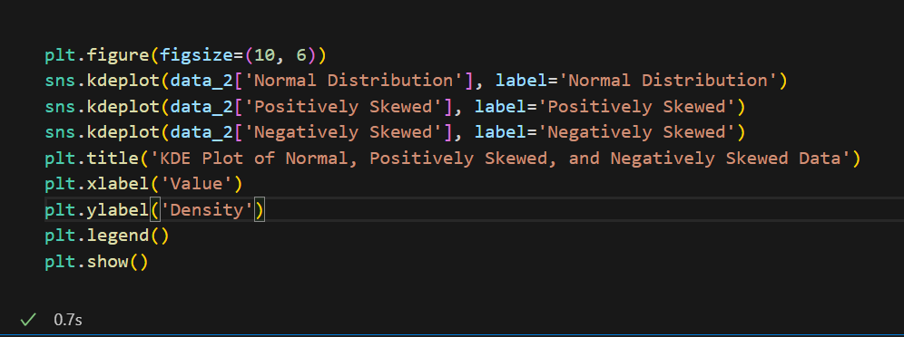
Kurtosis using python
First of all we need to know that there are three type of kurtosis
Mesokurtic -> this when kurtosis of data is equals to 3 then it’s normal distribution.
Leptokurtic -> when kurtosis of data is bigger than 3 (More outliers).
Platykurtic -> when kurtosis of data is less than 3 (Fewer outliers).

Slide 8
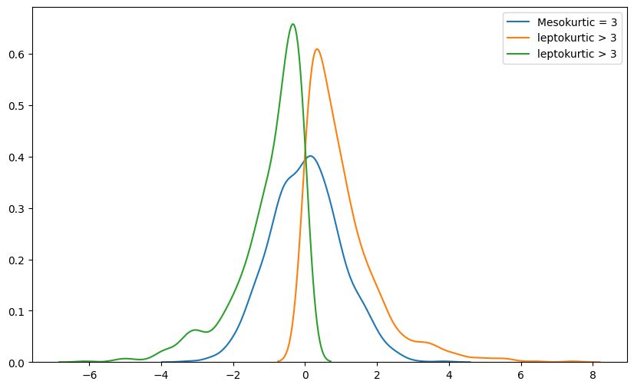
Output

Slide 9
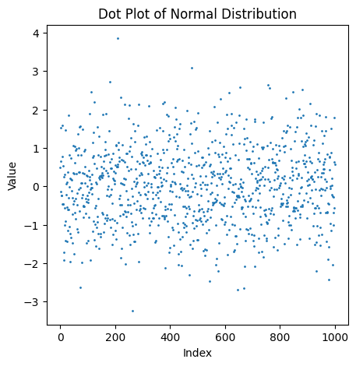
Dot plot
Is effective way to show the distribution of data .
It useful for the medium or small data size.
Also it shows the outliers.
X-axis is for values and y-axis is for count or frequency.
In this figure values is y-axis ,index is the frequency of this value.

Slide 10
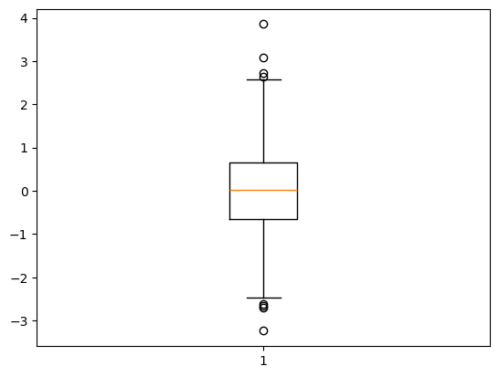
Box Plot
Is useful for those who want to know the maximum value and minimum value.
Also it shows the quartile and it’s values
Show the outliers, use it for data wrangling.
Shows mean and median, standard deviation.

Slide 11
Stem and leaf

