Slide 1

Project
احمد ناصر السيد عبد السيد 23010115
يوسف احمد محمد فتوحي 23011627
يوسف علاء مصطفى احمد 23011647
يوسف محمد حسن الحداد 23011651

Slide 2
Descriptive Statistics
Skewness and kurtosis
01
Some Plots like:
1- Dot Plot
2-Box Plot
3-Stem and Leaf
02
How to Define Skewness type from graph
03

Slide 3
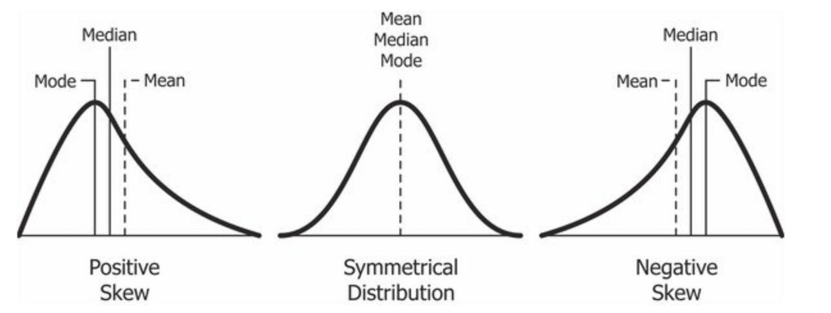
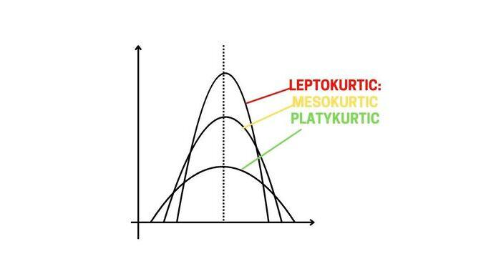
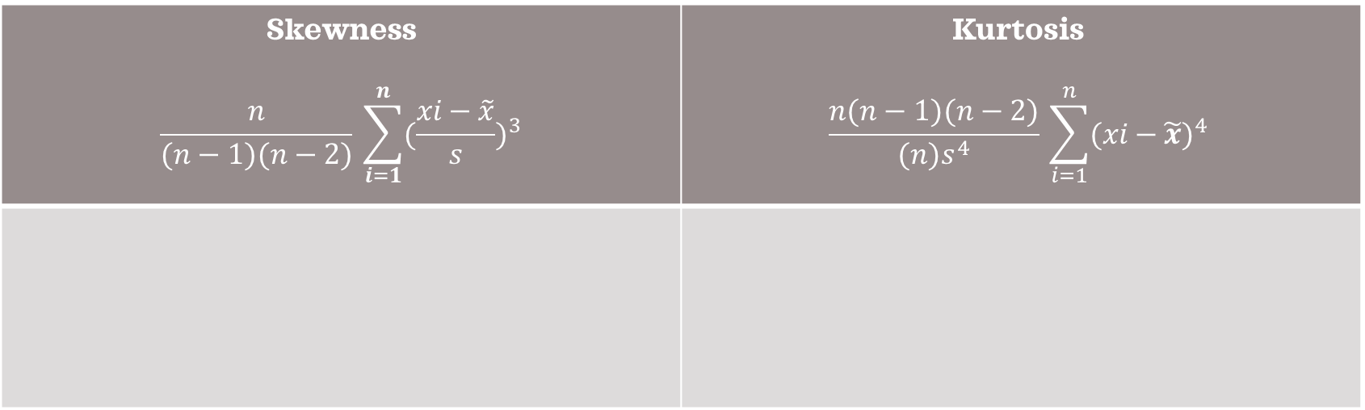
Skewness and Kurtosis
Skewness $$\frac{n}{(n−1)(n−2)}​\sum_{i=1}^{n}{{(\frac{xi​−\tilde{x}}{s})}^{3}}$$ | Kurtosis $$\frac{n(n−1)(n−2)}{(n)s^{4}}​\sum_{i=1}^{n}{{(xi​−\tilde{x})}^{4}}$$

Slide 4
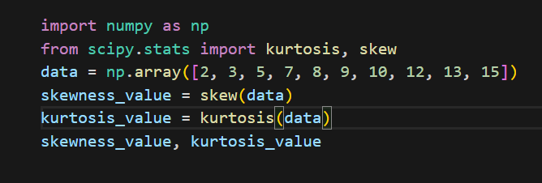
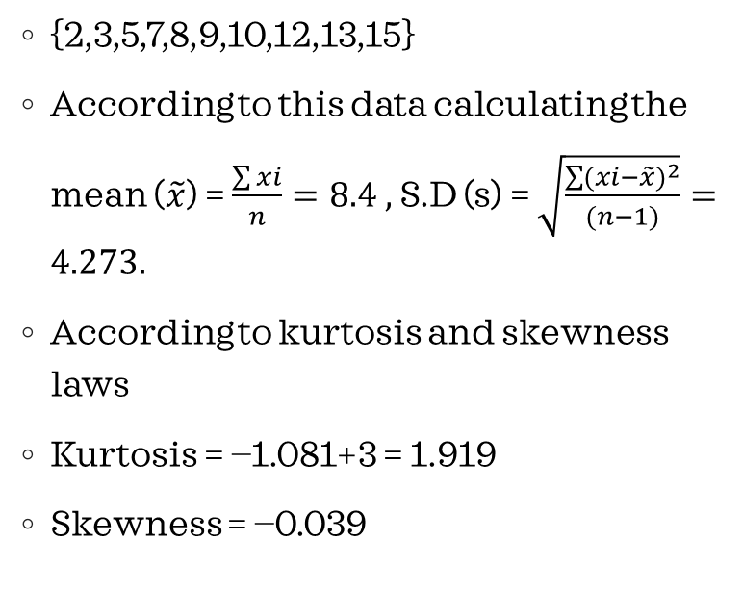
Example for calculating skewness and kurtosis
{2,3,5,7,8,9,10,12,13,15}
According to this data calculating the mean ($\tilde{x}$) = $\frac{\sum{xi}}{n}=8.4 ,$ S.D (s) = $\sqrt{\frac{\sum{{(xi−\tilde{x})}^{2}}}{(n−1)}}=4.273.$
According to kurtosis and skewness laws
Kurtosis = −1.081+3 = 1.919
Skewness = −0.039
We need to now that in denominator in kurtosis law may be you subtract by 3 or not this is for standardization .
Also we add 3 cause in python function it’s subtract by 3 .

Slide 5
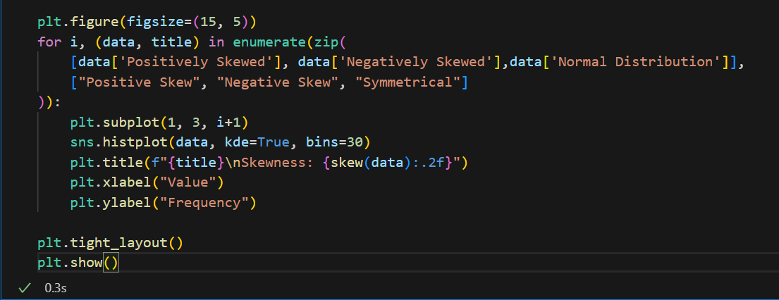
Skewness using python
We need to know that there are three types of skewness:
Left skewed we call it negatively skewed because the mean < median <mode.
Right skewed we call it positively skewed because mean > median > mode.
Normal Distribution doesn’t have skewness it’s approximately zero.

Slide 6
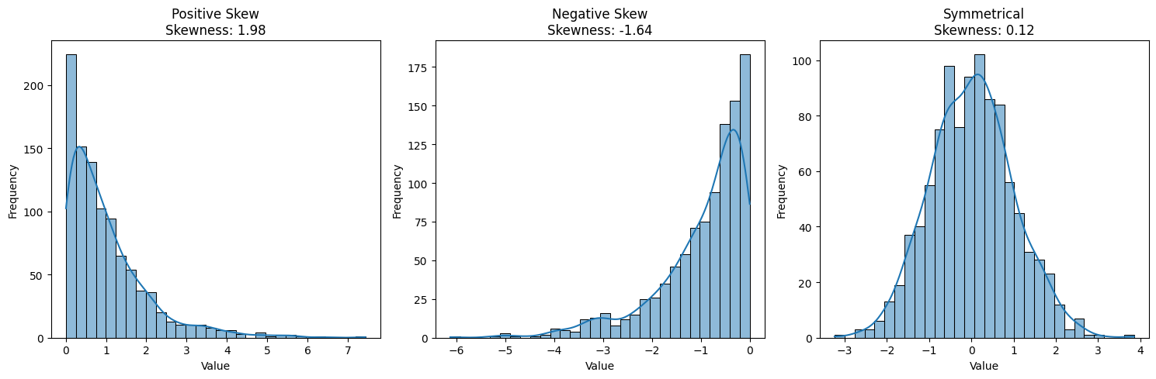
Output

Slide 7
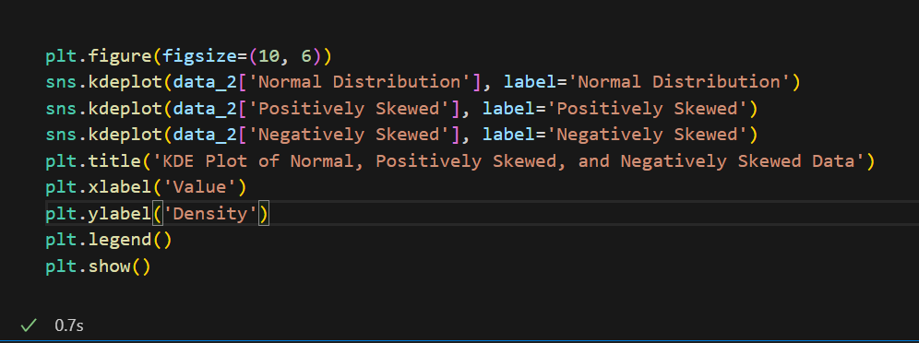
Kurtosis using python
First of all we need to know that there are three type of kurtosis
Mesokurtic -> this when kurtosis of data is equals to 3 then it’s normal distribution.
Leptokurtic -> when kurtosis of data is bigger than 3 (More outliers).
Platykurtic -> when kurtosis of data is less than 3 (Fewer outliers).

Slide 8
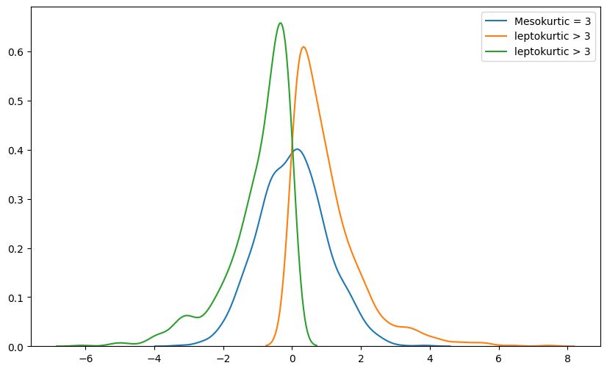
Output

Slide 9
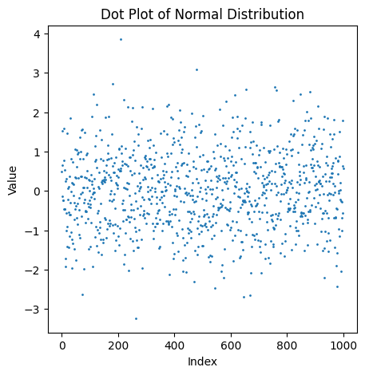
Dot plot
Is effective way to show the distribution of data .
It useful for the medium or small data size.
Also it shows the outliers.
X-axis is for values and y-axis is for count or frequency.
In this figure values is y-axis ,index is the frequency of this value.

Slide 10
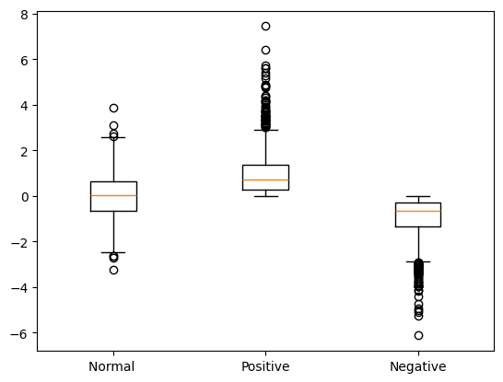
Box Plot
Is useful for those who want to know the maximum value and minimum value.
Also it shows the quartile and it’s values
Show the outliers, use it for data wrangling.
Shows mean and median, standard deviation.
First we need to calculate median and Q1 and inter quartile also max and min excluding outliers.
Also there are difference between right and left and normal skewed

Slide 11
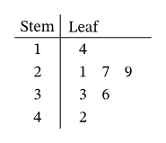
Stem and leaf
Stem and Leaf is way to display the leading digit (stem) and the trailing digit is (tail)
{14,21,27,29,33,36,42} here is data in ascending order so we put the leading digit in stem column and last digit in leaf column.
To plot it we should put the leading digit in x-axis and leaves (last elements) in y-axis.
We can use histogram to show the frequency of digits in this set of data

Slide 12
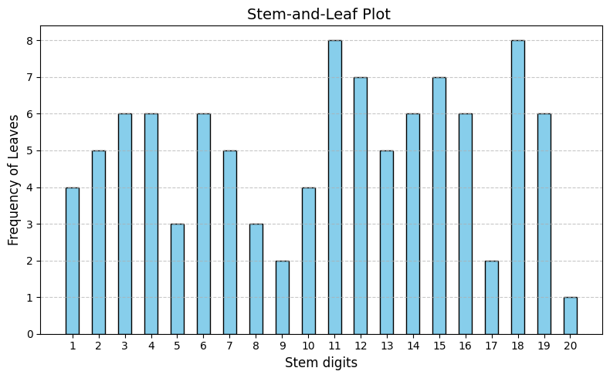
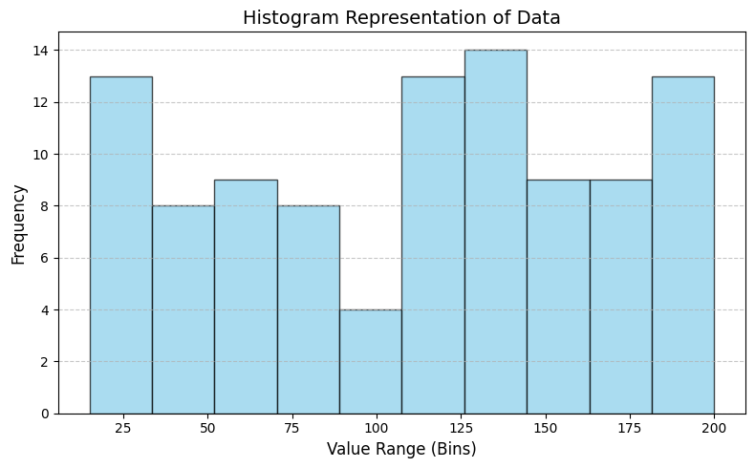
Output

Slide 13
What is ANOVA ?
ANOVA is Analysis of variance when there are more than two sample data
There are two models of ANOVA (One Way , Two Way)
One way is Analyze one factor or independent variable (Single factor analysis).
Two way is Analyze two or more factors or independent variables.
Assumptions of ANOVA:
Have same variance
Follow normal distribution
Data should be randomly and independently selected
There are two hypothesis of ANOVA:
Null Hypothesis(H): if mean1 = mean2 = ……. = mean(N)
Alternative Hypothesis (H₁): At least one group mean is different from the others.

Slide 14
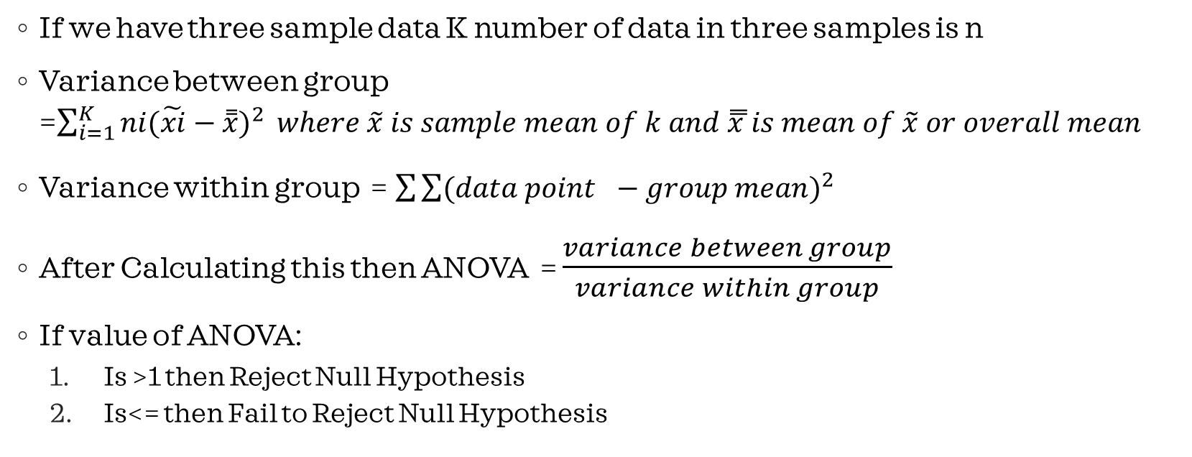
ANOVA’S LAW
If we have three sample data K number of data in three samples is n
Variance between group =$\sum_{i=1}^{K}{ni{(\tilde{xi}−\overset{̿}{x})}^{2}} where \tilde{x} is sample mean of k and \overset{̿}{x }is mean of \tilde{x} or overall mean$
Variance within group = $\sum{\sum{{(data point −group mean)}^{2}}}$
After Calculating this then ANOVA = $\frac{variance between group}{variance within group}$
If value of ANOVA:
Is >1 then Reject Null Hypothesis
Is<= then Fail to Reject Null Hypothesis

Slide 15
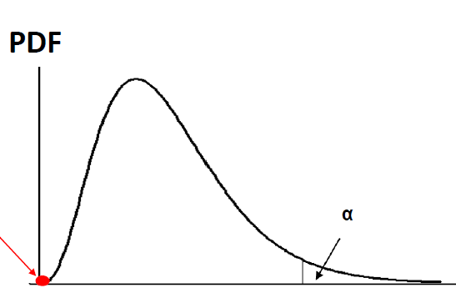

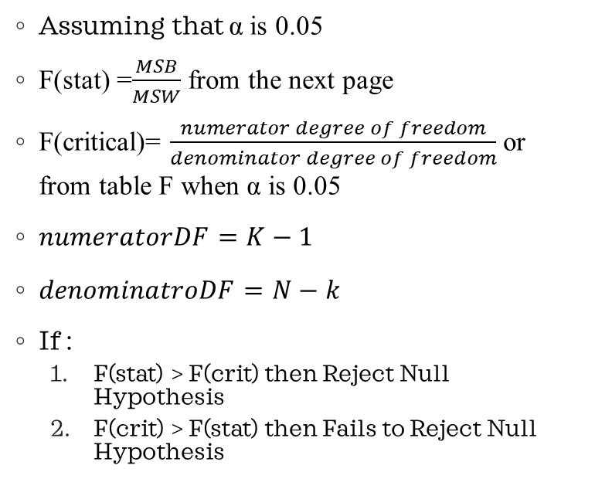
Using F-statistic and F-critical
Assuming that α is 0.05
F(stat) =$\frac{MSB}{MSW}$ from the next page
F(critical)= $\frac{numerator degree of freedom}{denominator degree of freedom}$ or from table F when α is 0.05
$numeratorDF=K−1$
$denominatroDF=N−k$
If :
F(stat) > F(crit) then Reject Null Hypothesis
F(crit) > F(stat) then Fails to Reject Null Hypothesis
Recall -> α is the area under the curve of PDF CDF(F) = 1- α
N -> is number of data in k samples also N = $\sum_{i=1}^{k}{(ni−1)}$

Slide 16
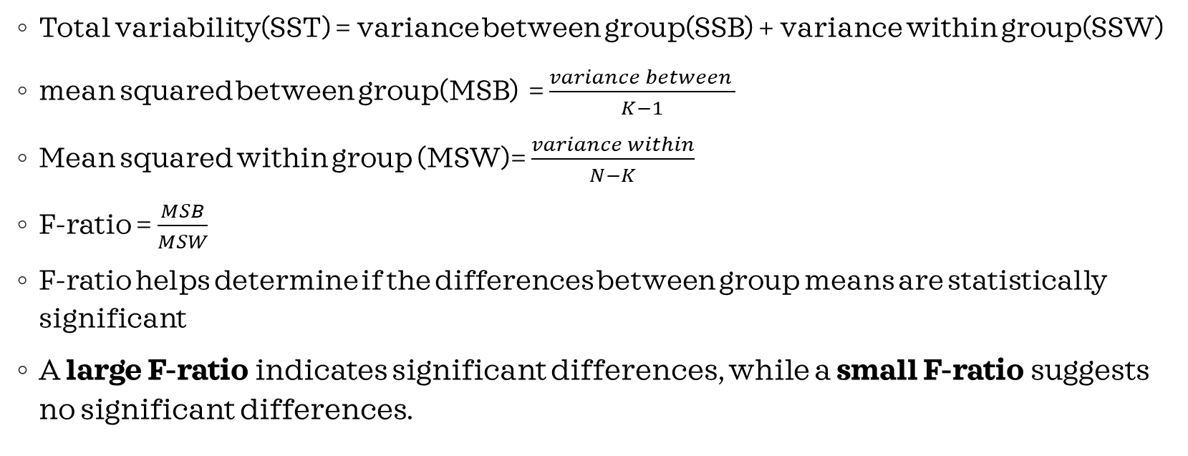
Variances
Total variability(SST) = variance between group(SSB) + variance within group(SSW)
mean squared between group(MSB) = $\frac{variance between }{K−1}$
Mean squared within group (MSW)= $\frac{variance within}{N−K}$
F-ratio = $\frac{MSB}{MSW}$
F-ratio helps determine if the differences between group means are statistically significant
A large F-ratio indicates significant differences, while a small F-ratio suggests no significant differences.

Slide 17
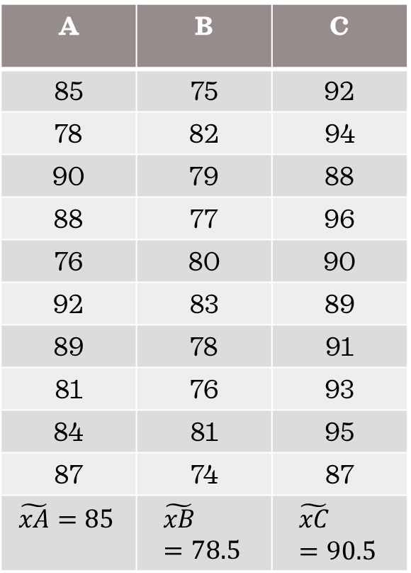
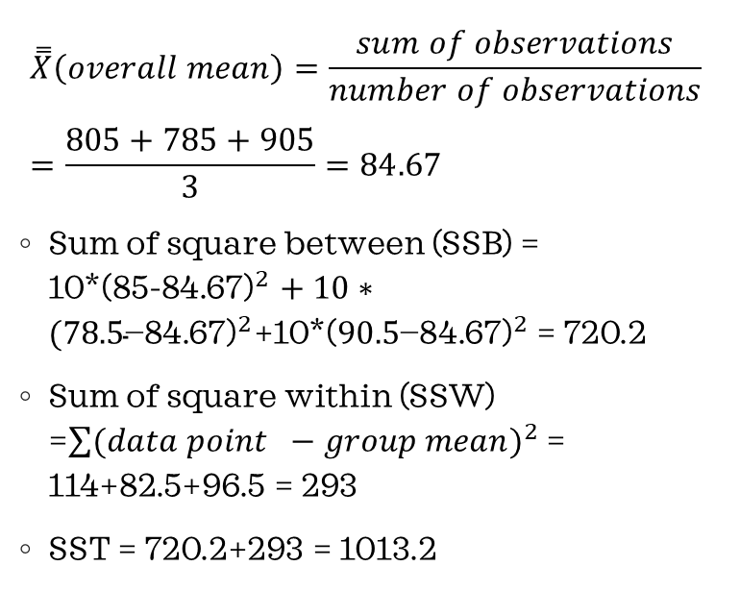
Example
A | B | C
85 | 75 | 92
78 | 82 | 94
90 | 79 | 88
88 | 77 | 96
76 | 80 | 90
92 | 83 | 89
89 | 78 | 91
81 | 76 | 93
84 | 81 | 95
87 | 74 | 87
$$\tilde{xA}=85$$ | $$\tilde{xB}=78.5$$ | $$\tilde{xC}=90.5$$
$$\overset{̿}{X}\left(overall mean\right)=\frac{sum of observations}{number of observations} =\frac{805+785+905}{3}=84.67$$
Sum of square between (SSB) = 10*(${\text{85−84.67)}}^{2}+10∗({\text{78.5}\text{−84.67)}}^{2}$+10*(${\text{90.5}\text{−84.67)}}^{2}$ = 720.2
Sum of square within (SSW) =$\sum{{(data point −group mean)}^{2}}$ = 114+82.5+96.5 = 293
SST = 720.2+293 = 1013.2

Slide 18
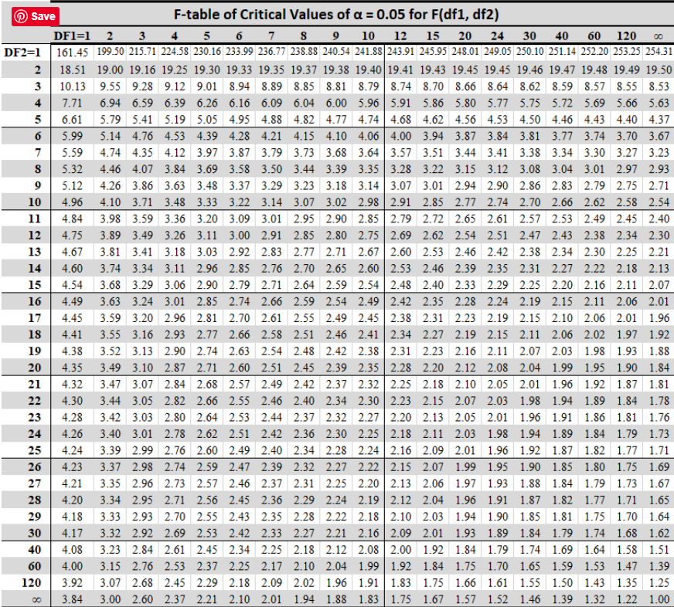
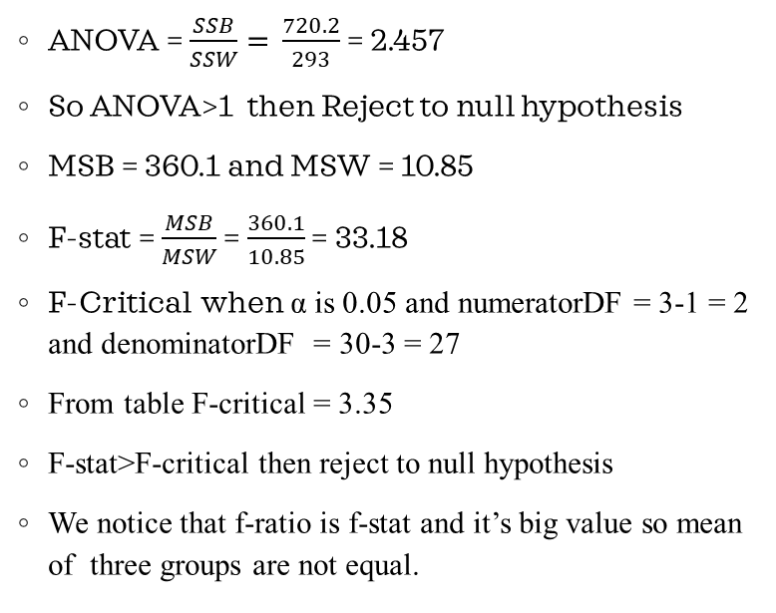
Test
ANOVA = $\frac{SSB}{SSW}=$ $\frac{720.2}{293}$ = 2.457
So ANOVA>1 then Reject to null hypothesis
MSB = 360.1 and MSW = 10.85
F-stat = $\frac{MSB}{MSW}$ = $\frac{360.1}{10.85}$ = 33.18
F-Critical when α is 0.05 and numeratorDF = 3-1 = 2 and denominatorDF = 30-3 = 27
From table F-critical = 3.35
F-stat>F-critical then reject to null hypothesis
We notice that f-ratio is f-stat and it’s big value so mean of three groups are not equal.

Slide 19
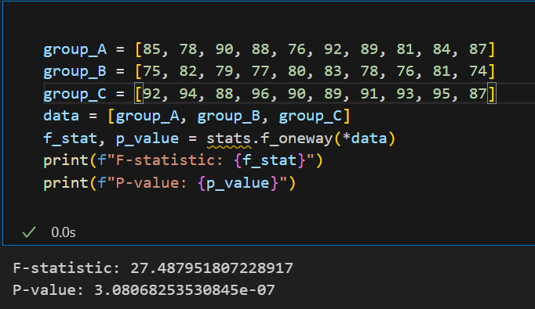
P-value
The p-value is the probability of observing your data assuming the null hypothesis is true.
If p-value ≤α reject the null hypothesis (there is a significant effect)
If p-value>α fail to reject the null hypothesis (no significant effect).
P-value = P(F>=F(Stat)) = 1- α = 1-CDF(F(stat), numeratorDF, denominatorDF))
Python code

